Slide 1
Discussions on CSI capture based positioning enhancement
Date: 2023-07-06
Authors:

Slide 2
Introduction
UHR discussed various solutions to improve network reliability, such as using AP MLD and AIML to enhance roaming efficiency.[1][2][3]
NGP, TGaz and TGbk have enumerated a number of positioning cases，such as navigation in public buildings，indoor geotagging，robot positioning, agricultural IOT, position for electronic tag ,etc.[4]
Some cases show that position information can help to improve the reliability of wireless networks:
1)Positioning for spectrum management, such as load balance and handover process.
2)Location Based Network Management. [4]

Slide 3
Positioning help to increase reliability case
--handover process
In corner scenarios, the network quality may suffer due to the drastic reduction in RSSI.
By calculating the location of STA, AP0 learns that STA is moving towards AP1 and increases the roaming threshold to trigger early roaming guidance.

Slide 4
Single-AP positioning
In the previously mentioned scenario, it may be necessary for a single AP to have complete terminal positioning capabilities.
  Obviously，in the right figure , the distance can be get from FTM.
  However, obtaining the azimuth angle or AOA worth further discussion.

Slide 5
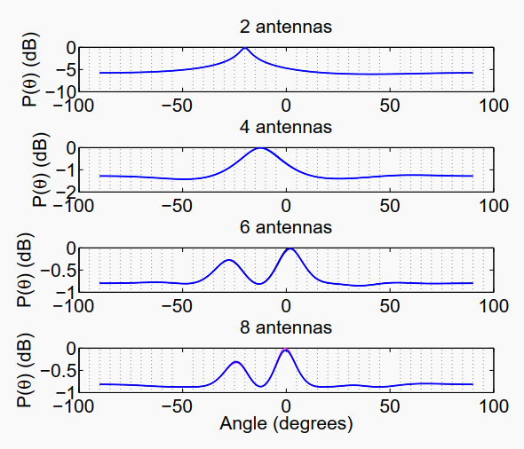
AOA needs
AOA needs more antennas.
AOA needs to switch the antenna array.
[5]Jie Xiong Kyle Jamieson :ArrayTrack: A Fine-Grained Indoor Location System , UCL CS Research Note RN/11/19
Multi-antenna group switch and AoA measurement procedure

Slide 6
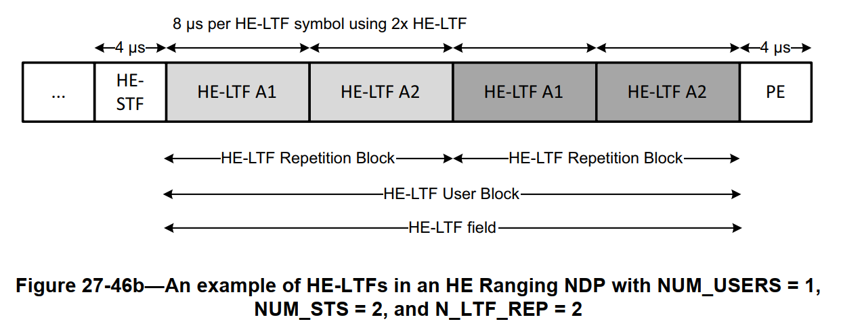
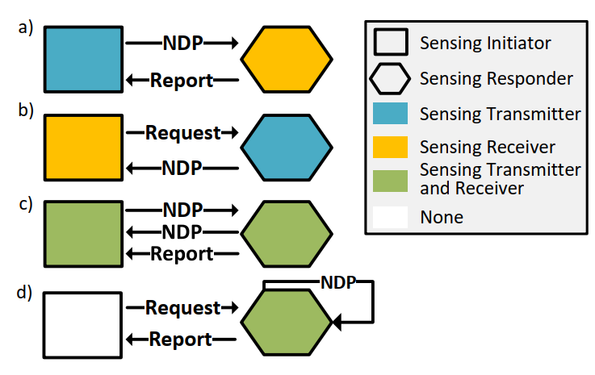
Ranging NDP and Sounding procedure
  11az has designed HE ranging NDP and HE trigger-based (TB) ranging NDP, which can improve the accuracy of channel and ToF estimation through HE-LTF repetition.
11az and 11bf have also developed various procedures for channel estimation through NDP. [6]

Slide 7
Switch and call cost too much
Switch and Measurement means multiple NDP---Ack processes are required over the air, which can significantly reduce the efficiency of air interface communication in high-density and multi-user scenarios.
Multi-antenna group switch and AoA measurement procedure

Slide 8
Suggestion
Refer to HE Ranging NDP, here is a suggestion for 802.11 PPDU ,Modified for antenna switch based AOA. Suggest to Add:
“AOA indicator” in X-SIG field;
“HE-LTF Repetition Antenna Group Block” in X-LTF field.

Slide 9
Suggestion
Antenna Switch base AOA Measurement could be trigger by an AOA request from an AOA Initiator.
Then the AOA responder send the modified AOA PPDU including AOA indicator and X-LTF repetition of antenna group block1~3. After sending each Antenna group block of X-LTF repetition, the AOA antenna array switch to the next ant-group state and waiting the next each Antenna group block of X-LTF repetition
HE-LTF repetition for Antenna Group Switch procedure

Slide 10
Conclusion
Positioning can assist in improving the reliability of wireless networks.
AOA angle measurement can assist FTM positioning to further improve positioning accuracy.
The new PPDU format can effectively improve the efficiency of CSI capture and AOA measurement.
helpful for integrated sensing and communication (ISAC)

Slide 11
References
802.11-23/480r1, UHR proposed PAR
802.11-22/1910r3, Seamless Roaming for UHR
802.11-22/475r3, Proposed IEEE 802.11 AIML TIG Technical Report Text for the AIML-based Roaming Enhancements Use Case
802.11-16/0137r4, NGP Use Case Template
Jie Xiong, Kyle Jamieson “ArrayTrack: A Fine-Grained Indoor Location System” , Usenix Conference on Networked Systems Design and Implementation. USENIX Association, 2013:71-84
Tanguy Ropitault, Claudio R. C. M. da Silva,“IEEE 802.11bf WLAN Sensing Procedure: Enabling the Widespread Adoption of Wi-Fi Sensing”

