Slide 1
RCM Follow up
Date: 2023-07-06
Authors:

Slide 2
Revision
Rev 0: initial revision

Slide 3
11bi requirement
R7 | 11bi shall define a mechanism for a CPE Client to initiate changing its own OTA MAC Address used with a CPE AP in Associate STA State 4 without any loss of connection.
R8 | 11bi shall define a mechanism for a CPE AP to initiate changing the OTA MAC Addresses of a set of associated CPE Client’s in the BSS (those CPE Clients in Associate STA State 4) without any loss of connection.
R9 | 11bi shall define a mechanism for a CPE Client and CPE AP to change the transmitted SN to an uncorrelated new value on downlink and uplink to new values in Associate STA State 4, without any loss of connection when the OTA MAC address of the CPE Client is changed
R10 | 11bi shall define a mechanism for a CPE Client and CPE AP to change the transmitted PN to an uncorrelated new value on downlink and uplink to new values in Associate STA State 4, without any loss of connection when the OTA MAC address of the CPE Client is changed
R11 | 11bi shall define a mechanism for a CPE Client and CPE AP to change the CPE Client’s AID to an uncorrelated new value in Associate STA State 4, without any loss of connection when the OTA MAC address of the CPE Client is changed
R30 | 11bi shall define a mechanism for a CPE Client and CPE AP to obfuscate the transmitted TID to an uncorrelated new value on downlink and uplink to new values in Associate STA State 4, without any loss of connection.

Slide 4
Overview
The RCM procedure is a method for obfuscating simultaneous multiple parameters (including the MAC Address) of a CPE Client while it is associated with a CPE AP. It is based on the standardized PRF (section 12.7.1.2 -IEEE Std 802.11-2020) executed in parallel by the CPE Client and the CPE AP with the same input parameters.
This procedure is made up of 3 mains steps:
  During, or after association, encrypted information (SERCM key) is shared between AP and non-AP STA
  Upon AP or non-AP STA request, both AP and non-AP STA compute and generate new uncorrelated values or new masks with a single execution of the standardized PRF performed in parallel
  At the starting of the transition period, both AP and non-AP STA initiate the obfuscation of the CPE parameters
Purpose of this document is to focus on the period surrounding the change of CPE Parameters.

Slide 5
Proposal
AP may initiate regular change of all non AP STAs (at once)
  Regular variable epoch period (~ 10 min).
    randomized around a 10 minutes average value.
    Computed, without information exchange between STA and AP, the STA MAC address change start time.
    Goal: difficult for eavesdroppers to determine the instant of change with no overhead.
The Non-AP Station may initiate its MAC Address change by sending a change request to the AP.
MAC address change time, between AP and non-AP, is then secured by introducing “margins” in the MAC address change time.

Slide 6
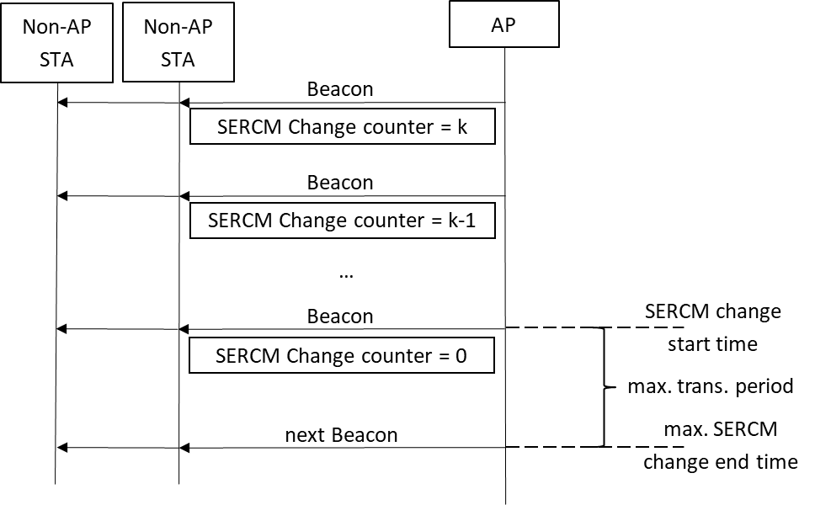
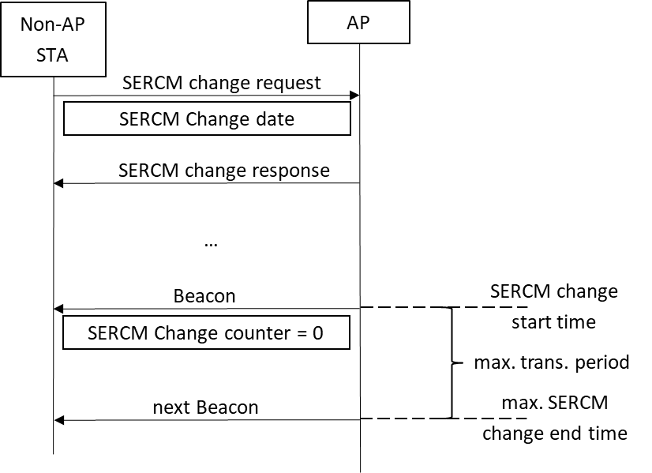
AP or non-AP Station may request Mac Address change of a non-AP STA
AP Initiation
Non-AP Initiation

Slide 7
RCM Procedure synchronization (“margin” management)
Before epoch transition: RCM Ready : p x TBTT before the Epoch transition.
  Station shall send MPDUs addressed only with Old MAC address.
  Station shall be ready to receive MPDUs addressed with Old MAC address or (future) new MAC address.
  Goal : avoid synchro issue (non AP STA late)
At epoch transition: duration ~ n x TBTT
  Retransmission of old MPDU uses param from old epoch.
  A-MPDU Aggregation, TXOP contains either only old MPDUs or only new MPDUs.
  Station may send buffered MPDUs already addressed with Old MAC address.
  Station shall send new MPDUs addressed with new MAC address.
  Station may receive MPDUs addresses with Old or new MAC address
  Goal : allow soft transition (no communication break)
After epoch transition: RCM Done : p x TBTT after transition
  Station shall send MPDUs addressed only with New MAC address.
  Station shall be ready to receive MPDUs addressed with New or Old MAC address.
  Goal : avoid synchro issue (non AP STA in advance).

Slide 8
RCM Procedure synchronization
Non-AP STA is late
  AP clock is the reference
AP
  RCM ready
  Non-AP clock drift
  RCM (n+1) ready
TA = @MAC(n)
RA = @MAC(n) or @MAC(n+1)
  Trans. start
TA = @MAC(n) or @MAC(n+1)
transition period
transition period
RA = @MAC(n) or @MAC(n+1)
  Trans. End
  Trans. End
TA = @MAC (n+1)
RA = @MAC(n+1) or @MAC(n)
  RCM done
  RCM (n+1) done

Slide 9
Benefits
Global user privacy is enhanced by allowing a station to change a set of its CPE parameters even in case of clock drift or loss of beacon counter synchronization.

Slide 10
Straw Poll #1
Do you support introducing margins mechanisms as described in slides 7 and 8, to ensure RCM synchronization ?
Yes
No
Abstain

Slide 11
Straw Poll #2
Do you support having a transition period, when changing CPE parameters to a new set, to flush MPDUs with Old CPE params (including MAC address).
Yes
No
Abstain

Slide 12
References
[1] IEEE 802.11-21/1848r16 : Requirements Document
[2] IEEE 802.11-22/0114r3 : Enhanced Randomized and Changing MAC address
[3] IEEE 802.11-23/0166r1 : Mechanism of simultaneous changes to SNscrambler seed PN AID and TID
[4] IEEE 802.11-23/336r1 : AID modification upon MAC address change
[5] IEEE 802.11-23/411r1 : Obfuscation of Multiple CPE Parameters
[6] IEEE 802.11-23/268r1 : OTA MAC Address Change

