Slide 1
SR2SR link setup in SBP
Date: 2023/6/xx
Authors:
Name | Affiliation | Address | Phone | Email
Narengerile | Huawei Technologies Co., Ltd. | Shenzhen, China |  | narengerile@huawei.com
Rui Du
Mengshi Hu
Zhuqing Tang
Yiyan Zhang

Slide 2
Introduction
This contribution proposes to resolve CID 2209:
Summary: To enable the SBP initiator to indicate to the SBP responder that which SR2SR channels should be measured.
CID | Commenter | Page | Comment | Proposed change
2209 | Narengerile | 191-194 | If SBP initiator is able to provide a list of sensing responders, the SBP initiator should also be able to request SR2SR sensing between certain pairs of sensing responders if the channel between sensing responders is of interest | The commenter will provide a contribution.

Slide 3
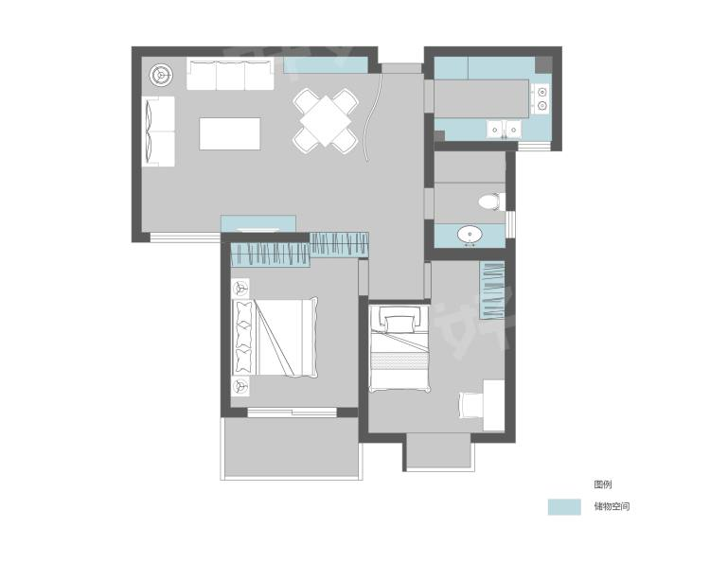








Potential problems – use case
Use case:
The application resides at the SBP initiator (non-AP STA A), which intends to monitor the health status of the people in the beds in Room 1 and Room 2, respectively.
AP is located in Room 3.
Assumptions:
All non-AP STAs are associated with the AP.
Non-AP STAs A (SBP initiator), B, C and D belong to the same system/product. (DCN 73r0)
  SBP initiator has prior knowledge about non-AP STA B, C, and D, e.g., location, power status, etc.
SBP initiator intends to estimate the channel between B and C (‘Channel BC’) and the channel between itself and D (‘Channel AD’).
Room 3
F
B
C
Room 1
E
SBP initiator
AP
A
D
Room 2
https://www.haohaozhu.cn/community/whole-house-detail/00024cm01000dseh
https://www.onlinewebfonts.com/icon/561539
What the current 11bf spec can do and cannot do?
SBP initiator provides a list of sensing responders: A, B, C and D (MAC address, AID/USID)
The SBP initiator is not enabled to indicate the need for SR2SR sounding, so the SBP responder (AP) is likely to measure the channel between the non-AP STA and the AP, not between non-AP STAs.
Since the SBP responder (AP) does not know about the application demands, the AP has no idea which non-AP STAs should be involved in the SR2SR sounding, or which non-AP STA should transmit and which should receive. For example, the CSI of Channel AB or Channel AC may not be of much use for the application.

Slide 4
Proposal
The SR2SR support in SBP is not sufficient in the current spec.
To support more use cases and enable more functionalities in the SBP procedure, we propose to enable SBP initiator to
  Indicate the need for SR2SR sounding;
  Indicate which sensing responders are requested to participate in SR2SR sounding;
  Indicate which SR2SR links are requested to be measured.
The proposal is based on the condition where the SBP initiator provides a list of sensing responders in the SBP Request frame.

Slide 5
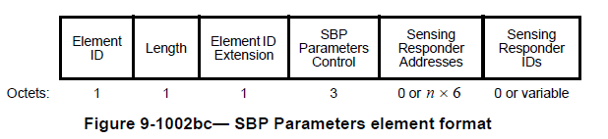
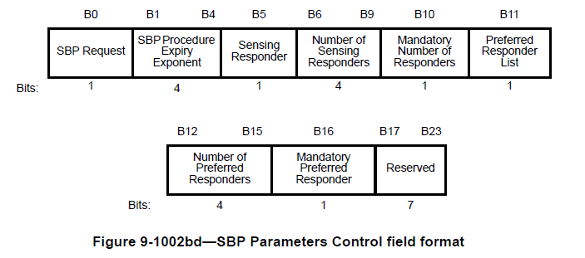
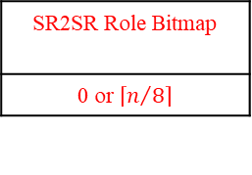
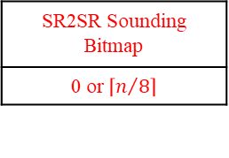
Proposal – spec changes (1/2)
Consider the previous use case: the SBP initiator intends to estimate Channel AD and Channel BC.
Based on the spec, SBP can provide a list of sensing responders including the MAC addresses of non-AP STAs A (SBP initiator itself), B, C, and D.
In SBP Parameters element,
SR2SR Sounding Bitmap
0 or $\left\lceil n/8\right\rceil$
SR2SR Role Bitmap
0 or $\left\lceil n/8\right\rceil$
Indicate which sensing responders are needed in SR2SR sounding
Indicate the sounding direction of the SR2SR channel
B17 | B18 | B19 | B20 B23
SR2SR | SR2SR Sounding Bitmap Present | SR2SR Role Bitmap Present | Number of SR2SR Links
1 | 1 | 1 | 4

Slide 6
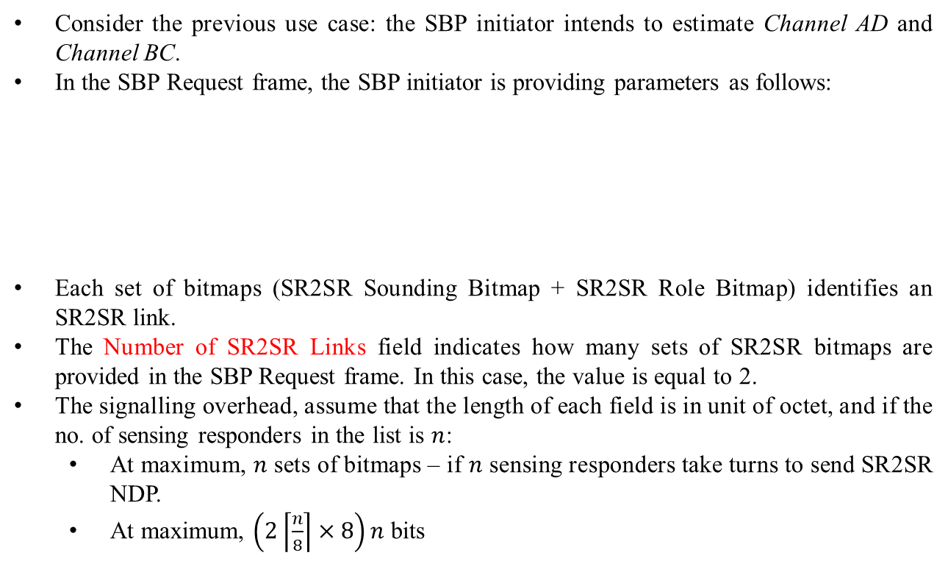
Proposal – spec changes (2/2)
Consider the previous use case: the SBP initiator intends to estimate Channel AD and Channel BC.
In the SBP Request frame, the SBP initiator is providing parameters as follows:
Each set of bitmaps (SR2SR Sounding Bitmap + SR2SR Role Bitmap) identifies an SR2SR link.
The Number of SR2SR Links field indicates how many sets of SR2SR bitmaps are provided in the SBP Request frame. In this case, the value is equal to 2.
The signalling overhead, assume that the length of each field is in unit of octet, and if the no. of sensing responders in the list is $n$:
  At maximum, $n$ sets of bitmaps – if $n$ sensing responders take turns to send SR2SR NDP.
  At maximum, $\left(2\left\lceil \frac{n}{8}\right\rceil ×8\right)n$ bits
Field | Sensing Responder Addresses | SR2SR Sounding Bitmap | SR2SR Role Bitmap | SR2SR Sounding Bitmap | SR2SR Role Bitmap
Content | ADDR of A, B, C, D | 1001 | 10 | 0110 | 01
Meaning | MAC addresses of non-AP STA A, B, C and D | The channel between A and D | Direction: A->D | The channel between B and C | Direction: C->B
Notes:
128 bits – 16 octets
3 responders will need 18 octets for MAC addresses

Slide 7
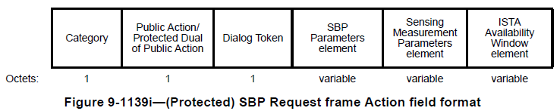
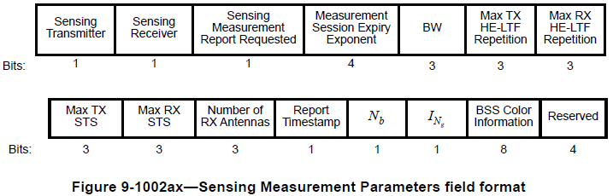
Further discussions
The current state of SBP setup in 11bf spec:
The SBP initiator sets up sensing measurement parameters within the Sensing Measurement Parameters element in the SBP Request frame, based on which, the SBP responder assigns parameters to sensing responder(s).
This means all sensing responders in the SBP procedure are acting as TX, or RX, or both TX and RX.
Such a strong constraint may limit the benefits of having downlink sounding and uplink sounding by only allowing one type of TB sensing measurement exchange in the SBP procedure. The characteristics from the AP and from the non-AP STA may be very different.
This may also limit the use cases.
How about we consider to enable the SBP initiator to suggest the role of sensing responders (provided in the SBP Request frame) or to allow the SBP responder to determine the role of each sensing responder?
Notes:
Since it is the SBP initiator that uses the measurement report, SBP initiator should be able to determine which non-AP does downlink and which uplink, based on its prior knowledge or even historical measurement reports.
Uplink and downlink characteristics can be different due to physical propagation characteristics and hardware designs.
For AP-STA, the role is set for one side. For STA-STA, the role should be set for both sides.

Slide 8
Conclusions
This contribution aims at enhancing the SBP procedure, which proposes to optionally enable the SBP initiator
  To indicate the sensing responders to perform SR2SR sounding;
  To assign the TX/RX role of the sensing responders in SR2SR sounding
Given the condition that the SBP initiator provides MAC addresses of sensing responders.
The benefits and limitations of this proposal are summarized as below:
  Benefits (for managed networks)
    Support more SBP use cases (SR2SR)
    Reduce resource waste for sending unwanted reports (link specification)
  Limitations
    Increase signaling overhead during SBP setup
This contribution also opens the discussion that should we allow the SBP responder to assign different roles to the sensing responders in the SBP procedure.

Slide 9
SP 1
Do you agree that the SBP initiator shall indicate in the SBP Request frame whether or not SR2SR sounding is requested in the SBP procedure?
  Use one reserved bit in SBP Parameters element for indication
  Y/N/A

Slide 10
SP 2
Do you agree that if the Preferred Responder List field in the SBP Request frame is set to 1, the SBP initiator is allowed to optionally specify the sensing responders in the Preferred Responder List to participate in SR2SR sounding phase in the SBP Request frame?
  Add an SR2SR Sounding Bitmap in SBP Parameters element.
  Y/N/A

Slide 11
SP 3
Do you agree that if the Preferred Responder List field in the SBP Request frame is set to 1, the SBP initiator is allowed to optionally specify the role (TX or RX) of sensing responders in the Preferred Responder List to participate in SR2SR sounding phase in the SBP Request frame?
  Add an SR2SR Sounding Role Bitmap in SBP Parameters element
  Y/N/A

Slide 12
Reference
[1] https://www.ieee802.org/11/private/Draft_Standards/11bf/Draft%20P802.11bf_D1.0.pdf

Slide 13
