Slide 1
Efficient Coordinated Spatial Reuse
Date: 2023-09-11
Authors:

Slide 2
Abstract
Coordinated Spatial Reuse (C-SR) is one of the Multi-AP transmission techniques that is being considered for UHR.
C-SR only requires RSSI or pathloss feedback as opposed to complete CSI between all APs and STAs.
C-SR can be implemented using the protocols used for CBF and JT [1],[2].
A unified multi-AP protocol is preferred but may not be the most efficient especially for C-SR.
In this contribution, we propose an efficient protocol for C-SR.

Slide 3
General Procedure for C-SR
AP1
(sharing AP)
AP2
(shared AP)
Interference Measurement
Phase
Transmission Phase
STA1
(Associated with AP1)
STA2
(Associated with AP2)
Interference measurement phase
  The sharing/shared APs measure interference or pathloss to each other’s target STA.
Transmission phase
  Initiated by the sharing AP. The sharing AP controls the transmit power and MCS of the shared APs.

Slide 4
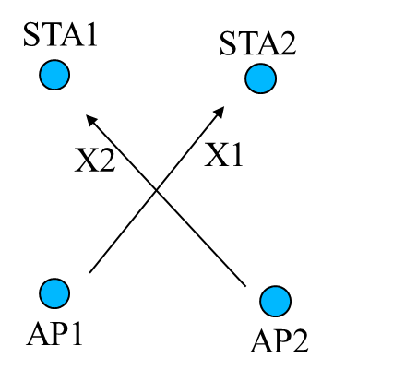
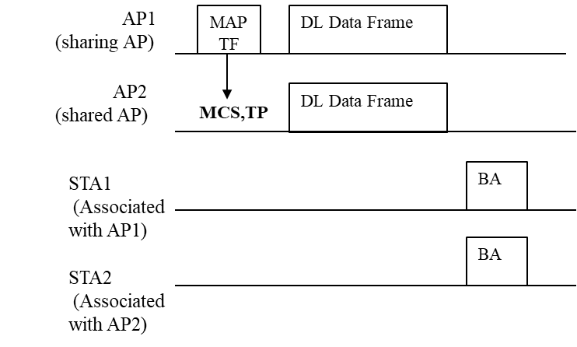
Shared AP Transmit Power and MCS
During the transmission phase, we assume that AP1 first decides its own transmit power and MCS. Based on these decisions, it computes the transmit power and MCS of the shared AP.
Transmit power of AP2- AP2 transmit power depends on the interference from AP2 to STA1 (X2).
MCS of AP2- The sharing AP (AP1) may indicate a maximum MCS of the shared AP. The MCS depends on the interference from AP1 to STA2 (X1).
Problem: While X1 can be measured directly by AP1, X2 needs to be obtained from either AP2 or STA1.

Slide 5
Interference Measurement Phase and Feedback Collection
AP1
(sharing AP)
MAP
TF
NDPA
NDP
BFRP
AP1
(sharing AP)
MAP
TF
NDPA*
measure X1
BFRP
AP2
(shared AP)
NDPA
NDP
AP2
(shared AP)
NDPA*
measure X2
BFR
X2
STA1
(Associated with AP1)
STA1
(Associated with AP1)
measure X2
BFR
X2
NDP
STA2
(Associated with AP2)
measure X1
BFR
X1
STA2
(Associated with AP2)
NDP
Option 1
Option 2
There are two options to obtain X1 and X2. Both options require the same number of steps.
For option 2, only X2 needs to be transferred (marginally more efficient).
We prefer a way where neither X1 nor X2 needs to be transferred, i.e. eliminate final BFRP-BFR exchange.
Option1

Slide 6
Proposed C-SR transmission method
AP1
(sharing AP)
MAP
TF
NDPA*
measure X1
MAP
TF
DL Data Frame
TP=f(X2,ARIL)
AP2
(shared AP)
NDPA*
measure X2
DL Data Frame
MCS,ARIL
STA1
(Associated with AP1)
NDP
BA
STA2
(Associated with AP2)
NDP
BA
Interference Measurement
Phase (Option 2)
Transmission Phase
We propose that the MAP TF does not directly indicate TP for the shared AP.
Instead, the MAP TF indicate an acceptable interference level (ARIL) parameter.
The shared AP can determine its transmit power based on the ARIL and its own measured X2.
Works well with Option 2 of Interference Measurement Phase. How to apply the same concept for Option 1 interference measurement phase is TBD.

Slide 7
Example
ARIL=-80 dBm
AP1
(sharing AP)
MAP
TF
NDPA*
MAP
TF
DL Data Frame
AP2 – STA1 Pathloss =90 dB
TP=ARIL+20-X2= 10 dBm
AP2
(shared AP)
NDPA*
X2 = -70 dBm
MCS, ARIL
DL Data Frame
STA1
(Associated with AP1)
IL = -80 dBm
NDP
BA
STA2
(Associated with AP2)
20 dBm
NDP
BA
The example shows how the sharing AP can control the interference of the shared AP without directly indicating the transmit power.
The transmit power of the PPDU (NDP) where X2 was measured needs to be known by AP2. How to signal this is TBD.

Slide 8
Benefits of the proposed CSR method
Very low overhead.
Simple implementation – very similar to PSR-based SR transmit power determination.
Distributed processing. Allow shared APs to compute parameters by themselves to reduce interference measurement procedure overhead.

Slide 9
Conclusion
We discussed a way to reduce the overhead of CSR by simply changing the transmit power signaling by the Sharing AP to the Shared AP.
The proposed method may require a specific interference measurement procedure to achieve the most gain.

Slide 10
References
[1] https://mentor.ieee.org/802.11/dcn/19/11-19-1097-00-00be-sounding-procedure-in-ap-collaboration.pptx
[2] https://mentor.ieee.org/802.11/dcn/19/11-19-1134-01-00be-consideration-of-multi-ap-sounding.pptx

