Slide 1
IEEE 802.11bd Awards
Date: 2023-05-18
Authors:

Slide 2
Abstract
This presentation contains the list of awards for the IEEE P802.11bd project

Slide 3
Some Trivia
The TG stuck closely to its plan and accomplished on time, as expected.
Lots of contributors participated only part of the development but still made great contribution to this project.

Slide 4
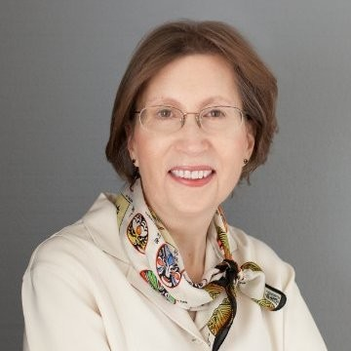
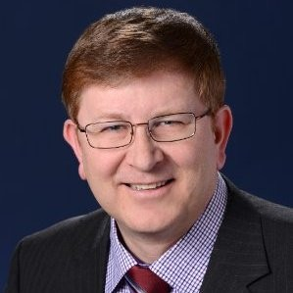
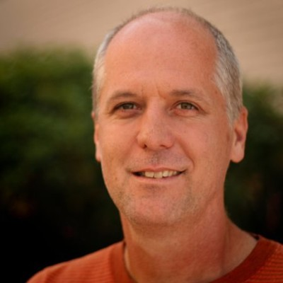
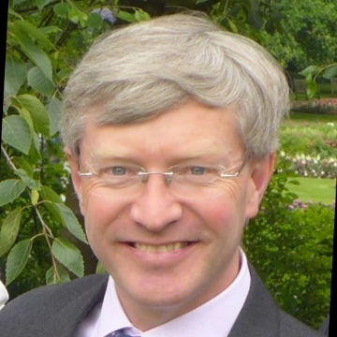
WG Officer Awards
Dorothy Stanley
(802.11 Chair)
Jon Rosdahl
(802.11 Vice Chair)
Robert Stacey
(802.11 Vice Chair)
Stephen McCann
(Secretary)
Thanks for all the support, for accommodating the requests for many time slots, the local coordination for mixed-mode meetings, and for teleconferences arrangement!

Slide 5
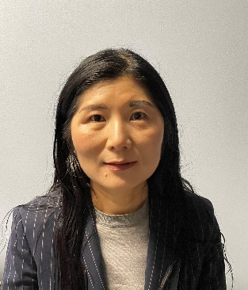
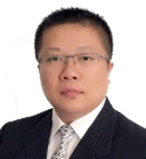
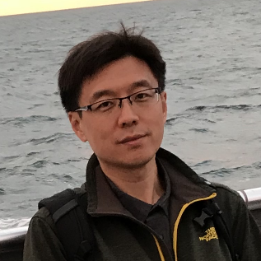
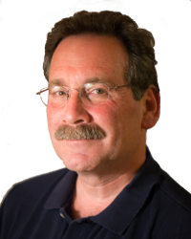
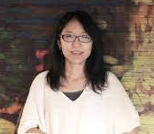
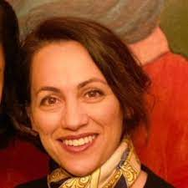
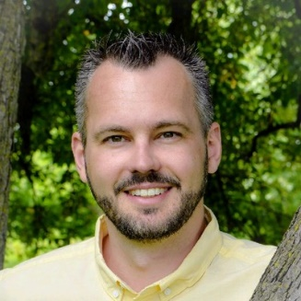
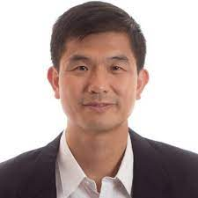
802.11bd TG Officers
Bo Sun
(TG Chair)
Hongyuan Zhang
(TG Vice Chair)
Joseph Levy
(TG Vice Chair)
Yan Zhang
(TG Secretary)
Yujin Noh
(TG Editor)
Bahar Sadeghi
(EX-TG Editor)
James Lepp
(EX-TG Secretary)
Qinghua Li
(PHY adhoc Co-chair)
Thanks for all your dedication and patience!

Slide 6
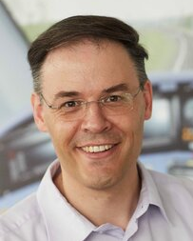
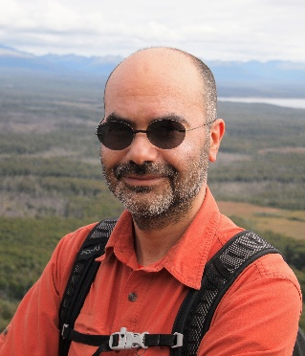
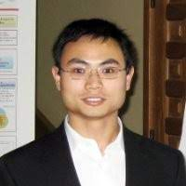
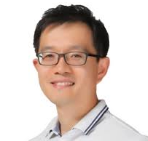

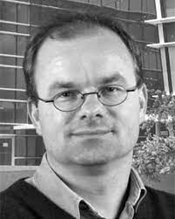
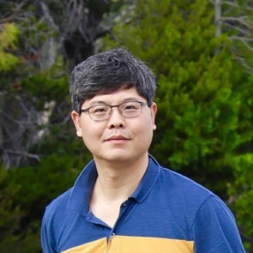
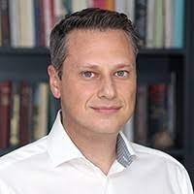
802.11bd PHY and Comment Resolutions
Rui Cao
Stephan Sand
Dongguk Lim
Miguel Lopez
Jianhan Liu
Ioannis Sarris
Prashant Sharma
Friedbert Berens
Thanks for all your dedication and patience!

Slide 7
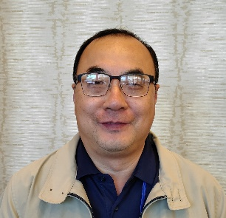
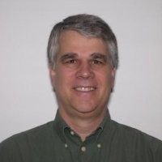
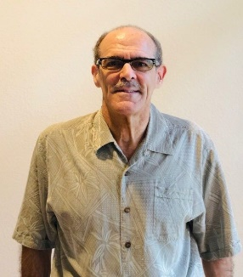



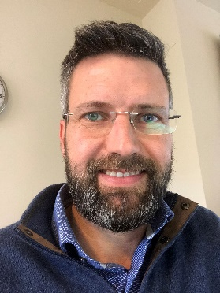
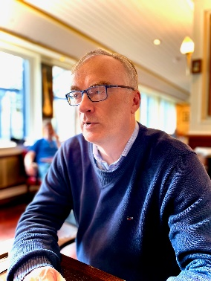
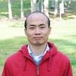

802.11bd MAC and Comment Resolutions
Liwen Chu
John Kenney
Michael Fischer
Hiroyuki Motozuka
Hanseul Hong
Rui Yang
Onn Haran
Alessio Filippi
Insun Jang
Feng Jiang
Yossi Shaul
Sean Coffey
Ronny Yongho Kim
Paul Unterhuber
Thanks for all your dedication and patience!

Slide 8
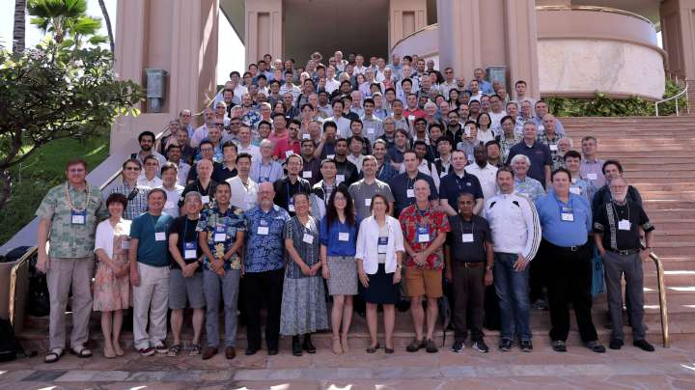
…. and the rest of 802.11 WG

