Slide 1
Low Latency Out-Of-Order Delivery
Date: 2023-07-05
Authors:

Slide 2
Abstract
This contribution discusses the Head-of-Line blocking issue for the low latency delivery.

Slide 3
Recap: In-Order Delivery Service
In 802.11-2020,
  “There shall be no reordering of individually addressed MSDUs with the same TID value and addressed to the same destination.”
  “The recipient shall always pass MSDUs or A-MSDUs up to the next MAC process in order of increasing Sequence Number subfield value.”

Slide 4
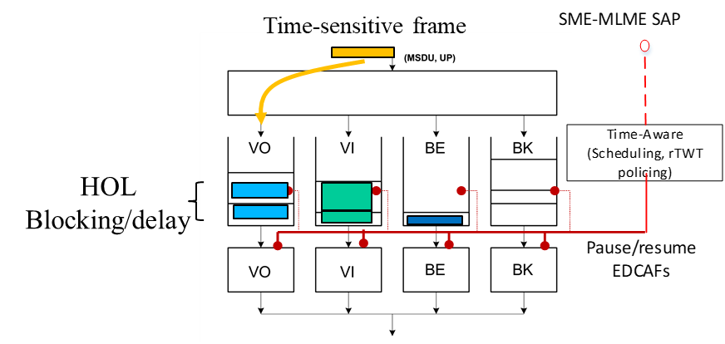
Low Latency Out-Of-Order Delivery
The multiple application flows can be multiplexed into the same TID.
The reordering of a low latency packet with the same TID should be allowed to address the Head-of-Line (HoL) blocking issue.
Gaps:
  802.1Qbv configuration should be provided to the 802.11be MAC as requirements/input (e.g., for scheduling of Restricted TWT SPs)
  Time-sensitive frames within the 802.11 MAC may be delayed if sharing a queue with other traffic (head of the line blocking & randomness) – 11be MAC need to isolate frames and consider per frame deadlines (time-aware)
<Source: Dave, et al., “Wireless TSN in 802.11 and New Requirements for 802.11be and 802.1”, 11-21/0628r0>

Slide 5
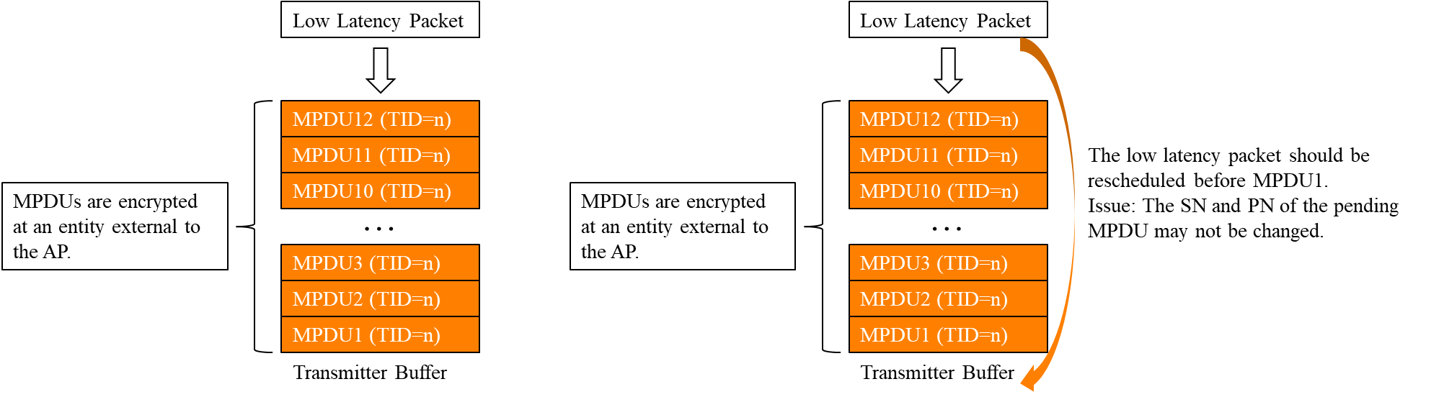
Low Latency Out-Of-Order Delivery
At a transmitter side, a low latency packet should be transmitted even though preceding MSDUs are not transmitted yet.
  Issues: When the PN is pre-assigned, the re-assignment of PN is needed. It can cause the re-encryption. If the MPDUs are encrypted at an entity external to the AP, then it is difficult to re-encryption the MPDU.

Slide 6
Low Latency Out-Of-Order Delivery
At a receiver side, a low latency packet should be delivered to an upper layer even though preceding MPDUs are not received yet.
  Issues: The replay counter is set to the PN value of accepted CCMP/GCMP MPDUs. A replayed frame occurs when the PN from a received frame is less than or equal to the current replay counter value for the frame’s MSDU or A-MSDU priority and frame type.
Traffic flow A
Traffic flow B
AP
MPDU0 [PN=0]
MPDU1 [PN=1]
MPDU2 [PN=2]
MPDU3 [PN=3]
STA
BA [Bitmap=0111]
STA can’t deliver MPDU2 and MPDU3 to the upper layer, even though there is no reordering issue.
Because the replay counter can’t be increased.

Slide 7
Low Latency Out-Of-Order Delivery
To solve the HoL blocking issue, we propose an independent PN sequence and replay counter for the low latency packet.
  It may be useful to process a low latency packet earlier while keep supporting the replay detection of other packets within the same TID.
  The MAC/CCMP header needs to indicate that the MPDU corresponds to a low latency packet and is encrypted with the PN sequence dedicated to the low latency packet.
Traffic flow A
Traffic flow B
AP
MPDU0 [PN=0]
MPDU1 [PN=1]
MPDU2 [PN=7]
MPDU3 [PN=8]
STA
BA [Bitmap=0111]
Different PN sequences are used for traffic flow A and B. The STA also use the different replay counters for flow A and B.
The STA can delivery MPDU2 and MPDU3 to the upper layer.

Slide 8
Conclusion
Currently low latency support mechanisms (e.g., R-TWT, QoS Characteristics element) have focused on the data delivery.
However, depending on the traffic scenario, the bottleneck of a low latency can be buffer management (e.g., HoL Blocking).
To address the HoL Blocking issue, UHR spec needs to allow an out-of-order delivery per TID while maintaining the delivery order within the same application flow.

Slide 9
References
https://mentor.ieee.org/802.11/dcn/21/11-21-0628-00-00be-wireless-tsn-in-802-11-and-new-requirements-for-802-11be-and-802-1.pptx
https://mentor.ieee.org/802.11/dcn/20/11-20-1217-04-00be-rts-trigger-su-ppdu.pptx
https://mentor.ieee.org/802.11/dcn/23/11-23-0018-01-0uhr-low-latency-support-in-uhr.pptx
https://mentor.ieee.org/802.11/dcn/22/11-22-1926-00-0uhr-challenges-to-achieve-low-latency.pptx

