Slide 1
WUR Applicability for AMP Downlink
Date: 2023-05-15
Authors:

Slide 2
Abstract
We discuss the applicability of WUR as downlink channel for the AMP devices

Slide 3
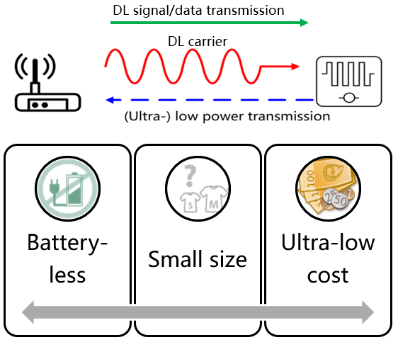
WUR Applicability for AMP Downlink
Suggested WUR
In [1] it was suggested to use the WUR (802.11ba) for the
Wi-Fi system → AMP-IoT-device link.
Many 802.11 devices can already transmit WUR signals, making such usage a cost-effective extention for 802.11 deployments
This contribution discusses the applicability of reusing the existing WUR standard for AMP devices.

Slide 4
WUR (802.11ba) Applicability for AMP Downlink (cont.)
AMP-IoT devices are characterized by ultra low power consumption and ultra low complexity
AMP-IoT devices are expected to transmit and receive very short messages
802.11 AMP is required to reuse existing 802.11 features as much as possible
Thus it is suggested to reuse the existing 802.11ba amendment for Wi-Fi system as AMP-IoT device downlink link

Slide 5
WUR (802.11ba) Applicability for AMP Downlink (cont.)
The existing 802.11 device can energize the AMP-tag devices by using 2.4GHz transmissions or 802.11ah 900MHz transmissions
  2.4GHz has lower cost and better harmonization
  900MHz has better coverage and better transmit power limitation on several regions
  Energizing signals are insensitive to interference
The existing 802.11 device can transmit to the AMP-IoT devices WUR frames as the downlink
  We propose to transmit the downlink over 2.4GHz.
  In addition, extend 802.11ba for 900MHz in order for 802.11ah devices to communicate with the AMP-IoT devices.
The downlink WUR frame can be used by the AMP for:
  Polling the non-AP devices for their ID
  Security
  Sensing or triggering

Slide 6
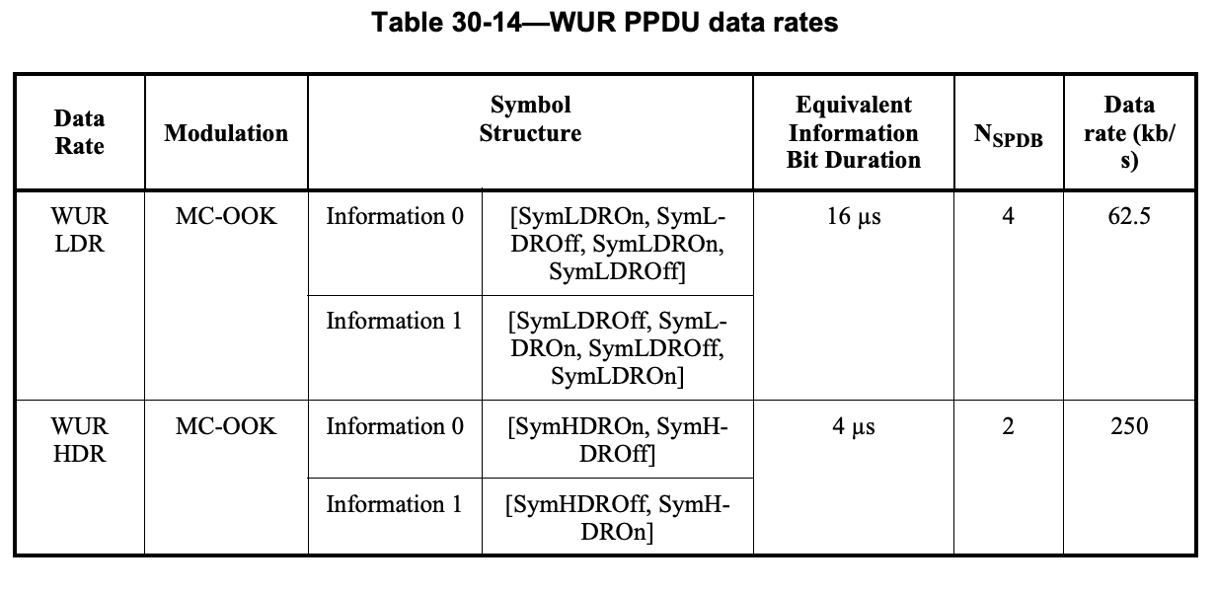
WUR Rates
Receiving both LDR (62.5Kbps) and HDR (250Kbps) are within the scope of AMP-IoT device ultra low power consumption and ultra low complexity.
HDR is advantageous for dense deployments since it is more efficient
LDR has lower sensitivity, so it can be used for longer range tags
The Wi-Fi system should be able
to transmit both LDR, HDR.
The AMP-IoT device should
support receiving at least one.
WUR receiver power
consumption at the AMP-IoT
can get as low as <50uW

Slide 7
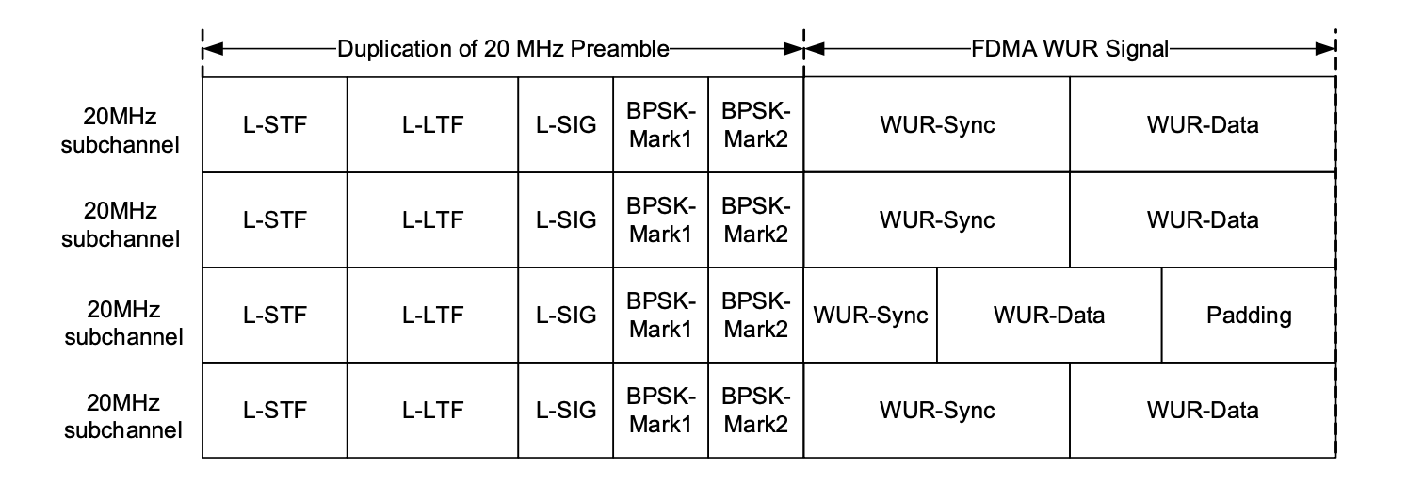
WUR - Structure
It is preferred to limit multi-channel 802.11ba signals to be transmitted with the same WUR-sync and WUR-data between channels - so that WUR is correctly received also by ultra low complexity AMP-IoT devices, with poor filtering abilities
Expected output power of AMP-IoT devices is low, so they require Wi-Fi system protection from interference
L-SIG: LENGTH field should be calculated such that it includes also the response of the AMP-IoT devices, not just the WUR Signal, as suggested by [2]
It suggested that in addition the
Wi-Fi system transmit
CTS-to-self frame before
the WUR frame

Slide 8
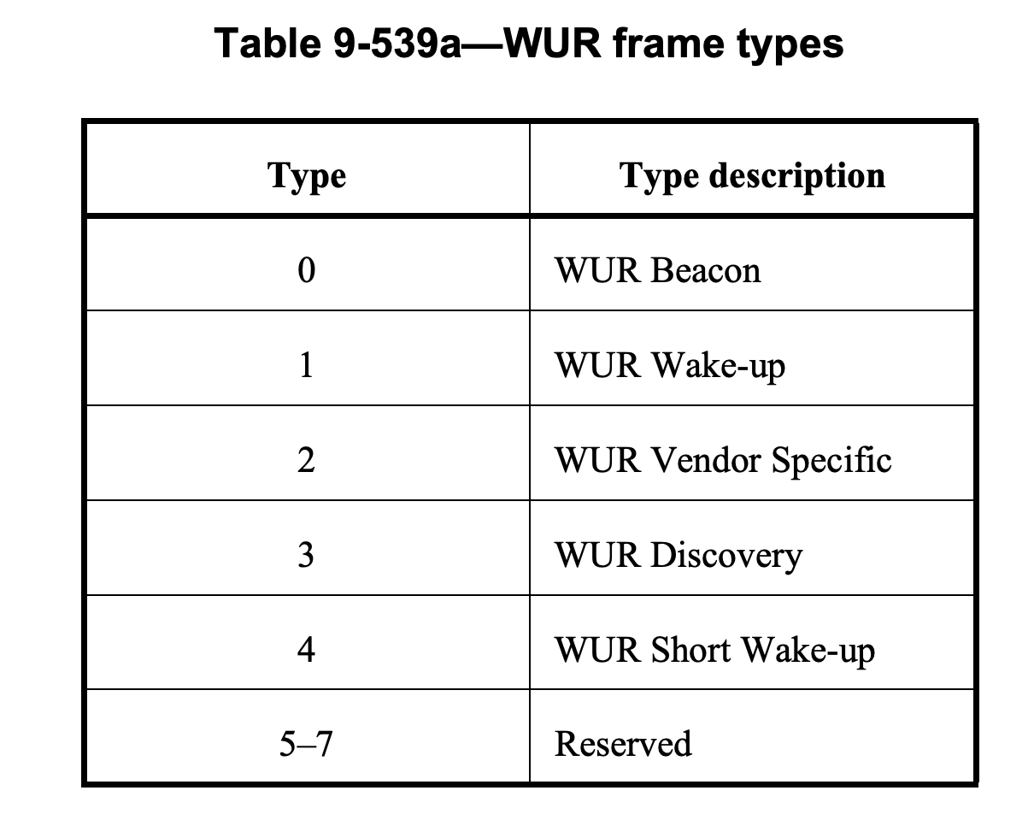
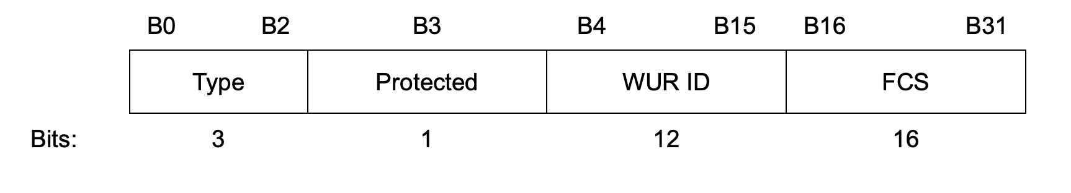
WUR Frame Types
It is suggested to use one of the reserved WUR frame types and define a new WUR frame type: AMP-WUR
Alternatively, AMP can use the
WUR Short Wake-Up frame

Slide 9
WUR Fields
WUR Group ID - can be used for simplifying protocol by addressing all tags at the same time.
This is very useful for dense deployments of AMP-IoT devices
WUR ID - 12 bits may be too small
FCS field can be reduced
  Impact of false-positive is low (integrity of the data sent to the AMP-IoT device)
  WUR receiver power consumption is increased due to the FCS calculation
  The FCS overhead is significant for very short packets

Slide 10
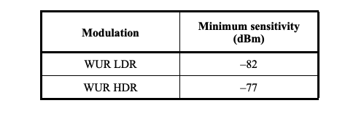
AMP non-AP Receiver Sensitivity
Current 802.11ba required sensitivity is set to:
The ultra low complexity
of AMP non-AP devices suggests
to increase these minimum sensitivity requirements beyond what is defined by 802.11ba.
Example of link budget for the downlink:
 | Energizing | Downlink
TX [dBm] | 20 | 20
RX [dBm] | -40 | -50

Slide 11
Summary
Applicability of 802.11ba for downlink channel of AMP was discussed
Such application will enable existing 802.11 devices to be able to communicate with AMP devices
The analysis suggests minor changes to existing WUR can enable its use on the AMP devices

Slide 12
References
[1] IEEE 802.11-22/1960r6: Summary and recommendation for AMP IoT
[2] IEEE 802.11-22/970r0: Feasibility of supporting AMP IoT devices in WLAN

