Slide 1
Coordinated Measurement
Date: 2023-06-26
Authors:
Name | Company | Address | Phone | Email
Kosuke Aio | Sony |  |  | Kosuke.Aio@sony.com
Yusuke Tanaka |  |  |  | Yusuke.YT.Tanaka@sony.com
Ryuichi Hirata |  |  |  | Ryuichi.Hirata@sony.com
Ken Tanaka |  |  |  | Ken.A.Tanaka@sony.com
Thomas Handte |  |  |  | Thomas.Handte@sony.com
Dana Ciochina |  |  |  | Dana.Ciochina@sony.com
Daniel Verenzuela |  |  |  | Daniel.Verenzuela@sony.com

Slide 2
Introduction
Scenario of overlapping BSS scenario is TGbn PAR scope [1].
Some features need to measure link quality (such as RSSI/SNR) among multiple BSSs. For example,
  Coordinated Spatial Reuse can improve system throughput and latency by using RSSI/SNR between STA and OBSS APs to calculate the appropriate Tx power for multiple APs [2].
  Seamless Roaming can maintain good link quality without interruption of data transmission by performing appropriate transitions using RSSI/SNR between STA and OBSS APs [3].
  Coordinated R-TWT can protect emergency data communication with STA which observes high interference from OBSS AP/STA [4].
In this contribution, we propose “coordinated measurement” schemes to collect all the necessary information for the above features in a short time.

Slide 3


Existing Measurement for OBSS Signal
AP can request intra-BSS STAs to measure OBSS signal by “Measurement Request/Response”.
  “Measurement Request/Response” mechanism defined in IEEE 802.11 allows APs to request intra-BSS STAs to measure OBSS signal.
  General Procedure
    AP sends “Measurement Request element” to intra-BSS STAs
    STA responses “Measurement Report element” to the AP
  Measuring Beacon frames is typically used for RSSI measurement because the Tx power is relatively static compered to other frames.
OBSS STA1
1. Measurement Request
STA1
OBSS AP1
AP1
2. Measure OBSS Signal
3. Measurement Report
OBSS AP2
OBSS STA2

Slide 4
Problem of Existing Measurement
Regardless of measurement type (active/passive), it typically takes more than 100-200ms to complete the measurement process.
  For passive measurement, Beacon interval is usually set to 100-200ms.
  For active measurement, STA allocate approximately 100-200ms to collect probe responses from all APs.
  In cases where a STA fails receiving Beacon from an OBSS AP for some reason, the measurement process will take even longer.
Considering mobility scenario, a more efficient OBSS signal measurement scheme is required.
  For instance, when STAs are moving, there is a high likelihood that RSSI values will have significantly varied.

Slide 5
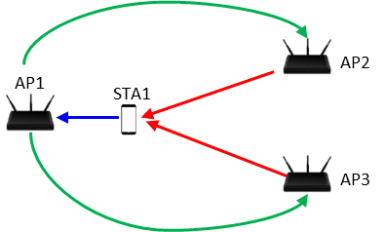
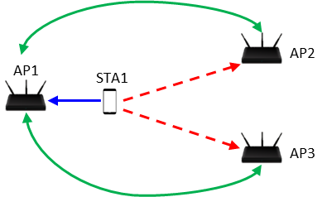
Proposal
We propose coordinated measurement schemes.
  Coordinated Measurement is the cooperative transmission/observation of test signals and sharing measurement results among multiple APs.
  By actively acquiring the OBSS signal, we can expect a significant reduction in measurement time.
There are two types of coordinated measurement: Implicit and Explicit type
Explicit Coordinated Measurement
Implicit Coordinated Measurement
(1) AP1 requests AP2/AP3 to send test signal.
(1) AP1 requests AP2/AP3 to measure STA1’s signal.
(3) STA1 measures RSSI from AP2/AP3
1 and report it to AP1
(2) STA1 sends UL signal by AP1’s trigger.
(2) AP2/AP3 send test signal.
(3) AP2/AP3 measure RSSI from STA1 and report it to AP1

Slide 6
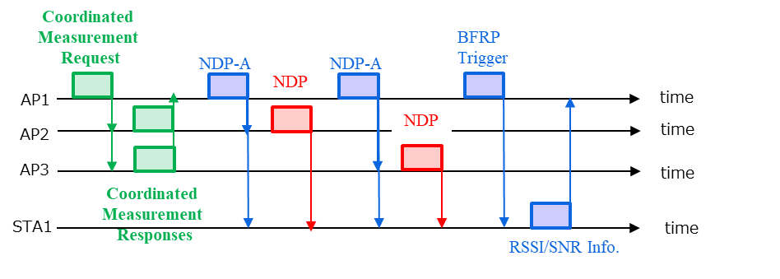
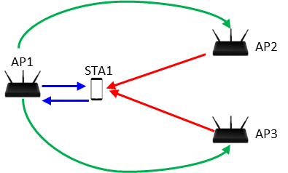
Coordinated Measurement: Explicit Type
Detail Procedure (reused 11ax Explicit BF Sounding Procedure)
  AP1 requests AP2/AP3 to send a test signal (e.g., NDP) and collect responses.
  AP1 sends a request frame (e.g., NDP-A) to request STAs to measure the signal from AP2/AP3.
  AP2/AP3 send the test signal sequentially (or simultaneously).
  The STAs measure RSSI/SNR of the test signals from AP2/AP3.
  AP1 sends a trigger frame (e.g., BFRP Trigger) to request the STAs to feedback the RSSI/SNR information in UL OFDMA.
  The STAs send the RSSI/SNR information to AP1.
①
⑤
②
②
①
③
④
③
③
②, ⑤
⑥
③
①
④
④
⑥

Slide 7
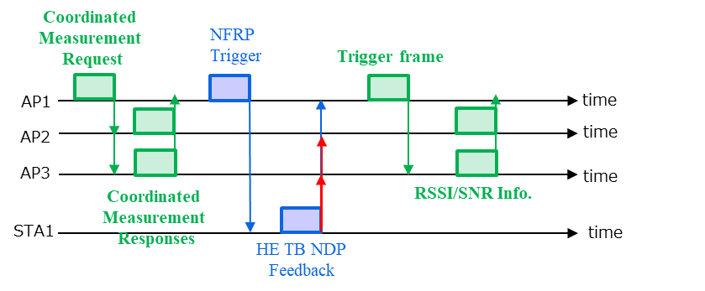
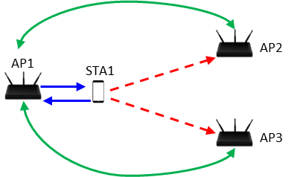
Coordinated Measurement: Implicit Type
Detail Procedure (reused 11ax NDP Feedback Report Procedure)
  AP1 requests AP2/AP3 to measure a test signal (e.g., HE TB feedback NDP) from STAs and collects responses.
  AP1 sends a trigger frame (e.g., NFRP Trigger) to request STAs to send the test signal.
  The STAs send the test signal.
  AP2 and AP3 measure RSSI/SNR of the test signals from the STAs.
  AP2 and AP3 report the RSSI/SNR information to AP1 (sequentially or simultaneously).
①,⑤
①
②
④
⑤
②
④
③
⑤
③

Slide 8
Evaluation Parameters
The total duration of each coordinated measurement is calculated.
Assumption
  3APs are installed, and 1/2/4/16 STAs per BSS
  NDP and TB PPDU are HE PPDU in 80MHz. Others are non-HE PPDU in 20MHz.
  NDP includes 2xHE-LTF with 0.8us GI
  MCS 0 for all frames.
  Frame length/duration of the existing frames
    NDP-A: 21byte + 4byte per STA
    BFRP Trigger frame: 28byte + 6byte per STA
    NFRP Trigger frame: 33byte
    HE Sounding NDP: 47.2us
    HE TB feedback NDP: 56us
  Frame duration of the new defined frames
    Coordinated Measurement Request: Like 11ax Trigger frame
      MAC Header + Common field + FCS(28byte) + User Info(6byte) per OBSS AP
    Coordinated Measurement Response: MAC Header (20byte) + Flag (1byte)
    RSSI Info: MAC Header (20byte) + RSSI value (1byte) per link

Slide 9
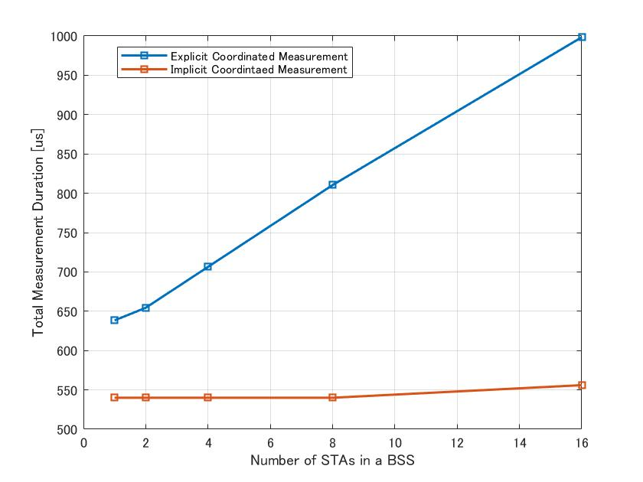
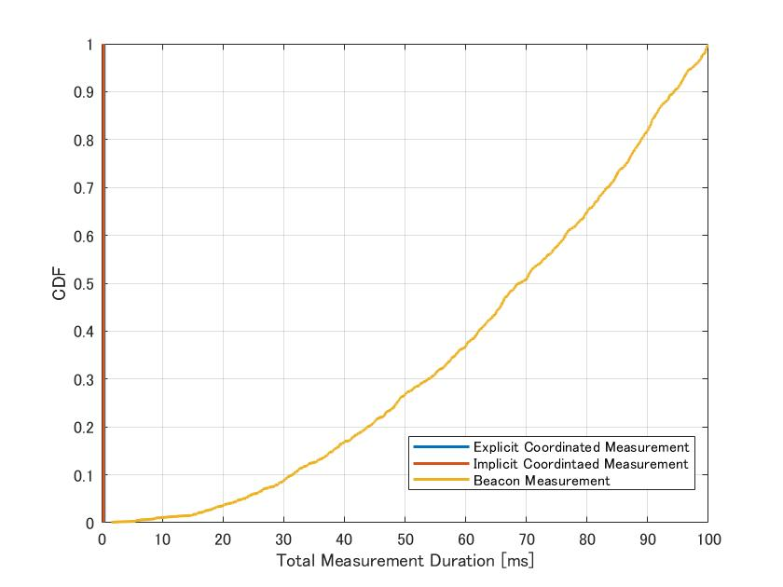
Comparison Results
Explicit v.s. Implicit
Coordinated v.s. Beacon Measurement (16STAs in a BSS)
Whereas Beacon Measurement takes tens of ms, both types of Coordinated Measurement for each BSS are completed in 1ms even if there a lot of STAs.

Slide 10
Further Consideration Points
How to use Implicit/Explicit type?
  When considering RF impairments of transceiver/receiver can be ignored (as symmetric link), we can use whichever type we prefer.
  Otherwise, the measurement type should be selected based on the primary usage scenario
    For example, when APs intend to use Coordinated SR in DL, they should measure RSSI/SNR of interference links using the Explicit type.
How to schedule Coordinated Measurement?
  Even if Sharing AP (AP obtaining TXOP) sends Coordination Measurement Requests, OBSS APs may not receive or may not be able to respond to the request due to other ongoing communications within the BSSs.
  To ensure effective Coordinated Measurement, it is advisable to pre-determine a service period by utilizing R-TWT or other means.
    This will help in coordinating the measurement process among the APs and mitigating potential conflicts with ongoing transmissions.

Slide 11
Summary
We proposed two coordinated measurement schemes to shorten measurement time.
  Implicit Coordinated Measurement
  Explicit Coordinated Measurement
According to the evaluation, both schemes can shorten measurement time substantially.
  Both measurements were completed in 1ms.
  Implicit has a shorter measurement time, and the difference between Implicit and Explicit becomes larger as the number of STAs becomes larger.

Slide 12
Reference
[1] Laurent Cariou (Intel), “UHR proposed PAR,” 23/0480r0, March 2023
[2] Kosuke Aio (Sony Group Corporation), “Recap on Coordinated Spatial Reuse Operation,” 22/1822r0, November 2022.
[3] Duncan Ho (Qualcomm), “Seamless Roaming for UHR,” 22/1910r1, January 2023
[4] SunHee Baek (LG Electronics), “Coordinated R-TWT Protection in Multi-BSS,” 23/0771r0, May 2023

Slide 13
SP
Do you agree “Coordinated Measurement” as UHR/TGbn’s feature?
  Coordinated Measurement is the cooperative procedure about transmission/observation of test signals and sharing measurement results among multiple APs.
  Yes
  No
  Abstain

Slide 14
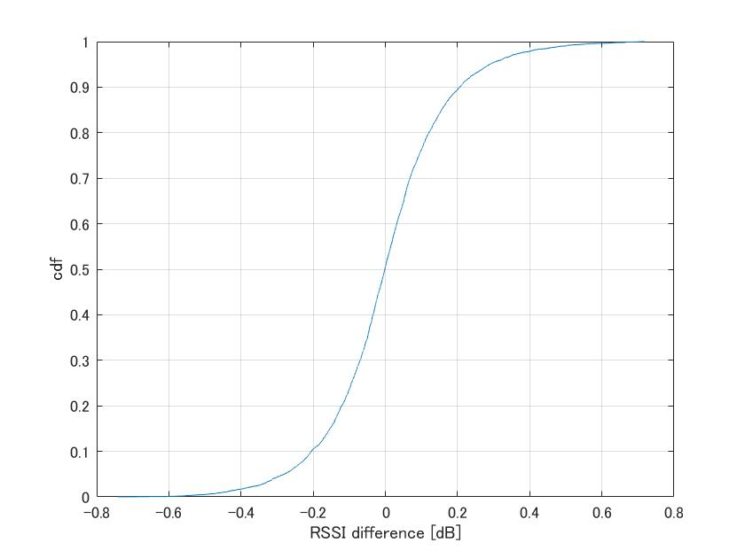
Appendix
Simulation of RSSI measurement by HE TB feedback NDP
  Parameter
    Channel Model: TGac_D NLOS
    (Freq, BW) = (5180MHz, 20MHz)
  RSSI difference = Real RSSI – Estimated RSSI
    Real RSSI is calculated from 252 subcarriers [-126:126] .
    Estimated RSSI is calculated from 6 subcarriers [-113,-77,-41,6,42,78].

