Slide 1
Discussions on CSI Feedback Reduction in UHR
Date: 05/04/2023
Authors:

Slide 2
Abstract
In this contribution, we discuss the need to reduce the overhead of Channel State Information (CSI) feedback for UHR and the potential methods of CSI feedback reduction.

Slide 3
Introduction
Potential features proposed for UHR may require high CSI feedback overhead
  Multi-AP: joint transmission/coordinated beamforming [2-5]
  Beamformed MIMO with a large number of antennas up to 16 SS at the AP [6-8]
  Larger number of antennas at STA [10]
  Large operating bandwidths (>= 320 MHz) [9]
  Any combined solutions [9] may further increase the airtime of CSI feedback transmission
Large CSI feedback overhead may:
  Limit the throughput improvement
  Prolong the delivery of low latency traffic

Slide 4
CSI Overhead Analysis
The required CSI airtime may be further increased by the large operational bandwidth, high number of STAs associated with one AP (e.g., dense Wi-Fi deployment), MAP joint transmission and coordinated beamforming, etc.

Slide 5
Benefits of Reduced CSI Feedback Overhead
Reduce the airtime of CSI feedback transmission and potentially improve the system throughput
Enable faster packet delivery with a shortened channel access time, especially for low latency traffic
Lessen the burden of frequent sounding sequences for CSI accuracy required in a more dynamic channel environment

Slide 6
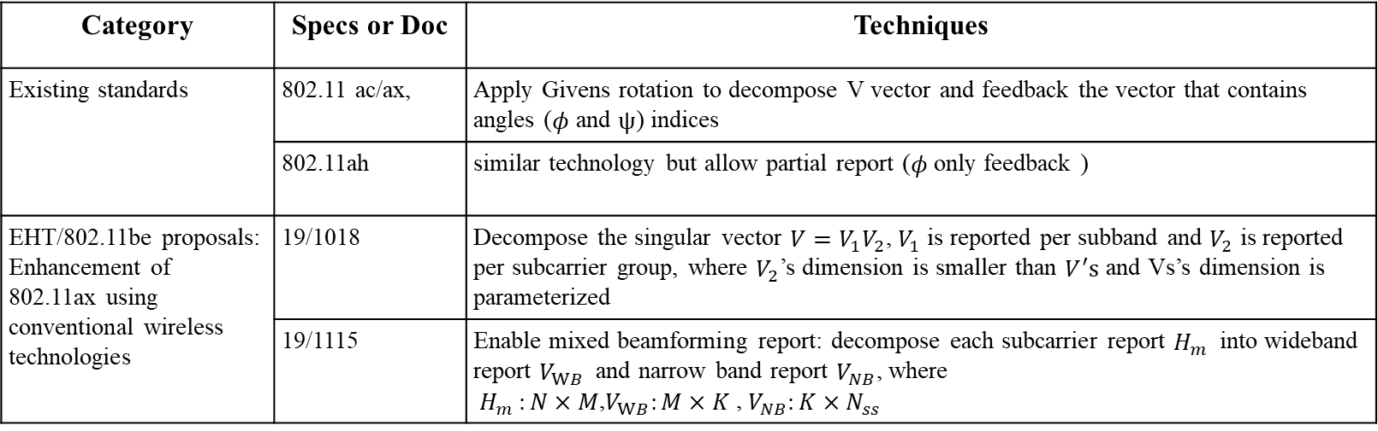
Recap: CSI Feedback Reduction Schemes Proposed in EHT and AIML (1/2)
The following directions to reduce the CSI feedback are discussed in the existing specs, EHT, AIML proposals
Category | Specs or Doc | Techniques
Existing standards | 802.11 ac/ax, | Apply Givens rotation to decompose V vector and feedback the vector that contains angles ($φ$ and $ψ$) indices
 | 802.11ah | similar technology but allow partial report ($φ$only feedback )
EHT/802.11be proposals: Enhancement of 802.11ax using conventional wireless technologies | 19/1018 | Decompose the singular vector $V={V_{1}V}_{2}$, $V_{1}$is reported per subband and $V_{2}$ is reported per subcarrier group, where $V_{2}$’s dimension is smaller than $V^{′}s$ and Vs’s dimension is parameterized
 | 19/1115 | Enable mixed beamforming report: decompose each subcarrier report $H_{m }$ into wideband report $V_{WB}$ and narrow band report $V_{NB}$, where $H_{m }:N×M$,$V_{WB}:M×K$ , $V_{NB}:K×N_{ss}$

Slide 7
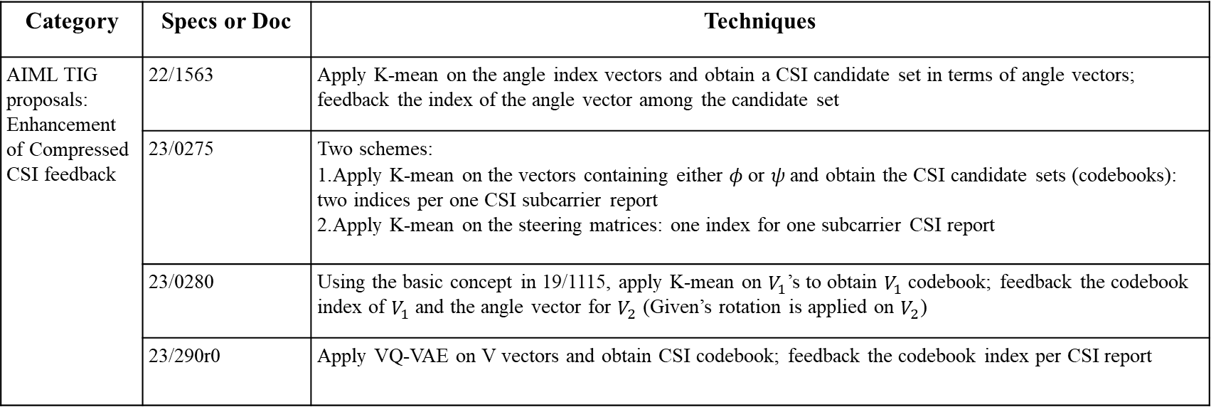
Recap: CSI Feedback Reduction Schemes Proposed in EHT and AIML (2/2)
Category | Specs or Doc | Techniques
AIML TIG proposals: Enhancement of Compressed CSI feedback | 22/1563 | Apply K-mean on the angle index vectors and obtain a CSI candidate set in terms of angle vectors; feedback the index of the angle vector among the candidate set
 | 23/0275 | Two schemes: Apply K-mean on the vectors containing either 𝜙 or 𝜓 and obtain the CSI candidate sets (codebooks): two indices per one CSI subcarrier report Apply K-mean on the steering matrices: one index for one subcarrier CSI report
 | 23/0280 | Using the basic concept in 19/1115, apply K-mean on $V_{1}$’s to obtain $V_{1}$codebook; feedback the codebook index of $V_{1}$ and the angle vector for $V_{2}$ (Given’s rotation is applied on $V_{2}$)
 | 23/290r0 | Apply VQ-VAE on V vectors and obtain CSI codebook; feedback the codebook index per CSI report

Slide 8
Challenges of Reducing CSI Feedback
Contributions (slides 6 and 7) indicate that the throughput may be boosted by the significantly reduced CSI feedback overhead. However, further compressed CSI feedback may lead to degraded PER performance compared with the current CSI compressed algorithm used in 802.11ax/be for the same MCS
  Some proposed CSI feedback reduction schemes may be applicable to the use case which requires high throughput but have less restriction on PER performance
  CSI feedback reduction schemes may be particularly beneficial to the small packet delivery
Multiple aspects need to be considered and balanced in CSI reduction schemes:
  Complexity of generating reduced CSI overhead schemes vs. CSI accuracy
  Delay reduction as a result of reduced CSI feedback overhead vs. CSI accuracy
  Sounding procedure frequency vs. CSI accuracy

Slide 9
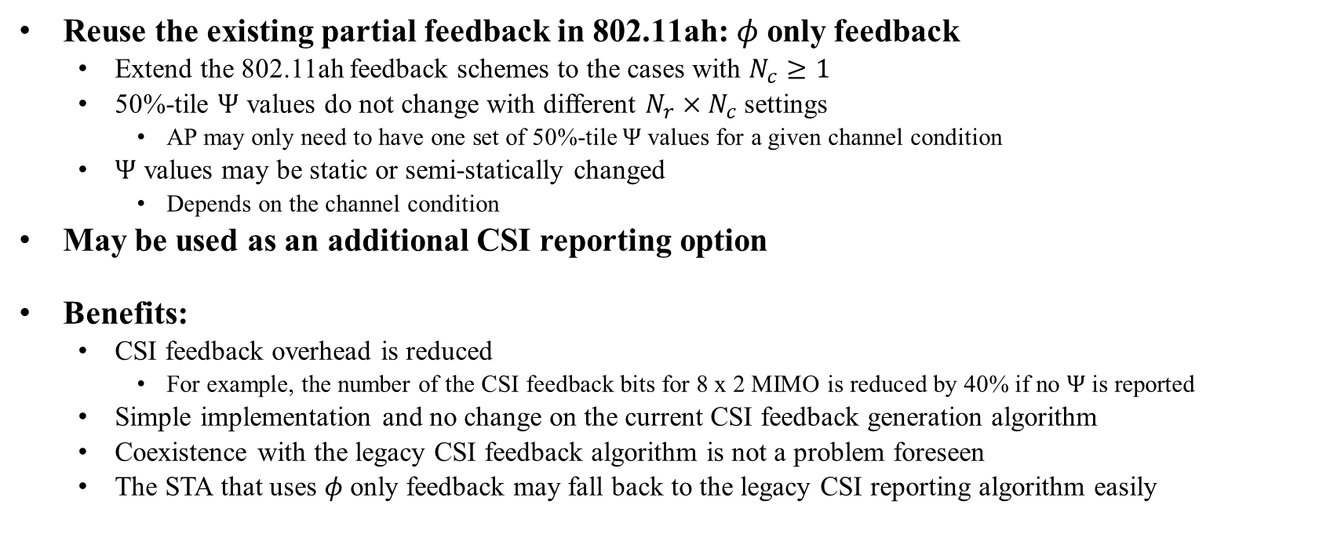
One Possible Solution
Reuse the existing partial feedback in 802.11ah:$φ$only feedback
  Extend the 802.11ah feedback schemes to the cases with $N_{c}≥1$
  50%-tile $Ψ$ values do not change with different $N_{r}×N_{c}$settings
    AP may only need to have one set of 50%-tile $Ψ$ values for a given channel condition
  $Ψ$ values may be static or semi-statically changed
    Depends on the channel condition
May be used as an additional CSI reporting option
Benefits:
  CSI feedback overhead is reduced
    For example, the number of the CSI feedback bits for 8 x 2 MIMO is reduced by 40% if no $Ψ$ is reported
  Simple implementation and no change on the current CSI feedback generation algorithm
  Coexistence with the legacy CSI feedback algorithm is not a problem foreseen
  The STA that uses $φ$only feedback may fall back to the legacy CSI reporting algorithm easily

Slide 10
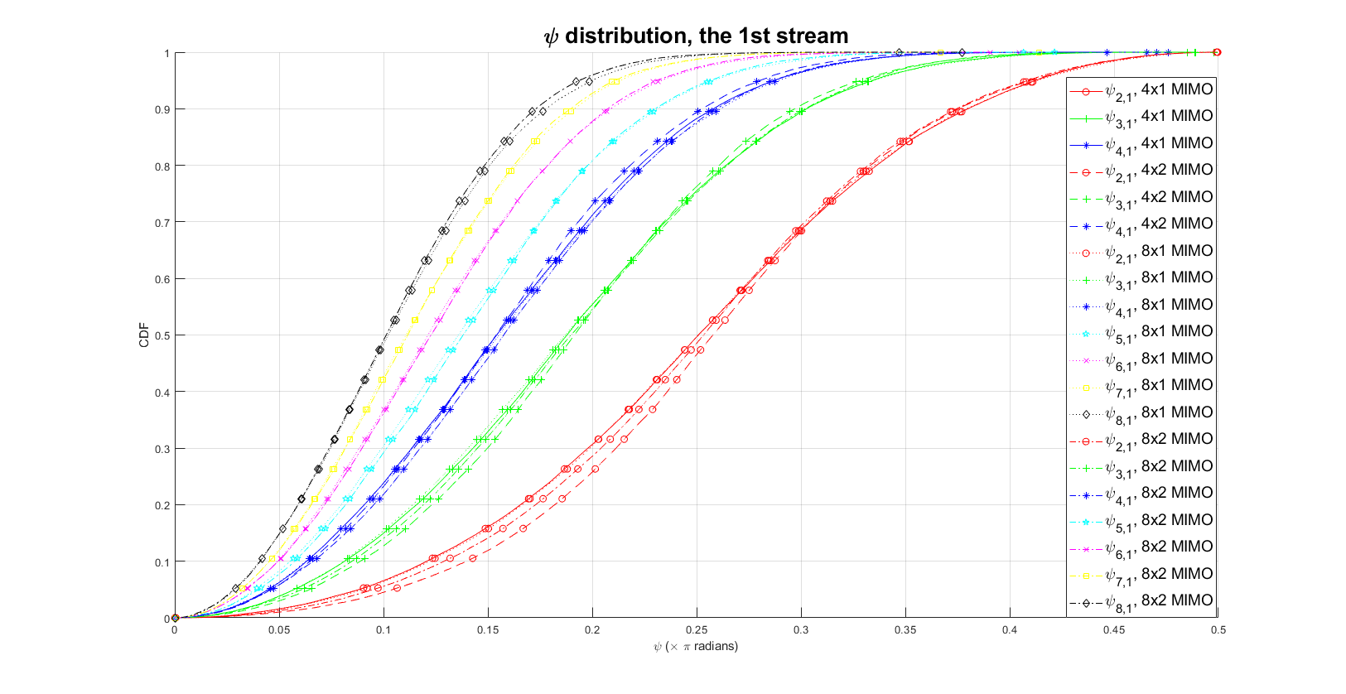
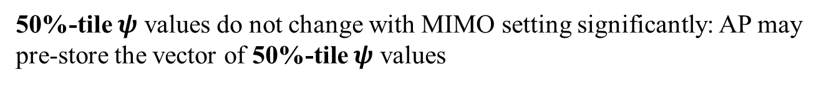
Simulation assumptions:
Channel A-E
Sim. for 1000 packets for each channel type
50%-tile $ψ$ values do not change with MIMO setting significantly: AP may pre-store the vector of 50%-tile $ψ$ values

Slide 11

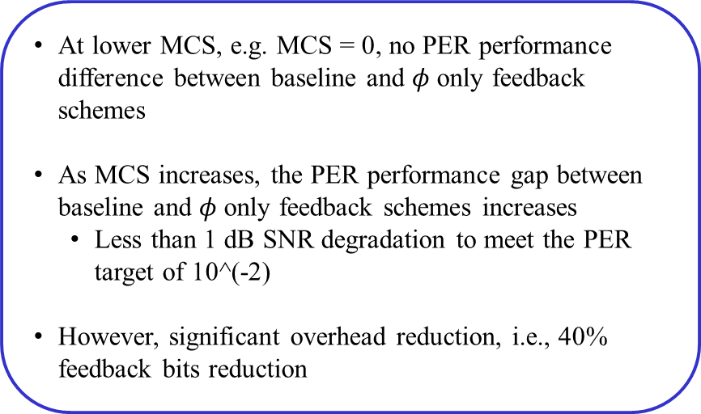
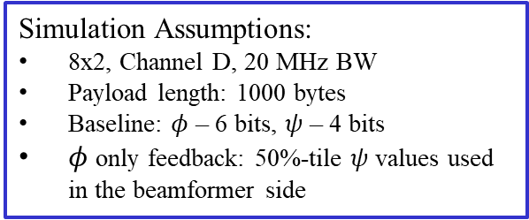
PER Performance of $φ$only feedback
Simulation Assumptions:
8x2, Channel D, 20 MHz BW
Payload length: 1000 bytes
Baseline: $φ$ – 6 bits, $ψ$ – 4 bits
$φ$ only feedback: 50%-tile $ψ$ values used in the beamformer side
At lower MCS, e.g. MCS = 0, no PER performance difference between baseline and $φ$only feedback schemes
As MCS increases, the PER performance gap between baseline and $φ$only feedback schemes increases
  Less than 1 dB SNR degradation to meet the PER target of 10^(-2)
However, significant overhead reduction, i.e., 40% feedback bits reduction

Slide 12
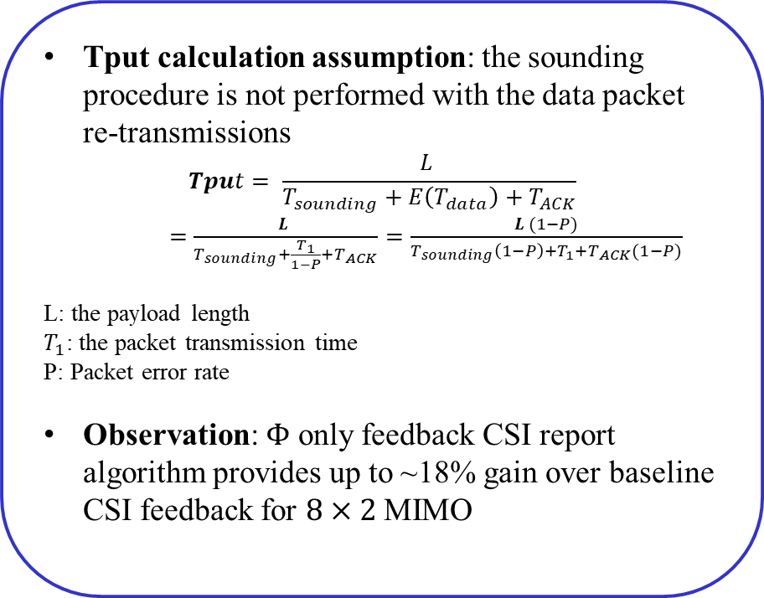
Simulation Results
Tput calculation assumption: the sounding procedure is not performed with the data packet re-transmissions
$$Tput= \frac{L }{T_{sounding}+E\left(T_{data}\right)+T_{ACK}}$$
    $=$ $\frac{L }{T_{sounding}+\frac{T_{1}}{1−P}+T_{ACK}}=\frac{L (1−P)}{T_{sounding}\left(1−P\right)+T_{1}+T_{ACK}(1−P)}$
L: the payload length
$T_{1}$: the packet transmission time
P: Packet error rate
Observation: $Φ$ only feedback CSI report algorithm provides up to ~18% gain over baseline CSI feedback for $8×2$MIMO
17.6%

Slide 13
Summary
Discuss the need to reduce the overhead of Channel State Information (CSI) feedback for UHR
Summarize the existing proposals of CSI feedback reduction using the wireless domain knowledge and/or AIML techniques
Propose to extend one existing solution to reduce CSI feedback for multiple spatial streams

Slide 14
References
[1] 11-23/480r0, UHR Proposed PAR
[2] 11-22/1515r0, A candidate feature: Multi-AP
[3] 11-22/1516, Considerations on Multi-AP Coordination
[4] 11-22/1821r1, System level simulation of Co-BF and Joint Tx
[5] 11-22/2188r0, Joint transmission for UHR – A Refresher and New Results
[6] 11-22/0932r0, Thoughts on Beyond 802.11be
[7] 11-22/1083r1, Next generation SG formation
[8] 11-22/685r0, Discussion on next generation Wi-Fi
[9] 11-22/2049r2, UHR PAR discussion
[10] 11-22/1804r0, Next Gen After 11be: Band and complexity discussion

