Slide 1
Impact of BT on WLAN performance
Author:
Name | Affiliation | Address | Email
Steve Shellhammer | Qualcomm | San Diego, CA, USA | sshellha qti qualcomm
Menzo Wentink | Qualcomm | Utrecht, The Netherlands | mwentink qti qualcomm

Slide 2
Introduction
In these slides we provide some test results for BT interference into Wi-Fi
  in these experiments, BT uses no LBT and AFH is turned off
  the experiments were run in 2.4 GHz
  these results were also presented by Steve Shellhammer in 802.15.4ab
    15-23-0119-00-04ab-importance-of-nba-mms-uwb-and-802-11-coexistence

Slide 3
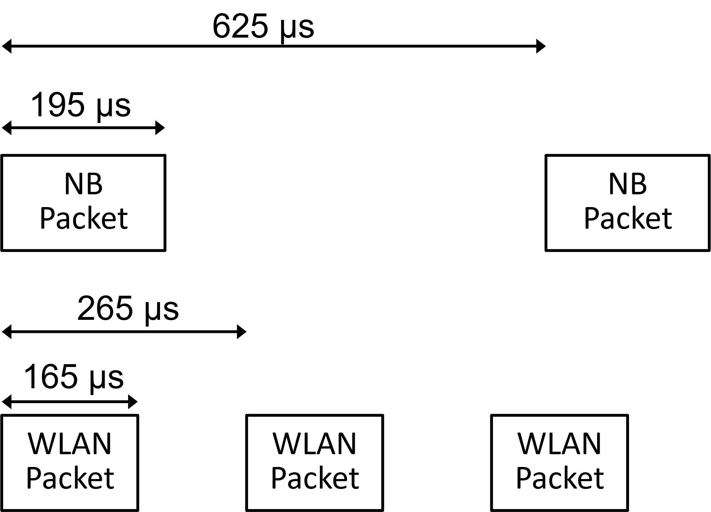
Packet timing
Here is an illustration of the NB (BLE) and WLAN packet timing

Slide 4
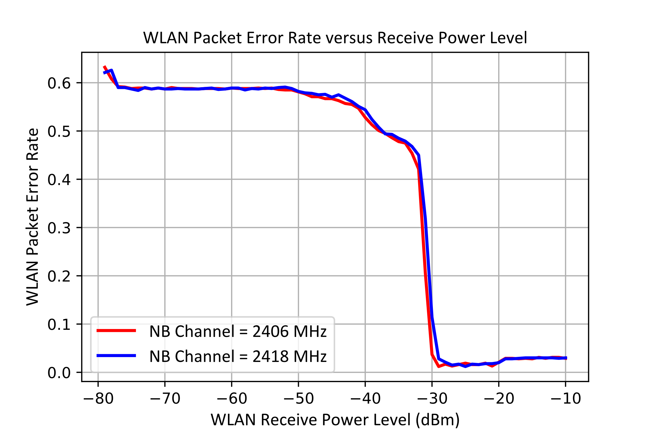
PHY layer testing results
Here we plot the WLAN Packet Error Rate (PER) for two cases when the narrowband signal is within the WLAN channel at −50 dBm
We see that the narrowband signal dramatically increases the WLAN PER when the WLAN Rx power is less than −35 dBm
The PER is less than 1 because the duty cycle of the test is such that some of the WLAN packets get through between the narrowband packets

Slide 5
Conclusions
In these slides we provided an overview of testing BT interference into Wi-Fi
  BT uses no LBT and AFH is turned off
We see that the narrowband signal dramatically increases the WLAN PER

