Slide 1
NB overview
Author:
Name | Affiliation | Address | Email
Menzo Wentink | Qualcomm | Utrecht, The Netherlands | mwentink qti qualcomm

Slide 2
Introduction

Slide 3
ETSI 6 GHz NB status
In the 6 GHz band in Europe, VLP NB operation can use a higher PSD when more than 15 hops are used
  NB is defined as < 20 MHz transmit BW
    max 10 dBm/MHz for VLP NB vs max 1 dBm/MHz for VLP WB, max 14 dBm EIRP
  the EC also requires ‘adequate spectrum sharing’
NB/Wi-Fi coexistence for 6 GHz was discussed in ETSI BRAN in ~2021 (EN 303 687)
  EN 303 687 is currently in the final stages of national review (ENAP) and EC review
EN 303 687 requires LBT with a 20 MHz CCA for NB (and for Wi-Fi, LAA, NR-U, etc.)
  in combination with either Frame Based access (FBE) or Load Based access (LBE)
    FBE has a short CCA at fixed periodic times ('frames'), immediately preceding the transmission
    LBE is the equivalent of Wi-Fi EDCA
  Detect and Avoid (DAA/eDAA) was also discussed for NB
    but the response time was considered to be too long by some, and DAA might also trigger on other NB transmissions, which complicates NB-to-NB coexistence
  new proposals are expected for the next revision of the 6 GHz standard
The VLP NB access rules in EN 303 687 are in summarized in the next slides

Slide 4
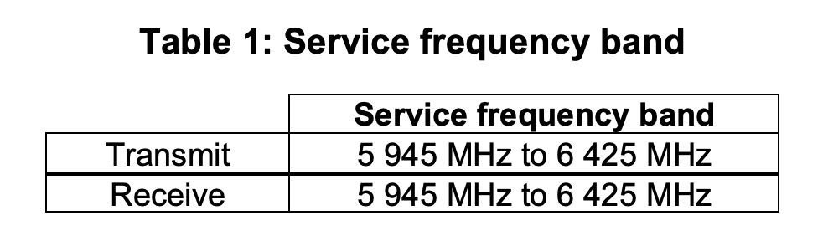
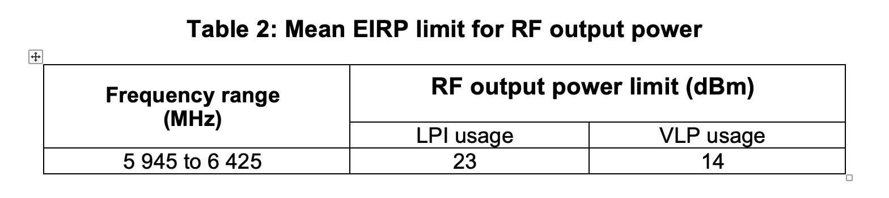
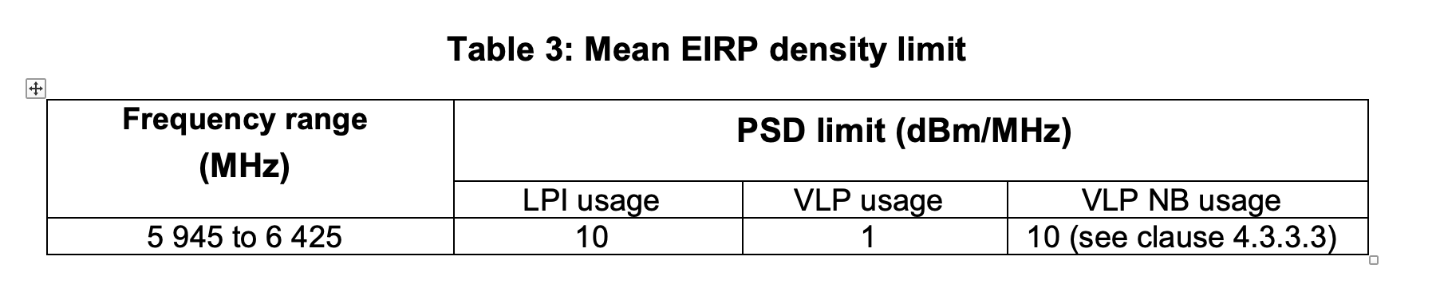
EN 303 687 overview

Slide 5
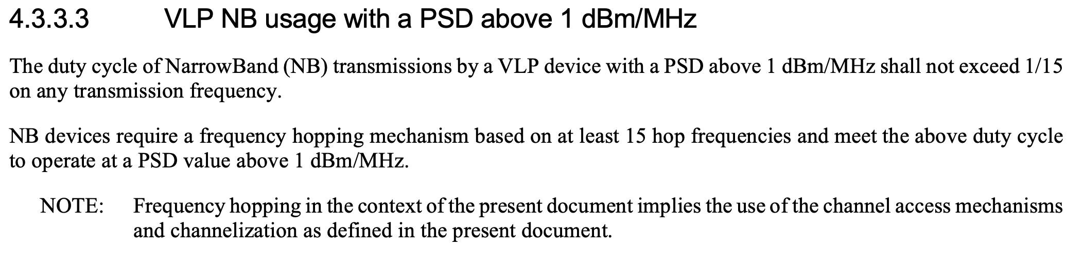
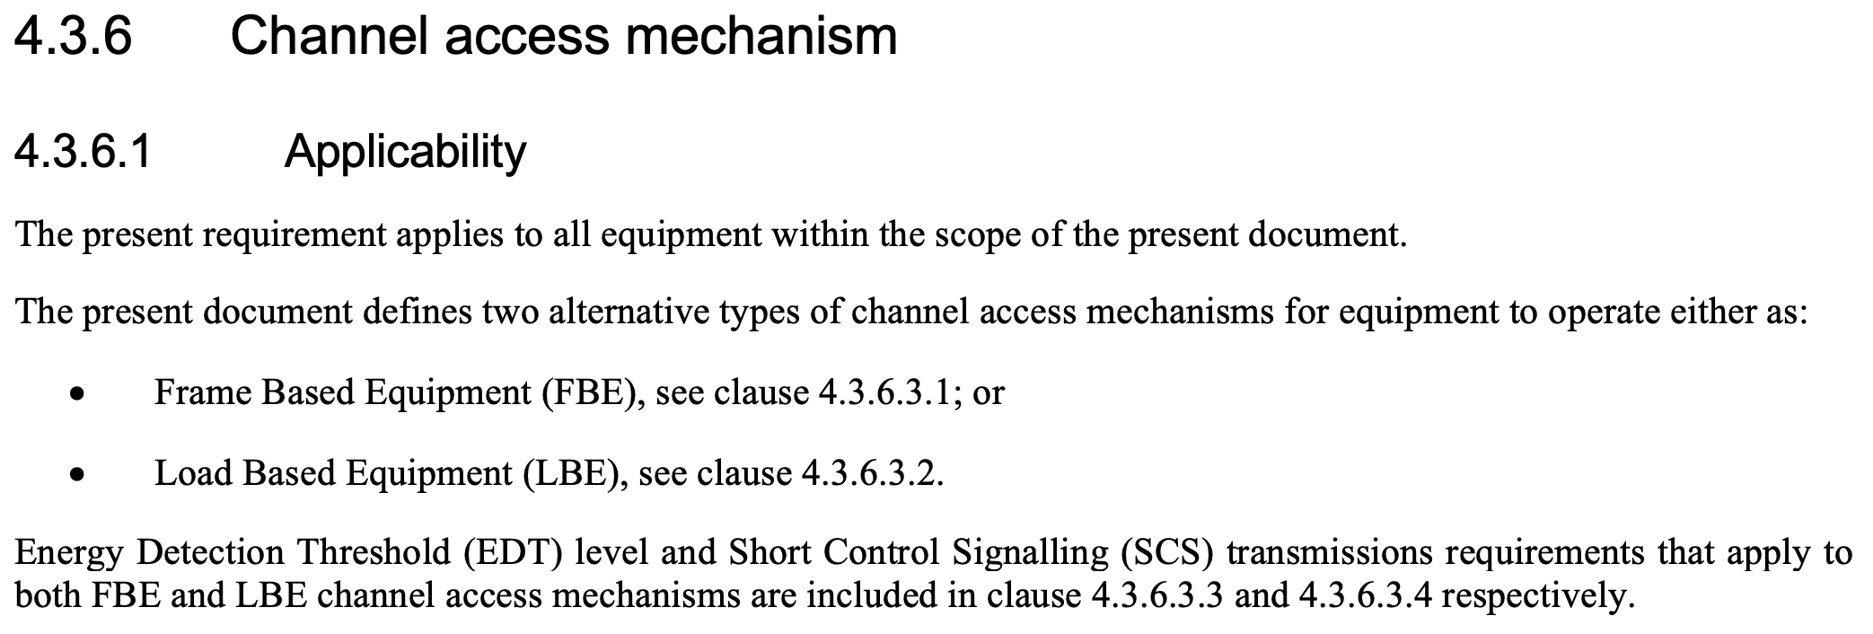
VLP NB rules in EN 303 687

Slide 6
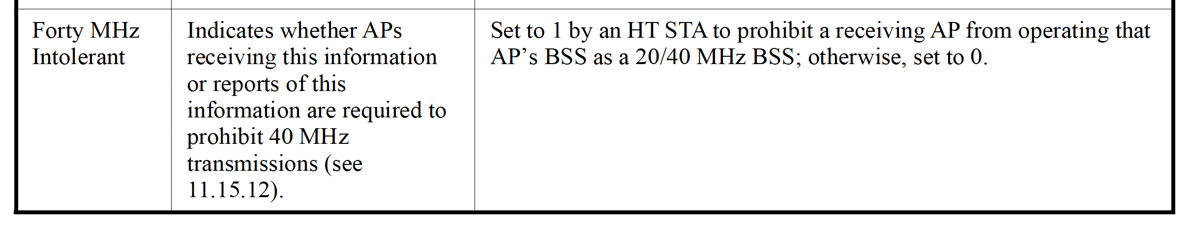
BT coex in 2.4 GHz
In 2.4 GHz, Wi-Fi/BT coexistence is partly achieved through the 'Forty MHz Intolerant' signaling defined in IEEE 802.11:
The Forty MHz Intolerant signaling effectively forces all Wi-Fi to operate in 20 MHz when BT is co-located in a nearby Wi-Fi device
  a kind of Frequency Division Multiple Access (FDMA), by reducing the Wi-Fi operating bandwidth
  Wi-Fi is limited to 20 MHz and BT uses the remaining 60 MHz of the 2.4 GHz band
  for non-co-location operation, Wi-Fi also sometimes uses Time Division Multiple Access (TDMA)

Slide 7
Co-located BT coex in 2.4 GHz
When BT is co-located with Wi-Fi in the same device, complex coexistence mechanisms are implemented to ensure that the two technologies coexist well
  antenna isolation helps, but certainly without isolation, the Wi-Fi module has to use dynamic switching in and out of power save to avoid receptions at a time when the BT module is transmitting (TDMA)
  these are complex mechanisms, which have to be tailored for specific BT traffic patterns

Slide 8
Overview of some NB channel access mechanisms

Slide 9
eDAA
Enhanced Detect and Avoid (eDAA) was proposed in ETSI BRAN as an enhanced version of DAA as defined in EN 300 328 (2.4 GHz), but with
  0.5 s between CCAs
  evacuation in 20 MHz blocks
  two options for channel restoration:
    option 1: after 0.5 s when CCA is clear
    option 2: after 2.5 s without CCA (exponentially increasing)

Slide 10
eDAA with CCA sweep
eDAA can use an offline sweep to determine a spectrum map
  the sweep can be in one go or in portions during the 0.5 s between CCA checks
  every 0.5 s eDAA would analyze the spectrum map and disable 20 MHz segments where WB is detected
    in the sims, WB is considered to be present when >60% of a 20 MHz segment has a CCA busy
  the use of a spectrum map avoids any issues between NB links, but it does not appear to be an improvement for coexistence with WB

Slide 11
LBT for NB
Listen before Talk (LBT) for NB uses a CCA before every hop
  LBT for NB could be based on channel access for Frame Based Equipment (FBE)
With some extra measures, the CCA time could be relatively short
  see next slide on LBT with CCA trigger
  without extra measures, the CCA time should be in the order of 187 us, so that access will not happen during Wi-Fi backoffs and SIFS intervals
    the high frequency of the NB CCAs makes it necessary that the CCA time is not too short
    but a long CCA time is difficult to integrate into the existing NB architecture

Slide 12
LBT with CCA trigger
CCA trigger uses a short CCA (e.g. 7 us) before every hop, but disables a 20 MHz segment when multiple consecutive CCA-busies ('triggers') occur in the segment, until several consecutive CCA-idles occur in the segment
  the NB node keeps a tally of consecutive CCA busy events ('triggers') in each segment that it hops in:
    +1 when the CCA before a hop inside the segment is busy
    –1 when the CCA before a hop inside the segment is idle
  when the number of triggers ≥ 3, the segment is blocked, otherwise it can be used (provided the CCA before hops in that segment is idle)
  the trigger count is capped between 0 and 6

Slide 13
Simulations

Slide 14
Simulation parameters
Wi-Fi settings
  Tx power: 23 dBm at AP (LPI), 21 dBm at STA (LPI)
  packet size: 2 ms
  downlink traffic, full buffer
  channel width: 160 MHz
  max bitrate: 2402 Mbps at HE MCS 11, 160 MHz, 2x996-tone RU, Nss = 2, 800 ns GI
  frame exchange: RTS/CTS/A-MPDU/BA
  start time: 5 s
NB settings
  Tx power: 14 dBm (VLP)
  dwell time: 625 us (BT LE)
  duty cycle 68%
  hop width: 4 MHz (30 Mbps max PHY rate, Nss = 1)
  hopping pattern: random, 125 hops (500 MHz total)
  eDAA settings: 0.5 s between CCAs, evacuation in 20 MHz blocks, two options for channel restoration:
    Option 1: after 0.5 when CCA is clear
    Option 2: after 2.5 s without CCA (exponentially increasing)
  eDAA CCA sweep settings: 0.5 s between spectrum scan evaluations, 100 MHz per sweep, 5 sweeps per 0.5 s, 60% occupation threshold per 20 MHz segment
  LBT settings: 187 us CCA before each hop, FBE
  CCA trigger settings: 7 us CCA before each hop, FBE, trigger threshold 3, 20 MHz segments
  start time at ~0.5 s intervals starting at 0 s
Channel model
  AWGN channel with a breakpoint at 5 m
    pathloss = 40.05 + 20log10(f/2.4) + 20log10(min(d, b)) + (d > b) * (35log10(d/b))
    where f = 5.18 GHz, d = distance, b = breakpoint = 5 m

Slide 15
Wi-Fi/NB coexistence setup
AP
LPI Wi-Fi link
downlink traffic
VLP NB links
VLP NB links
STA

Slide 16
Wi-Fi/NB (no NB)
Wi-Fi starts at 5 s
this plot is not defined for this experiment
nb_r412

Slide 17
Wi-Fi/NB (eDAA option 1)
1 s initial ramp-up time at Wi-Fi
Degraded throughput at Wi-Fi
Wi-Fi starts at 5 s
Significant latency at both Wi-Fi and NB
eDAA hop evacuation is uneven and unstable
NB starts at 0.5 s intervals
nb_r412

Slide 18
Wi-Fi/NB (eDAA option 2)
1 s initial ramp-up time at Wi-Fi
1 s gaps
An oscillation occurs because the NB nodes see the Wi-Fi signal at roughly the same time, and therefore the hops also return at roughly the same time, 2.5 s later.
The oscillation slowly fades within a few minutes, but Wi-Fi throughput remains degraded.
2.5 s gap repetitition time
Wi-Fi starts at 5 s
Significant latency at both Wi-Fi and NB
eDAA hop evacuation is uneven and unstable
NB starts at 0.5 s intervals
nb_r294b

Slide 19
Wi-Fi/NB (eDAA option 1, CCA sweep)
long ramp-up time at Wi-Fi
Degraded throughput at Wi-Fi
Wi-Fi starts at 5 s
Significant latency at both Wi-Fi and NB
eDAA hop evacuation is uneven and unstable
NB starts at 0.5 s intervals
nb_r752

Slide 20
Wi-Fi/NB (LBT 187 us CCA)
Immediate ramp-up at Wi-Fi
Wi-Fi has stable throughput when NB uses LBT with a 187 us CCA
Both NB and Wi-Fi have low latency
(This plot is not defined for LBT)
nb_r412

Slide 21
Wi-Fi/NB (LBT 70 us CCA)
Immediate ramp-up at Wi-Fi
but much reduced throughput at Wi-Fi
Both NB and Wi-Fi have low latency
(This plot is not defined for LBT)
nb_r412g

Slide 22
Wi-Fi/NB (LBT 7 us CCA)
Immediate ramp-up at Wi-Fi
but much reduced throughput at Wi-Fi
Both NB and Wi-Fi have low latency
(This plot is not defined for LBT)
nb_r412g

Slide 23
Wi-Fi/NB (LBT 7 us, CCA trigger)
Immediate ramp-up at Wi-Fi
Wi-Fi has stable throughput when NB uses LBT CCA trigger with 3 triggers per 20 MHz segment, with a 7 us CCA
Both NB and Wi-Fi have low latency
nb_r480

Slide 24
Conclusions
ETSI BRAN requires LBT with a 20 MHz CCA for NB operation in the 6 GHz band (EN 303 687)
Existing BT coexistence in the 2.4 GHz band builds on reducing the Wi-Fi bandwidth and the use of TDMA by Wi-Fi
  the current experience is not very positive, from the Wi-Fi perspective at least
eDAA appears to be inadequate as a coexistence mechanism, for Wi-Fi/NB and possibly also for NB/NB coexistence
  eDAA can have a long response time and exhibits oscillatory behavior
  channel evacuation might be incomplete due to eDAA CCAs not seeing Wi-Fi traffic (because Wi-Fi also defers for NB using LBT)
  eDAA might not necessarily coexist well with itself, because the penalty for an inter-hop collisions (CCA-busy) is high even when the hop collision probability is relatively low
LBT appears to work quite well
  low latency and stable throughput, both for Wi-Fi and NB
  for NB the LBT could be based on the LBT for Frame Based Equipment (FBE) as defined in EN 303 687
  LBT for NB works well because the penalty for a CCA-busy is just one hop, and the next hop, which is likely elsewhere in the spectrum, might have a CCA-idle
  a short CCA is possible in combination with a trigger mechanism that disables 20 MHz segments (CCA trigger)

Slide 25
References
BRAN(21)109h004r2_EN_303_687_NB_Proposals_for_DAA_Optimisation
BRAN(21)109h007_NB_coexistence_with_WB_in_6_GHz
ETSI EN 300 328 (2.4 GHz)
ETSI EN 301 893 (5 GHz)
ETSI EN 303 687 (6 GHz)

