Slide 1
AIML-based Roaming Enhancements Use Case
Date: 2023-03-14
Authors:

Slide 2
Abstract
The current document proposes AIML-based enhancements that can reduce the latency experienced by clients when they are operating in a highly roaming environment.

Slide 3
Use of AI/ML to improve roaming experience
Campus and enterprise networks experience a high level of roaming clients. Nowadays, client’s QoS is severely impacted due to the time a client takes to decide onto which AP it should roam.
The proposed use case applies AI/ML to determine the probability of a client to roam to a specific AP, based on the learned client roaming patterns.
Multiple possible implementations, e.g., Markov chains, GNN…

Slide 4
Perspective on 802.11k neighbor reports​
Sent by the AP upon STA request ​
  Indicates neighboring APs BSSID, channel, PHY type and optional elements (see 802.11-2020 9.4.2.36)​
  Useful to assist STA roaming decision (subset of channels and pre-scanned candidate list)
Not all neighbor APs are equally relevant for the clients to make optimal roaming decisions.
  AP can have tens of neighbors, close and far, STA may not roam to the closest or the farthest (depends on the path)​
  AP is not the STA (does not decide for the STA), and ’view from the ceiling’ is different from ‘view from the ground’

Slide 5
Proposal for roaming-aware neighbor reports​
AIML can help make the 11k neighbor reports more useful by deducting roaming patterns to compute the probability of a client roaming to a given target AP​
  Help clients to prioritize scanning towards APs that are more probable targets​
  Improve roaming speed and reliability​
AI/ML techniques used to compute the neighbour weight​
Can be complemented with likely roaming point

Slide 6
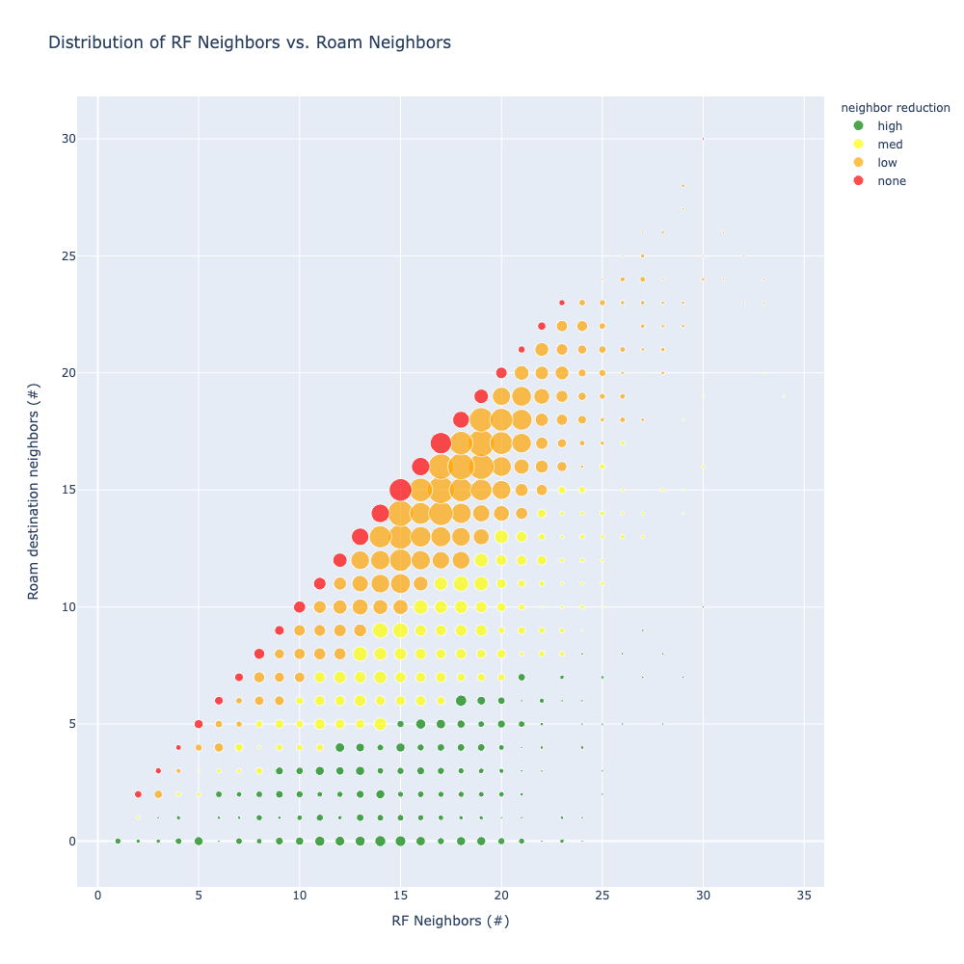
Usefulness evaluation: Impact Simulation 1
Computation on real network data:
Dataset info:
  6632 APs
  3 Million roaming events
  Distributed over 3 days
Chart info:
  Circle: group of APs having the same number of RF and roam neighbors
  X-axis: number of RF neighbors
  Y-axis: number of roaming neighbors
  Circle size: number of APs in the group
  Circle color: neighbor list reduction rate, by considering only roam neighbors
Greater impact in high-density environments

Slide 7
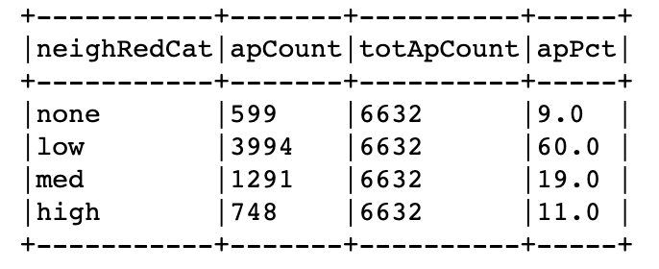
Usefulness evaluation: Impact Simulation 2
Computation on real network data:
6632 APs in total
  Over 90% of APs would benefit an improvement by just by restricting the neighbor report to the roaming neighbors
  30% of APs have a reduction > 33%
  This improvement is not considering the probability assigned to each roam neighbor

Slide 8
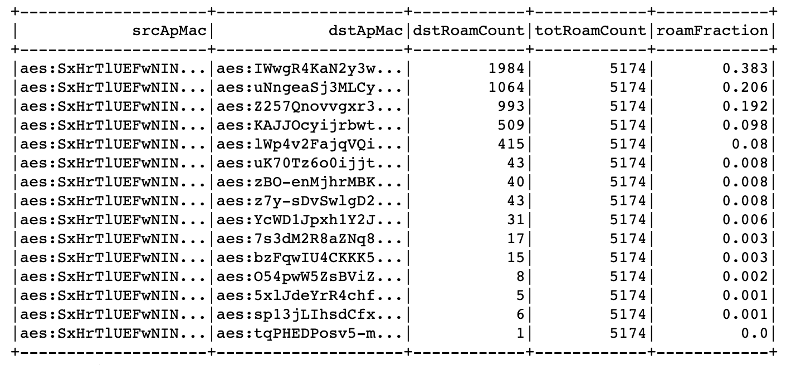
Neighbor List Enhancements – Adding neighbors weight​
The neighbor list can be further enhanced by adding the weight* based on the roaming paths/statistics:
In this example, out of 15 roaming neighbors, only 3 have a probability higher than ~20%
* Fraction of STAs roaming to each APs, and thus likelihood of each AP to be a good roaming candidate -> helps the STA sort the APs
Note: the reported MAC addresses are anonymized for privacy reasons as they come from a real production network​

Slide 9
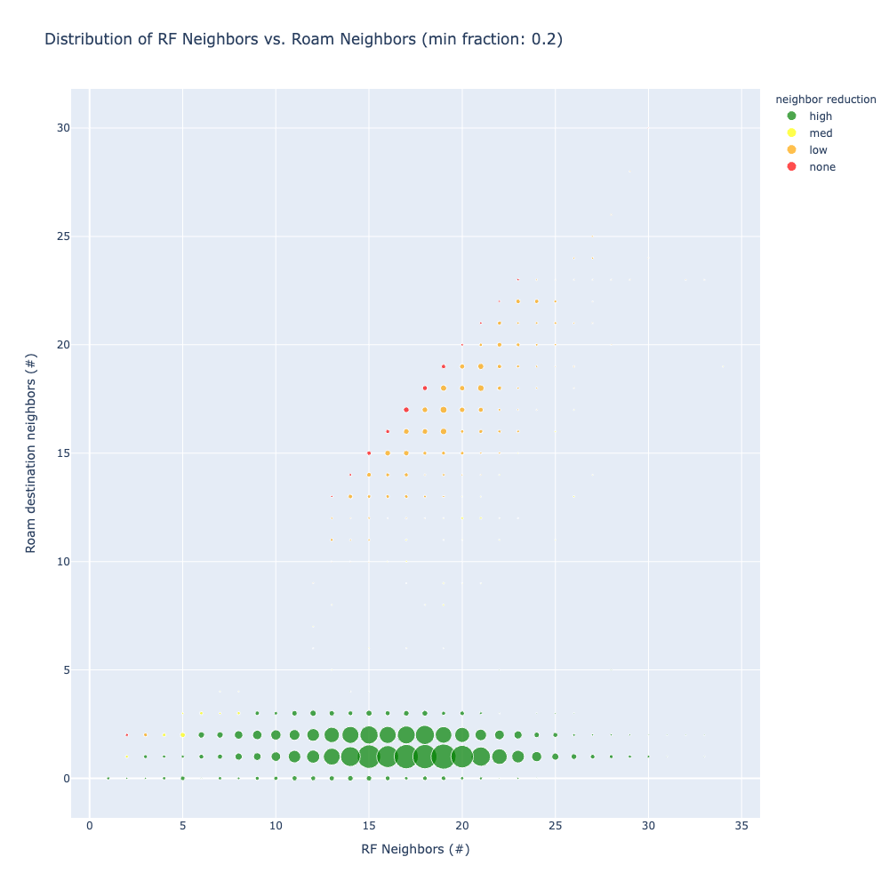
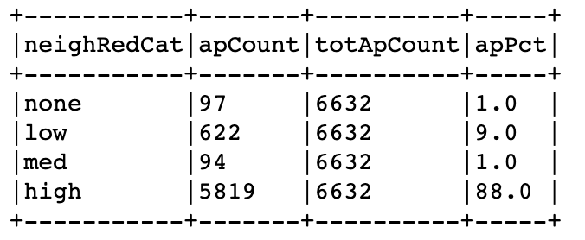
Adding neighbors weight​: Impact Simulation 1
The roaming-based neighbor weight helps further reducing the neighbor list:
Restricting the neighbor list to just APs with a probability higher than 0.2, if there’s at least one, else return all roam neighbors
The neighbor list would be reduced by more than 66% on 88% of the APs

Slide 10
Adding neighbors weight​: Impact Comparison
The reduction in advertised neighbors improves significantly by adding the roaming-based weight

Slide 11
Conclusion 1
Using AIML to compute the 11k neighbor report list can reduce the number of APs returned to the STA​
STA benefits:
  shorter time to discover possible neighbors of roaming
  possible higher confidence in the list returned by the AP

Slide 12
Implementation Notes​
  The results in the previous slides have been computed modeling the neighbor list as a Markov chain, where the probability distribution is computed using the successful roaming events to each AP’s RF neighbor.
  The advantage of this approach:
  Simple implementation
  Can be centrally computed for each AP and periodically re-trained
  No need to know the full client roaming path

Slide 13
  Possible Additional Enhancements 1​
  Make the list SSID-specific:
    Clients on different SSIDs may follow different roaming paths (e.g., enterprise scenario; from the building entrance, guests can reach only common areas while employees can also enter the office area)
  Add time information
    e.g., time of the day, day of the week
    The roaming path is likely different at different times of the day, e.g., people entering vs. exiting the building)
  Use GNN to model the full clients’ roaming paths:
    Currently under investigation
    More complex to maintain and generalize
    May not provide significant improvement over a simpler approach, also considering encoding in neighbor reports (e.g., having 2-bits to classify neighbors in 4 buckets)

Slide 14
  Possible Additional Enhancements 2​
  Add the mean roaming point (e.g., mean last RSSI/RSNI on AP1 vs first RSSI/RSNI on AP2)
    Allows the STA to find the mid-point between APs
    Allows the STA to roam “at fast speed” instead of waiting for usability threshold failure
    In low density, helps the STA wait for the right time to scan (battery saving)
60 Mbps

Slide 15

Without Mean Point Prediction
Case 1: Low AP density
Case 2: High AP density
-75 dBm
400 Mbps
240 Mbps
90 Mbps
45 Mbps
-75 dBm
15 Mbps
Large cells (e.g. warehouse), cell edge is at -78 dBm, STA scans from -75 dBm, wastes battery looking for a better AP that is not there
small cells (e.g. office), cell edge is at -62 dBm, STA could roam at 240 Mbps, but waits until -75 dBm to scan -> low efficiency throughput

Slide 16
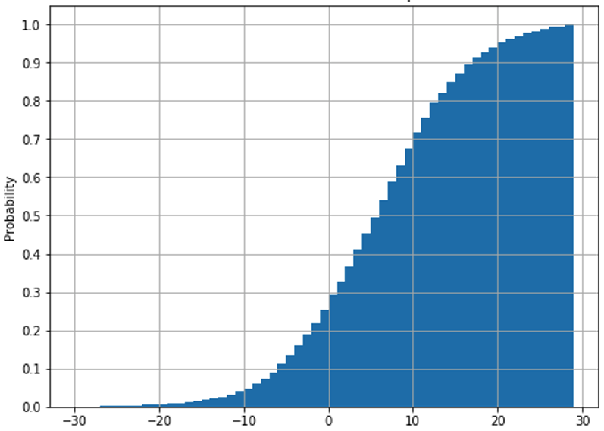
Mean Point Prediction Usefulness Evaluation
Sample size: 3142 APs, mild-dense deployments, observation period 6 months
Candidate roaming point definition (in this test): next AP RSSI 8 dB better than current AP
Observation: >50% STAs roam >6 dB after mean point
A
B
0 iif RSSI_{STAatB} = RSST_{STAatA}+8 (dBm)

Slide 17
Conclusion 2 - Standards Impact​
Adding additional information to an 802.11k neighbor list (or an 802.11v BTM request) could benefit the STAs without heavy standard changes (11k/v already allows for ‘optional elements’ of variable length)

Slide 18
Summary
Proposal to include a Roaming Enhancements Use Case to the AIML Technical Report
  AIML can greatly improve the client experience in a roaming scenario by providing a weighted list of AP roaming candidates
  The clients can use this info to prioritize scanning based on the probability to roam to specific neighbours, as computed by the infra​
  Backwards compatibility; clients not supporting this feature will simply use the neighbour report ignoring the weights

Slide 19
Straw Poll
Do you agree to include a Roaming Enhancements Use Case to the AIML Technical Report?
  Yes
  No
  Abstain

