Slide 1
Study on AI CSI Compression
Date: 2023-03
Authors:

Slide 2
Abstract
In this contribution, we
  review some existing works on AI CSI compression,
  introduce a new vector quantization variational autoencoder (VQ-VAE) method for CSI compression,
  discuss its performance and possible future work.

Slide 3
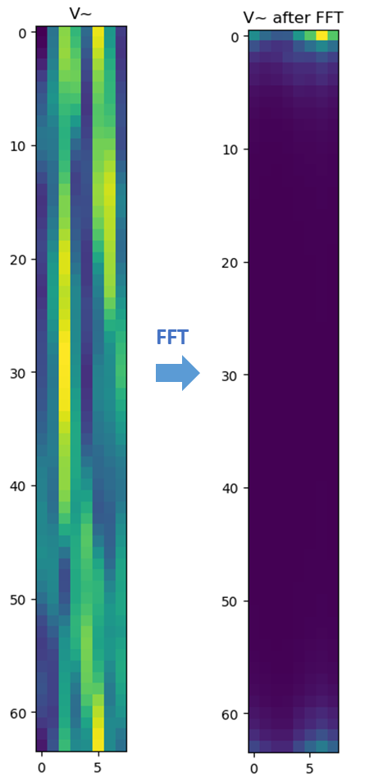
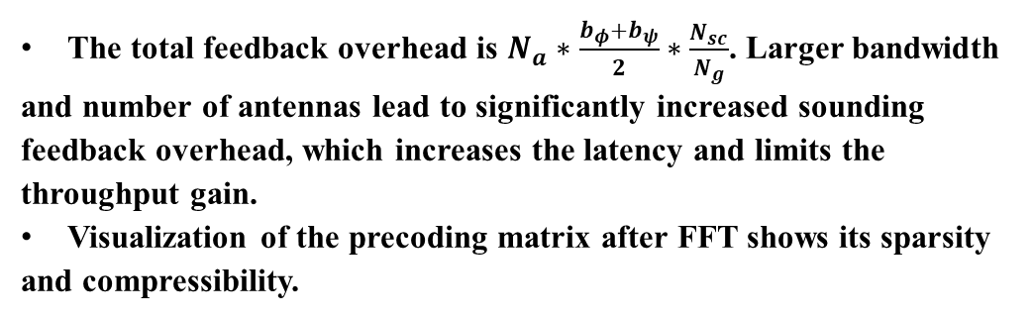
Background
The AP initiates the sounding sequence by transmitting the NDPA frame followed by a NDP which is used for the generation of V matrix at the STA.
The STA applies Givens rotation on the V matrix and feeds back the angels in the beamforming report frame.
The total feedback overhead is $N_{a}∗\frac{b_{φ}+b_{ψ}}{2}∗\frac{N_{sc}}{N_{g}}$. Larger bandwidth and number of antennas lead to significantly increased sounding feedback overhead, which increases the latency and limits the throughput gain.
Visualization of the precoding matrix after FFT shows its sparsity and compressibility.
Ntx=Nrx=Nss | BW=20MHz | BW=40MHz | BW=80MHz | BW=160MHz | BW=320MHz
2 | 0.12 (KBytes) | 0.24 | 0.50 | 1.00 | 1.99
4 | 0.73 | 1.45 | 2.99 | 5.98 | 11.95
8 | 3.39 | 6.78 | 13.94 | 27.89 | 55.78
16 | 14.52 | 29.04 | 59.76 | 119.52 | 239.04
20MHz, 8*2

Slide 4
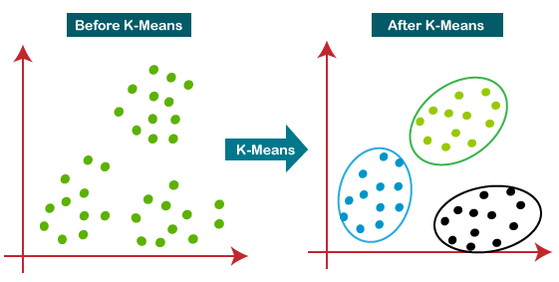
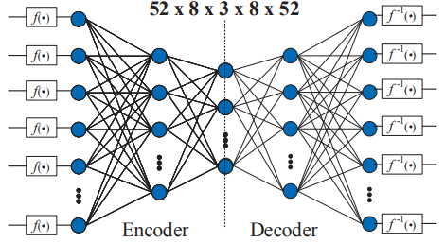
Existing Work on AI CSI Compression
ML solutions: no neural network
  [1][2] adopted a traditional machine learning algorithm, i.e., K-means, to cluster the angle vector after Givens rotation
  Beamformer and beamformee need to exchange and store the centroids
  Only transmit the centroid index during inference
  2dB PER loss, up to 50% goodput improvement
AI solutions: use neural network
  [3] adopted two autoencoders to compress two types of angles after Givens rotation separately
  Beamformer and beamformee need to exchange the store neural network models
  Only transmit the encoder output during inference
  Up to 70% overhead reduction and 60% throughput gain for 11ac system

Slide 5
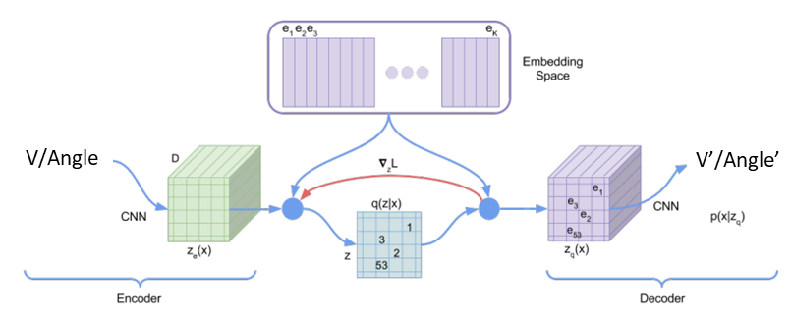
Our Study on AI CSI Compression
Vector quantization variational autoencoder (VQVAE) [4] is adopted for CSI compression
  Consists of encoder, codebook, decoder
  Learn how to compress and quantize automatically from the data
Convolutional neural network (CNN) or transformer could be used for both the encoder and decoder.
Input of NN could be the V matrix or the angles after Givens rotation.
Beamformer and beamformee need to exchange and store the codebook and half of the NN model.
Only transmit the codeword index during inference.

Slide 6
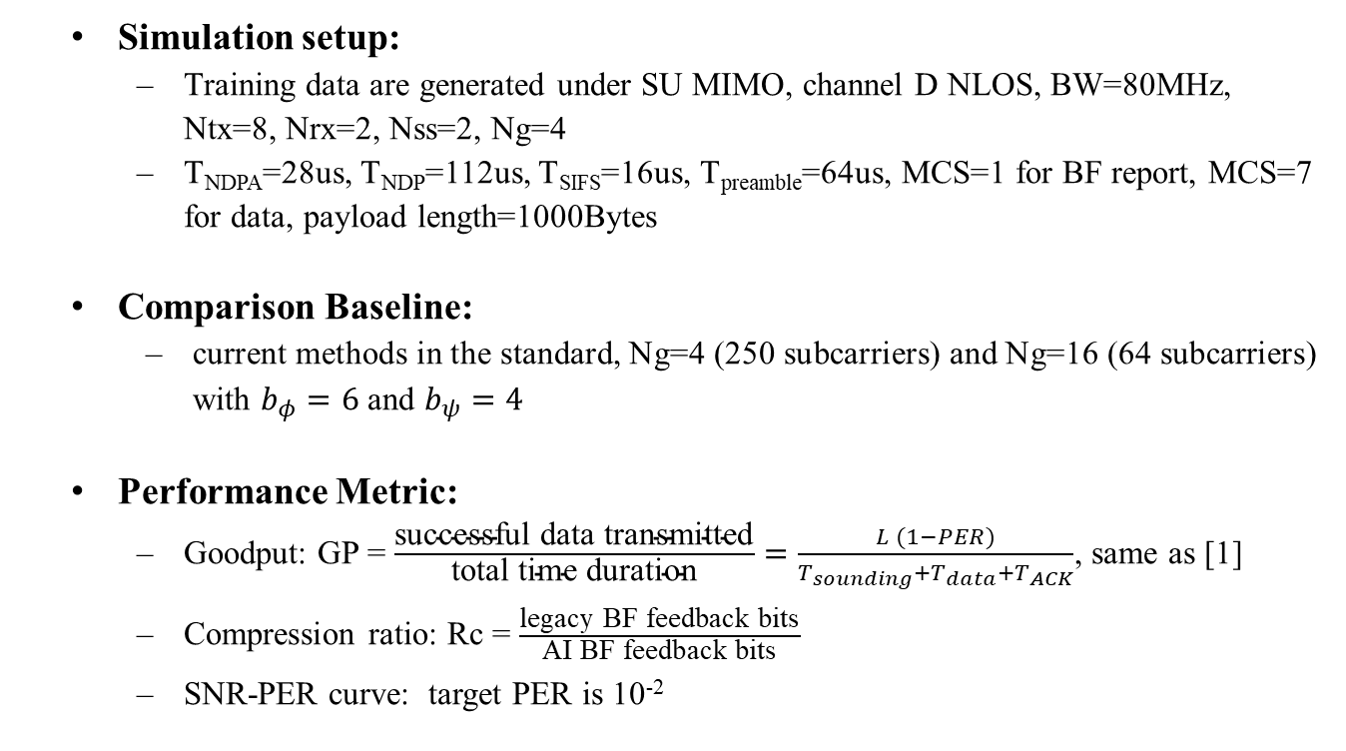
Performance Evaluation
Simulation setup:
  Training data are generated under SU MIMO, channel D NLOS, BW=80MHz, Ntx=8, Nrx=2, Nss=2, Ng=4
  T_{NDPA}=28us, T_{NDP}=112us, T_{SIFS}=16us, T_{preamble}=64us, MCS=1 for BF report, MCS=7 for data, payload length=1000Bytes
  Comparison Baseline:
    current methods in the standard, Ng=4 (250 subcarriers) and Ng=16 (64 subcarriers) with $b_{φ}=6$ and $b_{ψ}=4$
Performance Metric:
  Goodput: GP = $\frac{\text{successful} \text{data} \text{transmitted}}{\text{total} \text{time} \text{duration}}=\frac{L (1−PER)}{T_{sounding}+T_{data}+T_{ACK}}$, same as [1]
  Compression ratio: Rc = $\frac{\text{l}\text{egacy} \text{BF} \text{feedback} \text{bits}}{\text{AI} \text{BF} \text{feedback} \text{bits}}$
  SNR-PER curve: target PER is 10⁻²

Slide 7
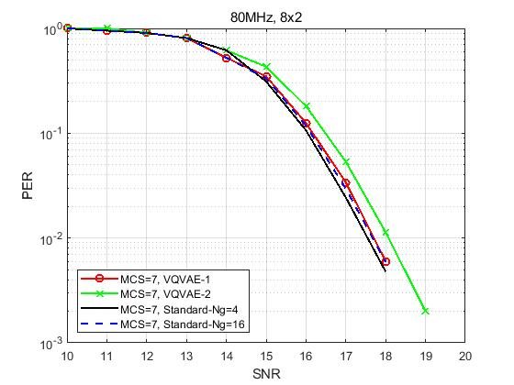
Performance Evaluation
Method | overhead Ng=4 (bits) | overhead Ng=16 (bits) | overhead VQVAE (bits) | Rc vs Ng=4 | Rc vs Ng=16 | Loss @ 0.01 PER (dB) vs Ng=4 | loss @ 0.01 PER (dB) vs Ng=16 | GP Ng=4 (Mbps) | GP Ng=16 (Mbps) | GP AI (Mbps) | GP gain (%) vs Ng=4 | GP gain (%) vs Ng=16
VQVAE-1 | 32500 | 8320 | 2560 | 12.70 | 3.25 | 0.16 | 0 | 5.13 | 11.01 | 15.15 | 195.45 | 37.60
VQVAE-2 | 32500 | 8320 | 1280 | 25.39 | 6.50 | 0.5 | 0.4 | 5.13 | 11.01 | 16.53 | 222.39 | 50.15
Notes:
Train the VQVAE model based on generated V matrices
Apply the trained model to do precoding
Run PER curve under

Slide 8
Further Study
Improve the goodput and reduce the feedback overhead
  Different neural network architecture
  Reduce codebook size and dimension
More complex scenarios
  More simulations under different configurations
  MU-MIMO scenarios
Increase model generalization
  One neural network can adapt to different channel models
  One neural network can adapt to different bandwidth and number of antennas

Slide 9
Summary
In this contribution, we
  reviewed the existing works on AI CSI compression,
  introduced a new VQ-VAE CSI compression scheme,
  showed its performance gain,
  and discussed possible future work to further improve the goodput and reduce the feedback overhead.

Slide 10
References
[1] M. Deshmukh, Z. Lin, H. Lou, M. Kamel, R. Yang, I. Güvenç, “Intelligent Feedback Overhead Reduction (iFOR) in Wi-Fi 7 and Beyond,” in Proceedings of 2022 VTC-Spring
[2] 11-22-1563-02-aiml-ai-ml-use-case
[3] P. K. Sangdeh, H. Pirayesh, A. Mobiny, H. Zeng, “LB-SciFi: Online Learning-Based Channel Feedback for MU-MIMO in Wireless LANs, ” in Proceedings of 2020 IEEE 28th ICNP
[4] A. Oord, O. Vinyals, “Neural discrete representation learning,” Advances in neural information processing systems, 2017.

