Slide 1
Light Communications in 802 Tutorial
Date: 2023-2-28
Authors:

Slide 2
Abstract
This presentation highlights the need, use-cases and technology of Light Communications in IEEE 802.11bb and IEEE 802.15.13.

Slide 3

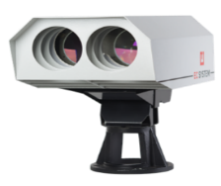
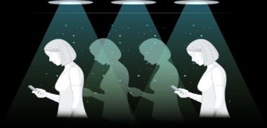
The Taxonomy of Light Communications
Not all light communications is LiFi. It’s is important to understand the differences between these types of communications, as they all have different applications.
Optical Camera Communications
Light Fidelity
Free Space Optics
OCC
Low Speed
Geo Location
Advertisements
Notifications
LiFi
Secure high-speed mobile wireless communications
FSO
Backhaul
Long-distance communications

Slide 4
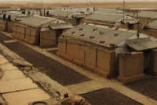


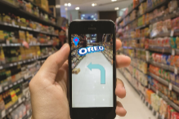


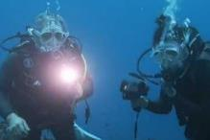
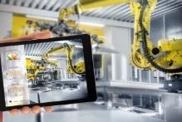

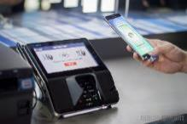

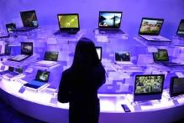
Various use-cases drive requirements where RF solutions have limitation
Defence & Environment | Data & Industrial | Office & Commercial | Retail & Financial | Smart City & Transport | Consumer & Lifestyle
Field command Secure comms Harsh enviro Underwater | Data centres Industry 4.0 IoT sensors Safe enviro | Smart building Secure comms Dense network Net offload | Indoor location Shop analytics Payments Back office | Smart city Smart transport Streetlights Backhaul | Mobile devices Smart home Entertainment Lighting

Slide 5
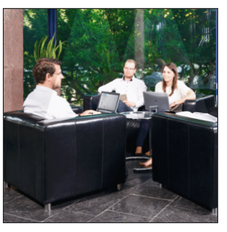
Light Communication
Key facts
Unique Selling Points
Mobile communication by using light
Bidirectional, high-speed
Useful complement to RF
Higher capacity/area in small “hotspots”
  1…10 Mbps/m² (RF)
  100+ Mbps/m² (LC)
Higher QoS: guaranteed delivery at low latency
Robust against jamming, enhanced privacy
RF is already mature and established in the market
LC to add new value to RF
Important synergies, both indoors and outdoors
  offloading, resilience against weather effects
RF systems take new opportunities by adding LC
Complement RF by LC

Slide 6
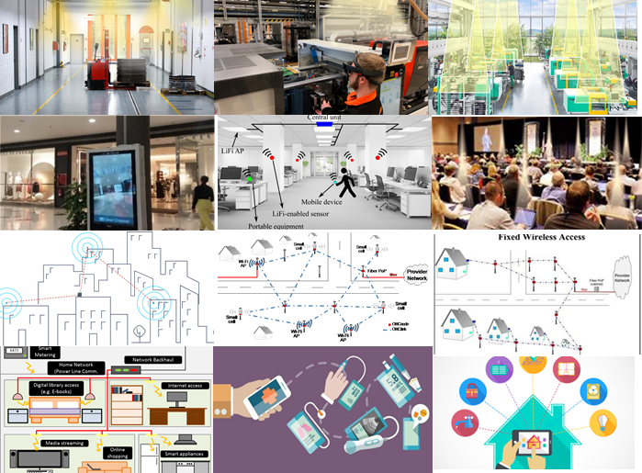
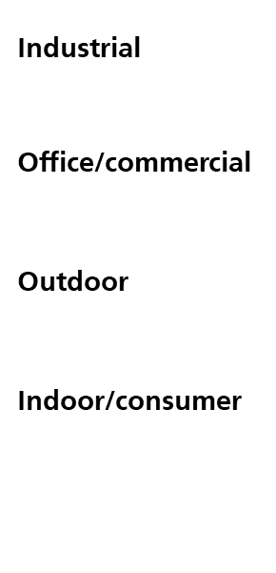
LC Use Cases in Future IoT
Future IoT
imaging sensors, video
reliable transmission at 100 Mbit/s/device
high density of devices
latency/jitter constraints
Great variety of use cases
EU H2020 IA ELIOT (Enhance Lighting for the Internet of Things, 2019-2022, www.eliot-h2020.eu/)
Create a new mass market
Use cases actually need networked LC, aka LiFi

Slide 7
IEEE 802 has 3 standards using the light medium
IEEE 802.15.7-2019
Optical Camera Communications
IEEE 802.15.13
Speciality networks including backhaul (FSO) communications
IEEE 802.11bb
Mass-market focused complementing WiFi

Slide 8
IEEE 802.11 offers the best path to mass market success
IEEE 802.11 is the world’s most common communications standard
  Over 3.8 billion Wi-Fi chipsets were shipped globally in 2021 in everything from smartphones, TVs, CCTV cameras, baby monitors, etc.
  The large established market and open standards have created a highly competitive, vibrant ecosystem of devices, testing facilities, etc.
Deploying LiFi on a global scale requires reducing the barrier to entry for anyone looking to produce interoperable systems
IEEE 802.11 offers the simplest integration route with the highest number of possible device integration options

Slide 9
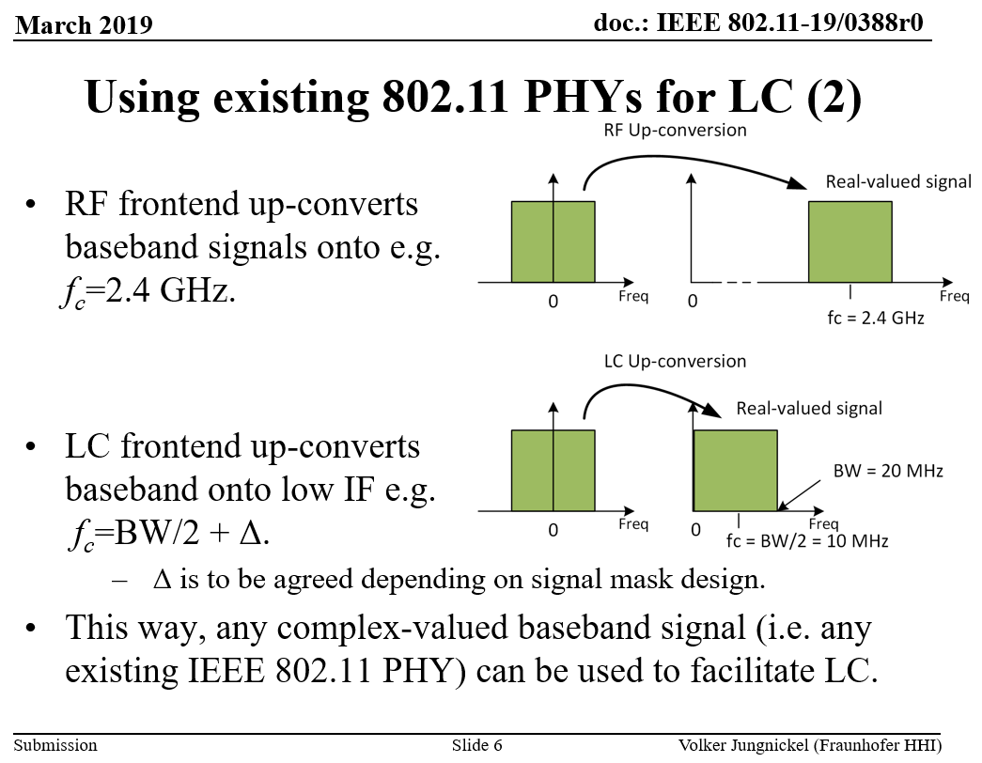
Operational Concept

Slide 10
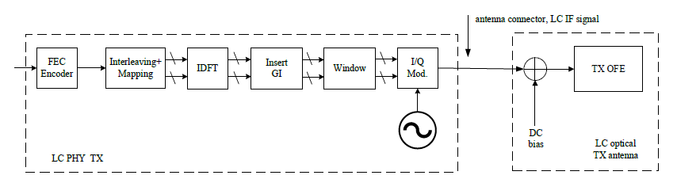
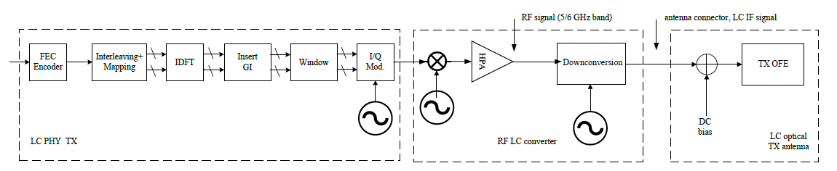
Implementation Options
Existing Wi-Fi chipsets
Direct Conversion
Direct Conversion
Up/Down Conversion from RF
Up/Down Conversion from RF

Slide 11
CCA and LC repetition
802.11bb systems shall have the same requirements for Clear Channel Assessment (CCA) as those for existing Wi-Fi 4, Wi-Fi 5 and Wi-Fi 6 chipsets
802.11bb also suggests the implementation of a LiFi repetition approach where the LiFi AP immediately retransmits the received signal from a STA using Amplify and Forward approach as an example

Slide 12
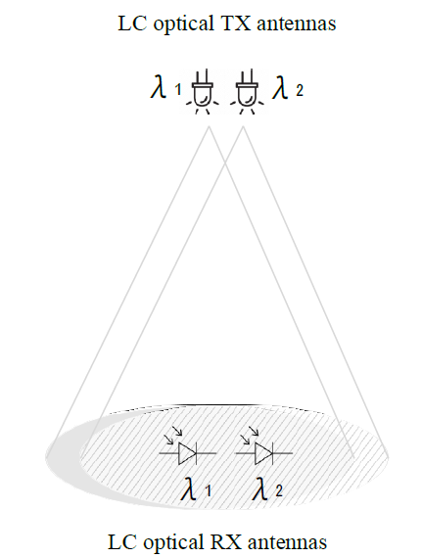
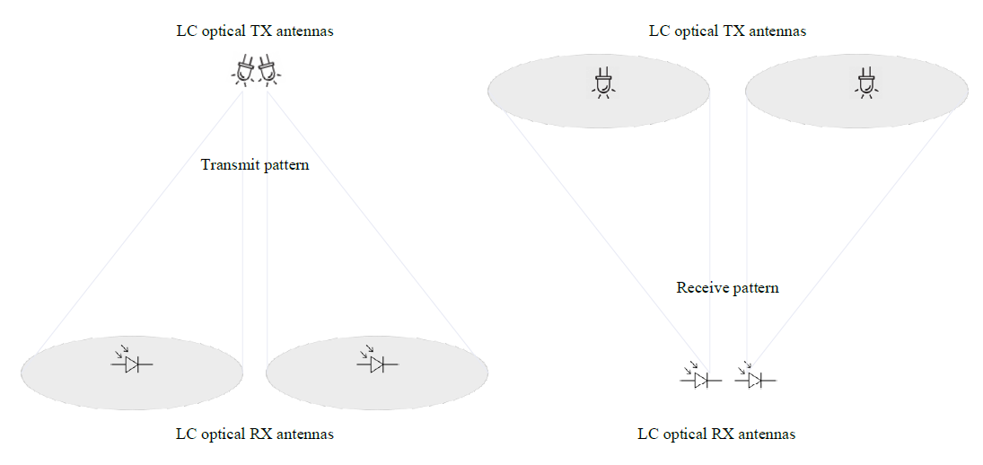
Spatial Multiplexing and WDM supported
Wavelength Division
Multiplexing
=> 800nm – 900nm
=> 900nm – 1000nm
Spatial Multiplexing

Slide 13
Timings
802.11bb Draft 7.0 has passed with 100% approval.
Expected RevCom & Standards Board Final Approval by Jul. 2023

Slide 14
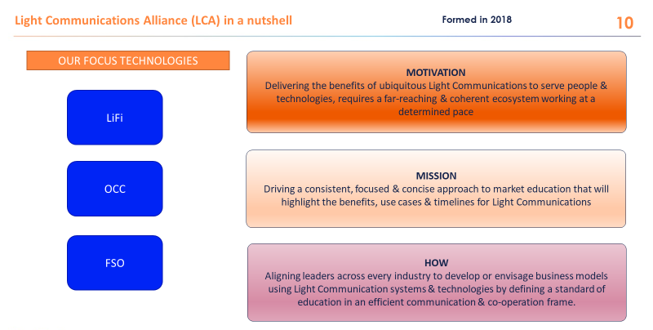

Slide 15
Next Steps
Support for continued education on the benefits of LiFi
  Consider joining the Light Communications Alliance
  http://lightcommunications.org/
Need/requirement for integrating Wi-Fi 7 support for LiFi
Identify certification body for LC
Define certification structure and technical requirements

Slide 16
References
https://mentor.ieee.org/802.11/dcn/23/11-23-0091-00-0wng-light-communication-for-uhr.pptx

