Slide 1
Improved AIML Enabled Index Based Beamforming CSI Feedback Schemes
Date: 2023-03-14

Slide 2
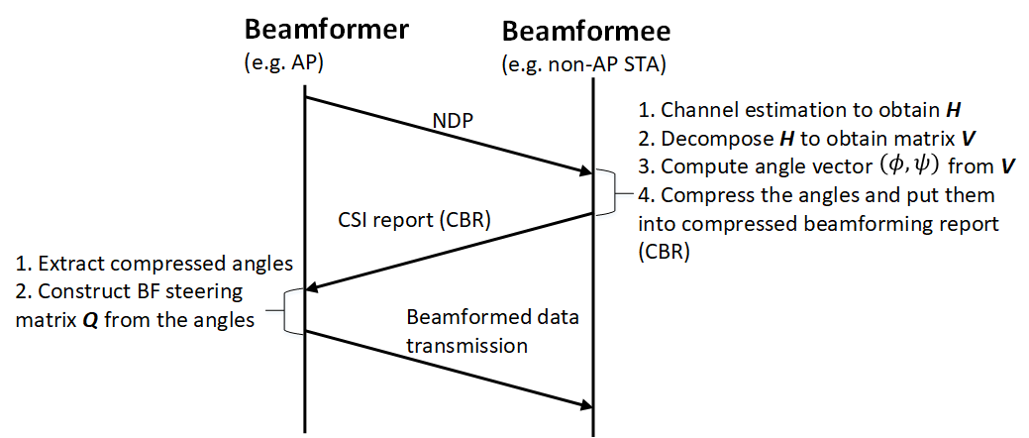
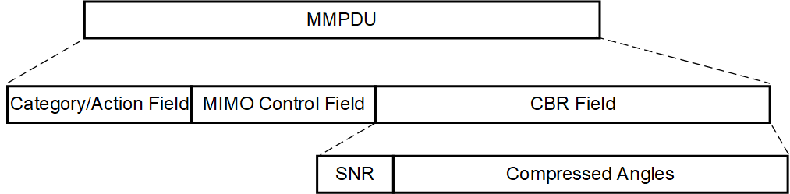
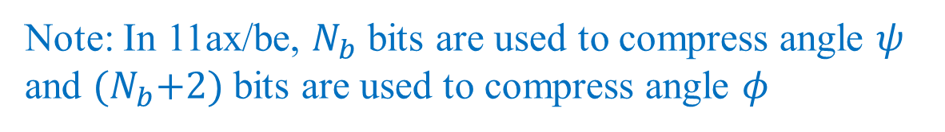
Recap: Legacy beamforming scheme
Note: In 11ax/be, $N_{b}$ bits are used to compress angle $ψ$ and ${(N}_{b}+2)$ bits are used to compress angle $φ$

Slide 3
Considered scenarios for AIML schemes
Online training [2]
The training data is collected using legacy CSI feedback reports (e.g., CBR) [3]
AIML is applied in AP only (training is performed at AP and the AIML database/codebook is sent to the non-AP STAs) [3]

Slide 4
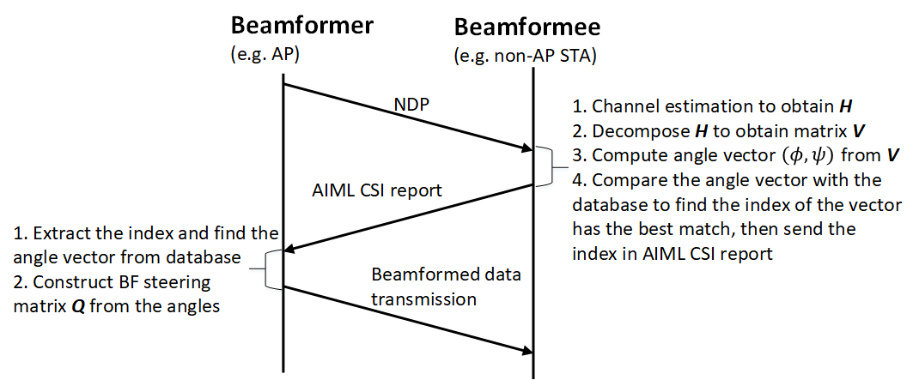
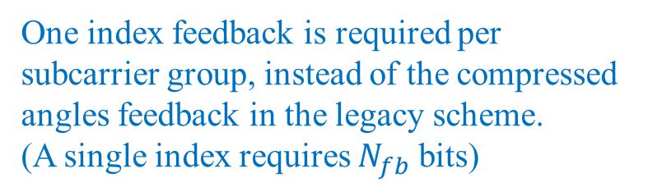
Recap: Existing AIML scheme in [1]
One index feedback is required per subcarrier group, instead of the compressed angles feedback in the legacy scheme.
(A single index requires $N_{fb}$ bits)

Slide 5
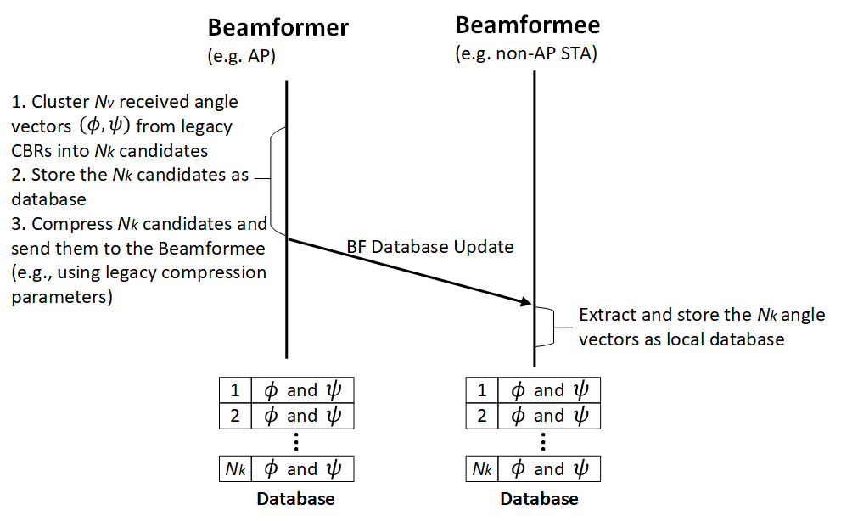

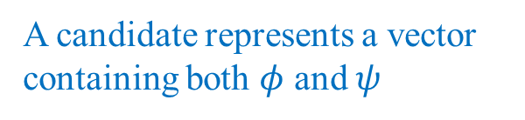
Recap: Reuse legacy CBR for AIML online training [2]-[4]
$$N_{k}=2^{N_{fb}}$$
(codebook)
A candidate represents a vector containing both $φ$ and $ψ$
(codebook)
(codebook)

Slide 6
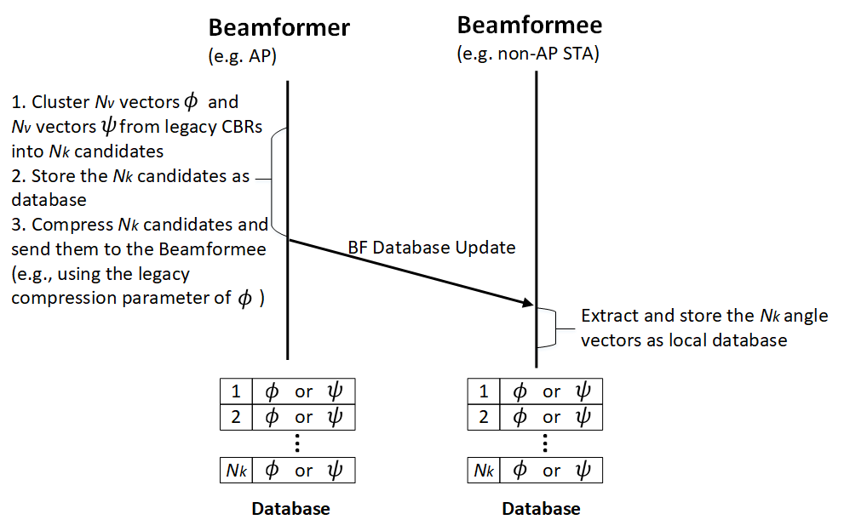
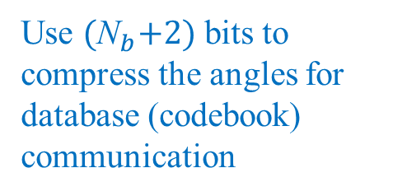
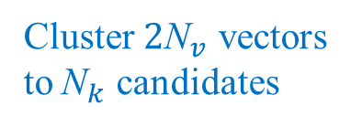
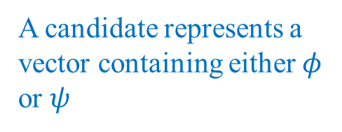
Proposed scheme I (Training phase)
Cluster ${\text{2}\text{N}}_{v}$ vectors
to${ \text{N}}_{k}$ candidates
(codebook)
Use ${\text{(}\text{N}}_{b}+2)$ bits to compress the angles for database (codebook) communication
A candidate represents a vector containing either $φ$ or $ψ$
(codebook)
(codebook)

Slide 7
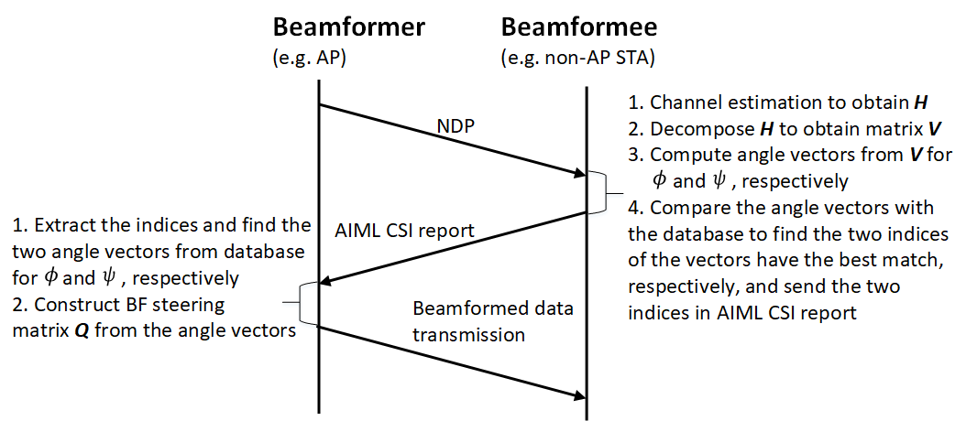
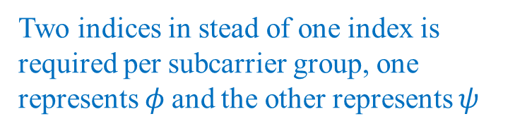
Proposed scheme I (Beamforming phase)
Two indices in stead of one index is
required per subcarrier group, one
represents $φ$and the other represents $ψ$

Slide 8
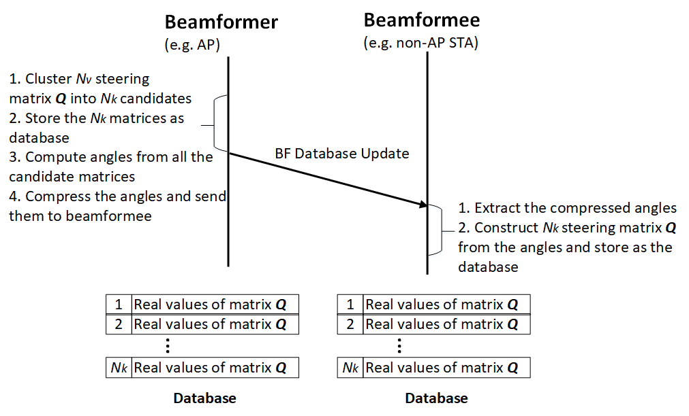
Proposed scheme II (Training phase)
Database is constructed in terms of steering matrices, instead of angles in the other two schemes
Can use legacy angle compression method
(codebook)
(codebook)
(codebook)

Slide 9
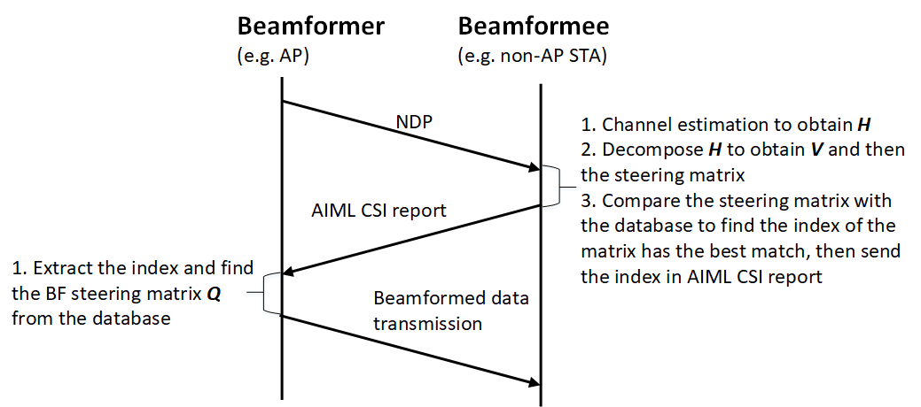
Proposed scheme II (Beamforming phase)
A single index is required per subcarrier group
Angle computation is not required at non-AP STA

Slide 10
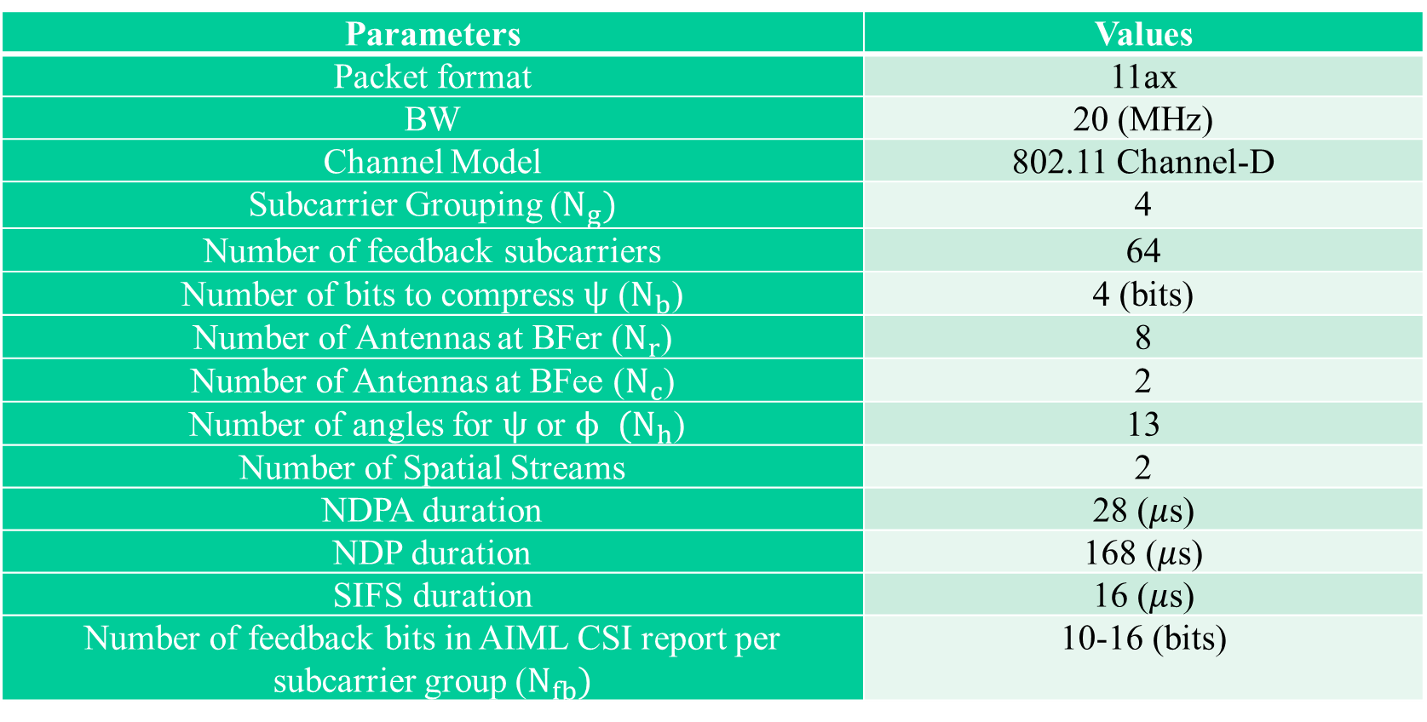
Considered system parameters for evaluations (an example)
Parameters | Values
Packet format | 11ax
BW | 20 (MHz)
Channel Model | 802.11 Channel-D
Subcarrier Grouping ($N_{g})$ | 4
Number of feedback subcarriers | 64
Number of bits to compress $ψ$ ($N_{b}$) | 4 (bits)
Number of Antennas at BFer ($N_{r}$) | 8
Number of Antennas at BFee ($N_{c}$) | 2
Number of angles for $ψ$ or $ϕ$ $(N_{h}$) | 13
Number of Spatial Streams | 2
NDPA duration | 28 ($μ$s)
NDP duration | 168 ($μ$s)
SIFS duration | 16 ($μ$s)
Number of feedback bits in AIML CSI report per subcarrier group ($N_{fb})$ | 10-16 (bits)

Slide 11
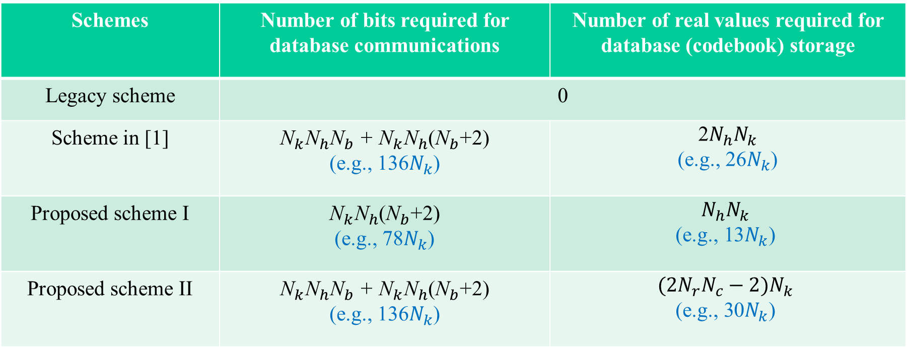
Comparisons of database communication and storage
Schemes | Number of bits required for database communications | Number of real values required for database (codebook) storage
Legacy scheme | 0
Scheme in [1] | ${\text{N}}_{k}{\text{N}}_{h}{\text{N}}_{b}$ + ${\text{N}}_{k}{\text{N}}_{h}$(${\text{N}}_{b}$+2) (e.g., 136$N_{k}$) | 2${N_{h}N}_{k}$ (e.g., 26$N_{k}$)
Proposed scheme I | ${\text{N}}_{k}{\text{N}}_{h}$(${\text{N}}_{b}$+2) (e.g., 78$N_{k}$) | $${N_{h}N}_{k}$$ $$\text{(}\text{e}\text{.}\text{g}\text{., 13}N_{k}\text{)}$$
Proposed scheme II | ${\text{N}}_{k}{\text{N}}_{h}{\text{N}}_{b}$ + ${\text{N}}_{k}{\text{N}}_{h}$(${\text{N}}_{b}$+2) (e.g., 136$N_{k}$) | $${({2N}_{r}N_{c}−2)N}_{k}$$ $$\text{(}\text{e}\text{.}\text{g}\text{., 30}N_{k}\text{)}$$

Slide 12
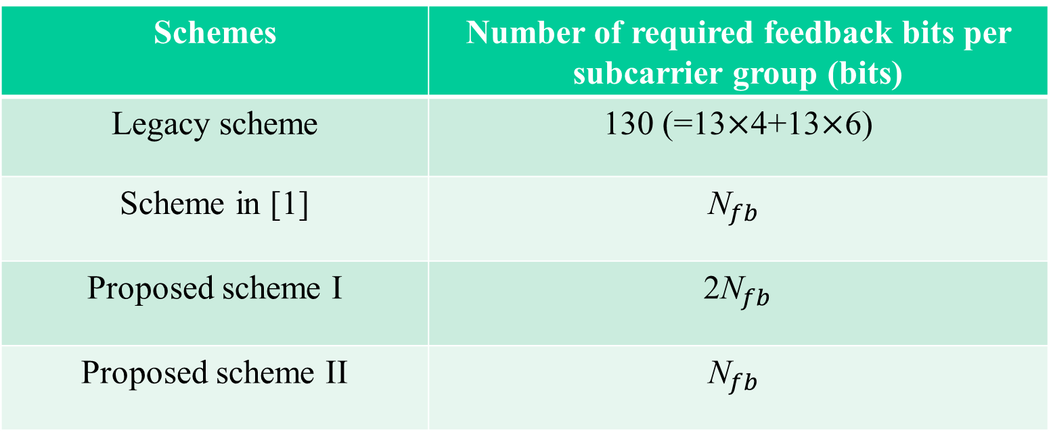
Comparisons of the number of feedback bits
Schemes | Number of required feedback bits per subcarrier group (bits)
Legacy scheme | 130 (=13$×$4+13$×$6)
Scheme in [1] | $${\text{N}}_{fb}$$
Proposed scheme I | 2${\text{N}}_{fb}$
Proposed scheme II | $${\text{N}}_{fb}$$

Slide 13
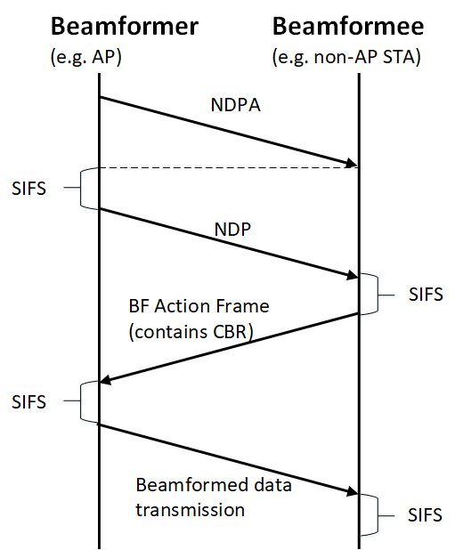
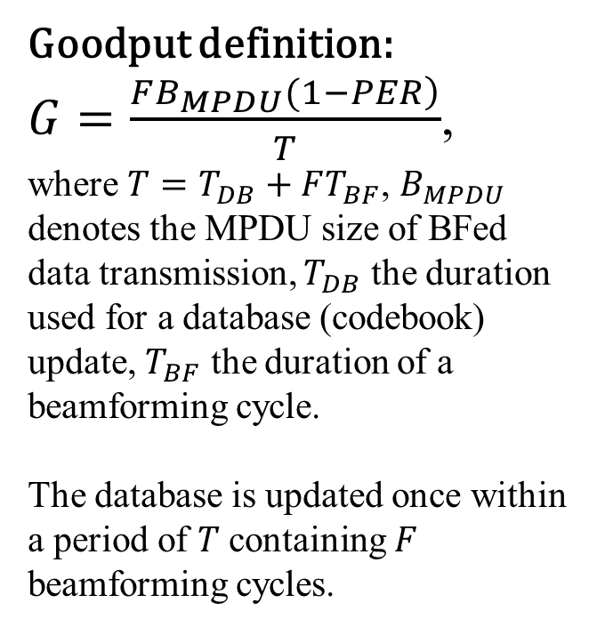
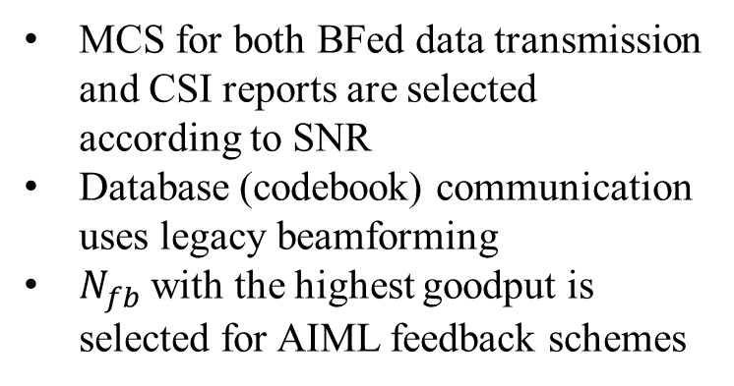
Goodput Evaluation (1)
Goodput definition:
$G=\frac{\left.FB_{MPDU}(1−PER\right)}{T}$,
where $T=T_{DB}+FT_{BF}$, $B_{MPDU}$ denotes the MPDU size of BFed data transmission, $T_{DB}$ the duration used for a database (codebook) update, $T_{BF}$ the duration of a beamforming cycle.
The database is updated once within a period of $T$containing $F$ beamforming cycles.
MCS for both BFed data transmission and CSI reports are selected according to SNR
Database (codebook) communication uses legacy beamforming
$N_{fb}$ with the highest goodput is selected for AIML feedback schemes
A beamforming cycle

Slide 14
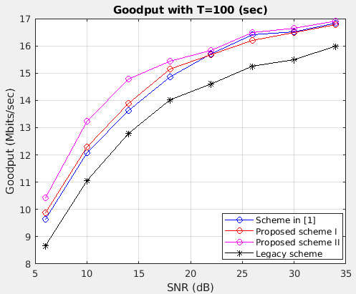


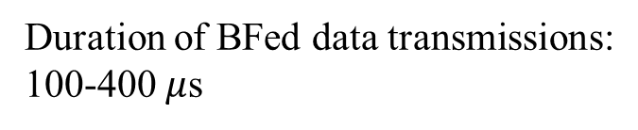
Goodput Evaluation (2)
Duration of BFed data transmissions:
100-400 $μ$s
Duration of CSI reports:
90-300 $μ$s
$T=100 (sec); B_{MPDU}$ = 1KB

Slide 15
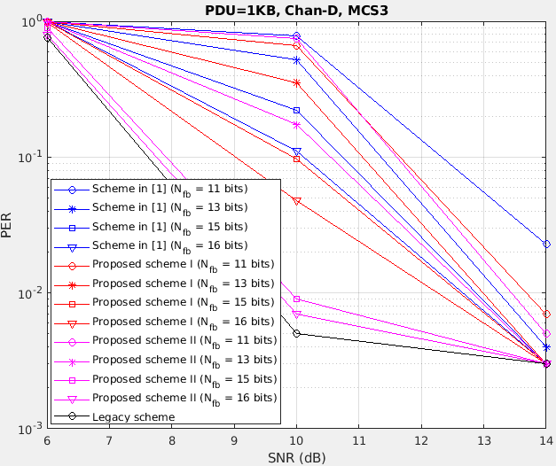
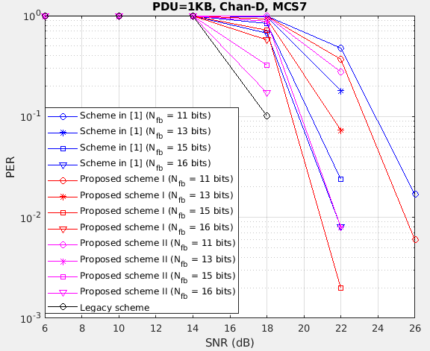
Goodput Evaluation (3)
PER performance of MCS 3&7 with $B_{MPDU}$ = 1KB

Slide 16
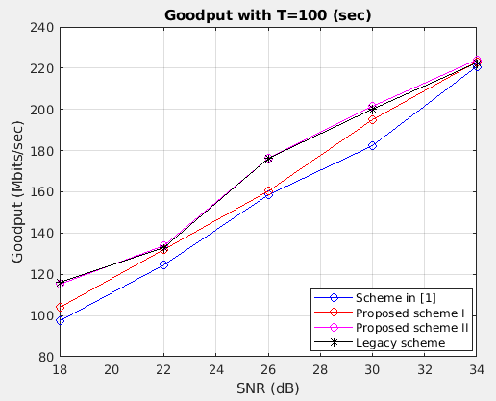

Goodput Evaluation (4)
Duration of BFed data transmissions:
around 5ms for all MCSs
$$T=100 (sec)$$

Slide 17
Summary of benefits and standard impact
AIML scheme | Key Benefits | Standard Impact
Scheme in [1] | Less CSI feedback | One index per subcarrier group
Proposed scheme I | Less database (codebook) communication overhead and storage | Two indices per subcarrier group
Proposed scheme II | Approaches the PER of legacy scheme Possibly has less computation at non-AP STA when training is complete (e.g., angle computation is not required) | Same as the scheme in [1]

Slide 18
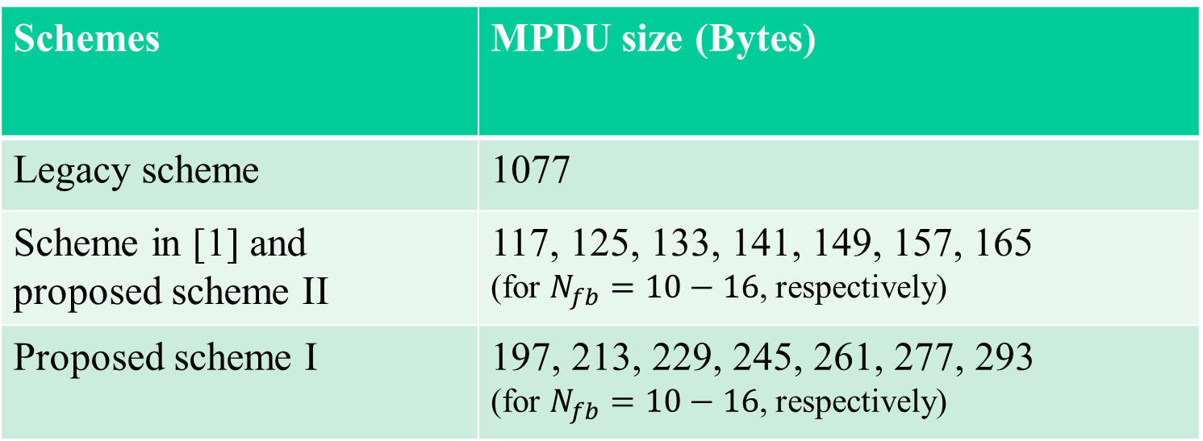
Comparisons of MPDU sizes of CSI reports (an example)
Schemes | MPDU size (Bytes)
Legacy scheme | 1077
Scheme in [1] and proposed scheme II | 117, 125, 133, 141, 149, 157, 165 (for $N_{fb}=10−16$, respectively)
Proposed scheme I | 197, 213, 229, 245, 261, 277, 293 (for $N_{fb}=10−16$, respectively)

Slide 19
Contribution to CSI Compression Use Case [4]
Add required AIML database (codebook) storage to Section 2.1.3 (requirements)

Slide 20
References
[1] M. Deshmukh, Z. Lin, H. Lou, M. Kamel, R. Yang, I. Güvenç, “Intelligent Feedback Overhead Reduction (iFOR) in Wi-Fi 7 and Beyond,” in Proceedings of 2022 VTC-Spring
[2] 11-22/0950r2, Discussion on Connection between AI/ML & Wireless LAN
[3] 11-22/1563r2, AI ML Use Case
[4] 11-22/1934r5, Proposed IEEE 802.11 AIML TIG Technical Report Text for the CSI Compression Use Case

