Slide 1
AIML-based Multi-AP Coordination Use Case
Date: 2023-02-13
Authors:

Slide 2
Abstract
Outline of a proposed use case (for the AIML TIG technical report) focusing on ML-based multi-AP coordination (MAPC).

Slide 3
Use Case Goal
This use case proposes to apply AIML methods (deployed at APs) to multi-AP coordination schemes to improve utilization of available resources while maintaining minimum inter-cell interference.

Slide 4
Background
Multi-AP coordination - a key feature discussed in UHR
Various coordination levels proposed
  [1] has two levels
    loose/light coordination
    tight coordination
  [2] has three levels (see next slide)
Various coordination subtypes [3]
  Coordinated OFDMA
  Coordinated Spatial Reuse
  Coordinated Beamforming
  Joint Transmissions

Slide 5
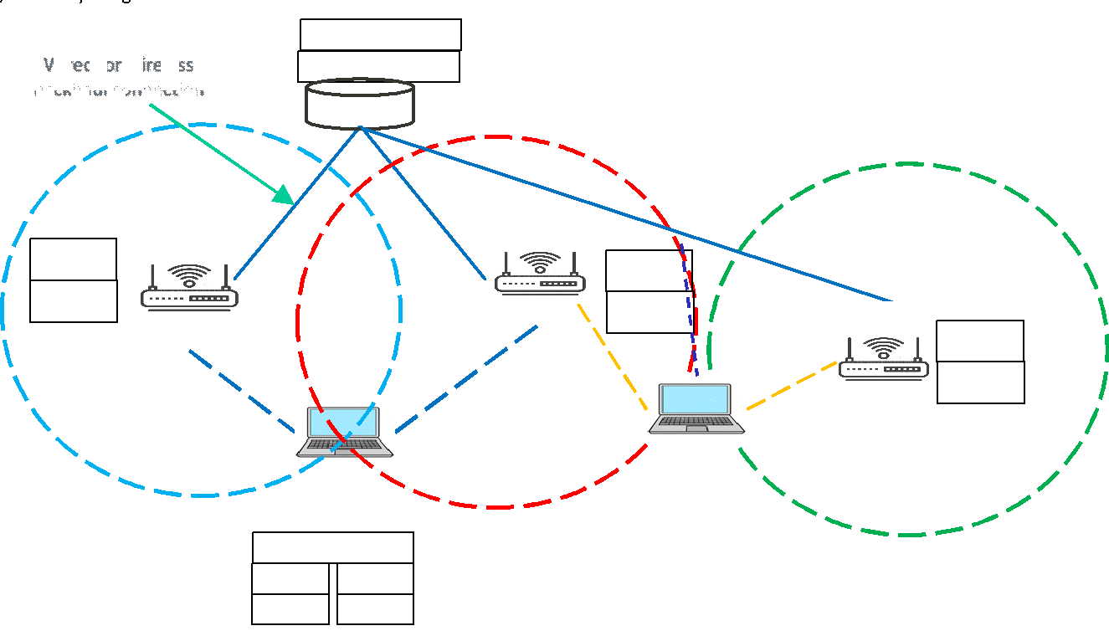
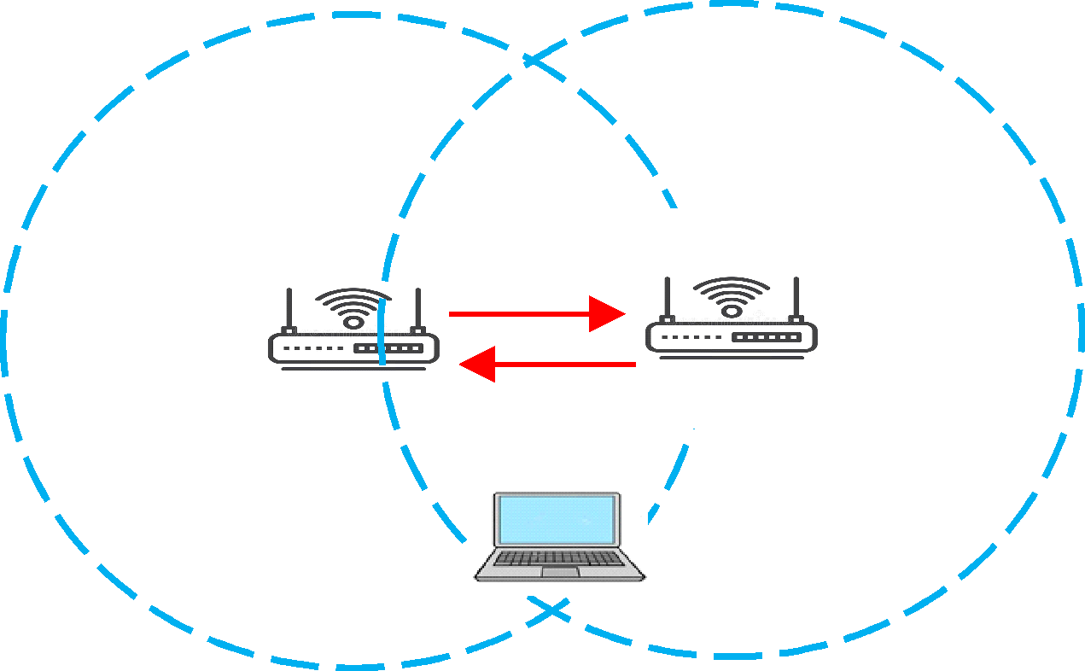
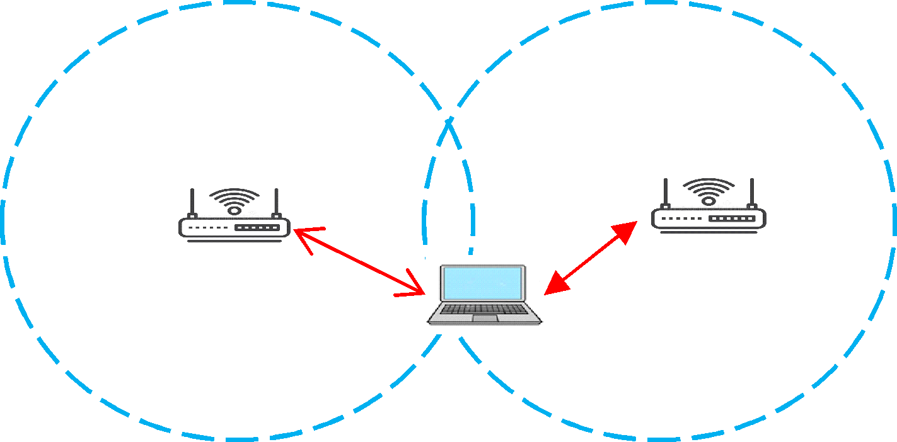
Coordination Levels [2]
    MLD to MLD coordination
MLD Coordinating distributed Affiliated APs
MLDs coordinating via non-AP STA(s)

Slide 6
Use Case Motivation
Where can AIML be applied?
  Learn and decide which
    devices (APs/STAs) to involve
    coordination level to use
    coordination subtype to apply
  Decisions can be inferred (predicted before use)

Slide 7
Literature Review
MAPC a key feature of future WLANs [4]
Many proposals of coordination mechanisms, eg [5]
Novel functionality with few ML-based solutions (as yet) [6]
Distributed MIMO method for Wi-Fi [7]
  APs replaced by radio heads
  DRL agents
  20% throughput improvement
  Works well in dynamic environments
MAPC channel access system with DRL [8]
MAPC with federated learning [9]

Slide 8
KPIs
Throughput
Latency and jitter
Reliability
Fairness
Learning latency: Additional delay is introduced by AIML exploration

Slide 9
Requirements
Reference scenarios for demonstrating performance improvement over non-AIML UHR
Performance evaluation targeting KPIs
Minimization of overhead (signalling, computational complexity, etc.)

Slide 10
Potential Features Analysis
Coordination level
  Centralized
  Distributed
Coordination subtype
  Coordinated OFDMA
  Coordinated Spatial Reuse
  Coordinated Beamforming
  Joint Transmissions

Slide 11
Standard Impact
Signaling and protocols related to parameter exchange between APs as well as between APs and non-AP STAs, e.g., capability indication, data report to facilitate training (exchange state info, eg buffer state, CSI info), management information (set up joint transmissions).

Slide 12
Technical Feasibility
Hardware/software capability: The APs that support AIML-based multi-AP coordination shall have the hardware and software capability to support AIML algorithm(s). The APs that support model training may require higher computation capabilities.

Slide 13
Summary
The reported use case of applying AIML for multi-AP coordination is important because MAPC is a strong candidate for adoption in UHR and can benefit from extending with AIML support.

Slide 14
References
[1] 11-22/1899 "Multi-AP Operation for Low Latency Traffic Delivery - Follow up"
[2] 11-22/1512 "Multi AP Coordination and Residential Wi-Fi"
[3] 11-22/1516 "Considerations on Multi-AP Coordination"
[4] C. Deng et al., "IEEE 802.11be Wi-Fi 7: New Challenges and Opportunities," in IEEE Communications Surveys & Tutorials, vol. 22, no. 4, pp. 2136-2166, Fourthquarter 2020, doi: 10.1109/COMST.2020.3012715.
[5] D. Nunez, F. Wilhelmi, S. Avallone, M. Smith and B. Bellalta, "TXOP sharing with Coordinated Spatial Reuse in Multi-AP Cooperative IEEE 802.11be WLANs," *2022 IEEE 19th Annual Consumer Communications & Networking Conference (CCNC)*, Las Vegas, NV, USA, 2022, pp. 864-870.
[6] S. Szott et al., "Wi-Fi Meets ML: A Survey on Improving IEEE 802.11 Performance With Machine Learning," in IEEE Communications Surveys & Tutorials, vol. 24, no. 3, pp. 1843-1893, thirdquarter 2022.
[7] N. Nurani Krishnan, E. Torkildson, N. B. Mandayam, D. Raychaudhuri, E. -H. Rantala and K. Doppler, "Optimizing Throughput Performance in Distributed MIMO Wi-Fi Networks Using Deep Reinforcement Learning," in IEEE Transactions on Cognitive Communications and Networking, vol. 6, no. 1, pp. 135-150, March 2020.
[8] L. Zhang, H. Yin, S. Roy and L. Cao, "Multiaccess Point Coordination for Next-Gen Wi-Fi Networks Aided by Deep Reinforcement Learning," in IEEE Systems Journal, 2022.
[9] G. Woo, H. Kim, S. Park, C. You, and H. Park, “Fairness-Based Multi-AP Coordination Using Federated Learning in Wi-Fi 7,” Sensors, vol. 22, no. 24, p. 9776, Dec. 2022.

