Slide 1
Realistic Rates on 60GHz Clients
Date: 2023-03-14 (Happy π day!)
Authors:
Name | Affiliations | Address | Phone | Email
Rethna Pulikkoonattu | Broadcom Inc | 16340 W Bernardo Dr, San Diego, CA, 92127 | 858-521-5000 | rethna@broadcom.com
Ron Porat
Vinko Erceg
Thomas Derham
Gabriel Desjardins

Slide 2
Abstract
This submission offers a fair evaluation of the feasible physical layer transmission rates for 60GHz clients in comparison to existing solutions in the 6GHz band.

Slide 3
Positing 60GHz in UHR
Wider spectrum is available in the 60GHz band.
Despite the signal power being allowed to reach a much higher level (~40dBm EIRP), this enhancement is swiftly nullified by the path loss, even at close ranges.
The 5-7GHz bands features mature MIMO solutions for the STA market, providing tangible product performance.
The implementation of 60GHz for the next generation involves significant changes to hardware, particularly the RF, causing a rise in power consumption, physical size, and cost. To make 60GHz a compelling choice, it is essential to determine its realistic benefits and weigh them against the well-established solutions in the 6GHz band.

Slide 4
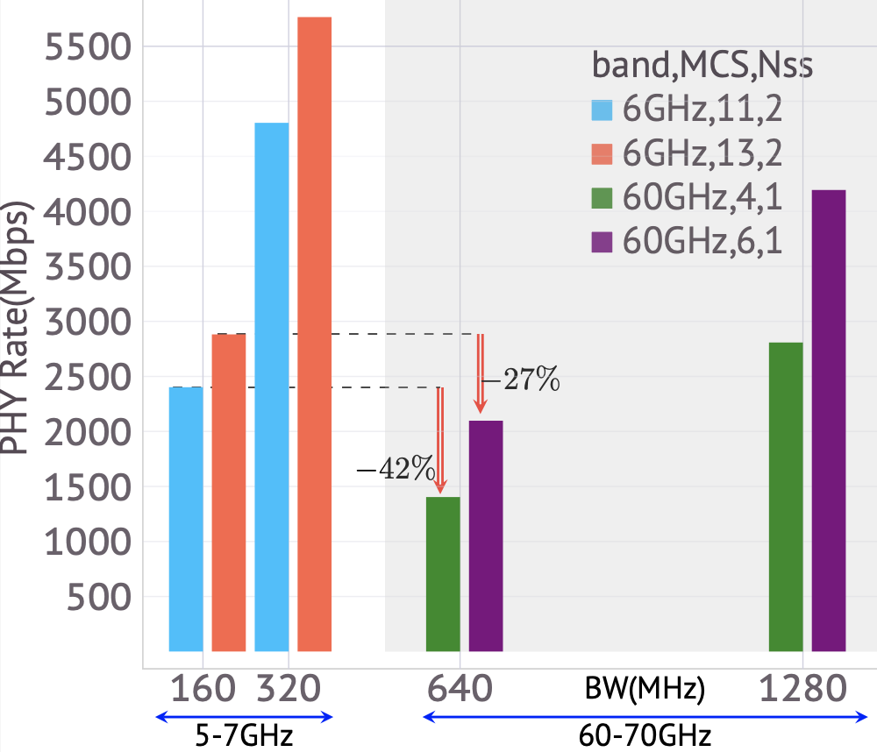
60GHz vs 6GHz: PHY Rate Comparisons
The complexity of supporting Nss=2 in the 60GHz band, with its demanding area and power needs, would render it inappropriate for handheld devices, even with advanced process nodes.
Despite utilizing four times the operating bandwidth, the 60GHz band does not significantly enhance throughput when compared to 5-7GHz band solutions.
  MCS 11 + 160 (320) MHz + Nss = 2 in 6GHz offers superior rate than MCS 4 + 640 (1280) MHz + Nss=1 in 60GHz
  MCS 13 + 160 (320) MHz + Nss = 2 in 6GHz offers superior rate than MCS 6 + 640 (1280) MHz + Nss=1 in 60GHz
Realistic 60GHz Configuration
  Nss=1, 16QAM and LDPC 3/4, 640MHz (1280MHz)
    Lower BW is desired after the 802.11ay experience [1,3]
  PHY based upon 11ac architecture/design [1-4]
    Reduce the symbol time by a factor of 8
RF Challenges
  Frequency droop
  Increased PLL noise (and current) [5]
  Frequency dependent IQ imbalance
  Power Amplifier memory, nonlinearity etc.,
Baseband/Mixed signal challenges
  Baseband complexity/power scales up
  RF impairments compensation gets harder

Slide 5
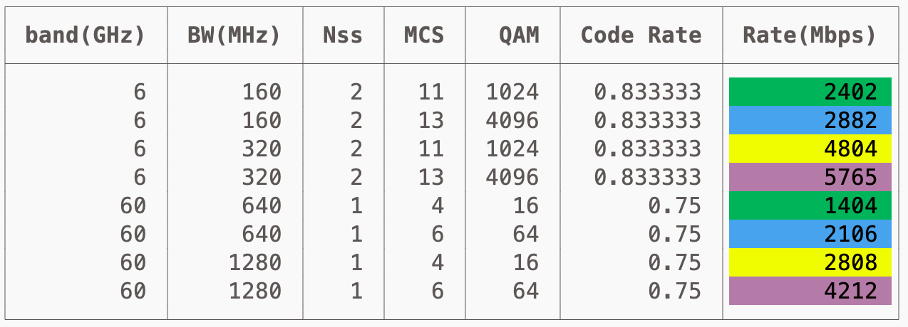
60GHz vs 6GHz: Feasible PHY Rates
Even with four times the operating bandwidth, the 60GHz band still struggles to deliver practical throughput numbers that can compete with what is possible in the 5-7GHz band, despite the extra complexity and work involved.
Notes
  The PHY parameters in this 60GHz design are based on a scaled-up version of the 802.11ac 80MHz PHY, without any limitations from the RF. The mapping of MCS in this design aligns with the that of 802.11ac/ax/be. 6GHz rates are for EHT. Comparable schemes (in terms of noise limits) marked with the same colors (e.g., MCS11/6GHz or MCS4/60GHz in skyblue).
  The challenge of supporting MCS6 at 60GHz due to RF noise is similar or harder than supporting MIMO MCS13 in 5-7GHz. Although MCS6 has a 16.5dB advantage in SNR in clear LOS channels, the change from 6 to 60GHz leads to a 20dB increased phase noise alone, giving a net loss of 3.5dB and significantly higher current consumption. While broader subcarrier spacing and phase tracking can help mitigate part of it, both configurations present comparable challenges..

Slide 6
Conclusion
A transition to the 60GHz band, even with four/eight times more operating bandwidth than in the 5-7GHz bands, does not result in substantial benefits in terms of throughput.
The pursuit of wider bandwidth in 60GHz, even at realistic rates (Nss=1, MCS=4), presents significant hurdles, particularly for client devices.
Spending effort in 60GHz does not seem like a wise choice, as the benefits it offers in realistic scenarios are modest compared to what can be achieved with the new and unoccupied 6GHz band.

Slide 7
References
“mmWave operation in UHR” IEEE 802.11-22/1884r0
“Thoughts on Utilizing mmWave” IEEE 802.11-23/0066r0
“Considerations on PHY designs for mmWave band”, IEEE802.11-22/1872r0
“Some questions to answer in the SG”, IEEE802.11-22/1595r1
Hajimiri, A. (2001, February). Noise in phase-locked loops. In 2001 Southwest Symposium on Mixed-Signal Design, Invited Paper, (Cat. No. 01EX475) (pp. 1-6). IEEE. (see e.g., Fig.12)

