Slide 1
Ambient IoT Device Demo
Date: 2023-01-16
Authors:

Slide 2
Abstract
This presentation follows the demo presented at the face to face meeting

Slide 3
Main Demonstration
Ambient IoT devices that come in the form of a ultra low complexity and low cost stickers
Energizing and reading of 8 devices at distance > 10m
Temperature readings of the devices

Slide 4
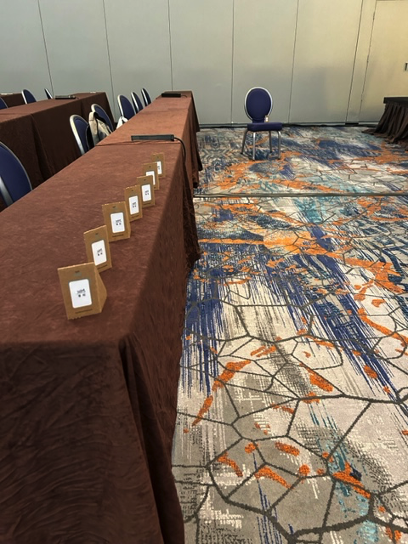
The Devices
Each device comes in a sticker form factor
The stickers are sticked onto small carton plates

Slide 5
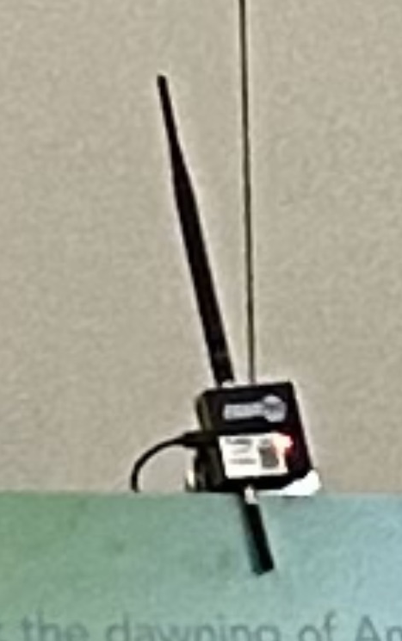
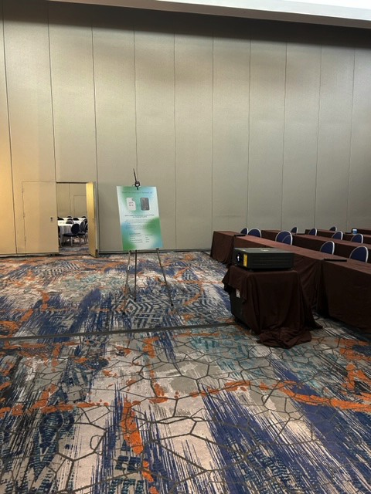
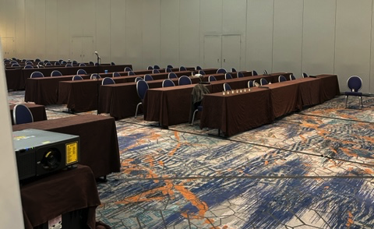
The Energizing Module
Off the shelf device that can energize the
ambient IoT device
Standard iphone is used as the reader using
proper application
Distance between devices and energizer is <10m

Slide 6
Properties of The Ambient IoT Devices
Parameters
Operational Frequency | 900MHz/2.4GHz
Bandwidth | 1MHz
RF harvesting sensitivity | -32 dBm
Transmission power (EH) | 30dBm

Slide 7
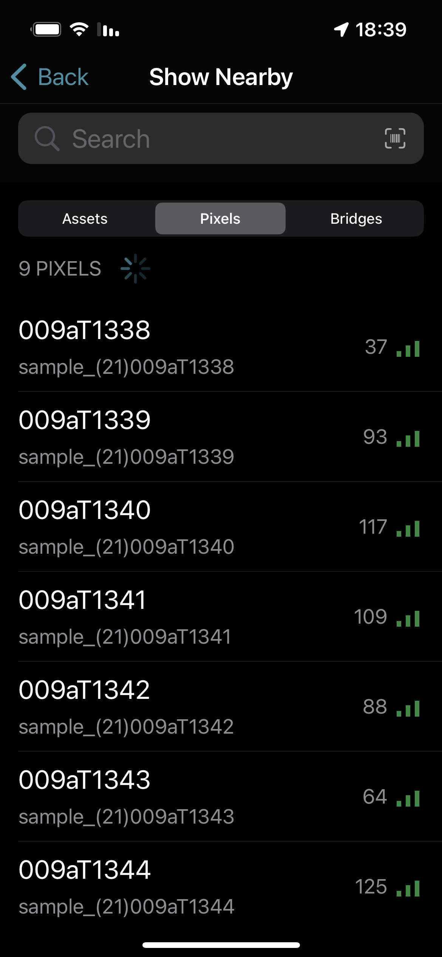
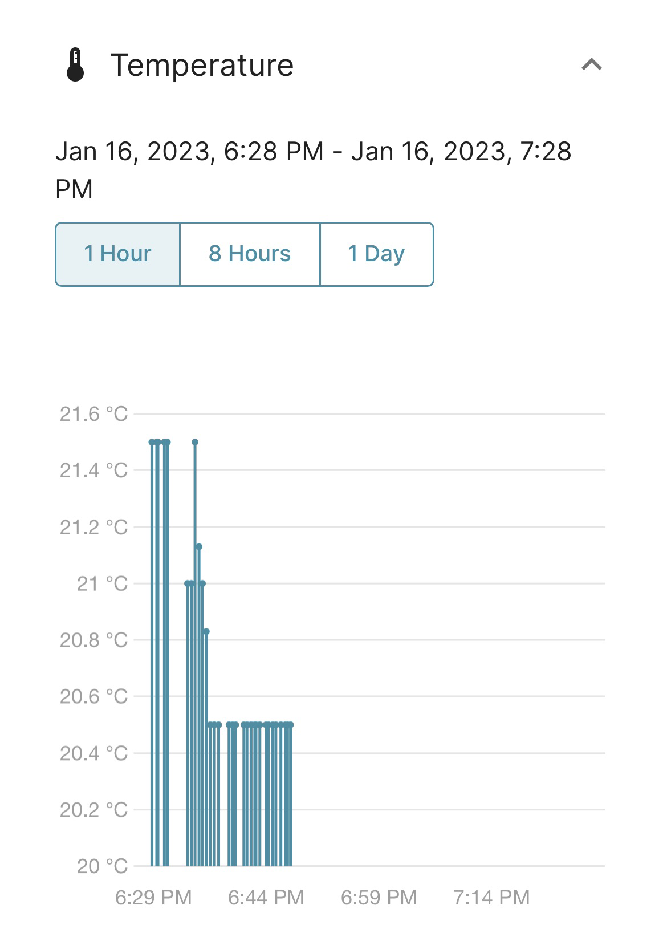
Reading The Devices
Each device that was energized and received is displayed
The three lines represent good reception
The number besides each tag represent number of packets received from tag
Cloud storage logs the temperature readings per tag. This can then be accessed by the application as well.

Slide 8
References

