Slide 1
Discussions on Preamble Puncturing in 320MHz Ranging NDP
Date: 2023-01-19
Authors:
Name | Affiliations | Address | Phone | Email
Tianyu Wu | Apple. Inc |  |  | tianyu@apple.com
Anuj Batra
Wook Bong Lee
Notes:
September 2012

Slide 2
Introduction
Preamble puncture is defined to improve spectrum utilization when a portion of the operating channel is not available.
  However, typical ranging algorithms assume continuous spectrum.
  Preamble puncturing does not provide attractive accuracy improvement
11bk has agreed to be a short project with simple extensions of 11az to support 320MHz ranging NDP
  11az does not support preamble puncturing
  There are many preamble puncturing modes defined for 320MHz PPDU in 11be.
  Supporting all preamble puncturing modes will delay the progress and add a lot of complexity (in terms of testing).
We propose that 11bk only supports non-punctured 320MHz ranging NDP and continuous 240MHz ranging NDP.

Slide 3
Ranging Accuracy vs Complexity
Peak throughput linearly increase with total BW, but ranging accuracy does not
  From 160MHz to 320MHz, expect 20%-30% accuracy improve¹
  Smaller gain expected for 160MHz to 240MHz or 160 to 280MHz
  What if an AP supports preamble puncturing, but STA only measures ToF based on a continuous portion of the spectrum in the Ranging NDP?
    If ranging initiator and ranging responder use different BWs, the accuracy will be limited by the device using smaller BW.
    Example: If AP measures ToF on 80+160MHz BW and STA measures ToF on 80MHz BW, the ranging accuracy will be limited by the STA side, similar accuracy as using 80MHz NDP.
Complexity increase with the number of modes supported.
  There are 24 preamble puncturing modes for 320MHz PPDU
    Supporting so many modes will result in excessive testing effort.
    Not a good tradeoff considering the very limited gain in ranging accuracy.
1: In rich multipath environments

Slide 4
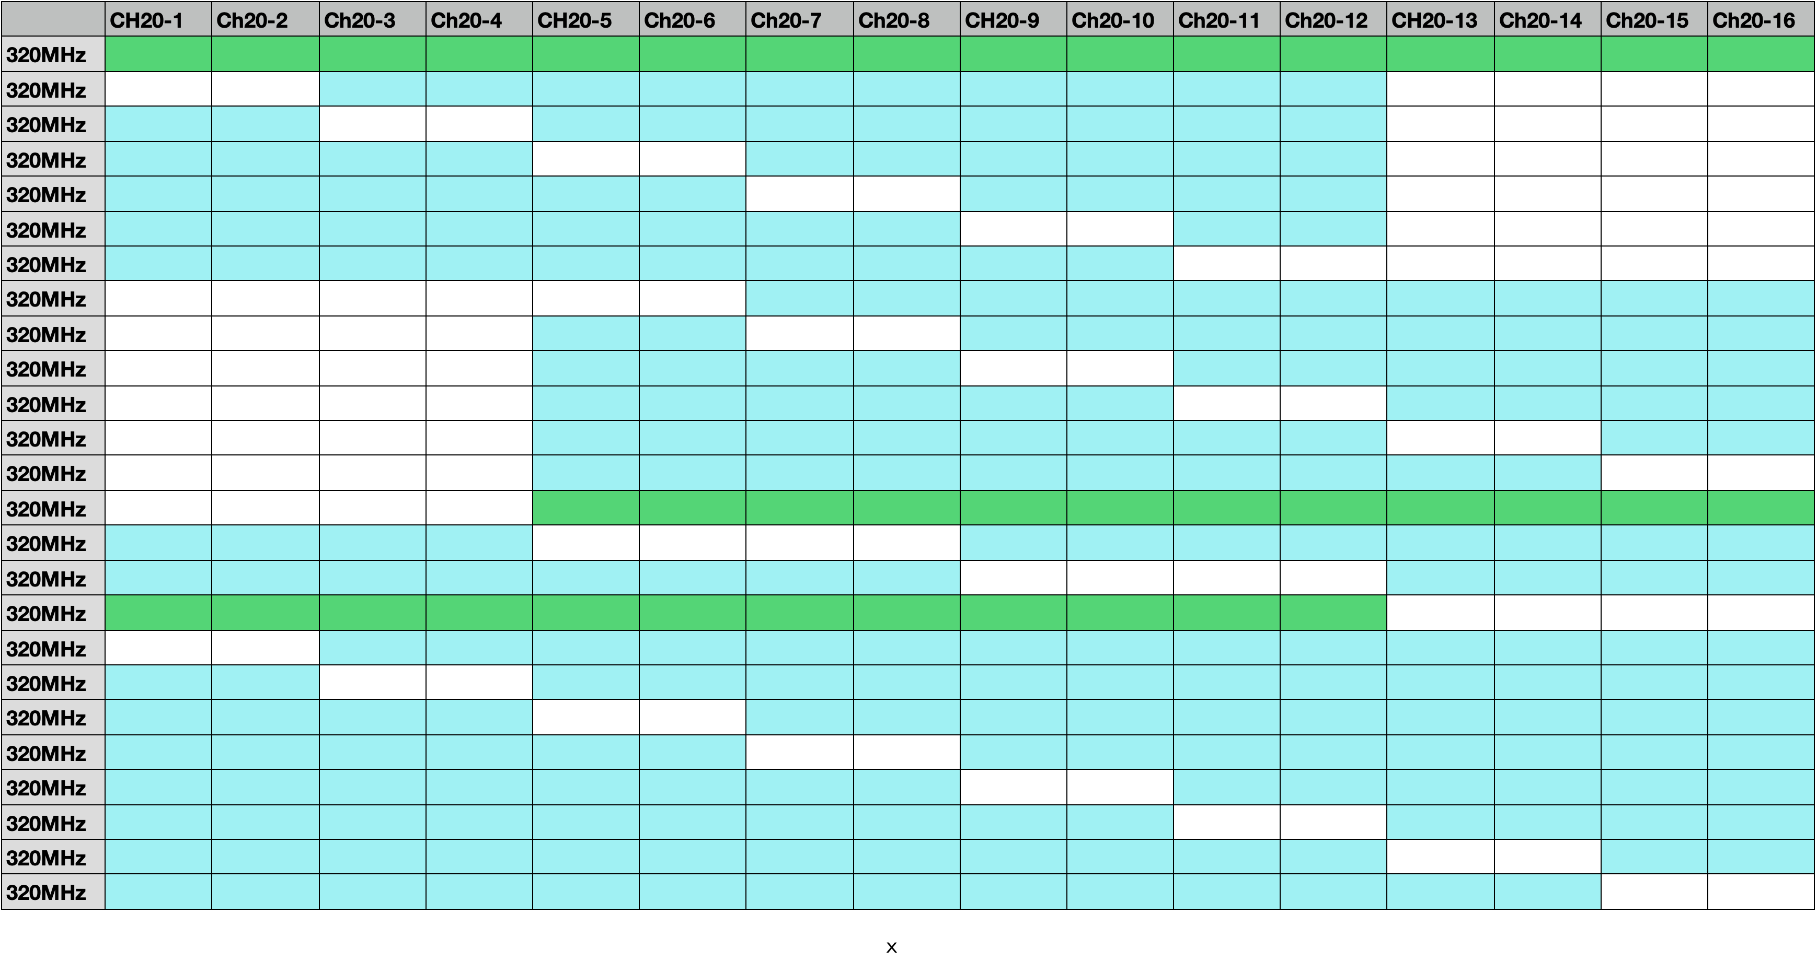
Preamble puncturing in 320MHz PPDU
Non-punctured 320MHz PPDU and 24 preamble puncture modes
  Continuous 240MHz PPDU are two special puncture modes that can also be seen as full BW 240MHz PPDU. 240MHz modes can be used in regulatory regions without 320MHz channel.
Non-punctured 320MHz PPDU
Continuous 240MHz PPDU

Slide 5
Concerns on supporting all puncturing modes in Ranging
For STA that prefer not to process non-continuous spectrum, there maybe many drawbacks
Consider a STA that only processes 160 MHz from 160+80MHz:
  Need to zero out 80MHz which is equivalent to convolving time-domain waveform with a filter – could degrade ranging accuracy of 1st path detection (needs to be verified)
  Power loss: Wasted 1/3 of power on the 80MHz portion of the channel (1.8dB)
  Additional testing and verification efforts for ranging of these modes – beyond 11be testing and verification
  Medium access: Chance to obtain idle channel on 160 is higher than 320MHz
  Increased risk due to additional protocol complexity – STAs start with 11bk 320MHz, but fallbacks to 11az 160MHz when 160+80 mode is used in 11bk 320MHz ranging session – increases time/overhead for ranging

Slide 6
Proposal
We propose:
Only support non-punctured 320MHz Ranging NDP and continuous 240MHz Ranging NDP in 11bk.
Discussions
  Note that 11az only support a subset of 11ax PHY modes to simplify the design. For example,
    11az only support 2x LTF with 1.6us GI mode.
    11az does not support preamble puncturing modes
  We prefer to follow the same design philosophy as 11az and limit the supported preamble puncturing modes in 11bk.

Slide 7
Straw Poll 1
Do you agree that 11bk only support non-punctured 320MHz Ranging NDP and continuous 240MHz Ranging NDP?
  Y
  N
  A

Slide 8
Reference
11-22/1981r0 Thoughts on 320MHz Ranging NDP

