Slide 1
Comments on “BEREC Report on the impact of Artificial Intelligence (AI) solutions in the telecommunications sector on regulation”
Date: 2023-01
Authors:

Slide 2
Background
EU BEREC Report on AI in telecommunication sector
  802.18 Chair sent out an email on this on Jan 8, 2023
Feedback to 802.18 by 8 am on Thursday (Jan 19)
In this contribution, we prepare several comments for discussion.

Slide 3
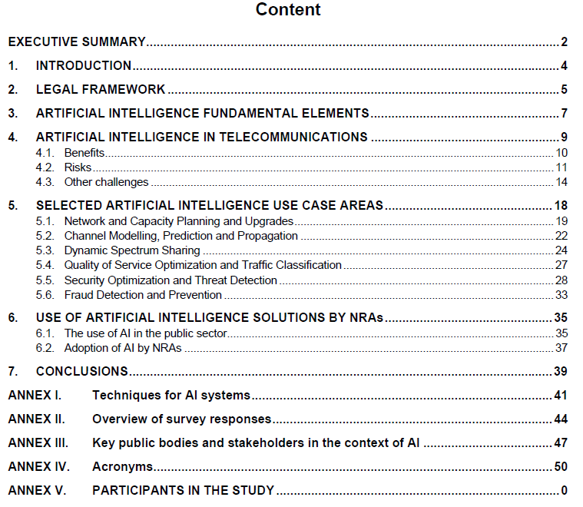
Brief summary of the report
10 participants of the studies:
TRANSATEL
Telefonica, S.A.
Liberty Global
Telia Company
European Competitive Telecom Association
KPN
Telefónica Germany
Turkcell
Amazon Web Services
Dialogic innovation & interaction
Selected 6 use cases of AI

Slide 4
Comment 1
4. ARTIFICIAL INTELLIGENCE IN TELECOMMUNICATIONS
4.2. Risks
4.2.3. Lack of trust in decision making
AI systems allow the processing of large amounts of data, automation of processes as well as the detection of patterns in datasets. Yet the complexity of AI systems, in particular AI systems using ML approaches, may render the evaluation of the results validation as a major challenge. Methods and procedures which ensure that the results presented by AI systems need to be understood and evaluated. In particular, the enhancement of the explainability of the outputs will be crucial to guarantee that disputes between stakeholders in the telecommunications sector can be tackled.
AI explainability relates to the means that allow users to understand and trust AI outputs. When involving decisions or profiling involving individuals, the provisions in art 22 of the GDPR establish the data subject’s right to obtain human intervention and an explanation of the decision reached (Rec 71 GDPR). There are several technical frameworks for Explainable AI and enhance transparency such as What-if Tool (tensor flow), LIME, DeepLIFT, Shapley etc. Survey respondents rated concerns about the opacity of AI systems with an average of 3.4 (being 5 the highest rate). Several technical measures to ensure explainability and to increase trust in the decision making have been implemented by the responding stakeholders, such as logging and reporting systems, levels of explanation tailored to stakeholder groups, detailed documentation and triggers with thresholds to identify critical deviations.
AI regulation would also be a way to increase trust in AI. For example, regulation can set the performance requirements of AI and constrain the abnormal decision-making of AI, thereby improving trust in AI through some prescribed assessment processes in various settings and conditions.

Slide 5
Comment 2
5. SELECTED ARTIFICIAL INTELLIGENCE USE CASE AREAS
5.3. Dynamic Spectrum Sharing
5.3.2. Related applications
Deep reinforcement learning for dynamic spectrum access
Conventional dynamic spectrum access is based on centralized control node that is responsible for the spectrum allocation to users. Prior to making decisions, this centralized node needs to collect information across the network. For instance, information regarding the users’ position and base stations. This information is complex and disperse. The difficulties of obtaining this information hinders the appropriate functioning of the network when there is a sufficient large number of users, which, ultimately, could yield to poor performance.
To solve this problem, reinforcement learning can be used. This technique consists of a learning process, where an agent can periodically make decisions, observe the results, and then automatically adjust its strategy to achieve the optimal policy. However, there are also limitations, mainly referred to the amount of time that is necessary to reach a solution since it requires gaining knowledge of an entire system. Fortunately, Deep Reinforcement Learning (DRL) can overcome those limitations and improve the learning speed and the performance of algorithms. Hence, it enables centralized control nodes to solve non-convex and complex problems, to achieve optimal solutions without complete and accurate network information.
Research on DRL-based spectrum access on unlicensed band is active [1][2]. DRL-based spectrum access mechanisms have been shown to achieve higher spectrum efficiency and lower latency than conventional mechanisms on unlicensed band, which rely on randomization to mitigate collisions.
[1] Z. Guo, Z. Chen, P. Liu, J. Luo, X. Yang and X. Sun, “Multi-Agent Reinforcement Learning-Based Distributed Channel Access for Next Generation Wireless Networks,” in IEEE Journal on Selected Areas in Communications, vol. 40, no. 5, pp. 1587-1599, May 2022, doi: 10.1109/JSAC.2022.3143251.
[2] W. Wydmański and S. Szott, “Contention window optimization in IEEE 802.11ax networks with deep reinforcement learning,” in Proc. 2021 IEEE Wireless Commun. Netw. Conf. (WCNC), 2021, pp. 1–6, doi: 10.1109/WCNC49053.2021.9417575.

Slide 6
Comment 3
5. SELECTED ARTIFICIAL INTELLIGENCE USE CASE AREAS
5.3. Dynamic Spectrum Sharing
5.3.3. Conclusions and regulatory implications
The realization of dynamic spectrum access with cognitive radio largely depends on the willingness of the regulators to open the spectrum for unlicensed access, but it also involves a technical component that need multidisciplinary approach from different fields, such as machine learning, computer networking, information theory or signal processing. In recent years, there is a trend for a more flexible approach to spectrum regulation. For instance, in November 2008 the Federal Communications Commission (FCC) presented a document with proposals for removing unnecessary regulations that restricted the development of spectrum markets⁷⁵. In the UK, the Office of Communications (OFCOM) proposed to allow licence exempt use of interleaved spectrum for cognitive devices⁷⁶.
Reviewed evidence in this section shows that there exists room for improvement in spectrum management, and AI techniques are a well-suited technology to foster this new dynamic approach that will be needed to satisfy future demand. These AI-based Dynamic Spectrum Management mechanisms have shown to achieve better performance and robustness than conventional schemes. However, there are also some challenges that must be addressed, both technologically and regulatory. To maximize the value of these algorithms, regulators should shift from a fixed to dynamic and more flexible approach. Regulations on unlicensed band spectum access should also be flexible to allow AI-based mechanisms.
Reason: Exiting studies showed that conventional backoff mechanism for unlicensed band spectrum access leads to large latency. Regulations should not force to use such backoff mechanism when AI techniques are employed.

Slide 7
Comment 4
Two Typos:
1. INTRODUCTION
For the last sentence of this part, ANNEX I is not the full list of respondents.
4.2.1. Availability of unbiased and reliable data
Reference is missed at the end of the 1st paragraph.

