Slide 1
More Discussions on Deep (Reinforcement) learning for WLAN
Date: 2023-01
Authors:

Slide 2
Introduction
In previous UHR meetings, we discussed the latency sensitive use cases and latency reduction methods using machine learning techniques, especially distributed channel access using neural network [1].
In [2], we introduced a deep reinforcement learning (DRL)-based channel access scheme, showed its effectiveness on latency reduction, and discussed possible standard impacts.
In [3], we addressed some questions regarding RTS/CTS, coexistence issue among AI-enabled and legacy devices, and NN model generalization.
In this contribution, we discuss some general considerations on introducing neural network/deep (reinforcement) learning for WLAN.

Slide 3
Recap
Standard Impact [2]
Train@AP
Capability
  AP needs training capability, ~3.24M FLOPs (n=10)
  Non-AP STAs need inference capability, ~9K FLOPs (~256-FFT)
NN Architecture
  Standardized basic components
  Extra signaling to support more configurations
Non-AP STAs —> AP : Training data report
  Real-time report
  Batch report
AP —> non-AP STAs : NN parameter (weights and bias) deployment
  Unicast or broadcast to refresh NN parameters (4770 parameters, ~5KB using 8-bit quantization)
Data report
AP
Model deployment
STA 1
STA 3
STA 2
Inference@STA
Historical Observations
Transmit or Wait
Neural Network (NN)
DRL-based channel access [2]:
learns the wireless environment via NN
makes channel access decisions based on local observations (CCA, packet delay,…)

Slide 4
Questions Received
What is the overhead of neural network model deployment?
How often does the neural network model need to be updated?
How to limit AI’s decision and ensure less performance degradation of legacy devices?

Slide 5
Overhead Reduction for Model Deployment
When introducing AI techniques in WLAN, it may involve NN model deployment, i.e., AP sends the trained NN model to non-AP STAs.
It is necessary to consider the overhead reduction of model deployment.
The overhead reduction can be considered from two aspects:
  NN model size, i.e., how large is the NN model
  NN model update frequency, i.e., how often does the NN model need to be updated
Train@AP
AP
Model deployment
STA 1
STA 3
STA 2
Inference@STA

Slide 6
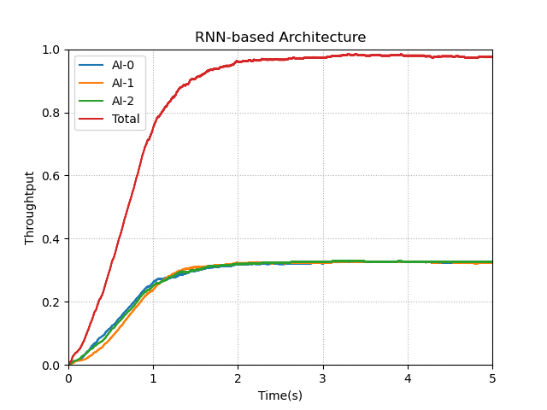
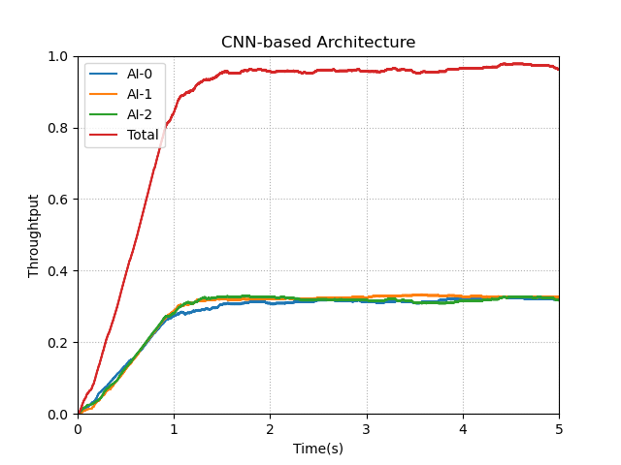
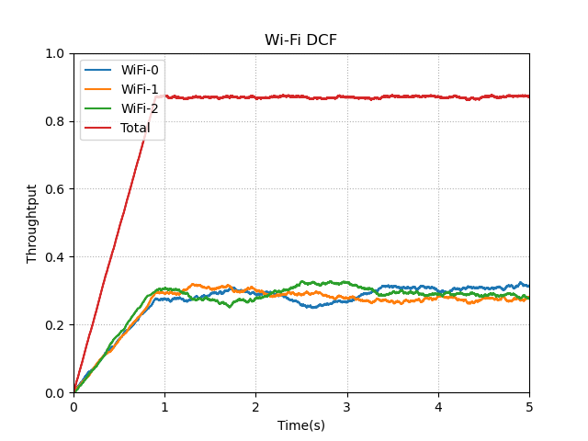
Overhead Reduction for Model Deployment
In [3], the NN model size used for DRL-based channel access is ~5KB, which is at the same level as the compressed beamforming report with BW=80MHz, Ntx=8, Nrx=2/4.
Our study showed that the NN model size can be further reduced by optimizing the NN model architecture:
  The RNN-based architecture in [3] is replaced with a CNN-based architecture.
  The simulation results show that similar performance can be achieved while reducing the NN model size to ~1KB.
RNN
CNN
Wi-Fi

Slide 7
Overhead Reduction for Model Deployment
For the model update frequency, it depends on several factors: scenario, AI use cases, training accuracy, hardware limitation.
  In office and home scenarios, the wireless environment is quasi-static. The model update frequency can be minutes, hours, or even days. Thus, the overhead of model deployment can be negligible.
  Some use cases do not need frequent model learning and update, such as channel assignment and compressed CSI feedback.
  Other aspects such as training method/accuracy and hardware limitation are highly dependent on vendor’s implementation.
We suggest NN model update frequency is not regulated by standard, and is left for vendor’s implementation.

Slide 8
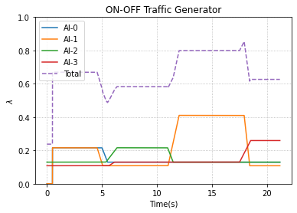
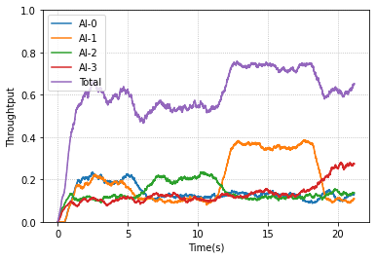
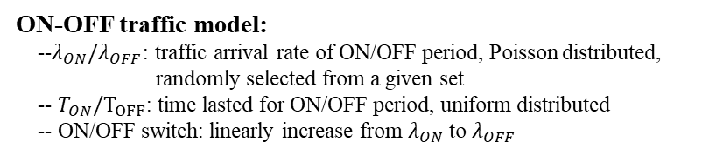




Overhead Reduction for Model Deployment
Our study showed that a well-trained NN model is able to adapt to dynamic traffic, and reduce the model update frequency.
An ON-OFF traffic model (similar to NS3 network simulator) is adopted to characterize dynamic environment and evaluate the NN model robustness/generalization.
NN model is trained in various traffic settings and tested in a random and dynamic setting (no further training in the testing phase).
$$T_{ON}$$
$$T_{OFF}$$
ON
OFF
ON
OFF
$$λ_{ON}∈\{λ_{ON}^{1},…,λ_{ON}^{N}\}$$
$$λ_{OFF}∈\{λ_{OFF}^{1},…,λ_{OFF}^{N}\}$$
ON-OFF traffic model:
--$λ_{ON}/λ_{OFF}$: traffic arrival rate of ON/OFF period, Poisson distributed, randomly selected from a given set
-- $T_{ON}/T_{OFF}$: time lasted for ON/OFF period, uniform distributed
-- ON/OFF switch: linearly increase from $λ_{ON}$ to $λ_{OFF}$
A snapshot of tested traffic
Real-time throughput without online training

Slide 9
Overhead Reduction for Model Deployment
From the perspective of algorithm design, more AI techniques can be investigated to improve NN model robustness/generalization, which further reduce the model update frequency, e.g.,
  data augmentation
  incremental learning
From the perspective of standardization, several aspects can be discussed on model deployment to reduce its overhead, e.g.,
  trigger time, when and what event to trigger model deployment
  transmission duration, limit the duration of the frame containing model parameters
  access category/priority for model deployment frame

Slide 10
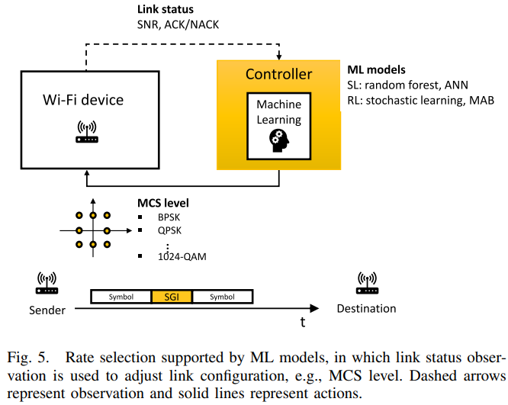
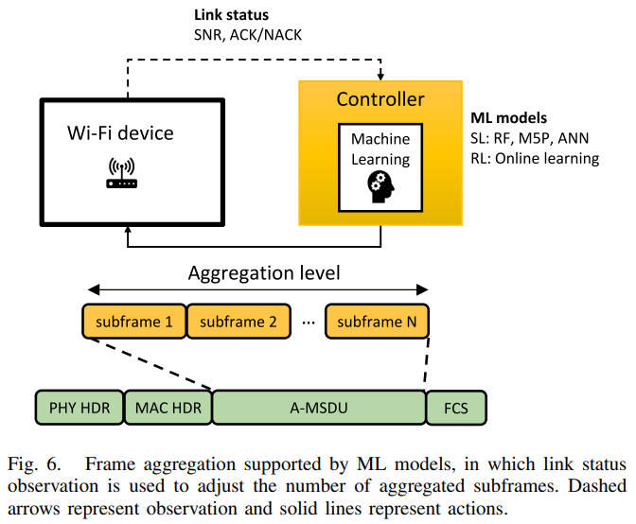
Explore Model Reuse
MAC layer features, such as channel access, rate adaptation, etc., have the same goal of improving channel efficiency.
The inputs of NN models are local radio measurements at PHY/MAC layer. Different features may adopt same input observations, e.g., AI-based rate selection and AI-based frame aggregation both adopt SNR and ACK as NN inputs [6].
Different features with same inputs
Model architecture and/or parameter reuse can be further studied to reduce implementation complexity and facilitate standardization.

Slide 11
Filter of AI’s Decision
Controlled decision is important when deploying AI in real-world WLAN use cases [4-5].
  Taking channel access as an example, we cannot promise that AI nodes will not "greedily" occupy the channel. A well-trained NN model can deliver good performance in most cases, but in extreme case, NN can make anomalous decisions.
One possible solution is to place a filter behind the AI decision to filter out abnormal decisions.
Taking channel access as an example, if the AI node "greedily" occupies the channel, it can be requested to defer for a period of time.
Moreover, to monitor and manage AI STA, we suggest to define new service/functionality in wireless network management (WNM) , e.g., NN model deployment management service, abnormal event report.
Standard Defined Rules
Decision Filter
Filtered Action
Historical observations
Neural Network (NN)
Action

Slide 12
Aspects of Standardization
NN Architecture
  Standardized basic components, such as DNN&CNN
NN model deployment
  Necessary signaling
  Flexible model size and model update frequency to support various use cases and implementations
  Trigger time, transmission duration, access priority
  New NN model deployment service/functionality in WNM
  Training data report
NN model operation and maintenance (O&M)
  Define rules to filter out abnormal decisions
  New service/functionality in WNM , e.g., abnormal event report

Slide 13
Summary
In this contribution, we discussed some general considerations for introducing neural network/deep (reinforcement) learning in WLAN, including overhead reduction for NN model deployment, exploration of model reuse, AI decision filter and aspects of standardization.

Slide 14
Reference
[1] 11-22-1519-00-0uhr-requirements-of-low-latency-in-uhr
[2] 11-22-1931-00-uhr-follow-up-on-latency-reduction-with-machine-learning-techniques
[3] 11-22-1942-00-aiml-follow-up-on-drl-based-channel-access
[4] V. Berggren, K. Dey, J. Jeong and B. Guldogan, “Bringing reinforcement learning solutions to action in telecom networks”, ERICSSON BLOG, Mar 2022, https://www.ericsson.com/en/blog/2022/3/reinforcement-learning-solutions
[5] D. Wu and J. Wang, “Empowering the Telecommunication System with Reinforcement Learning”, Samsung AI Center, Apr 2022, https://research.samsung.com/blog/Empowering_the_Telecommunication_System_with_Reinforcement_Learning
[6] S. Szott, K. Kosek-Szott, P. Gawłowicz, J. Torres Gómez, B. Bellalta, A. Zubow and F. Dressler, "Wi-Fi Meets ML: A Survey on Improving IEEE 802.11 Performance with Machine Learning," in IEEE Communications Surveys & Tutorials, doi: 10.1109/COMST.2022.3179242.

