Slide 1
New Use Case for Amp IoT Devices
Date: 2022-12-13
Authors:

Slide 2
Abstract
Following use cases have been previously discussed in meetings and the conference calls
Smart manufacturing
Data center
Smart home
Logistics and warehouse
Smart agriculture
Indoor positioning
Smart Grid
We propose a new use case:
Fresh Food Supply Chain

Slide 3
Fresh Food Supply Chain: Background
Problem Statement
  In the United States alone, food waste is estimated at between 30-40 percent of the food supply [2].
  This is a significant contribution to global carbon footprint.
  The FDA is taking a new approach to food safety, leveraging technology and other tools and approaches to create a safer and more digital, traceable food system [3].
  Nov22 FDA Announced the Final Rule for Food Traceability Under FSMA [4].
  It is known that controlled environment for most of the fresh foods, like vegetables or meat, is critical for both the safety of the food [3-4] as well its shelf life expectancy [5-6].

Slide 4
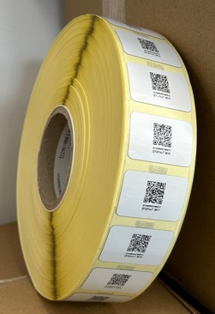
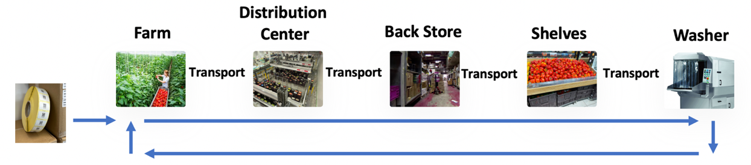
Fresh Food Supply Chain
  The fresh products are usually stored in RTIs (Reusable
  Transport Item). RTI are made from plastic or wood.
  The AMP stickers come as a reel and are attached to each RTI.
  The products are first loaded into the RTI at the farm or at a nearby post-harvesting facility.
  They are then transported, either nationally in tracks/trains or internationally
  in ships or airplanes, to the supplier distribution center (DC).
  From the DC, products are transported into the stores according to demand and
  supply, where they are first stored and then moved to the front shelves.
  After each use, the RTI are sent for recycling and then to the washer to be used again.
  The sensory data is stored in the cloud so the supplier’s applications can access it.

Slide 5
Example 1: Fresh Food Distribution Center (DC)
DC functions and targets
  DCs are required in order to control and optimize the food
  distribution to the stores.
  Example DC size ~30,000m2
  Example DC throughput ~50K RTIs per day
  Each product has its own storage requirements, demand
  and supply
Usage of the AMP sticker enables
  Control and route the RTIs going in, while inside and then
  out of the DC.
  Optimize the temperature x time per product

Slide 6
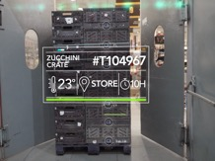
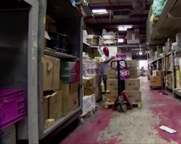
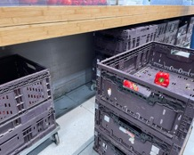
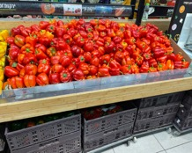
Example 2: Backstore and Shelves
From DC to the Backstore and into Shelves
  Products arrive to the backstore based on consumption estimations
  They are stored and then moved to the shelf once there is shortage
  Temperature monitoring keeps track that no product is wasted or stored out of fridge for too long.
Usage of Ambient IoT enables
  The products are controlled until they reach the customer. Each product route and condition can be seen in the cloud application which is used by the supplier.
  The location, temperature and occupancy of each RTI are monitored and adherence to FIFO/FEFO (First Expired First Out) is obtained.
  The store is connected to the supplier network, for real time supply optimization.

Slide 7

Fresh Food Supply Chain: Business Case
2021 Global food market is 11T$ [7], and the cold supply chain is
242B$ [8]
Customer benefits
  Full transparency over the end-to-end supply chain
  Actionable alerts to do with product (e.g. ripe bananas should go to shelf),
  workflow (e.g. Locate miss-routed RTI) and facility (e.g. monitor the cooling facility)
Each AMP sticker is ultra low cost (<10¢) in order to be cost effective and
attached to low cost things, like RTI and even single use cardboards
Data pricing on top of very low margins of HW is a promising new business model
The infrastructure that reads the stickers is based on 802.11 devices
  Cost effective deployments, significantly cheaper than infrastructure with RFID readers
  The 802.11 deployments are in-use for many other applications as well.
  Inherent IP connectivity efficiently and reliably transfers the sensor data to the supplier’s cloud application.

Slide 8
AMP Advatages for the Fresh Food Supply Chain Use Case
802.11 widespread adoption and eco-system
  Coverage and connectivity already exists at tracks, airplanes, most of the buildings and almost all handheld devices. Good coverage for the use case.
ISM radio bands used by 802.11
  Bands are largly harmonized, which keeps the ultra low price per AMP tag.
  Both S1G and higher bands can be used.
  802.11 provides good interference protection for this use case.
Ultra low cost and a sticker form factor
  Ambient power and RF harvesting significantly reduce the cost of the devices and allow them to run maintainance free
Use case requires infrequent access to sensors
  Once in 15 minutes is enough, and does not jam the network.

Slide 9
Fresh Food Supply Chain: KPIs and Gap Analysis
Range | Data Payload | Energy consumption per readout | Readout interval | Device Density | Other requirements
10-20 m | 100-256 bits | TBD | 15 minutes | ~250-500 devices per AP | Maintenance-free, ultra low cost, sticker form factor with low BOM
State-of-the-art solution | Issues for state-of-the-art solutions | Benefits of AMP IoT
RFID | 1. Manual scanning of RFID tags takes long time and requires manual work 2. Dedicated high cost/massive deployment of readers due to short communication distance. 3. Limited and predefined information types and sizes do not fit all sensors types. 4. No IP stack is defined. | 1. Lower density/cost effective deployments of APs provide wide coverage 2. Improved performance in terms of communication distance, sensitivity and system efficiency 3. Inherent, standardized and secured internet connectivity 4. Location services
802.11 existing | High energy consumption requires battery and maintenance High device cost prohibits sticker cost and form factor Massive numbers of AMP devices using existing connectivity and security protocols will jam the 802.11 network | Low total energy consumption through improved system efficiency for energy harvesting device. Ultra low cost Support for massive number of AMP devices in the network

Slide 10
References
  IEEE 802.11-22/0963r0, Use Cases for AMP IoT Devices.
  https://www.usda.gov/foodwaste/faqs
  https://www.fda.gov/food/new-era-smarter-food-safety#:~:text=Welcome%20to%20the%20New%20Era,reducing%20the%20number%20of%20illnesses
  https://www.fda.gov/food/food-safety-modernization-act-fsma/fsma-final-rule-requirements-additional-traceability-records-certain-foods
  Alam AU, Rathi P, Beshai H, Sarabha GK, Deen MJ. Fruit Quality Monitoring with Smart Packaging. Sensors (Basel). 2021 Feb 22;21(4):1509. doi: 10.3390/s21041509. PMID: 33671571; PMCID: PMC7926787.
  Taoukis, Petros & Nychas, George-John. (2000). Use of time-temperature integrators and predictive modeling for shelf life control of chilled fish under dynamic storage conditions. International journal of food microbiology. 53. 21-31. 10.1016/S0168-1605(99)00142-7.
  https://www.grandviewresearch.com/industry-analysis/food-grocery-retail-market
  https://www.grandviewresearch.com/industry-analysis/cold-chain-market

