Slide 1
mmWave Phase Feedback
Date: 2023-03-13
Authors:
Name | Affiliation | Address | Phone | Email
Kevin Tsunghan Tsai | Mediatek Inc | 2840 Junction Ave, San Jose, CA 95134, USA |  | kevin.tsai@mediatek.com
Dennis Liu |  |  |  | dennis.liu@mediatek.com
Shuling (Julia) Feng |  |  |  | julia.feng@mediatek.com

Slide 2






Introduction
Vital sign det. includes breathing rate and heart rate detection and can be used in many health applications
Vital sign is one of 11BF use cases [1]
  Health case - remote diagnostics measurements
  of breathing rate, heart rate etc.
AP: Initiator
feedback
feedback
feedback
STA1
STA2
STA3
detection
detection
detection

Slide 3
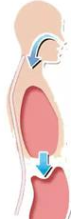












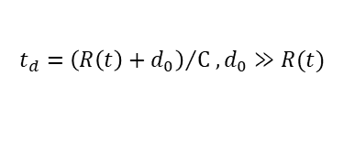
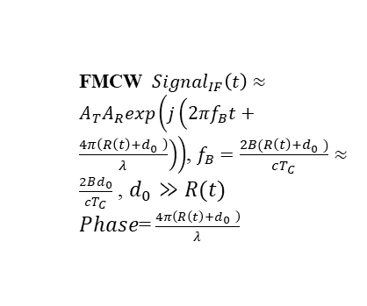





Vital Signs Detection by Phase
Chest up and down is a small distance variation
  Small distance variations cause signal traveling different distances and result in phase variations at target bin
  Hence, we propose to add target bin phase as a report type for vital sign detection
Distance
exhale
$$distance=R\left(t\right)+d_{0}$$
$$d_{0}$$
$$∆_{d}$$
$$Δθ$$
inhale
$$t_{d}={\left(R\left(t\right)+d_{0}\right)}/{C ,d_{0}≫R(t)}$$
time
Freq
$$t_{d}$$
$$t_{d}$$
$$t_{d}$$
$$t_{d}$$
TX chirp
RX chirp
FMCW
time
Find the variation period of target bin can get breathing rate
  FMCW ${Signal}_{IF}\left(t\right)≈$ $A_{T}A_{R}exp\left(j\left(2πf_{B}t+\frac{4π\left(R\left(t\right)+d_{0} \right)}{λ}\right)\right)$, $f_{B}=\frac{2B(R\left(t\right)+d_{0} )}{cT_{C}}≈$ $\frac{2Bd_{0}}{cT_{C}}$ , $d_{0}≫R(t)$
  $Phase$= $\frac{4π\left(R\left(t\right)+d_{0} \right)}{λ}$
frame0
frame1
frame2
frame3
Phase of $f_{B}$ bin
Mag.
Phase= $\frac{4π\left(d_{0}+∆_{d}\right)}{λ}$
Mag.
Mag.
Mag.
exhale
Phase= $\frac{4π\left(d_{0}\right)}{λ}$
Phase= $\frac{4π\left(d_{0}−∆_{d}\right)}{λ}$
Phase= $\frac{4π\left(d_{0}\right)}{λ}$
$$θ_{0}$$
$$∆_{θ}$$
velocity
velocity
velocity
velocity
inhale
$θ_{0}$= $\frac{4π\left(d_{0}\right)}{λ}$,$∆_{θ}$= $\frac{4π\left(∆_{d}\right)}{λ}$
$$f_{B}$$
Range
$$f_{B}$$
Range
$$f_{B}$$
Range
$$f_{B}$$
Range
time

Slide 4
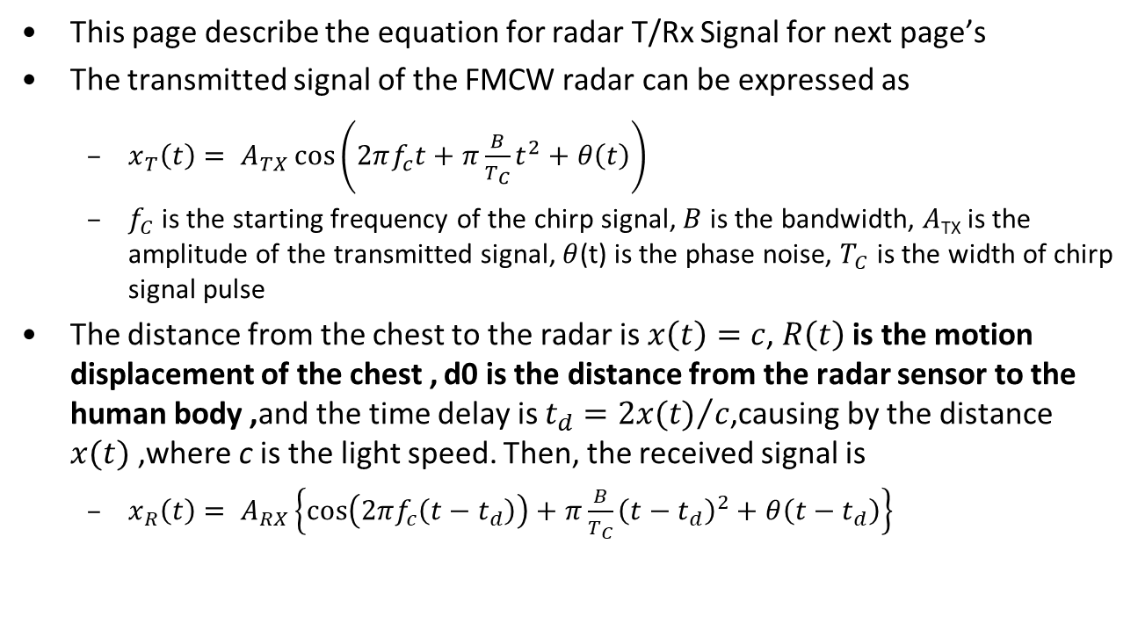
Vital Signs Detection by Phase[2]
This page describe the equation for radar T/Rx Signal for next page’s
The transmitted signal of the FMCW radar can be expressed as
  $x_{T}\left(t\right)= A_{TX}\cos\left(2πf_{c}t+π\frac{B}{T_{C}}t^{2}+θ\left(t\right)\right)$
  $f_{C}$ is the starting frequency of the chirp signal, $B$ is the bandwidth, $A$_{TX} is the amplitude of the transmitted signal, $θ$(t) is the phase noise, $T_{C}$ is the width of chirp signal pulse
The distance from the chest to the radar is $x\left(t\right)=c$, $R\left(t\right)$is the motion displacement of the chest , d0 is the distance from the radar sensor to the human body ,and the time delay is $t_{d}={2x(t)}/c$,causing by the distance $x(t)$,where c is the light speed. Then, the received signal is
  $x_{R}\left(t\right)= A_{RX}\left\{\cos\left(2πf_{c}\left(t−t_{d}\right)\right)+π\frac{B}{T_{C}}{\left(t−t_{d}\right)}^{2}+θ\left(t−t_{d}\right)\right\}$

Slide 5
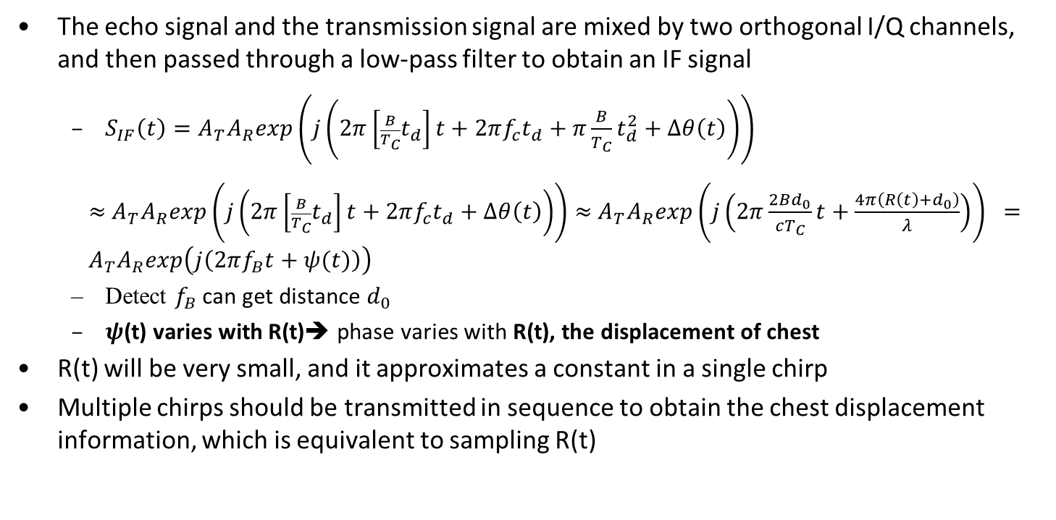
Vital Signs Detection by Phase[2]
The echo signal and the transmission signal are mixed by two orthogonal I/Q channels, and then passed through a low-pass filter to obtain an IF signal
  $S_{IF}\left(t\right)=A_{T}A_{R}exp\left(j\left(2π\left[{\frac{B}{T_{C}}t}_{d}\right]t+2πf_{c}t_{d}+π\frac{B}{T_{C}}t_{d}^{2}+Δθ\left(t\right)\right)\right)$
  $≈$ $A_{T}A_{R}exp\left(j\left(2π\left[{\frac{B}{T_{C}}t}_{d}\right]t+2πf_{c}t_{d}+Δθ\left(t\right)\right)\right)$ $≈$ $A_{T}A_{R}exp\left(j\left(2π\frac{2Bd_{0}}{cT_{C}}t+\frac{4π\left({R\left(t\right)+d}_{0}\right)}{λ}\right)\right) ={ A}_{T}A_{R}exp\left(j\left(2πf_{B}t+ψ(t)\right)\right)$
  Detect $f_{B}$ can get distance $d_{0}$
  $ψ$(t) varies with R(t)➔ phase varies with R(t), the displacement of chest
R(t) will be very small, and it approximates a constant in a single chirp
Multiple chirps should be transmitted in sequence to obtain the chest displacement information, which is equivalent to sampling R(t)

Slide 6
Vital Signs Detection by Phase[2]
Breathing Detection test
  Using phase variation to calculate breathing rate
Breathing rate~=17 per min
FFT

Slide 7









Breathing rate detection by doppler?
Breathing rate is 0.1-0.6 Hz (6-36 times per minute) [3][4]
Chest displacement due to respiration between 0.004 and 0.012m[3]
Assume it need resolution 0.004m/sec to detect respiration rate
If we use 40us chirp and 1ms interval per chirp,
  V_{res}=λ/2Tf=C/Fc/2Tf=3e8/60e9/(2*1e-3*1024)=0.0024m/s
  V_{max}=λ/4Tc=C/Fc/4Tc=3e8/60e9/(4*1e-3)=1.25m/s
It need 1.024 sec to get a measurement for such high resolution , it can only detect rate< 0.5Hz (Breathing rate is 0.1-0.6 Hz )
$$0.004m$$
inhale
$$chest$$
$$displacement$$
$$0$$
1
2
3
4
time (sec)
$$X=A×\sin\left(2πft\right)$$
-$0.004m$
exhale
$$0.004m/s$$
inhale
$$verlocity$$
$$0$$
1
2
3
4
time (sec)
$$V=\frac{dX}{dx}=A×\cos\left(2πft\right)$$
-$0.004m/s$
exhale
Example for respiration rate 0.25Hz

Slide 8









Heart rate detection by doppler?
Heart rate is 0.8–3 Hz(60 to 180 times per min)[3][4]
Chest displacement due to Heart rate alone ranges between 0.0002 and 0.0005 m[3]
Assume it need resolution 0.0002m/sec to detect heart rate
If we use 40us chirp and 1ms interval per chirp,
V_{res}=λ/2Tf=C/Fc/2Tf
=3e8/60e9/(2*1e-3*16384)=0.00015m/s
V_{max}=λ/4Tc=C/Fc/4Tc=1.25m/s
➔It need 16.384 sec to get a measurement for such high resolution ,so it’s impossible to be used to detect a 0.8~3Hz signal (Heart rate )
➔Using phase to detect heartbeat don’t need such high velocity resolution, hence it can detect higher freq. signal
$$0.0002m$$
$$chest$$
$$displacement$$
$$0$$
1/4
2/4
3/4
1
time (sec)
$$X=A×\sin\left(2πft\right)$$
$$−0.0002m$$
exhale
$$0.0002m/s$$
inhale
$$verlocity$$
$$0$$
1/4
2/4
3/4
1
time (sec)
$$V=\frac{dX}{dx}=A×\cos\left(2πft\right)$$
-$0.0002m/s$
Example for Heartbeat 1Hz

Slide 9
Summary
Vital sign detection is one of 11BF use cases
  Need range bin phase to detect vital sign
Propose to add phase report in (E)DMG report elements for vital sign detection
  Add phase report in image report or target report

Slide 10
Signaling
During sensing measurement setup, let responder know the need of phase feedback
  Add option 7 and 8 for reporting both power and phase
  Avoid confusion ,add wording “Power” for original option 2~6
  Table 9-401v—Report Type subfield definition
Value | Description
0 | No report
1 | CSI
2 | DMG Sensing Image Direction Power
3 | DMG Sensing Image Range-Doppler Power
4 | DMG Sensing Image Range-Direction Power
5 | DMG Sensing Image Doppler-Direction Power
6 | DMG Sensing Image Range-Doppler Direction Power
7 | DMG Sensing Image Direction Power and Phase
8 | DMG Sensing Image Range-Direction Power and Phase
9 | Target
10-255 | Reserved
Value | Description

Slide 11
Phase Report for Vital Sign Detection
An indicator for phase report
    Figure 9-1002cc—DMG Sensing Image Report Data element format
Subelement ID | Length | Data Block SN | Axis Present | Reflection Power Bias | Reflection Power Slope
Octets: 1 1 1 1 1 1
Number of Reflection Subelements | Reflection Subelements | Reserved
Octets: 3 variable variable
    Figure 9-1002cd—Axis Present field format
B0 B1 B2 B3 B4 B5 B7
Range Axis Present | Doppler Axis Present | Receiver Beam Index Present | Transmitter Beam Index Present | Reflection Phase Present | Reserved
Bits: 1 1 1 1 1 3

Slide 12
Phase Report for Vital Sign Detection
Axis #1 | Axis #2 | Reflection Power | Reflection Phase
Bits: S1 S2 12 12
Figure 9-1002ce—Reflection subelement format for 2 axes
Axis #1 | Axis #2 | Axis #3 | Reflection Power | Reflection Phase
Bits: S1 S2 S3 12 12
Figure 9-1002cf—Reflection subelement format for 3 axes
Axis #1 | Axis #2 | Axis #3 | Axis #4 | Reflection Power
Bits: S1 S2 S3 S4 12
Figure 9-1002cg—Reflection subelement format for 4 axes

Slide 13
SP1
Do you agree to add the following to 11bf SFD:
  The 11bf amendment shall add an option to report phase in image report
    Y
    N
    Abstain

Slide 14
SP2
Do you agree to add the following to 11bf SFD:
  Add two more options in Table 9-401v—Report Type subfield definition
    Option 7 :DMG Sensing Image Direction Power and Phase
    Option 8 :DMG Sensing Image Range-Direction Power and Phase
    Add wording “Power” in option 2~6
  Y
  N
  Abstain
  Table 9-401v—Report Type subfield definition
Value | Description
0 | No report
1 | CSI
2 | DMG Sensing Image Direction Power
3 | DMG Sensing Image Range-Doppler Power
4 | DMG Sensing Image Range-Direction Power
5 | DMG Sensing Image Doppler-Direction Power
6 | DMG Sensing Image Range-Doppler Direction Power
7 | DMG Sensing Image Direction Power and Phase
8 | DMG Sensing Image Range-Direction Power and Phase
9 | Target
10-255 | Reserved
Value | Description

Slide 15
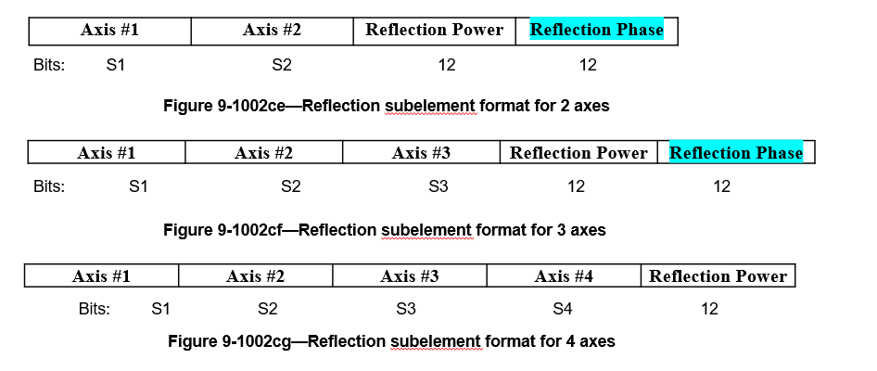
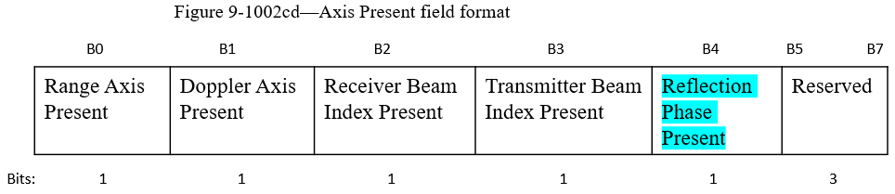
SP3
Do you agree to add the following to 11bf SFD:
  Use B4 in Axis Present field format to indicate Reflection Phase is presented or not
  Add one option field “Reflection Phase” in Reflection subelement format for 2 axes and 3 axes, the number of bits is 12bits
    Y
    N
    Abstain

Slide 16
Reference
[1] 11-20-1712-01-00bf-wifi-sensing-use-cases
[2] Y. Wang, W. Wang, Mu Zhou, A. Ren, Z. Tian, “Remote Monitoring of Human Vital Signs Based on 77-GHz mm-Wave FMCW Radar”, Sensors, 2020
[3] D. Obeid, S. Sadek, G. Zaharia, and G.E. Zein,”Doppler radar for heartbeat rate and heart rate variability extraction”, E-Health and Bioengineering Conference (EHB), 2011
[4] M. Alizadeh, G. Shaker, J. C. M. De Almeida, P. P. Morita and S. Safavi-Naeini, "Remote monitoring of human vital signs using mm-wave fmcw radar", IEEE Access, 2019.
[5] IEEE 802.11BF D1.0

