Slide 1
Follow-up on DRL-based Channel Access
Date: 2022-11
Authors:

Slide 2
Abstract
In this contribution, we have a follow-up discussion on DRL-based channel access [1] and address the questions received.
  Discuss on RTS/CTS
  Highlight fairness/coexistence issue
  Discuss on model update frequency and overhead

Slide 3
Summary of Questions on [1]
Q1: Performance gain over DCF with RTS/CTS is applied
  -- DRL-based channel access outperforms DCF with and without RTC/CTS.
  -- RTS/CTS may reduce MAC efficiency when the packet length is not large enough.
  -- DRL-based channel access can also use RTS/CTS mechanism to solve hidden node problem.
Q2: Coexistence with legacy devices
  -- Different fairness metrics are used to study coexistence problem in literature.
  -- DRL-based channel access can fairly coexist with legacy devices.
  -- Legacy STAs may benefit from reduced collisions.
Q3: Update frequency and overhead of NN Model
  -- Pre-stored NN models can help reduce the model training and update frequency.
  -- With well-designed algorithm, NN model can adapt to the traffic load changes without parameter update.
  -- The overhead of NN model deployment is at the same level as the compressed beamforming report.

Slide 4
RTS/CTS Discussion
DRL-based channel access outperforms DCF with and without RTC/CTS.
RTS/CTS may reduce MAC efficiency when the packet length is not large enough (< 7000 Bytes).
DRL-based channel access can also use RTS/CTS mechanism to solve hidden node problem.
7000 Bytes
Number of contending STA = 5
Simulation settings: no hidden node, CWmin=32, CWmax = 1024, RTS/CTS MCS = 2 (24 Mbps), Data MCS = 5 (65 Mbps)

Slide 5
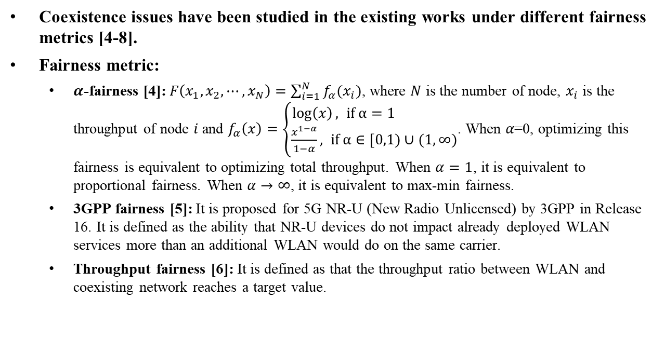
Coexistence Discussion
Coexistence issues have been studied in the existing works under different fairness metrics [4-8].
Fairness metric:
  $α$-fairness [4]: $F\left(x_{1},x_{2}, ⋯,x_{N}\right)=\sum_{i=1}^{N}{f_{α}(x_{i})}$, where $N$ is the number of node, $x_{i}$ is the throughput of node $i$and $f_{α}\left(x\right)=\left\{\begin{aligned}\log\left(x\right), if α=1 \\ \frac{x^{1−α}}{1−α}, if α∈[0,1)∪(1,∞)\end{aligned}\right.$. When 𝛼=0, optimizing this fairness is equivalent to optimizing total throughput. When $α=1$, it is equivalent to proportional fairness. When $α→∞$, it is equivalent to max-min fairness.
  3GPP fairness [5]: It is proposed for 5G NR-U (New Radio Unlicensed) by 3GPP in Release 16. It is defined as the ability that NR-U devices do not impact already deployed WLAN services more than an additional WLAN would do on the same carrier.
  Throughput fairness [6]: It is defined as that the throughput ratio between WLAN and coexisting network reaches a target value.

Slide 6
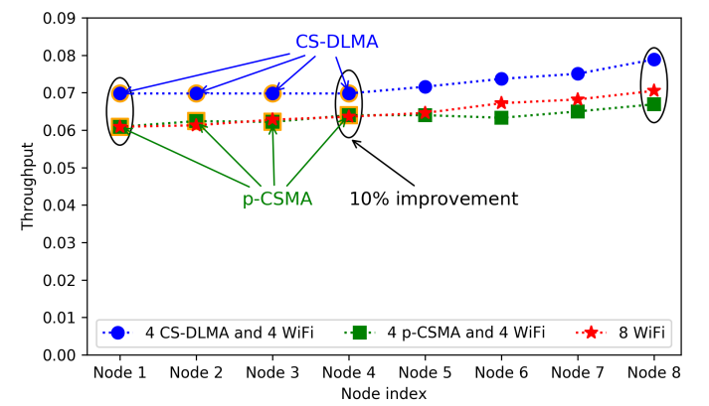
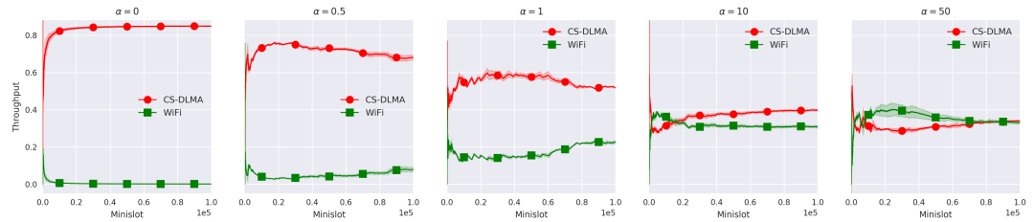

Coexistence Performance
$α$-fairness is used as an optimization objective in [7].
The proposed DRL-based channel access (CS-DLMA) is able to fairly coexist with Wi-Fi under different $α$ values.
The individual throughput of WLAN nodes and the overall network throughput become better when introducing AI nodes.

Slide 7
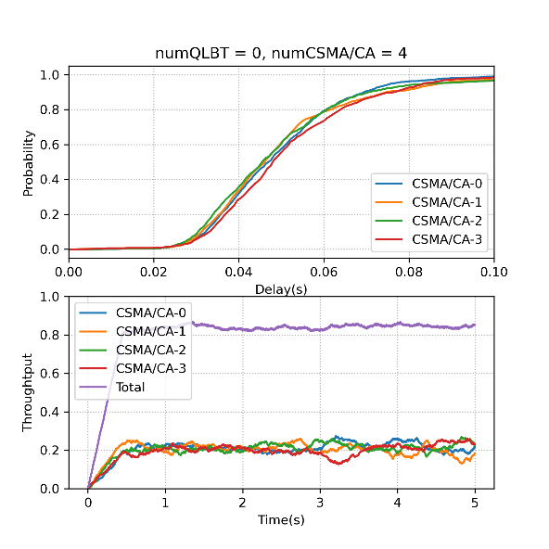
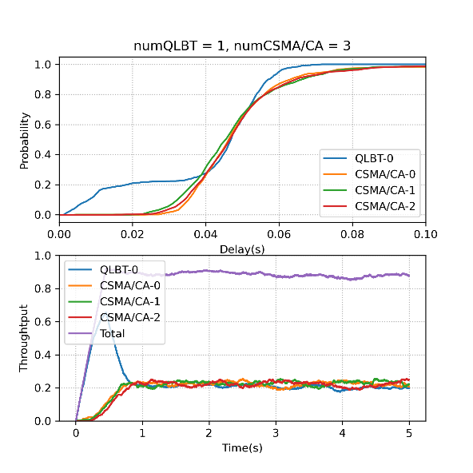
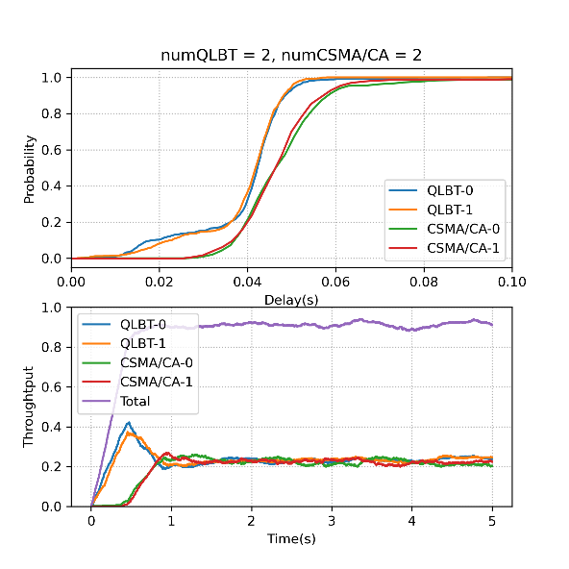
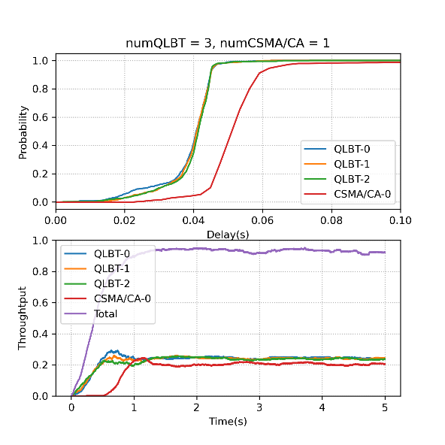
Coexistence Performance
3GPP fairness is adopted as a fairness metric in [8].
The proposed DRL-based channel access (QLBT) is shown to be able to guarantee 3GPP fairness, i.e., the performance of the remaining WLAN nodes will not be degraded when some nodes in the network are replaced with AI nodes.
Latency of legacy STAs and overall network throughput are improved in coexistence scenarios.

Slide 8
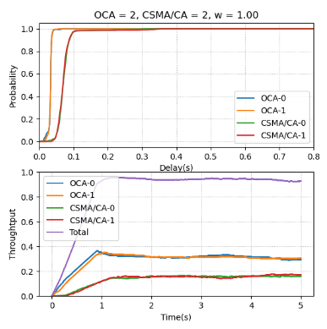
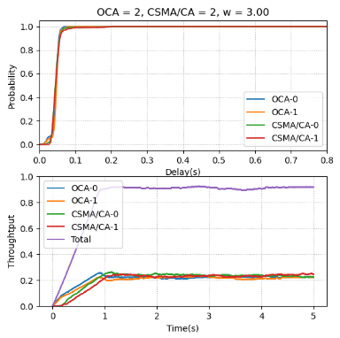
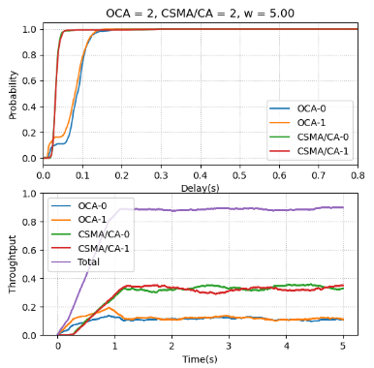
Coexistence Performance
Our initial study shows that DRL-based channel access scheme is feasible to coexist with WLAN at any throughput ratio.
DRL > WLAN
DRL = WLAN
DRL < WLAN

Slide 9
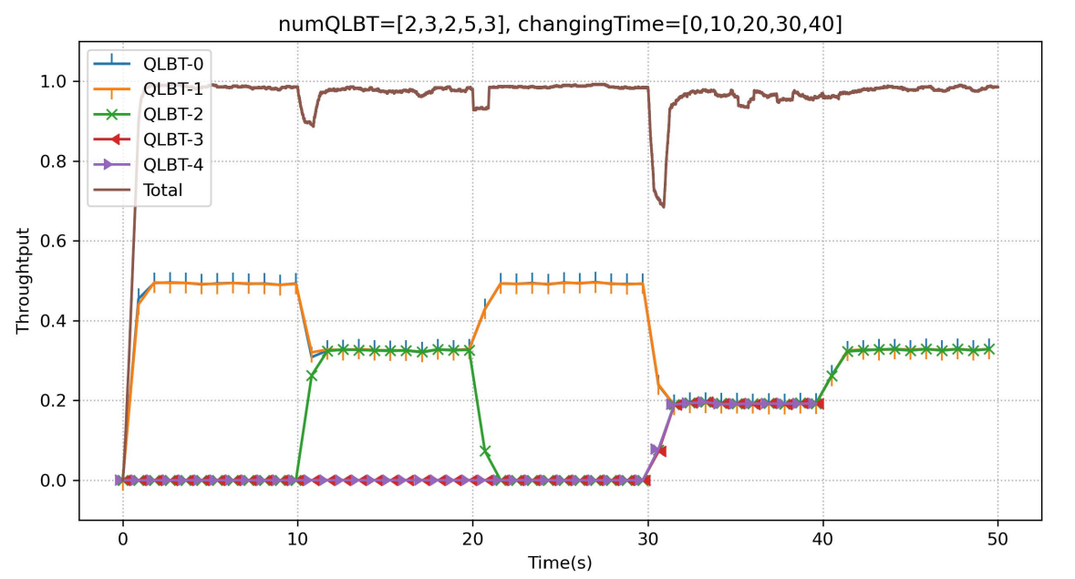
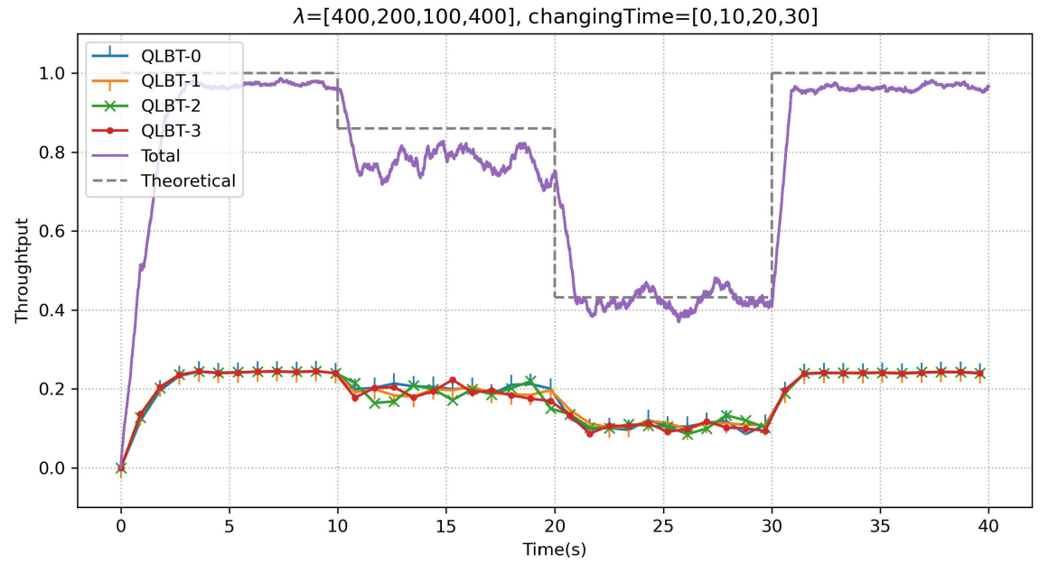
Model Update Frequency
NN model may need to be trained and updated frequently in dynamic environment. Our study provides possible solutions to this problem [8].
Dynamic network size and dynamic traffic load are considered.
When the number of associated station changes, switching to a pre-stored NN model helps the proposed DRL-based channel access maintain good performance without any training.
When the traffic load changes, the proposed method can still have good performance without any model update.

Slide 10
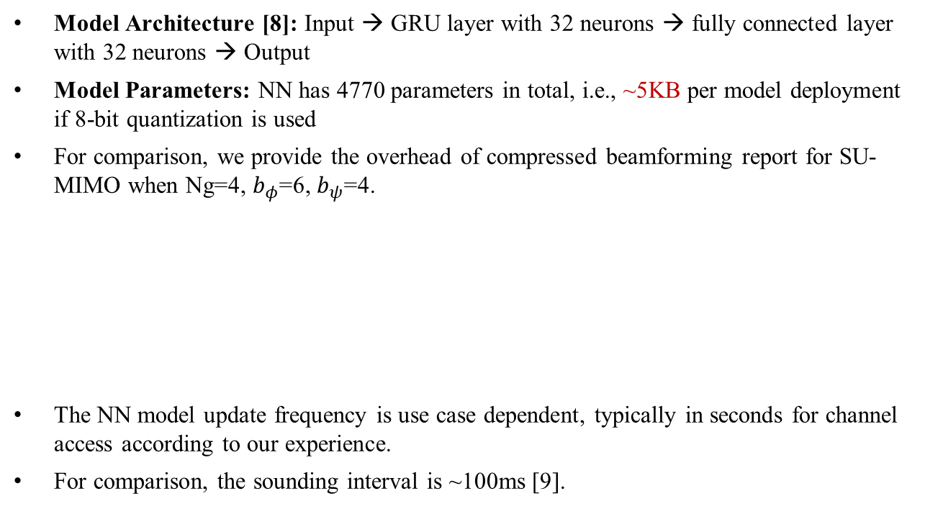
Model Update Overhead
Model Architecture [8]: Input → GRU layer with 32 neurons → fully connected layer with 32 neurons → Output
Model Parameters: NN has 4770 parameters in total, i.e., ~5KB per model deployment if 8-bit quantization is used
For comparison, we provide the overhead of compressed beamforming report for SU-MIMO when Ng=4, $b_{φ}$=6, $b_{ψ}$=4.
The NN model update frequency is use case dependent, typically in seconds for channel access according to our experience.
For comparison, the sounding interval is ~100ms [9].
BW(MHz) | Ntx | Nrx | Overhead (KB)
80 | 8 | 2 | 4.06
80 | 8 | 4 | 6.88
160 | 8 | 2 | 8.13
160 | 8 | 4 | 13.75

Slide 11
Summary
Discussed AI-based channel access as one potential use case.
Studied related topics on RTS/CTS performance, fairness/coexistence issue and model update overhead.

Slide 12
References
[1] 11-22-1522-00-aiml-drl-based-channel-access
[2] 11-14-0546-IEEE-802.11ax-High-Efficiency-WLAN-Packet-measurement-around-Boulder-CO
[3] Y. Yin, Y. Gao, S. Manzoor and X. Hei, "Optimal RTS Threshold for IEEE 802.11 WLANs: Basic or RTS/CTS?," 2019 IEEE SmartWorld, Ubiquitous Intelligence & Computing, Advanced & Trusted Computing, Scalable Computing & Communications, Cloud & Big Data Computing, Internet of People and Smart City Innovation, 2019, pp. 1620-1625, doi: 10.1109/SmartWorld-UIC-ATC-SCALCOM-IOP-SCI.2019.00289.
[4] J. Mo and J. Walrand, " Fair end-to-end window-based congestion control," IEEE/ACM Transactions on Networking (ToN), vol. 8, no. 5, pp. 556–567, 2000
[5] 3GPP, "Study on NR-based access to unlicensed spectrum; study on NR-based access to unlicensed spectrum (Release 16)," 3rd Generation Partnership Project (3GPP), Tech. Rep. 38.889, Dec. 2018, V16.0.0.
[6] X. Sun and D. Lin,"Towards Fair and Efficient Spectrum Sharing Between LTE and WiFi in Unlicensed Bands: Fairness-Constrained Throughput Maximization," IEEE Transactions on Wireless Communications, vol. 19, no. 4, pp. 2713-2727, 2022
[7] Y. Yu, S. C. Liew and T. Wang, "Non-Uniform Time-Step Deep Q-Network for Carrier-Sense Multiple Access in Heterogeneous Wireless Networks," in IEEE Transactions on Mobile Computing, vol. 20, no. 9, pp. 2848-2861, 1 Sept. 2021, doi: 10.1109/TMC.2020.2990399.
[8] Z. Guo, et al. "Multi-agent reinforcement learning-based distributed channel access for next generation wireless networks." IEEE Journal on Selected Areas in Communications vol. 40, no. 5, pp. 1587-1599, 2022
[9] G. Redieteab, et al. "PHY+MAC channel sounding interval analysis for IEEE 802.11ac MU-MIMO." 2012 International Symposium on Wireless Communication Systems (ISWCS), DOI: 10.1109/ISWCS.2012.6328529
Notes:
On the Fairness of Wi-Fi and LTE-LAA Coexistence, https://www.andrew.cmu.edu/user/antonior/files/report-overhead.pdf
PHY+MAC Channel Sounding Interval Analysis for IEEE 802.11ac MU-MIMO, https://ieeexplore.ieee.org/stamp/stamp.jsp?tp=&arnumber=6328529
[10] R. Yin et al., “Distributed Spectrum and Power Allocation for D2D-U Networks: a Scheme Based on NN and Federated Learning”，Mobile Networks and Applications (2021) 26:2000–2013

