Slide 1
Roaming handoff time reduction to improve user experience
Date: 2022-xx-xx
Authors:

Slide 2
Abstract
Introduction
Observation
Some suggestions
Conclusion

Slide 3
Introduction
With the rise of mobile working, video and voice conferencing are widely used.
IEEE 802.11k/v/r greatly reduce the detection and authentication time of WiFi roaming; IEEE 802.11e QoS reduces the transmission latency of audio and video packets. However, up to now, the actual WiFi roaming handoff process still makes users feel video and call interruptions.
Although these interruptions of application layer are closely related to cache, codec, traffic prediction algorithm; on the other hand, if Wi-Fi can further reduce the service interruption time of roaming handoff or provide a relatively reliable prediction of interruption time, it is believed that the user-level experience will be greatly improved.

Slide 4


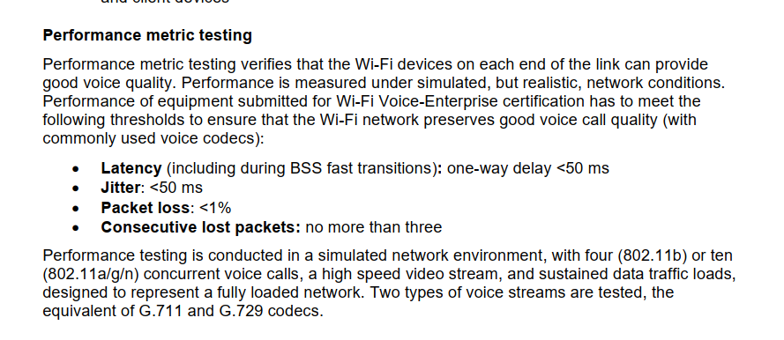
Introduction
The latency requirement for the overall end-to-end chain in VR is commonly targeted at 20 ms However, in AR the requirement is even stricter. Some sources identify the limit for a perfect AR experience at 5 ms--------《 Cloud AR/VR Whitepaper》
The Wi-Fi Alliance provides “Voice-Enterprise” certification, aimed at voice over Wi-Fi application. The Latency threshold is below 50 ms.

Slide 5
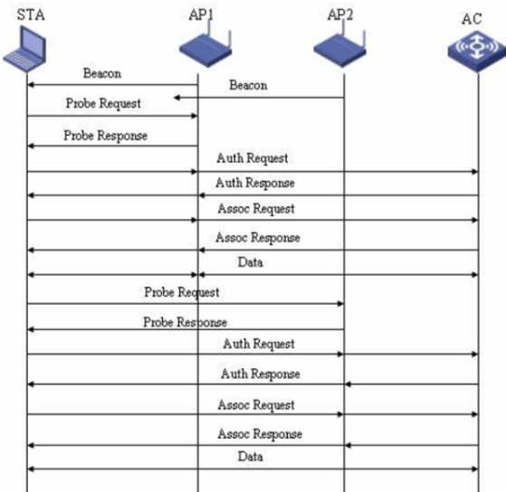
Observations
L2 layer roaming test
The test is performed in the roaming handoff system in the shield box. The actual service interruption time during roaming is tested by sending data packets at an interval of 10ms.

Slide 6
Observations
Stage | Time Phasing | Stage description | Average time consumption in each stage Unit: ms | Time consuming in stages Unit: ms | Dominant role
Pre-roaming | T0-T1 | STAs meet roaming threshold or receive bss transition management(BTM)request, and prepare to send probe request. | 3.5 | 47 | STA
 | T1-T2 | STAs get into PS status, change to different channels and send probe request | 25 |  | STA+AP
 | T2-T3 | STAs receive probe response or not, back to working channel , quit PS status and response to BTM | 5 |  | STA
 | T3-T4 | STAs decide to roam, refresh state machine,prepare to get into PS mode | 1 |  | STA
 | T4-T5 | In working channel, STAs get into PS mode In new channel, STAs send Auth request to a new AP | 12.5 |  | STA
Roaming | T5-T6 | The new AP response to theAuth | 1 | 32.5(10.5) | AP
 | T6-T7 | STAs send Reassoc Req | 5.5 |  | STA
 | T7-T8 | AP reponses to the Reasso Rsp | 4 |  | AP
 | T8-T9 | 4 way handshake of WPA2/PSK | 22 0 if 802.11r |  | AP+STA
Post-roaming | T9-T10 | STAs quit PS mode | 5 | 23 | STA
 | T10-T11 | STAs start to send /answer packets | 15 |  | STA+AP
 | T11-T12 | STAs complete to send the packets that buffer before roaming | 3 |  | STA+AP
The roaming process could be divided into three stages: pre-roaming, roaming and post-roaming.
After testing, we observed that packet loss or delay during roaming handoff occurred in either phase.
It is observed that although it is generally believed that the average time of roaming handoff (time between Auth~4WAY handshake) is only 32.5ms. (if implement fast bss transition(802.11r), the time could reduce to 10.5 ms .)
However, if it is added these delay below
1.packets are cached in advance due to the cross-channel probe of the terminal before roaming;
2. The waiting time between the terminal entering power saving and issuing Auth;
3. After completing the reassoc and stating to send packets.
In the worst case, even if it impements fast bss transition, it would cost average 80.5 ms for roaming handoff. Obviously, it’s not enough for most vowifi application, let alone AR/VR

Slide 7
Some suggestions
The state machine transition of the terminal /AP in the Handoff process is time-consuming
The station empties the cache more aggressively before roaming
Links are quickly recovered after roaming, and the wireless rate adjustment and aggregation process are accelerated

Slide 8
Conclusion
Low latency is one important KPI for future wireless networks, according to 4K/AR/VR applications.
Current handoff time of roaming between two APs does not meet the application aoove requirements.

Slide 9
References
11-18/1231r4, “EHT Draft Proposed PAR”
11-22/0708r3, “Beyond be Next Step”
Wi-Fi CERTIFIED Voice-Enterprise:https://www.wi-fi.org/discover-wi-fi/wi-fi-certified-voice-enterprise
Cloud AR/VR Whitepaper:https://www.gsma.com/futurenetworks/wiki/cloud-ar-vr-whitepaper/#_ftn9

