Slide 1
CSD Configuration for Sensing
Date: 2022-10-06
Authors:
Name | Affiliations | email
Qinghua Li | Intel | Qinghua.li@intel.com
Cheng Chen |  | Cheng.chen@intel.com
Hao Song |  | Hao.song@intel.com
Dibakar Das
Juan Fang
Robert Stacey

Slide 2
Outline
CSD Recap
Problem statement
Proposed solution
Summary

Slide 3
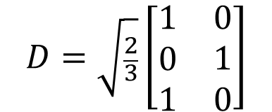

CSD Recap (1/3)
Two types of CSD, per-antenna and per-stream
D
Per-antenna CSD 1
Per-stream CSD 1
Per-antenna CSD 2
Per-stream CSD 2
Per-antenna CSD 3
$$D=\sqrt{\frac{2}{3}}\left[\begin{matrix}\begin{matrix}1 \\ 0 \\ 1\end{matrix} & \begin{matrix}0 \\ 1 \\ 0\end{matrix}\end{matrix}\right]$$
$$Q_{k}=M_{CSD}(k)·D$$
Per-antenna

Slide 4
CSD Recap (2/3)
Single stream transmission with only per-antenna CSD
Per-antenna CSD 1
Per-antenna CSD 2
Per-antenna CSD 3

Slide 5
CSD Recap (3/3)
Per-stream CSD values are specified in the spec
Per-antenna CSD values are specified for single stream transmission, but they are up to implementation for multi-stream transmission in which case Rx doesn’t know the CSD values applied at Tx as specified in
19.3.11.11.2 Spatial mapping

Slide 6
Problem Statement
Per-antenna CSD causes the overlapping of two sets of multipaths such that the path of interest can be interfered by overlapping paths
Rx can’t tell whether a detected path was delayed or not such that the sense of distance may be wrong
Wrong sense of multipath spread
Path covered by overlapping

Slide 7
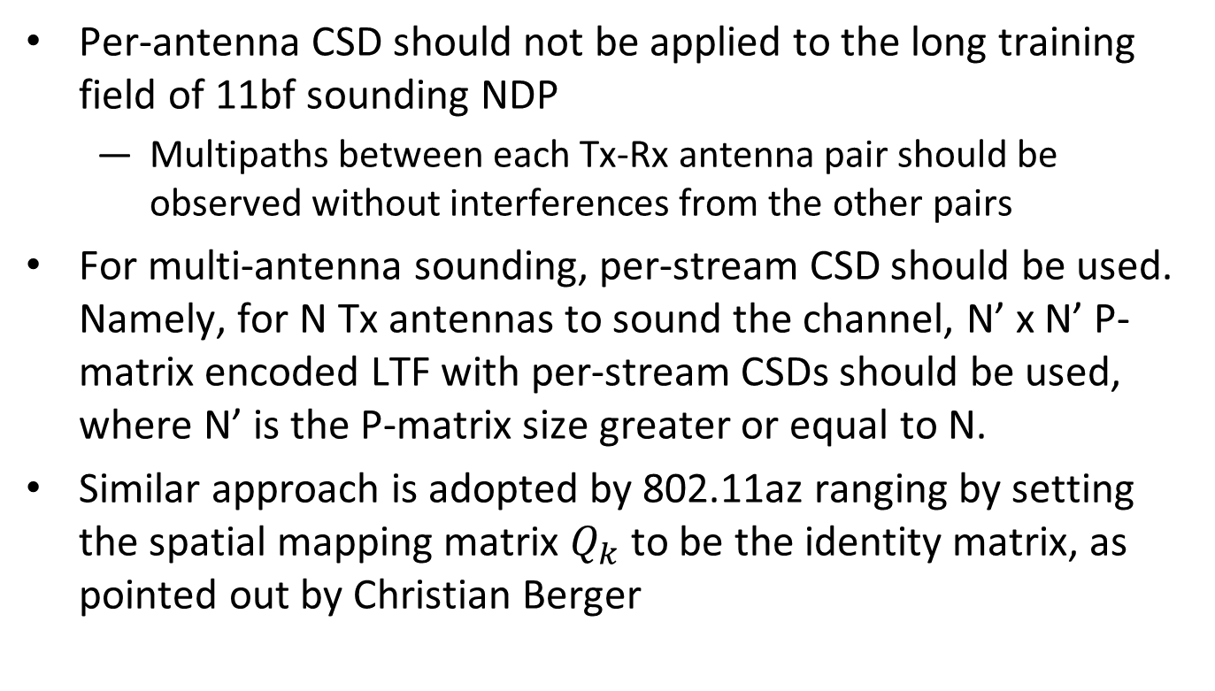
Proposed Solution
Per-antenna CSD should not be applied to the long training field of 11bf sounding NDP
  Multipaths between each Tx-Rx antenna pair should be observed without interferences from the other pairs
For multi-antenna sounding, per-stream CSD should be used. Namely, for N Tx antennas to sound the channel, N’ x N’ P-matrix encoded LTF with per-stream CSDs should be used, where N’ is the P-matrix size greater or equal to N.
Similar approach is adopted by 802.11az ranging by setting the spatial mapping matrix $Q_{k}$ to be the identity matrix, as pointed out by Christian Berger

Slide 8
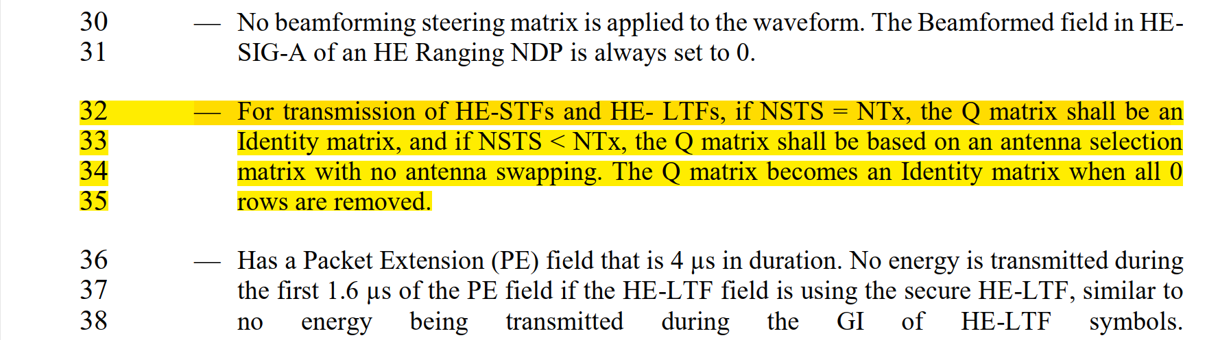
CSD of 11az Ranging NDP
27.3.18a.1 HE Ranging NDP

Slide 9
Conclusions
Per-antenna CSD causes the overlapping and shift of multipath that degrade the detection of the interested path or the sense of distance
For 11bf multi-antenna sensing, only per-stream CSD should be used, which is similar to 11az

Slide 10
Straw Poll 1
Do you support that per-antenna CSD shall not be used in the sounding LTF of sensing NDP?
Y/N/A

Slide 11
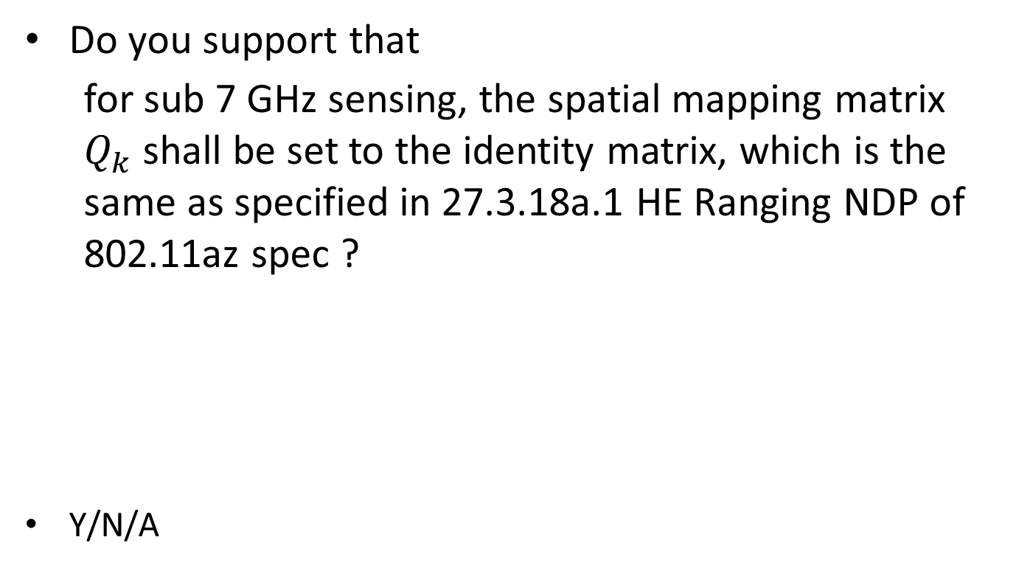
Straw Poll 2
Do you support that
  for sub 7 GHz sensing, the spatial mapping matrix $Q_{k}$ shall be set to the identity matrix, which is the same as specified in 27.3.18a.1 HE Ranging NDP of 802.11az spec ?
Y/N/A

Slide 12
Backup

Slide 13
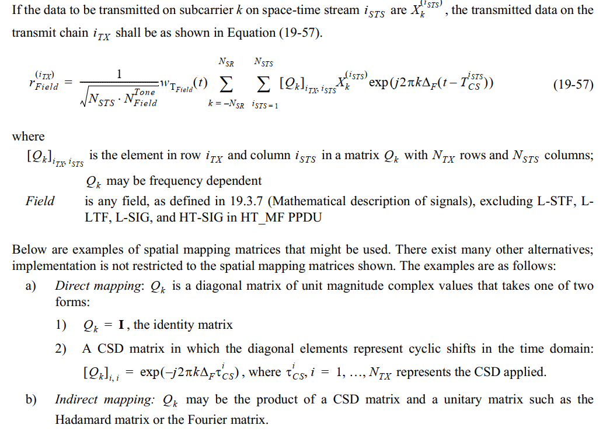
CSD Setting in 11me Spec (1/2)

Slide 14
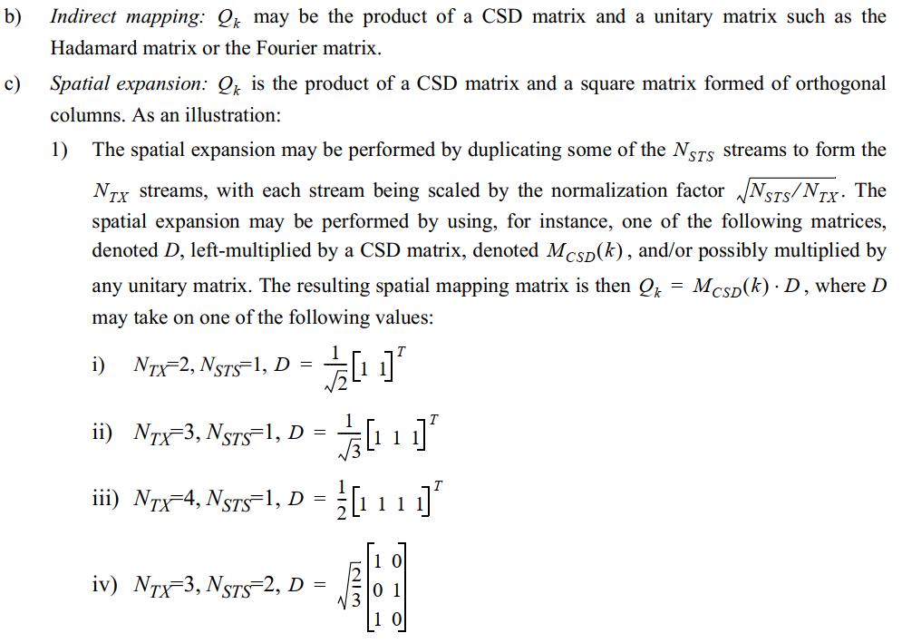
CSD Setting in 11me Spec (2/2)

