Slide 1
Updates on channel model and evaluation methodology documents to support a simulation framework for TGbf
Date: 2022-09-12
Authors:

Slide 2
Abstract
In [1], an example of link level simulation using ray tracing channel at 60GHz in indoor scenario is presented and discussed.
In [2], an open-source mmWave suite of tools (DMG/EDMG) has been presented, as well as a 60GHz channel model for representing sensing scenarios [3].
In [4] a common framework to compare TGbf proposals has been proposed.

Slide 3
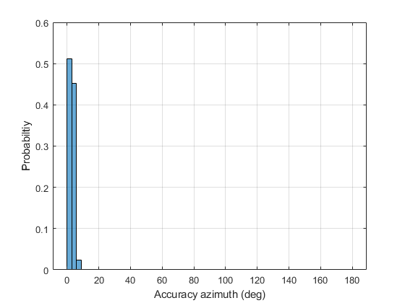
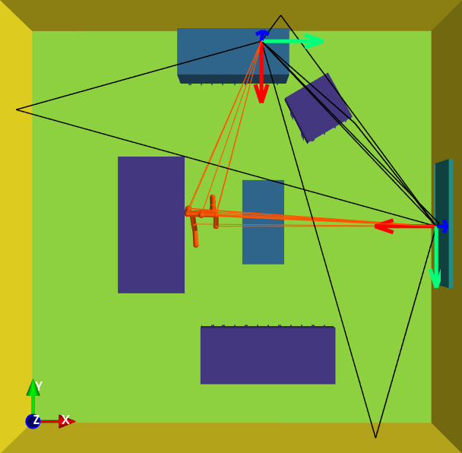
Proposed changes
Channel model [5]
Support for bi/multi-static
Evaluation Methodology [6]
Option to evaluate scenarios
using phased antenna arrays
Include bi-static scenario

Slide 4
SP
Do you support modifying the official channel model document IEEE 802.11 (21/0782r3) as IEEE 802.11 (21/0782r5) by adding the section 4.3 – Living Room Channel Model – Mono/Bistatic/Multi-static, section 7.3 Channel Data for Bi-Static-Directional Sub-Scenario and section 7.4 Channel Data for Isotropic Sub-Scenario?

Slide 5
SP
Do you support modifying the official evaluation methodology document IEEE 802.11 (21/0876r3) as IEEE 802.11 (21/0876r5) by adding the option to evaluate scenarios using phased antenna arrays and by adding Section 2.4 Scenario 3: Bistatic indoor living room

Slide 6
References
[1] 11-21-0352-01- WLAN sensing link level simulation - follow ups.pptx
[2] 11-21-0746-01-00bf-q-d-simulation-modeling-framework-for-sensing.pptx
[3] 11-21-0747-01-00bf-a-preliminary-channel-model-using-raytracing-to-detect-human-presence.pptx
[4] 11-22-0803-00-00bf-dmg-edmg-link-level-simulation-platform
[5] 11-21-0782-04-00bf-channel-models-for-wlan-sensing-systems.docx
[6] 11-21-0876-04-00bf-11bf-evaluation-methodology-and-simulation-scenarios.doc

