Slide 1
DRL-based Channel Access
Date: 2022-09-12
Authors:

Slide 2
Abstract
In this contribution, we
  review the existing works on Deep Reinforcement Learning (DRL)-based channel access,
  summarize their performance metrics, neural network (NN) models and inputs of NN,
  discuss their standard impacts.

Slide 3
Introduction
As mentioned in [1], the intrinsic random deferment feature of CSMA/CA makes it upper-bounded by a relative low MAC efficiency [2] and suffers from fairness and latency issues in many realistic scenarios [3].
AI-enabled channel access can be considered as a candidate use case[1] to reduce access delay and jitter, and improve channel efficiency.
In [4], channel access optimization via Reinforcement Learning (RL)-based contention window (CW) selection has been discussed, including its challenges and limitations [5].
In this contribution, we focus on the works of DRL-based channel access that directly decide whether to transmit or not, rather than optimizing parameters on top of CSMA/CA.
Historical Observation
Neural Network (NN)
Transmit or Not

Slide 4
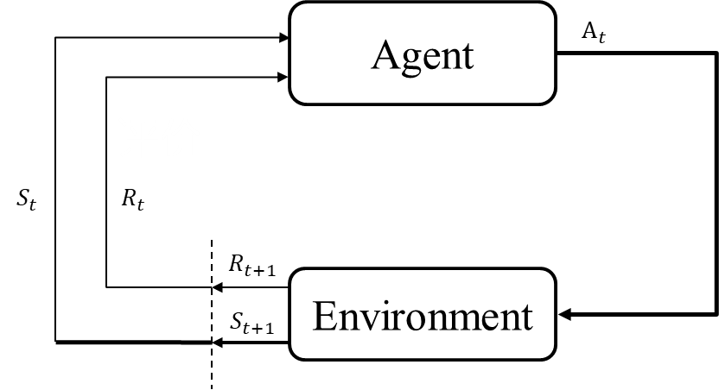

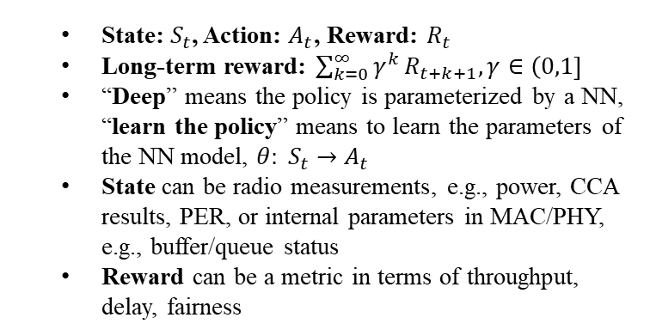
Preliminary
Deep Reinforcement Learning: learn the policy that maximizes a long-term reward via interaction with the environment
DRL is an efficient AI tool for solving decision-making problems such as channel access, power control, MAC parameter optimization
Common DRL Algorithms: DQN (Deep Q Network), QMIX, PPO (Proximal Policy Optimization), DDPG (Deep Deterministic Policy Gradient)
Training data for DRL: $S_{t},A_{t},R_{t+1},S_{t+1},A_{t+1},R_{t+2}…$
State: $S_{t}$, Action: $A_{t}$, Reward: $R_{t}$
Long-term reward: $\sum_{k=0}^{∞}{γ^{k}}R_{t+k+1}, γ∈\left(0,1\right]$
“Deep” means the policy is parameterized by a NN, “learn the policy” means to learn the parameters of the NN model, $θ: S_{t}→A_{t}$
State can be radio measurements, e.g., power, CCA results, PER, or internal parameters in MAC/PHY, e.g., buffer/queue status
Reward can be a metric in terms of throughput, delay, fairness

Slide 5
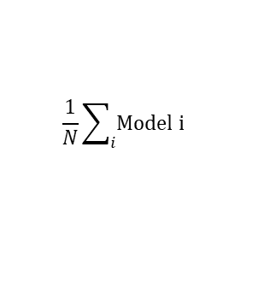
Learning Architecture
AP
AP: Training
AP: Model Average
Assisted info
Measurement report
Model
Model i
$$\frac{1}{N}\sum_{i}{Model i}$$
Non-AP: Training & Inference
Non-AP: Inference
Non-AP: Training & Inference
Distributed Learning
Training and Inference @STAs, i.e., Type 1 in [11]
Need training capability support
Standard impact:
  -- (maybe) Assisted info to facilitate training or inference
Related works on channel access [6]
Centralized Learning
Training @AP, Inference @STAs，i.e., Type 2 in [11]
Only AP needs training capability
Standard impact:
    -- (maybe) New measurement report to facilitate training;
    -- Model deployment
Related works on channel access [7]
Federated Learning
Training and Inference @STAs, i.e., Type 2 in [11]
Need training capability support
Standard impact:
    -- Model report
    -- (averaged) Model deployment
Related works on channel access[8]

Slide 6
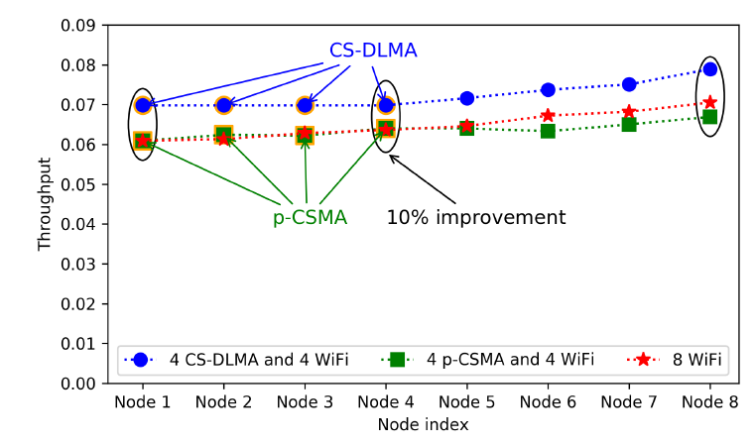
Channel Access with Distributed Learning
In [6], a DRL-based channel access scheme for heterogeneous wireless networks is proposed, named as Carrier-Sense Deep reinforcement Learning Multiple Access (CS-DLMA).
CS-DLMA achieves intelligent coexistence with other MAC protocols, e.g., TDMA, Aloha, Wi-Fi.
Performance Evaluation:
  Individual throughput, sum throughput
* Throughput (channel efficiency) is individual throughput. The network throughput is ~8*0.07, ~0.56

Slide 7
Channel Access with Distributed Learning
AP
Assisted info
Non-AP: Training & Inference
DRL algorithm: DQN [9]
Neural Network (NN): LSTM + fully-connected layer
Input of NN: a sequence of historical CCA results (Busy or Idle), actions (Transmit or Wait), and transmission results (successful or failed)
Standard impact:
-- Assisted info for training: Transmission results of other STAs or rewards

Slide 8
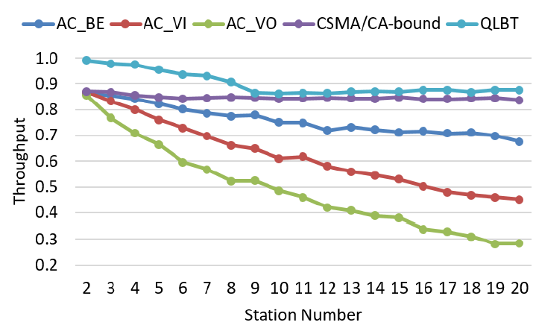
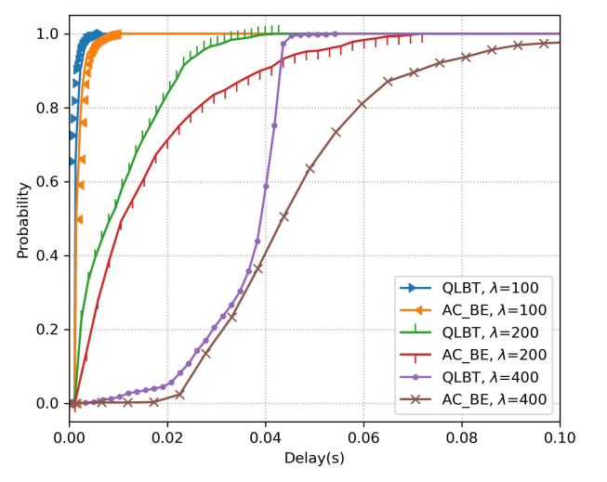
Channel Access with Centralized Learning
In [7], a DRL-based channel access scheme with centralized learning architecture is proposed, named as QMIX-advanced Listen-Before-Talk (QLBT).
Centralized training maximizes the use of environmental observations
Performance Evaluation:
  Channel efficiency: Outperforms CSMA/CA and even the upper bound [2] (~0.85)
  Delay: bounded delay under heavy traffic load

Slide 9
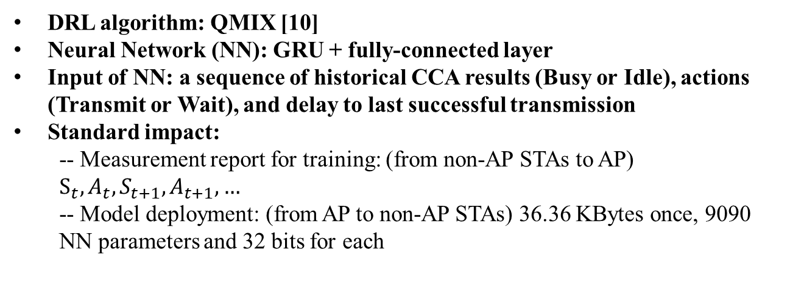
Channel Access with Centralized Learning
AP: Training
Measurement report
Model
Non-AP: Inference
DRL algorithm: QMIX [10]
Neural Network (NN): GRU + fully-connected layer
Input of NN: a sequence of historical CCA results (Busy or Idle), actions (Transmit or Wait), and delay to last successful transmission
Standard impact:
  -- Measurement report for training: (from non-AP STAs to AP) $S_{t},A_{t},S_{t+1},A_{t+1},…$
  -- Model deployment: (from AP to non-AP STAs) 36.36 KBytes once, 9090 NN parameters and 32 bits for each

Slide 10
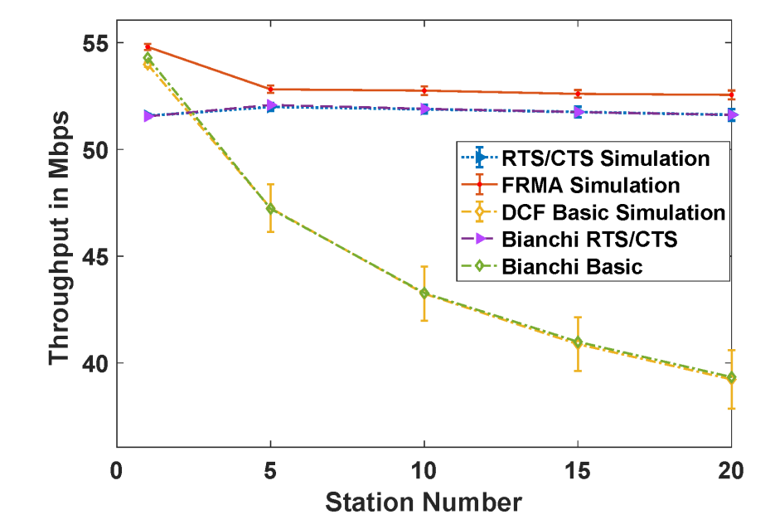
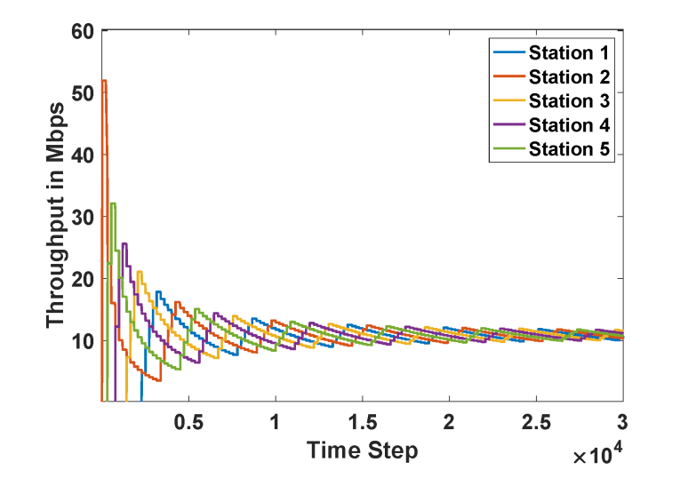
Channel Access with Federated Learning
In [8], a DRL-based channel access scheme aided by Federated Learning (FL) is proposed, named as Federated Reinforcement Multiple Access (FRMA).
The FL algorithm is applied to achieve fairness among users.
Performance Evaluation:
  Throughput: Outperforms CSMA/CA with/without RTS/CTS
  Fairness: the proportional fairness among users

Slide 11
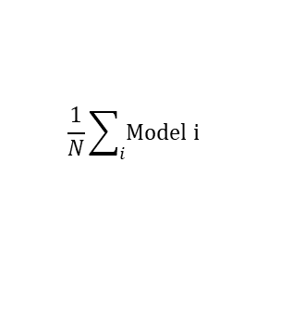
Channel Access with Federated Learning
AP: Model Average
Model i
$$\frac{1}{N}\sum_{i}{Model i}$$
Non-AP: Training & Inference
DRL algorithm: DQN
Neural Network (NN): six fully connected layers with skip connections
Input of NN: a sequence of historical CCA results (Busy or Idle) and actions (Transmit or Wait)
Standard impact:
  -- Model report: (from non-AP STAs to AP) 94.216 KBytes once
  -- Model deployment: (broadcast the averaged model to non-AP STAs) 94.216 KBytes once, 23554 NN parameters and 32 bits for each

Slide 12
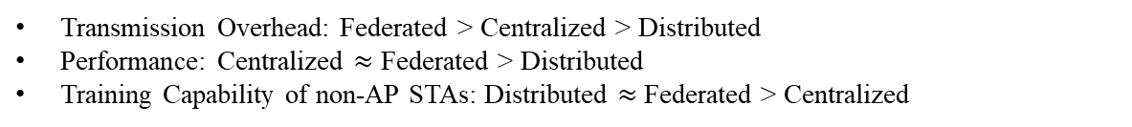
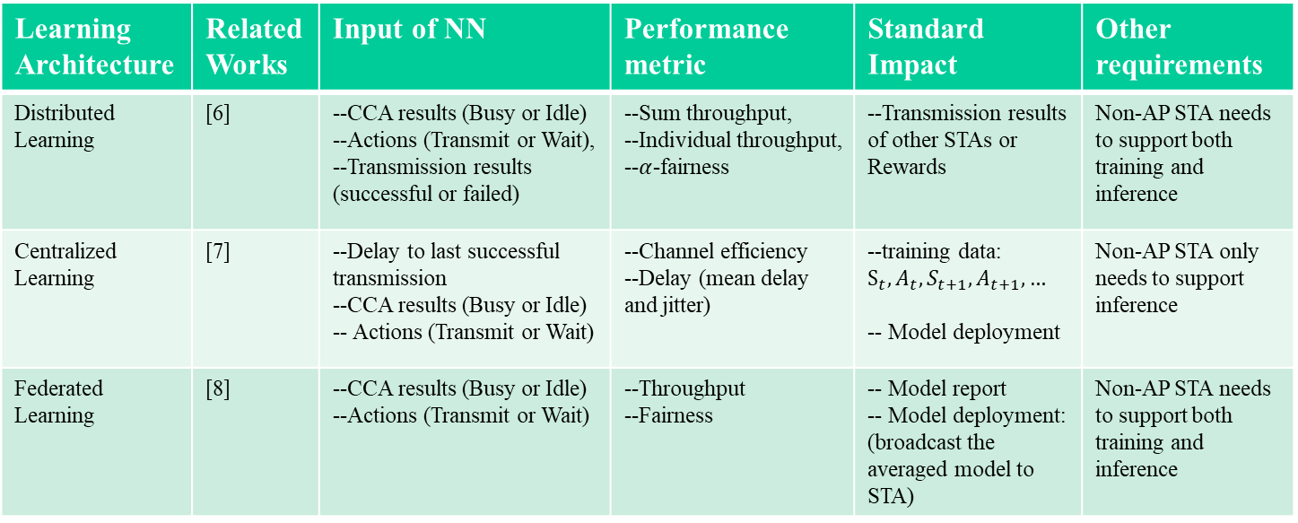
Existing Work Comparison
Learning Architecture | Related Works | Input of NN | Performance metric | Standard Impact | Other requirements
Distributed Learning | [6] | --CCA results (Busy or Idle) --Actions (Transmit or Wait), --Transmission results (successful or failed) | --Sum throughput, --Individual throughput, --$α$-fairness | --Transmission results of other STAs or Rewards | Non-AP STA needs to support both training and inference
Centralized Learning | [7] | --Delay to last successful transmission --CCA results (Busy or Idle) -- Actions (Transmit or Wait) | --Channel efficiency --Delay (mean delay and jitter) | --training data: $S_{t},A_{t},S_{t+1},A_{t+1},…$ -- Model deployment | Non-AP STA only needs to support inference
Federated Learning | [8] | --CCA results (Busy or Idle) --Actions (Transmit or Wait) | --Throughput --Fairness | -- Model report -- Model deployment: (broadcast the averaged model to STA) | Non-AP STA needs to support both training and inference
Transmission Overhead: Federated > Centralized > Distributed
Performance: Centralized $≈$ Federated > Distributed
Training Capability of non-AP STAs: Distributed $≈$ Federated > Centralized

Slide 13
Summary
In this contribution, we have reviewed three works on DRL-based channel access. They all show performance gain compared with CSMA/CA.
Channel access can be considered as a good starting use case for Wi-Fi AI.
Three learning architectures (distributed, centralized and federated) and their comparisons are discussed.
To analyze the standard impacts of DRL-based channel access, different learning architecture need to be discussed separately.
Model deployment could be discussed in priority as it has the greatest impact on standardization.

Slide 14
References
[1] 11-22-0458-01-0wng-look-ahead-to-next-generation-follow-up
[2] L. Dai and X. Sun, “A unified analysis of IEEE 802.11 DCF networks: Stability, throughput, and delay,” IEEE Trans. Mobile Comput., vol. 12, no. 8, pp. 1558–1572, Aug. 2013
[3] M. Cagalj, S. Ganeriwal, I. Aad, and J.-P. Hubaux, “On selfish behavior in CSMA/CA networks,” in Proc. IEEE 24th Annu. Joint Conf. IEEE Comput. Commun. Soc., vol. 4, 2005, pp. 2513–2524.
[4] 11-22-0979-01-Applying ML to 802.11: Current Research and Emerging Use Cases
[5] S. Szott, M. Natkaniec, and A.R. Pach. "An IEEE 802.11 EDCA model with support for analyzing networks with misbehaving nodes." EURASIP Journal on Wireless Communications and Networking 2010 (2010): 1-13.
[6] Y. Yu, S. C. Liew and T. Wang, "Non-Uniform Time-Step Deep Q-Network for Carrier-Sense Multiple Access in Heterogeneous Wireless Networks," in IEEE Transactions on Mobile Computing, vol. 20, no. 9, pp. 2848-2861, 1 Sept. 2021, doi: 10.1109/TMC.2020.2990399.
[7] Z. Guo, et al. "Multi-agent reinforcement learning-based distributed channel access for next generation wireless networks." IEEE Journal on Selected Areas in Communications 40.5 (2022): 1587-1599.
[8] L. Zhang, et al. "Enhancing WiFi multiple access performance with federated deep reinforcement learning." 2020 IEEE 92nd Vehicular Technology Conference (VTC2020-Fall). IEEE, 2020.
[9] V. Mnih et al., “Human-level control through deep reinforcement learning,” Nature, vol. 518, no. 7540, pp. 529–533, 2015.
[10] T. Rashid, M. Samvelyan, C. Schroeder, G. Farquhar, J. Foerster, and S. Whiteson, “QMIX: Monotonic value function factorisation for deep multi-agent reinforcement learning,” in Proc. Int. Conf. Mach. Learn., 2018, pp. 4295–4304.
[11] 11-22-0723-01-0wng-further-discussion-on-next-generation-wlan

