Slide 1
Wireless for ML - Over-the-Air Computation
Date: 2022-09-13
Authors:

Slide 2
Abstract
In this talk, we provide a brief discussion on how over-the-air computation (OAC) can address the latency and spectral congestion in a wireless network when a neural network is aimed to be trained in a distributed manner and discuss its impact on the PHY design

Slide 3
ML for Wireless vs. Wireless for ML
Two different paths for the merge of communications and ML:
ML for Wireless
Wireless for ML
Approach: Use ML as a method to
improve communication blocks [1]
Goal: Better communications
Info: Images, video, audio, ...
Approach: Use communications as a
method to improve ML [2]
Goal: Better ML performance
Info: Model parameters, gradients, ...

Slide 4
ML for Wireless vs. Wireless for ML
Two different paths for the merge of communications and ML:
ML for Wireless
Wireless for ML
Approach: Use ML as a method to
improve communication blocks [1]
Goal: Better communications
Info: Images, video, audio, ...
Approach: Use communications as a
method to improve ML [2]
Goal: Better ML performance
Info: Model parameters, gradients, ...
This talk

Slide 5
Distributed Learning over A wireless Network
Part – I

Slide 6



Centralized Learning over a Wireless Network
Assume that a deep neural network (DNN) is desired to be trained based on the local datasets at $K$ STAs
Local dataset
Procedure:
Step 1: All STAs transmit their local datasets
Step 2: Obtain the trained model parameters with an algorithm
STA $1$
Local dataset
AP
STA 2
…
…
Local dataset
STA $K$

Slide 7


Centralized Learning over a Wireless Network
Assume that a deep neural network (DNN) is desired to be trained based on the local datasets at $K$ STAs
Local dataset
Procedure:
Step 1: All STAs transmit their local datasets
Step 2: Obtain the trained model parameters with an algorithm
STA $1$
Local dataset
AP
STA 2
…
…
Local dataset
STA $K$

Slide 8

Centralized Learning over a Wireless Network
Assume that a deep neural network (DNN) is desired to be trained based on the local datasets at $K$ STAs
Local dataset
Procedure:
Step 1: All STAs transmit their local datasets
Step 2: Obtain the trained model parameters with an algorithm
STA $1$
Local dataset
AP
STA 2
…
…
…
Local dataset
STA $K$

Slide 9
Centralized Learning over a Wireless Network
Assume that a deep neural network (DNN) is desired to be trained based on the local datasets at $K$ STAs
Local dataset
Procedure:
Step 1: All STAs transmit their local datasets
Step 2: Obtain the trained model parameters with an algorithm
STA $1$
Local dataset
AP
STA 2
…
…
…
Local dataset
STA $K$
Potential issues: Data/user privacy, spectral congestion, energy consumption
(as large datasets move one node to another node [3])

Slide 10
Merit of Distributed Learning
Philosophy: Data samples are generated at edge devices and should always stay the edge devices [3]
  More privacy-preserving
  Better latency
  Better battery life
There are various distributed learning paradigms, e.g.,
  Federated learning (FL) [4]
  Split learning [5]

Slide 11


How Does FL Work over a Wireless Network?
Consider the previous scenario:
An example procedure [4]:
Step 1: AP broadcasts the model
Step 2: Each STA calculates the gradients
Step 3: Each STA transmits the gradients
Step 4: AP averages the received gradients and updates the model (and goes back Step 1)
Local dataset
STA $1$
Local dataset
AP
STA 2
…
…
Local dataset
STA $K$

Slide 12


How Does FL Work over a Wireless Network?
Consider the previous scenario:
An example procedure [4]:
Step 1: AP broadcasts the model
Step 2: Each STA calculates the gradients
Step 3: Each STA transmits the gradients
Step 4: AP averages the received gradients and updates the model (and goes back Step 1)
Local dataset
STA $1$
Local dataset
AP
STA 2
…
…
Local dataset
STA $K$

Slide 13


How Does FL Work over a Wireless Network?
Consider the previous scenario:
An example procedure [4]:
Step 1: AP broadcasts the model
Step 2: Each STA calculates the gradients
Step 3: Each STA transmits the gradients
Step 4: AP averages the received gradients and updates the model (and goes back Step 1)
STA $1$
AP
STA 2
…
…
STA $K$
Calculate gradients

Slide 14

How Does FL Work over a Wireless Network?
Consider the previous scenario:
An example procedure [4]:
Step 1: AP broadcasts the model
Step 2: Each STA calculates the gradients
Step 3: Each STA transmits the gradients
Step 4: AP averages the received gradients and updates the model (and goes back Step 1)
Local dataset
STA $1$
Local dataset
AP
STA 2
…
…
Local dataset
STA $K$

Slide 15


How Does FL Work over a Wireless Network?
Consider the previous scenario:
An example procedure [4]:
Step 1: AP broadcasts the model
Step 2: Each STA calculates the gradients
Step 3: Each STA transmits the gradients
Step 4: AP averages the received gradients and updates the model (and goes back Step 1)
Local dataset
STA $1$
Local dataset
AP
STA 2
…
…
Local dataset
…
STA $K$
Gradient averaging
& model update

Slide 16




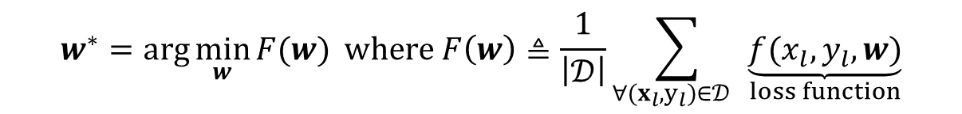

Why Does [Plain] FL Work?
A typical training obtains the model parameters $w$ by solving an optimization problem
weights: $w∈ℝ^{q}$
A data sample (e.g., image)
A label (e.g., chair)
$$(x_{l},y_{l})∈𝒟$$
$$x_{l}$$
Detected label: ${\hat{y}}_{l}$
$𝒟$: Training dataset
$$w^{∗}=\arg{\min_{w}{F(w)}} where F\left(w\right)≜\frac{1}{\left|𝒟\right|}\sum_{∀(x_{l},y_{l})∈𝒟 }{\underset{loss function}{\underbrace{f(x_{l},y_{l},w)}}}$$

Slide 17
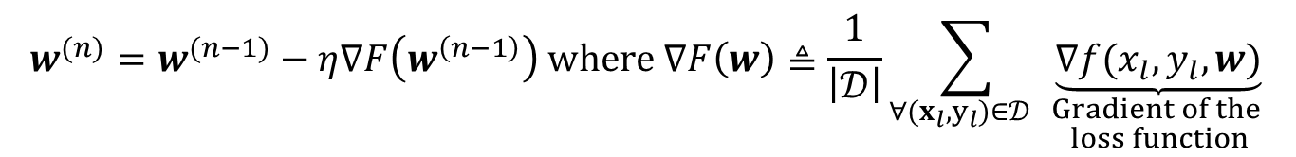
Why Does [Plain] FL Work?
An iterative solution: Stochastic gradient descend (SGD) with a learning rate η
$$w^{(n)}=w^{(n−1)}−η∇F\left(w^{\left(n−1\right)}\right) where ∇F\left(w\right)≜\frac{1}{\left|𝒟\right|}\sum_{∀(x_{l},y_{l})∈𝒟 }{\underset{\begin{aligned}Gradient of the \\ loss function\end{aligned}}{\underbrace{∇f(x_{l},y_{l},w)}}}$$

Slide 18


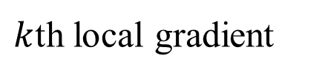
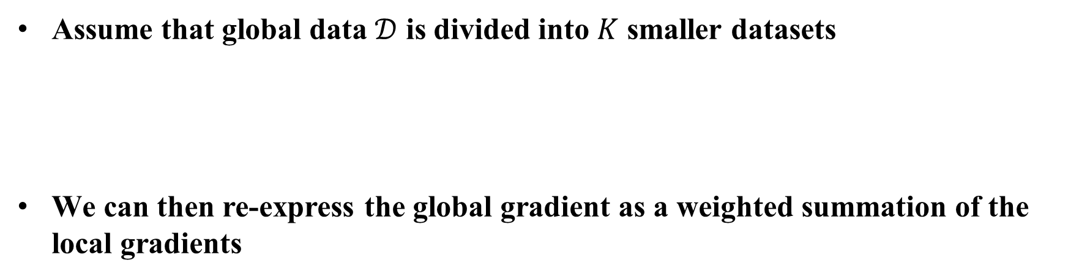

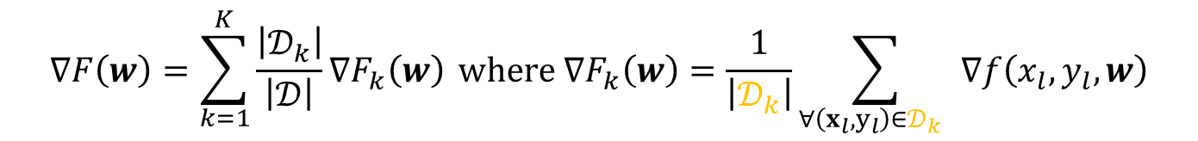



Why Does [Plain] FL Work?
Assume that global data $𝒟$ is divided into $K$ smaller datasets
We can then re-express the global gradient as a weighted summation of the local gradients
…
$𝒟_{i}⋂𝒟_{j}≠∅$ for $i≠j$
$$𝒟_{1}$$
$$𝒟_{2}$$
$$𝒟_{3}$$
$$𝒟_{K}$$
$$𝒟$$
$$∇F\left(w\right)=\sum_{k=1}^{K}{\frac{\left|𝒟_{k}\right|}{\left|𝒟\right|}∇F_{k}\left(w\right)} where ∇F_{k}\left(w\right)=\frac{1}{\left|𝒟_{k}\right|}\sum_{∀\left(x_{l},y_{l}\right)∈𝒟_{k} }{∇f\left(x_{l},y_{l},w\right)}$$
global gradient
$k$th local gradient

Slide 19
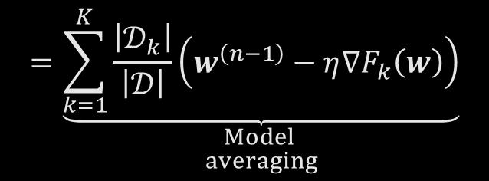
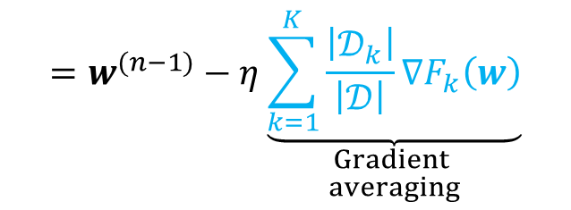



Why Does [Plain] FL Work?
Let’s rewrite the update rule as follows:
Uplink (UL) data: Gradient
$$w^{(n)}=w^{(n−1)}−η∇F\left(w^{\left(n−1\right)}\right)$$
$$=w^{(n−1)}−η\underset{\begin{aligned}Gradient \\ averaging\end{aligned}}{\underbrace{\sum_{k=1}^{K}{\frac{\left|𝒟_{k}\right|}{\left|𝒟\right|}∇F_{k}\left(w\right)}}}$$
STA $1$
AP
STA 2
…
…
$$=\underset{\begin{aligned}Model \\ averaging\end{aligned}}{\underbrace{\sum_{k=1}^{K}{\frac{\left|𝒟_{k}\right|}{\left|𝒟\right|}\left(w^{\left(n−1\right)}−η∇F_{k}\left(w\right)\right)}}}$$
…
STA $K$
Gradient averaging
& model update

Slide 20
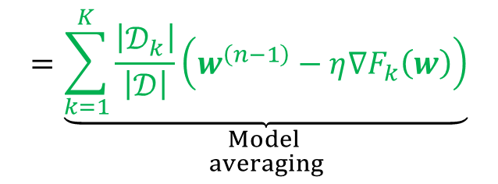
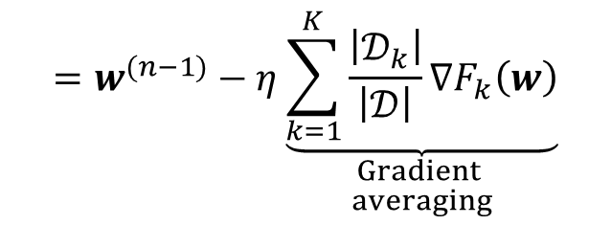
Why Does [Plain] FL Work?
Let’s rewrite the update rule as follows:
Uplink (UL) data: Model parameters
$$w^{(n)}=w^{(n−1)}−η∇F\left(w^{\left(n−1\right)}\right)$$
$$=w^{(n−1)}−η\underset{\begin{aligned}Gradient \\ averaging\end{aligned}}{\underbrace{\sum_{k=1}^{K}{\frac{\left|𝒟_{k}\right|}{\left|𝒟\right|}∇F_{k}\left(w\right)}}}$$
STA $1$
AP
STA 2
…
…
$$=\underset{\begin{aligned}Model \\ averaging\end{aligned}}{\underbrace{\sum_{k=1}^{K}{\frac{\left|𝒟_{k}\right|}{\left|𝒟\right|}\left(w^{\left(n−1\right)}−η∇F_{k}\left(w\right)\right)}}}$$
…
STA $K$
Model averaging

Slide 21
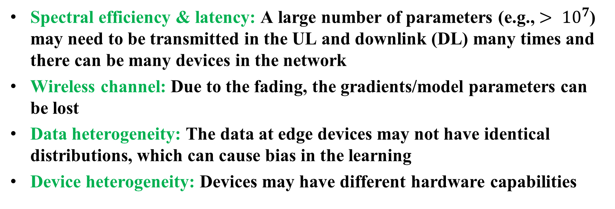
Potential Issues for FL over a Wireless Network
Spectral efficiency & latency: A large number of parameters (e.g., $> {10}^{7}$) may need to be transmitted in the UL and downlink (DL) many times and there can be many devices in the network
Wireless channel: Due to the fading, the gradients/model parameters can be lost
Data heterogeneity: The data at edge devices may not have identical distributions, which can cause bias in the learning
Device heterogeneity: Devices may have different hardware capabilities

Slide 22

Potential Issues for FL over a Wireless Network
Spectral efficiency & latency: A large number of parameters (e.g., $> {10}^{7}$) may need to be transmitted in the UL and downlink (DL) many times and there can be many devices in the network
Over-the-air computation (OAC) addresses the spectral efficiency &
latency challenge [2,6]

Slide 23
Over-the-air Computation
Part – II

Slide 24








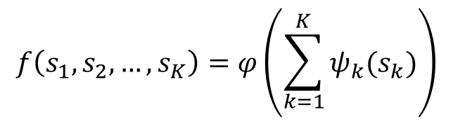


Over-the-Air Computation
OAC exploits the superposition property of wireless multiple access channels to perform numerical calculations over the air [7]
$$f\left(s_{1},s_{2},…,s_{K}\right)=φ\left(\sum_{k=1}^{K}{ψ_{k}(s_{k})}\right)$$
$$ψ_{1}\left(⋅\right)$$
$$s_{1}$$
$$ψ_{2}\left(⋅\right)$$
$$s_{2}$$
$$z$$
$$φ\left(⋅\right)$$
$$f:ℝ^{K}→ℝ$$
…
$$ψ_{k}\left(⋅\right)\text{: }\text{Pre}\text{−}\text{processing} \text{function}$$
$$φ\left(⋅\right)\text{: }\text{Post}\text{−}\text{processing} \text{function}$$
$$ψ_{K}\left(⋅\right)$$
$$s_{K}$$
Several “air-computable” functions: Mean,
weighted sum, polynomials, norm
Ideal multiple-access channel

Slide 25
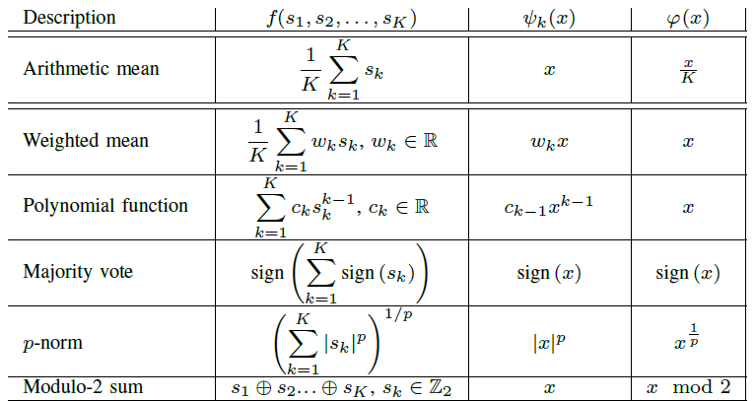
Over-the-Air Computation
OAC exploits the superposition property of wireless multiple access channels to perform numerical calculations over the air [7]
$$ψ_{1}\left(⋅\right)$$
$$s_{1}$$
$$ψ_{2}\left(⋅\right)$$
$$s_{2}$$
$$z$$
$$φ\left(⋅\right)$$
…
$$ψ_{K}\left(⋅\right)$$
$$s_{K}$$
Ideal multiple-access channel

Slide 26





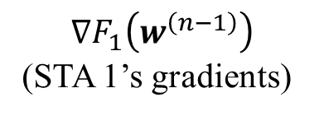
Why Does It Matters? - Case: FL “without” OAC
Frequency
$$𝒟_{1}$$
STA $1$
$$∇F_{1}\left(w^{\left(n−1\right)}\right)$$
(STA 1’s gradients))
$$𝒟_{2}$$
AP
STA 2
Bandwidth
…
…
$$𝒟_{K}$$
STA $K$
Time
Occupied time

Slide 27





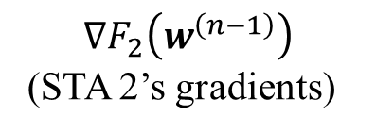
Why Does It Matters? - Case: FL “without” OAC
Frequency
$$𝒟_{1}$$
STA $1$
$$∇F_{2}\left(w^{\left(n−1\right)}\right)$$
(STA 2’s gradients))
$$𝒟_{2}$$
AP
STA 2
Bandwidth
…
…
$$𝒟_{K}$$
STA $K$
Time
Occupied time

Slide 28





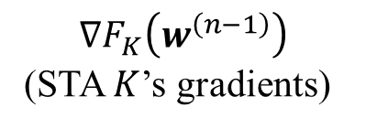
Why Does It Matters? - Case: FL “without” OAC
Frequency
$$𝒟_{1}$$
STA $1$
$$∇F_{K}\left(w^{\left(n−1\right)}\right)$$
(STA $K$’s gradients))
$$𝒟_{2}$$
AP
STA 2
Bandwidth
…
…
…
$$𝒟_{K}$$
STA $K$
Time
Occupied time

Slide 29





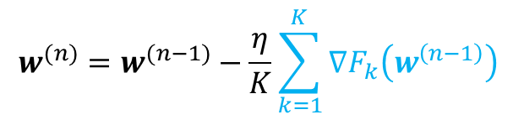
Why Does It Matters? - Case: FL “without” OAC
Frequency
$$𝒟_{1}$$
STA $1$
$$𝒟_{2}$$
AP
STA 2
Bandwidth
…
…
…
…
$$𝒟_{K}$$
Gradient averaging
STA $K$
Time
Occupied time
$$w^{(n)}=w^{(n−1)}−\frac{η}{K}\sum_{k=1}^{K}{∇F_{k}\left(w^{\left(n−1\right)}\right) }$$

Slide 30
Why Does It Matters? - Case: FL “without” OAC
Frequency
$$𝒟_{1}$$
STA $1$
$$𝒟_{2}$$
AP
STA 2
Bandwidth
…
…
…
…
$$𝒟_{K}$$
Gradient averaging
STA $K$
Time
Occupied time
$$w^{(n)}=w^{(n−1)}−\frac{η}{K}\sum_{k=1}^{K}{∇F_{k}\left(w^{\left(n−1\right)}\right) }$$
Problem: Latency increases linearly with the number of STAs (due to orthogonal user multiplexing)

Slide 31





Why Does It Matters? - Case: FL “with” OAC
Frequency
$$𝒟_{1}$$
STA $1$
$$𝒟_{2}$$
AP
STA 2
Bandwidth
…
…
$$𝒟_{K}$$
STA $K$
Time

Slide 32
Why Does It Matters? - Case: FL “with” OAC
Frequency
$$𝒟_{1}$$
All STAs transmit simultaneously & gradient aggregation occurs through signal superposition in the channel
STA $1$
$$𝒟_{2}$$
AP
STA 2
Bandwidth
…
…
“One-shot” aggregation in the channel
$$𝒟_{K}$$
STA $K$
…
Time
Occupied time
$$w^{(n)}=w^{(n−1)}−\frac{η}{K}\sum_{k=1}^{K}{∇F_{k}\left(w^{\left(n−1\right)}\right) }$$
Result: Latency does not scale with the number of STAs if OAC is employed

Slide 33











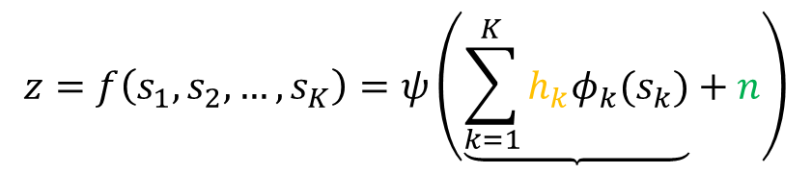



OAC under Multi-path Channel & Noise
Wireless channel does not allow coherent addition as in an ideal channel
A typical equalization cannot be used as the superposition occurs after the impact of channels on the transmitted signals
$$h_{1}$$
$$φ_{1}\left(⋅\right)$$
$$s_{1}$$
$$φ_{2}\left(⋅\right)$$
$$z=f\left(s_{1},s_{2},…,s_{K}\right)=ψ\left(\underbrace{\sum_{k=1}^{K}{h_{k}φ_{k}(s_{k})}}+n\right)$$
$$s_{2}$$
$$z$$
$$ψ\left(⋅\right)$$
$$h_{2}$$
$$n$$
…
$$h_{K}$$
$$incoherent$$
$$additions$$
$$noise$$
$$φ_{K}\left(⋅\right)$$
$$s_{K}$$
Multi-path channel & noise?

Slide 34

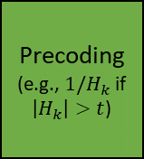



State-of-the Art Solutions: Precoding
Use a precoding that reverses the impact of channel and modulate OFDM subcarriers with model parameters/gradients [8]
Shortcomings:
Channel state information (CSI) should be available at the STAs
Information related to the gradients or model parameters can be lost if the channel fades
It can be sensitive to the phase synchronization errors
STA $1$
Model
DFT
IDFT
Precoding
(e.g., $1/H_{k}$ if $\left|H_{k}\right|>t$)
CP-
CP+
Calculate Gradients
STA $k$
Dataset
aggregation
over-the-air
$$CSI:H_{k}$$
STA $K$
CP: Cyclic prefix

Slide 35










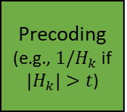

State-of-the Art Solutions: Precoding + Majority Vote
Use the sign of gradients to modulate OFDM subcarriers and determine the gradient direction at the AP with majority vote [9,10]
Advantages:
More compatible with today’s digital modulation schemes
Shortcomings:
CSI should be available at the STAs
Truncation still occurs if the channel fades
It can be sensitive to the phase synchronization errors
Majority vote: $\{1,0,−1\}$
STA $1$
Model
$$sign\left(⋅\right)$$
DFT
…
IDFT
Precoding
(e.g., $1/H_{k}$ if $\left|H_{k}\right|>t$)
$$…$$
$$sign\left(⋅\right)$$
Calculate Gradients
CP-
CP+
$$sign\left(⋅\right)$$
STA $k$
Gradient aggregation
over-the-air
…
$$CSI:H_{k}$$
e.g.,
$$1,0,−1,1$$
e.g.,
$$0.1,0,−0.3,0.01$$
STA $K$

Slide 36



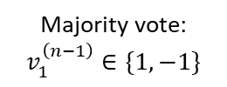





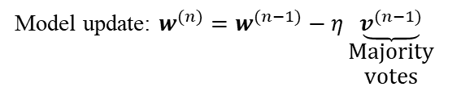
State-of-the Art Solutions: Non-coherent Transmission + Majority Vote
Use non-coherent transmission/detector along with the majority vote [11-14]
$$1$$
Advantages:
No precoding at the STAs
No CSI overhead
A low-complexity scheme
Robust against the time-synchronization errors
Shortcomings:
Probabilistic behavior due the randomness in the channel
Doubling the utilized resources
Majority vote: $v_{1}^{\left(n−1\right)}∈\{1,−1\}$
Energy
detector
DFT
IDFT
$$sign\left(⋅\right)$$
STA $1$
$$\sqrt{E_{s}}$$
Model
Local dataset
-1
…
0
…
CP-
CP+
…
Calculate Gradients
STA $k$
Majority vote: $v_{M}^{\left(n−1\right)}∈\{1,−1\}$
…
$$1$$
Energy detector
Aggregation
over-the-air
$$\sqrt{E_{s}}$$
STA $K$
-1
0
Model update: $w^{(n)}=w^{(n−1)}−η\underset{\begin{aligned}\text{Majority} \\ \text{votes}\end{aligned}}{\underbrace{v^{(n−1)}}}$
Frequency-shift keying

Slide 37


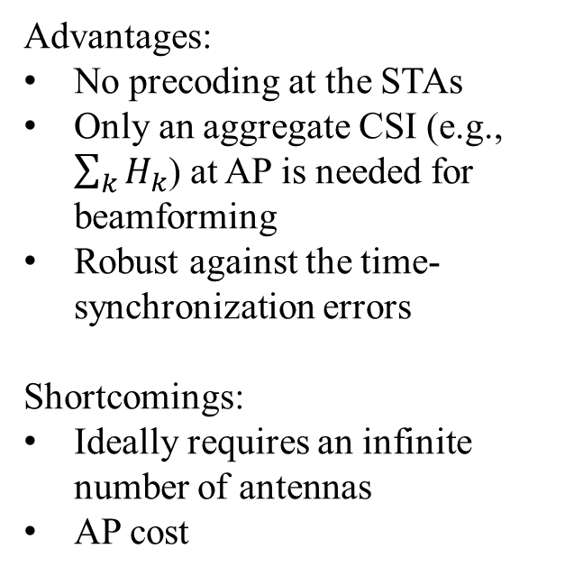

State-of-the Art Solutions: Beamforming
Use heavy beamforming to mitigate the impact channel on aggregation [15]
Advantages:
No precoding at the STAs
Only an aggregate CSI (e.g., $\sum_{k}{H_{k}}$) at AP is needed for beamforming
Robust against the time-synchronization errors
Shortcomings:
Ideally requires an infinite number of antennas
AP cost
…
STA $1$
Model
DFT
IDFT
CP+
Calculate Gradients
CP-
STA $k$
Dataset
aggregation
over-the-air
STA $K$

Slide 38
A Demonstration of OAC for FL
Part – III

Slide 39
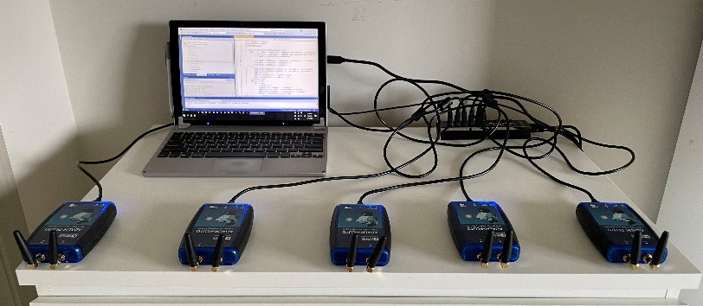
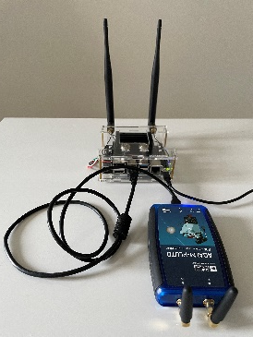











A Demonstration of OAC for Federated Learning
Task: Handwritten-digit recognition
  5 STAs, 1 AP, 500 images/digit (based on MNIST database)
  OAC scheme: FSK over OFDM + majority vote [14]
  Sample rate: 20 Msps, IDFT size: 256, # of active subcarriers: 192
  A neural network with 29034 parameters (~300 OFDM symbols)
  In-door environment (low mobility)
$$1$$
Majority vote: $v_{1}^{\left(n−1\right)}∈\{1,−1\}$
Energy
detector
DFT
IDFT
$$\sqrt{E_{s}}$$
$$sign\left(⋅\right)$$
STA $1$
Model
Local dataset
-1
…
0
…
CP-
CP+
…
Calculate Gradients
STA $k$
$$1$$
Majority vote: $v_{M}^{\left(n−1\right)}∈\{1,−1\}$
Energy detector
…
$$\sqrt{E_{s}}$$
STA $5$
-1
0
Model update: $w^{(n)}=w^{(n−1)}−η\underset{\begin{aligned}\text{Majority} \\ \text{votes}\end{aligned}}{\underbrace{v^{(n−1)}}}$
Frequency-shift keying

Slide 40







A Demonstration of OAC for Federated Learning
AP:
Trigger
Majority votes
$$t$$
STA1
STA 2
STA 3
STA 4
STA 5
STA 1:
Sign of local gradients
$$t$$
1st round:
AP transmits a trigger signal
STA 2:
Sign of local gradients
$$t$$
STA 3:
Sign of local gradients
$$t$$
AP
STA 4:
Sign of local gradients
$$t$$
STA 5:
Sign of local gradients
$$t$$

Slide 41
A Demonstration of OAC for Federated Learning
AP:
Trigger
Majority votes
$$t$$
STA1
STA 2
STA 3
STA 4
STA 5
STA 1:
Sign of local gradients
$$t$$
1st round:
Simultaneous transmissions of
signs of local gradients
with FSK over OFDM
STA 2:
Sign of local gradients
$$t$$
STA 3:
Sign of local gradients
$$t$$
AP
STA 4:
Sign of local gradients
$$t$$
STA 5:
Sign of local gradients
$$t$$
Signal superposition (Encoding for each STA: FSK over OFDM)

Slide 42

A Demonstration of OAC for Federated Learning
STA1
STA 2
STA 3
STA 4
STA 5
1st round:
Simultaneous transmissions of
signs of local gradients
with FSK over OFDM
AP
Uplink channels $@ t=t_{1}$

Slide 43
A Demonstration of OAC for Federated Learning
AP:
Trigger
Majority votes
$$t$$
STA1
STA 2
STA 3
STA 4
STA 5
STA 1:
Sign of local gradients
$$t$$
STA 2:
Sign of local gradients
$$t$$
1st round:
AP calculates
and broadcast
the majority votes
STA 3:
Sign of local gradients
$$t$$
AP
STA 4:
Sign of local gradients
$$t$$
STA 5:
Sign of local gradients
$$t$$

Slide 44










A Demonstration of OAC for Federated Learning
e.g, $g_{1}=−0.3⇒sign\left(g_{1}\right)=−1$
-1
$$\sqrt{E_{s}}$$
$$1$$
0
FSK
STA $1$:
Subcarriers
STA1
STA 2
STA 3
STA 4
STA 5
STA $2$:
Subcarriers
1st round:
AP broadcasts
the majority votes
STA $3$:
Subcarriers
AP
Superposed
symbols at the AP:
Subcarriers
Majority vote:
$$v_{0}=1$$
$$v_{1}=1$$
$$v_{2}=0$$
$$v_{3}=−1$$
$$v_{4}=−1$$

Slide 45
A Demonstration of OAC for Federated Learning
AP:
Trigger
Majority votes
$$t$$
STA1
STA 2
STA 3
STA 4
STA 5
STA 1:
Sign of local gradients
$$t$$
1st round:
STAs update their models
STA 2:
Sign of local gradients
$$t$$
STA 3:
Sign of local gradients
$$t$$
AP
STA 4:
Sign of local gradients
$$t$$
STA 5:
Sign of local gradients
$$t$$

Slide 46
A Demonstration of OAC for Federated Learning
For this scenario, the test accuracy reaches to 97% while the training loss gradually decreases without sharing the local datasets

Slide 47
Takeaways
Wireless for ML and ML for wireless are the two fundamental paths for combining ML and communications
  Distributed learning is a use case that can affect the design of a wireless network for AI/ML
OAC is a promising way to address the latency challenge of implementation of distributed learning over wireless networks
  Signal superposition in multiple access channels turns out to be a useful phenomenon to compute some functions
  Power control, time-frequency synchronization, CSI acquisition, retransmissions, and compression are several other major aspects for achieving reliable OAC

Slide 48
References
[1] T. O’Shea and J. Hoydis, “An introduction to deep learning for the physical layer,” IEEE Transactions on Cognitive Communications and Networking, vol. 3, no. 4, pp. 563–575, Dec. 2017.
[2] H. Hellstrom, J. M. B. da Silva Jr, M. Chen, V. Fodor, V. Poor, and C. Fischione, “Wireless for Machine Learning: a Survey,” Foundations and Trends® in Signal Processing, vol. 15, no, 4, pp. 290-399, 2022
[3] P. K. et. al., “Advances and open problems in federated learning,” Foundations and Trends® in Machine Learning, vol. 14, no. 1–2, pp. 1–210, 2021.
[4] H. B. McMahan, E. Moore, D. Ramage, S. Hampson, and B. A. y Arcas, “Communication-efficient learning of deep networks from decentralized data,” 2017.
[5] A. Singh, P. Vepakomma, O. Gupta, and R. Raskar, “Detailed comparison of communication efficiency of split learning and federated learning,” ArXiv, vol. abs/1909.09145, 2019.
[6] M. Chen, D. Gunduz, K. Huang, W. Saad, M. Bennis, A. V. Feljan, and H. V. Poor, "Distributed Learning in Wireless Networks: Recent Progress and Future Challenges," in IEEE Journal on Selected Areas in Communications, vol. 39, no. 12, pp. 3579-3605, Dec. 2021
[7] M. Goldenbaum, H. Boche, and S. Stanczak, “Harnessing interference for analog function computation in wireless sensor networks,” IEEE Trans. Signal Process., vol. 61, no. 20, pp. 4893–4906, Oct. 2013.
[8] G. Zhu, Y. Wang, and K. Huang, “Broadband analog aggregation for low-latency federated edge learning,” IEEE Trans. Wireless Commun., vol. 19, no. 1, pp. 491–506, Jan. 2020.
[9] G. Zhu, Y. Du, D. Gunduz, and K. Huang, “One-bit over-the-air aggregation for communication-efficient federated edge learning: Design and convergence analysis,” IEEE Trans. Wireless Commun., vol. 20, no. 3, pp. 2120–2135, Nov. 2021.
[10] J. Bernstein, Y.-X. Wang, K. Azizzadenesheli, and A. Anandkumar, “signSGD: Compressed optimisation for non-convex problems,” in Proc. in International Conference on Machine Learning, vol. 80. Proceedings of Machine Learning Research, 10–15 Jul 2018, pp. 560–569.
[11] S. Hoque, M. H. Adeli, A. Sahin, "Chirp-Based Over-The-Air Computation for Long-Range Federated Edge Learning," IEEE International Symposium on Personal, Indoor and Mobile Radio Communications (PIMRC), 2022
[12] M. H. Adeli, A. Sahin, "Multi-cell Non-coherent Over-the-Air Computation for Federated Edge Learning," IEEE International Conference on Communications (ICC), 2022
[13 ]A. Sahin, B. Everette, S. Hoque, "Over-the-Air Computation with DFT-spread OFDM for Federated Edge Learning," IEEE Wireless Communications and Networking Conference (WCNC), 2022
[14] A. Sahin, B. Everette, S. Hoque, "Distributed Learning over a Wireless Network with FSK-Based Majority Vote," IEEE International Conference on Advanced Communication Technologies and Networking (CommNet), 2021
[15] M. M. Amiria, T. M. Duman, D. Gunduz, S. R. Kulkarni, and H. Vincent Poor, “Collaborative machine learning at the wireless edge with blind transmitters,” IEEE Trans. Wireless Commun., pp. 1–1, Mar 2021.

