Slide 1
Use Cases of smart manufacturing
August 2022
Doc.: IEEE 802.11-22/1339r0
Date: 2022-08-16
Authors:
Name | Affiliation | Address | Phone | Email
Shichao Zhao | Haier |  |  | zhaoshichao@haier.com
Zhaojuan Du |  |  |  | duzhaojuan@haier.com

Slide 2
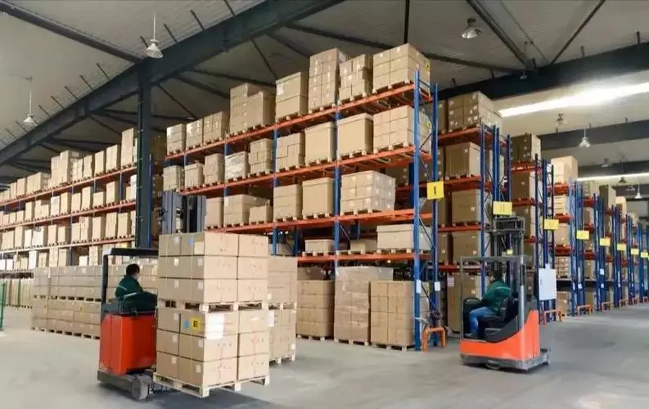


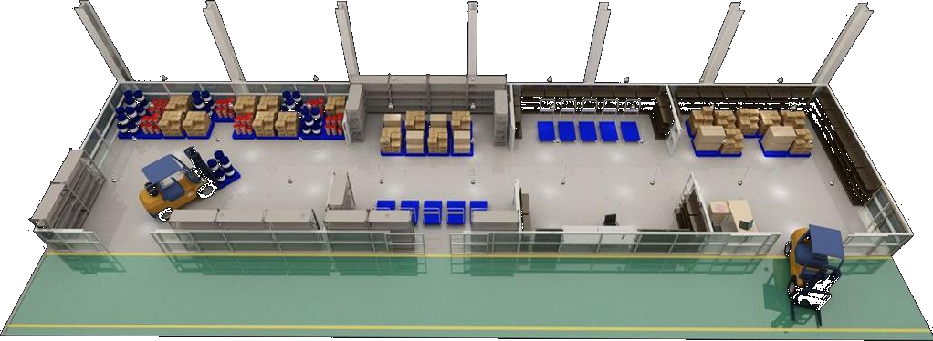


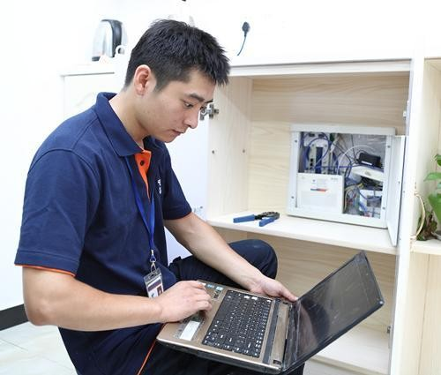

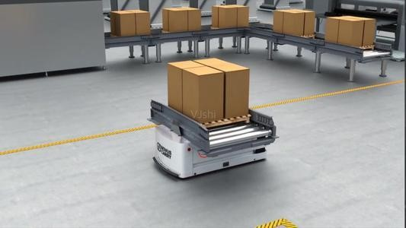



August 2022
Doc.: IEEE 802.11-22/1339r0
Use Case 1: Identification and Positioning
  Asset Management and Worker tracking
  Identification of human beings and assets including production materials, storage tanks, etc.
    Inventory check
    Anti-counterfeiting via ID tracing
    Attendance check
  Horizontal and vertical positioning of materials and products.
  Potential Requirements
  Small size, maintenance-free, battery-free, and ultra-low-cost IoT devices
  Coverage: 10-30 meters for indoor (a product line has an area of 25 thousands m2)
  Positioning accuracy: 1~3 m horizontal accuracy and 1~2 m vertical accuracy
Internet
Asset Management Platform
Slide 2
Shichao Zhao (Haier)

Slide 3

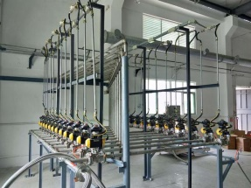

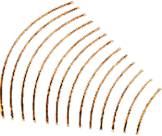

August 2022
Doc.: IEEE 802.11-22/1339r0
Use Case 2: Environmental Sensing
  Sensing and Real Time Monitoring
    Motion and pressure detection
    Detection of gas leakage in gas tanks and pipelines
    Real-time temperature and humidity monitoring for computing and data centres, distribution boxes, and other equipment
  Potential Requirements
    Battery-free thus no need to replacing battery, low complexity and energy consumption
    Long lifespan, e.g., more than 10 years
Temperature/Humidity Sensor
AP
Pressure Sensor
Ambient IoT Device
Gas Sensor
Motion Sensor
Slide 3
Shichao Zhao (Haier)

Slide 4




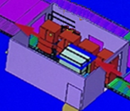

August 2022
Doc.: IEEE 802.11-22/1339r0
Example: Washing Drum Factory
State of the Art
Real time quality inspection and tracing of the assembly line is based on conventional RFID tags on the product trays
  The Product line occupies an area of 25 thousand m2 and it supports more than 20 process
Deploying a large number of readers to determine the product trays 'position
Collected info passed to the digital twin platform.
4. Automatic cabinet scanning
5.Automatic cabinet tilting
Major Issues
Extremely high density deployment of RFID readers is required (one Reader for one process)
The placement of the readers should be adjusted frequently to avoid incorrect identification between adjacent working spots
RFID tags on the product trays can not be properly scanned even with a slight change of facing direction
Requirements:
Larger coverage thus less readers
Simpler and more efficient data collection
Much less stringent requirements for reader and RFID tag placement
6. Counterweight elevator
3. Inner and outer washing drum reversal
7. Automatic water injection
2. Inner and outer washing drum placement
8. Automatic vibrating block reinstall
16. Vertical cabinet dimension detection
17.Top computer board inspection
3. Horizontal cabinet dimension detection
10.Residual water extractor
9. Automatic draining pipe reinstall
15. Foamed cabinet weight detection
11. Automatic detection
14. Real-time sensing of cabinet form temperature
18. Energy consumption sticker printer
12.Nameplate printer
19. Automatic backing
22. Automatic barcode paste
20. Automatic energy consumption sticker paste
13.Multi-code detection
21.Automatic screw tightening
Slide 4
Shichao Zhao (Haier)

Slide 5
Summary
July 2022
Doc.: IEEE 802.11-22/1339r0
This submission presents
  Use of smart manufacturing
  The typical requirements of the use case, including
    Support Inventory, positioning, sensor data collection
    Small size, maintenance-free, battery-free, and ultra-low-cost IoT devices
    Coverage: 10-30 meters for indoor
    Positioning accuracy: 1~3 m horizontal accuracy and 1~2 m vertical accuracy

