Slide 1
Agenda for IEEE 802.11 Coexistence SC hybrid meeting in September 2022
14 September 2022
Authors:
Name | Company | Phone | email
Andrew Myles | Cisco | +61 418 656587 | amyles@cisco.com

Slide 2
Welcome to the second hybrid meeting of the IEEE 802.11 Coexistence SC in September 2022
IEEE 802.11 PDED ad hoc
1 | Warsaw | Sep 2016
2 | San Antonio | Nov 2016
3 | Atlanta | Jan 2017
4 | Vancouver | Mar 2017
5 | Daejeon | May 2017
IEEE 802.11 Coexistence SC
9 | Bangkok | Nov 2018
10 | St Louis | Jan 2019
11 | Vancouver | Mar 2019
12 | Atlanta | May 2019
13 | Vienna | Jul 2019
14 | Hanoi | Sep 2019
15 | Hawaii | Nov 2019
16 | Irvine | Jan 2020
17 | Virtual 1 | Jul 2020
18 | Virtual 2 | Sep 2020
19 | Virtual 3 | Nov 2020
20 | Virtual 4 | Jan 2021
21 | Virtual 5 | Mar 2021
22 | Virtual 6 | May 2021
IEEE 802.11 Coexistence SC
23 | Virtual 7 | Jul 2021
24 | Virtual 8 | Sep 2021
25 | Virtual 9 | Nov 2021
26 | Virtual 10 | Jan 2022
27 | Virtual 11 | Mar 2022
28 | Virtual 12 | May 2022
29 | Montreal/H | Jul 2022
30 | Hawaii/H | Sep 2022
IEEE 802.11 Coexistence SC
1 | Berlin | July 2017
2 | Hawaii | Sep 2017
3 | Orlando | Nov 2017
4 | Irvine | Jan 2018
5 | Chicago | Mar 2018
6 | Warsaw | May 2018
7 | San Diego | July 2018
8 | Hawaii | Sep 2018

Slide 3
Registration is required for the IEEE 802.11 WG electronic interim session in September 2022
  This meeting is part of the September 802 wireless interim session
  You must pay the registration fee whether attending in-person or remotely
  If you have not already done so …
    … you can register here
  If you do not intend to register for this session …
    … you must leave this meeting
    … and, if you have logged attendance on IMAT, email the 802.11 chair or vice chairs to have your attendance cancelled

Slide 4
Coex SC minutes today will be kept by our permanent SC secretary
  It is important to keep proper minutes of all Coexistence SC meetings …
  … and fortunately, way back in July 2017 in Berlin in a time pre-COVID
  … Guido Hiertz (Ericsson) agreed to be appointed the IEEE 802.11 Coexistence SC’s permanent Secretary
  … which means we have now passed a five year anniversary!

Slide 5
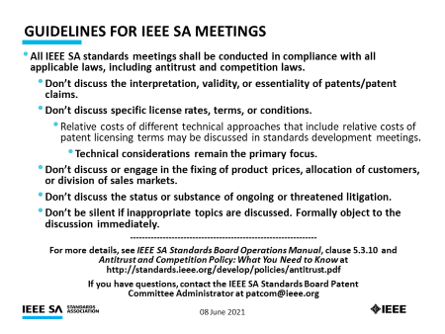
The Coex SC will review the official IEEE-SA patent material for pre-PAR groups
Approved slide

Slide 6
Participant behavior in IEEE-SA activities is guided by the IEEE Codes of Ethics & Conduct
Approved slide
  All participants in IEEE-SA activities are expected to adhere to the core principles underlying the:
    IEEE Code of Ethics
    IEEE Code of Conduct
  The core principles of the IEEE Codes of Ethics & Conduct are to:
    Uphold the highest standards of integrity, responsible behavior, and ethical and professional conduct
    Treat people fairly and with respect, to not engage in harassment, discrimination, or retaliation, and to protect people's privacy.
    Avoid injuring others, their property, reputation, or employment by false or malicious action
  The most recent versions of these Codes are available at
    http://www.ieee.org/about/corporate/governance

Slide 7
Participants in the IEEE-SA “individual process” shall act independently of others, including employers
Approved slide
  The IEEE-SA Standards Board Bylaws require that “participants in the IEEE standards development individual process shall act based on their qualifications and experience”
  This means participants:
    Shall act & vote based on their personal & independent opinions derived from their expertise, knowledge, and qualifications
    Shall not act or vote based on any obligation to or any direction from any other person or organization, including an employer or client, regardless of any external commitments, agreements, contracts, or orders
    Shall not direct the actions or votes of other participants or retaliate against other participants for fulfilling their responsibility to act & vote based on their personal & independently developed opinions
  By participating in standards activities using the “individual process”, you are deemed to accept these requirements; if you are unable to satisfy these requirements then you shall immediately cease any participation

Slide 8
IEEE-SA standards activities shall allow the fair & equitable consideration of all viewpoints
Approved slide
  The IEEE-SA Standards Board Bylaws (clause 5.2.1.3) specifies that “the standards development process shall not be dominated by any single interest category, individual, or organization”
    This means no participant may exercise “authority, leadership, or influence by reason of superior leverage, strength, or representation to the exclusion of fair and equitable consideration of other viewpoints” or “to hinder the progress of the standards development activity”
  This rule applies equally to those participating in a standards development project and to that project’s leadership group
  Any person who reasonably suspects that dominance is occurring in a standards development project is encouraged to bring the issue to the attention of the Standards Committee or the project’s IEEE-SA Program Manager

Slide 9
Participants are required to adhere to the IEEE SA Copyright Policy
Approved slide
  By participating in this activity, you agree to comply with the IEEE Code of Ethics, all applicable laws, and all IEEE policies and procedures including, but not limited to, the IEEE SA Copyright Policy.
    Previously Published material (copyright assertion indicated) shall not be presented/submitted to the WG nor incorporated into a WGdraft unless permission is granted.
    Prior to presentation or submission, you shall notify the WG Chair of previously Published material and should assist the Chair in obtaining copyright permission acceptable to IEEE SA.
    For material that is not previously Published, IEEE is automatically granted a license to use any material that is presented or submitted.

Slide 10
Participants are required to adhere to the IEEE SA Copyright Policy
  The IEEE SA Copyright Policy is described in the IEEE SA Standards Board Bylaws and IEEE SA Standards Board Operations Manual
    IEEE SA Copyright Policy, see:
      Clause 7 of the IEEE SA Standards Board Bylaws
      Clause 6.1 of the IEEE SA Standards Board Operations Manual
  Other material
    IEEE SA Copyright Permission
    IEEE SA Copyright FAQs
    IEEE SA Best Practices for IEEE Standards Development
    Distribution of Draft Standards (see Clause 6.1.3 of the SASB Operations Manual)

Slide 11
The Coex SC will only meet once during the hybrid IEEE 802.11 WG plenary meeting in September 2022
Schedule
  Wednesday, 14 September 2022 @ 4-6pm ET
Webex details
  Join the Webex meeting here:
    https://ieeesa.webex.com/ieeesa/j.php?MTID=mbfd5edcef560adbe15fad0ab6fd98d96
  Meeting number: 2349 664 1296
  Meeting password: wireless

Slide 12
The Coex SC will consider a proposed agenda for its hybrid meeting in Sep 2022
Planned agenda
  Bureaucratic stuff
    Scope of IEEE 802.11 Coex SC
    Approve minutes from Jul 2022
  What is happening this week? (in no particular order)
    ETSI BRAN update
      Meeting scheduled
      EN 301 893 (5 GHz)
      EN 303 687 (6 GHz)
    Do we still have a coex issue between Wi-Fi & LAA/NR-U?
      Questions for Nov 2022
    EN 301 893 (5 GHz) … and the 802.11be issue!
      Questions for Nov 2022
    Updates
      SL-U
      IEEE 802.15.4ab in 6 GHz
      Bluetooth in 6 GHz
      6 GHz spectrum & coex
      60 GHz coex
    Plans for meeting in Nov 2022

Slide 13
  Scope of IEEE 802.11 Coexistence SC

Slide 14
The Coex SC scope was revised in Sept 2020
IEEE 802.11 Coex SC Scope
  The Coex SC shall promote, within the 802.11 WG and externally, an environment that enables IEEE 802.11 technologies to have equitable access to unlicensed spectrum globally
  The Coex SC should focus particularly on coexistence of 802.11ax & 802.11be with LAA & NR-U in the 5 GHz & 6 GHz bands globally
  The Coex SC may consider coexistence with other technologies and in other bands as directed by the Chair of the 802.11 WG
IEEE 802.11 Coex SC close down criteria
  802.11 WG Chair has authority to close down SC

Slide 15
The scope of the Coex SC was expanded in March 2021 to include 60 GHz coexistence issues
  It was noted during the March 2021 plenary that ETSI BRAN is working on 60 GHz Harmonised Standards that may impact IEEE 802.11ay coexistence
  Subsequently, the 802.11 Chair directed the Coex SC to consider 60GHz coexistence within scope
    At today's WG11 Opening Plenary, the comment was made that ETSI BRAN is also considering operational and coexistence requirements related to 57-71 GHz (60GHz) spectrum, relevant of course to 802.11ad and 11ay
    The scope of the Coex SC focuses on, "coexistence of 802.11ax & 802.11be with LAA & NR-U in the 5 GHz & 6 GHz bands globally". However, it "may consider coexistence with other technologies and in other bands as directed by the Chair of the 802.11 WG". So the Coex SC can consider 60 GHz issues if directed by the WG Chair
    I have directed the Coex SC to additionally consider coexistence topics for 60GHz operation

Slide 16
  Minutes

Slide 17
The Coex SC will consider the approval of its hybrid meeting minutes from July 2022
  The draft minutes for the Coex SC at the hybrid meeting in July 2022 are available on Mentor:
    See 11-22-1310-00
  Proposed motion:
    The IEEE 802 Coex SC approves 11-22-1310-00 as the minutes of its virtual meeting in July 2022
    Moved:
    Seconded:
    Result:

Slide 18
Coex SC
Key messages for Sep 2022

Slide 19
There are few key message for the Coex SC that arise out of today’s session
Key coex messages from today’s session include …
  There is not much LAA/NR-U yet …
    … but it appears LAA/NR-U will not coexist well with Wi-Fi
    … which means we might (or might not) have a coex problem
  EN 301 893 (5 GHz) generally protects Wi-Fi …
    … but the compromise may (or may not) result in 802.11be suffering
  IEEE 802.11 WG needs to decide how to respond to the
  European rules …
    … in both EN 301 893 (5 GHz) & EN 303 687 (6 GHz)
  And we are tracking an increasing number of coexistence topics
    SL-U, NB-FH, BT SIG, 60 GHz, 802.15.4ab, 6 GHz
… you can leave if you are not interested in the details ☺
Plan to focus on building consensus in Nov 2022 …
… when Chair available in person
… when more evidence is available

Slide 20
  Agenda items
  What is happening in ETSI BRAN?

Slide 21
The Coex SC has been tracking two Harmonised Standards in ETSI BRAN for 5/6 GHz coexistence
Defined by ESTI BRAN
EN 301 893
(5 GHz)
EN 303 687
(6 GHz)
Satisfying the requirements & tests in these Harmonised Standards provides one mechanism to access the European markets

Slide 22
Note that ESTI BRAN documents are available to IEEE 802.11 WG members
  Today’s material references ETSI BRAN documents
  They are (or should be) available in the IEEE 802.11 WG members area
    See http://www.ieee802.org/11/private/ETSI_documents/BRAN
  Please remember that these documents are not public …
  … and have only been made available to IEEE 802.11 WG members under special arrangement

Slide 23
ETSI BRAN will continue to discuss coexistence & other issues going forward
Meeting schedule for 2022
  BRAN #116
    17 Oct 2022 until 21 Oct 2022
    Hybrid (as normal)
  Some ad hocs have been scheduled after BRAN#116
  BRAN #117
    5 Dec 2022 until 9 Dec 2022
    Hybrid (as normal)

Slide 24
  Agenda items
  What is happening in ETSI BRAN?
  EN 301 893 (5 GHz)

Slide 25
The latest revision of EN 301 893 (5 GHz) is progressing slower than hoped/expected
Document status
  Draft EN 301 893 v.2.1.48 (stable draft), dated: 10 Jun 2022 …
    … with latest changes in BRAN(22)115026r2 (v.2.1.48g)
Commentary
  v2.1.48 was published after BRAN#114 with mostly editorial changes
    Compromise for adaptivity (& associated testing) remains, as originally agreed way back in BRAN#109
  BRAN #115 mostly conducted a very careful editorial review that is taking longer than many hoped/expected
    Adaptivity compromise remains, but the question of 802.11be performance (vs 802.11ax) was raised again, with a proposal to change to ED-only @ -62 dBm; more on this later
  The draft will probably not be sent to the HAS consultant or ENAP ballot until after BRAN#116

Slide 26
  Agenda items
  What is happening in ETSI BRAN?
  EN 303 687 (6 GHz)

Slide 27
The latest revision of EN 303 687 (6 GHz) will now be sent for EC review
Document status
  Draft EN 303 687 v1.0.1 (Sep 2022)
Commentary
  v0.0.20 was completed after BRAN#113
    Adaptivity based on ED-only at -72 dBm included
    Some aspects of NB FH in 4.3.3.2 (specification) & 5 (testing) included
    All support for C2C features removed, at least for the moment
  The ENAP ballot on Draft EN 303 687 v1.0.0 passed in late July 2022
    Comments resolutions are in BRAN(22)115030, with nothing relevant to coex
  The resulting Draft EN 303 687 v1.0.1 (currently in BRAN(22)115030a1) will now be sent the HAS consultant for EC review
    This was a step that was missed before the ENAP

Slide 28
There are some open issues in the current EN 303 687 that may be addressed in the next revision
NB FH operations
  The next version of EN 303 687 will specify that NB FH uses the LBE/FBE channel access mechanisms & channelization’s
  Future revisions of EN 303 687 may extend NB FH further
    See BRAN(21)112011 (Apple) - Narrow Band Channel Access in 6 GHz for some initial discussions
  The plan is for the Coex SC to monitor any future discussions …
  … but in the meantime, NB FH is partially enabled by EN 303 687
C2C operations
  Various efforts were made to specify requirements in EN 303 687 for C2C operations to be enabled by “hearing” any AP in any channel
  There was no agreement on a sufficient level of “hearing” and so the issue has probably been deferred to the next revision
  The plan is for the Coex SC to monitor any future discussions …
  … but in the meantime C2C is not yet enabled by EN 303 687

Slide 29
Coex SC has parked the issue of 802.11be compatibility with EN 301 893 (5 GHz) & EN 303 687 (6 GHz)
  Both EN 301 893 (5 GHz) & EN 303 687 (6 GHz) are based on EDCA style access, which was suitable for 802.11ax (Wi-Fi 6/6E)
    Actually, given the EN 301 893 draft, anything in 802.11ax is allowed in 5 GHz
  802.11be is being developed, and the following generation (UHR) is in discussion, with new features that might not all be aligned with the HS’s
  This suggests two ongoing tasks/options for the Coex SC/TGbe/UHR
    Identify any likely future features that may not be allowed by EN 301 893
    (5 GHz) and EN 303 687 (6 GHz)
    Plan to make a case to ETSI BRAN to refine EN 301 893 (5 GHz) and EN 303 687 (6 GHz) to allow these features
  So far, discussions with TGbe/UHR experts have not identified any features not aligned with EN 301 893 (5 GHz) & EN 303 687 (6 GHz)
    Maybe MLO & Multi-AP Coordination?????
  It is proposed we park this issue until such issues are identified …

Slide 30
  Agenda items
  Do we still have a coex issue
  between Wi-Fi & LAA/NR-U?

Slide 31
Coex work in the IEEE 802.11 WG over the last 5+ years has had a positive impact (directly & indirectly)
  The Coex SC has been monitoring issues related to multi-technology coexistence, especially in the 5/6 GHz bands, for the last 5+ years
  Its work has assisted the avoidance of the worst coex outcomes for
  Wi-Fi (by direct & indirect influence) :
    LTE-U, which had some very undesirable coex properties, appears to no longer have any market relevance, even in the US
    MulteFire Alliance now mainly does 5G marketing rather than specifying technology with questionable coex properties
    3GPP specified LAA & NR-U use EDCA-like access with Wi-Fi compatible timing parameters
      Albeit with unsophisticated “listening” based on ED-only …
      … rather than the more diverse Wi-Fi multi-level approach combining ED & PD at the PHY level with NAV based reservations (including RTDS/CTS) at the MAC level
    ETSI BRAN HS for 5 GHz (EN 301 893) & 6 GHz (EN 303 687) are based on access requirements very much aligned with the “Wi-Fi way”
      But are focused on unsophisticated “listening” based on ED-only

Slide 32
Coexistence between different technologies may still be a problem in real deployments
  The overall coexistence situation has converged on some imperfect compromises … and there are a variety of ongoing risks
    Particularly related to coexistence between Wi-Fi & LAA/NR-U in 5/6 GHz
  While handwaving & simulations suggest LAA/Wi-Fi coex is OK on average … it turns out that real deployments are not average
    University of Chicago’s measurements of real (not average) LAA deployments suggest that LAA sometimes ignores Wi-Fi …
    … probably because the use of ED only by LAA for listening does not work very well, probably due to classic hidden station issues
  While no measurements have been undertaken on NR-U/Wi-Fi coexistence … it seems likely similar issues will arise in real deployments

Slide 33
The Coex SC heard about an LAA/Wi-Fi coexistence studies in Chicago throughout 2021
No change from
Jul 2022
  One of concerns with many of the conclusions drawn in relation to coexistence is that they are based on simulation studies …
  … which have been used over the years to provide evidence for just about any conclusion one might want to draw
  A good complement to simulation studies is measurements of actual deployments …
  … recognising they also have limitations
  During 2021, the Coex SC heard about various LAA/Wi-Fi coexistence measurements undertaken in the in the Chicago area
    See 11-20-1973 (Jan 2021)
    See 11-21-1858 (Nov 2021)

Slide 34
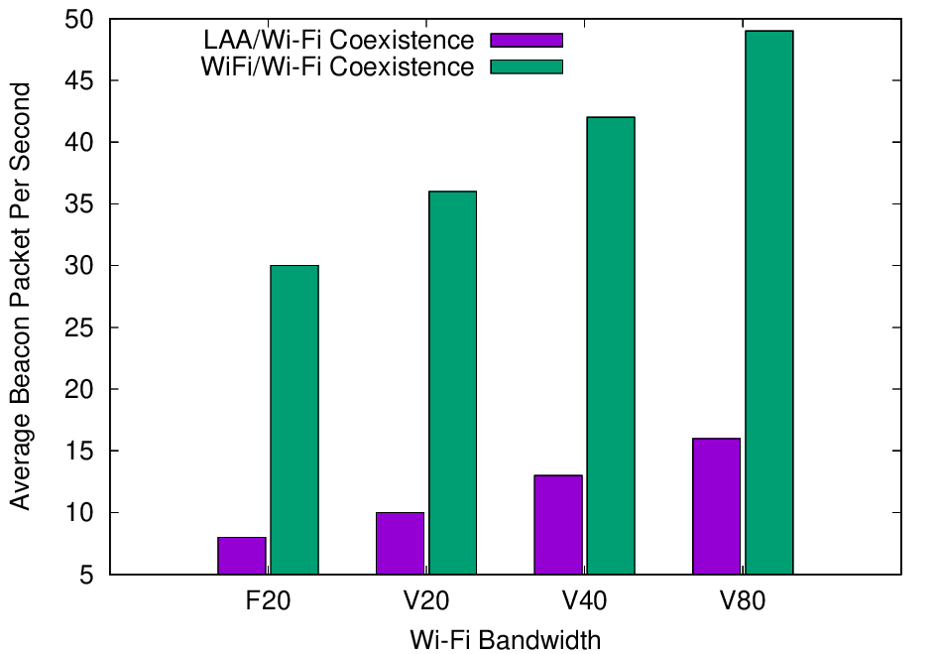
Experiments reported in Jan 2021 showed LAA has a significant adverse impact on Wi-Fi Beacons
No change from
Jul 2022
  The Uni of Chicago study (11-20-1973) investigated the effect of LAA on Wi-Fi operation in various typical configurations, including hidden nodes
  The work showed that LAA
  caused significant interference
  to Wi-Fi Beacons in the tested
  configuration
    Probably because LAA is:
      Using ED @ -72 dBm
      Rather than PD @ - 82 dBm
    Also because LAA typically uses
    long TxOPs (~8 ms)
Addition of a single LAA system to five Wi-Fi systems causes successful Beacon rate to reduce by > 75%
Pushing Wi-Fi APs into the same channel also causes successful Beacon rate to reduce, but by less than LAA

Slide 35
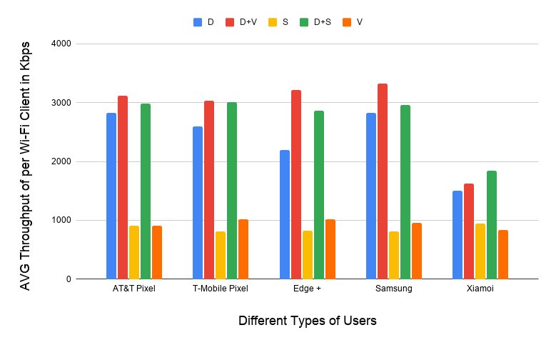
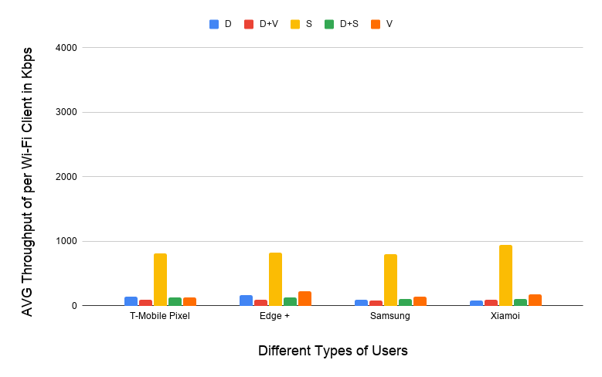
Experiments reported in Jan 2021 showed LAA also has a significant adverse impact on Wi-Fi data
No change from
Jul 2022
  The Uni of Chicago study (11-20-1973) showed that LAA caused significant interference to data traffic in the tested configuration
    Probably because LAA is using ED @ -72 dBm rather than PD @ - 82 dBm
    Also because Wi-Fi’s hidden station mitigation mechanisms based on RTS/CTS have no effect on LAA
5 Wi-Fi APs on one channel, no LAA
5 Wi-Fi APs on one channel, one LAA
11-20-1973 slide 16
All client close
to Wi-Fi APs
Addition of LAA caused all Wi-Fi traffic to collapse …
… except streaming because LAA used licensed for streaming

Slide 36
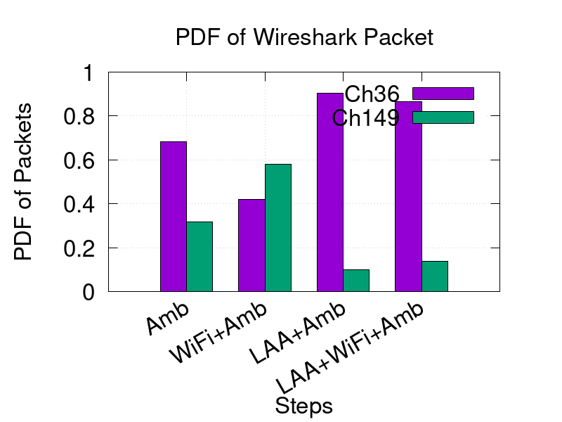
New measurements reported in Nov 2021 seem to confirm the adverse impact of LAA on Wi-Fi
No change from
Jul 2022
  The latest Uni of Chicago results (11-21-1858-01) confirmed previous results …
  … that LAA seems to block most Wi-Fi traffic on an LAA channel
    The problem appears to be that LAA doesn’t back off because it is hidden from the indoor Wi-Fi APs
  It doesn’t help that deployed LAA & Wi-Fi systems are typically quite static in their choice of channels
    Neither system are sharing by avoiding using the same channels

Slide 37
There will not be a Wi-Fi/LAA coexistence problem if LAA is not widely deployed
  Of course, the Uni of Chicago measurements suggesting poor coex between Wi-Fi & LAA in actual deployments only matter if LAA is widely deployed
  If LAA is not widely deployed, we can all just focus on continuing to make Wi-Fi even better than today!
    Wi-Fi 6/6E -> Wi-Fi 7 -> Wi-Fi 8
  The good news is that the evidence so far suggests that LAA may not be as widely deployed as some hoped …

Slide 38
There was a some LAA deployment in
Chicago as early as Jan 2020
No update
Chicago LAA deployment (Jan 2020)
  A study in Chicago in Jan 2020 shows a significant LAA deployment … that was expanding rapidly
    In Jan 2020, AT&T mostly used channel 149 & Verizon mostly used channel 36, avoiding intra-LAA coex issues
  See Measurement-based coexistence studies of LAA & Wi-Fi deployments in Chicago
    Vanlin Sathya, Muhammad Iqbal Rochman, & Monisha Ghosh (Uni of Chicago)
AT&T
Verizon
T-Mobile

Slide 39
We have tracked the use of 5G by SPs in unlicensed bands to highlight the importance of coexistence work
Refined
Tech | Stage | GSMA¹ (July ‘18) | GSA² (Oct ‘18) | GSA³ (Jan ‘19) | GSA⁴ (Jul ‘19) | GSA⁵ (Nov ‘19) | GSA⁶ (Dec ‘19) | GSA⁷ (Mar ‘20) | GSA⁸ (Aug ‘20) | GSA⁹ (Oct ‘20)
LAA | Trials/plans | 23 | 22 | 26 | 29 | 30 | 29 | 29 | 28 | 27
 | Deployed | 4 | 6 | 6 | 8 | 8 | 8 | 9 | 9 | 9
LWA | Trials/plans | ? | 2 | 2 | 2 | 2 | 2 | 2 | 2 | 2
 | Deployed | ? | 1 | 1 | 1 | 1 | 1 | 1 | 1 | 1
LTE-U | Trials/plans | ? | 8 | 8 | 8 | 8 | 9 | 9 | 9 | 9
 | Deployed | ? | 3 | 3 | 3 | 3 | 3 | 3 | 3 | 3
GSMA (July 2018)
GSA: Evolution from LTE to 5G: Global Market Status (Nov 2018)
GSA: LTE in unlicensed and shared spectrum (Jan 2019)
GSA: Evolution from LTE to 5G: Global Market Status (Aug 2019)
GSA: LTE Unlicensed - LTE in Unlicensed and Shared Spectrum (Nov 2019
GSA: LTE and 5G Market Statistics (Dec 2019)
GSA: LTE in Unlicensed Spectrum and Shared Spectrum (Mar 2020)
GSA: LTE and 5G in Unlicensed Spectrum: Trials, Deployments & Devices (Aug 2020)
GSA: LTE and 5G Market Statistics (Oct 2020)

Slide 40
We have tracked the use of 5G by SPs in unlicensed bands to highlight the importance of coexistence work
Latest
data
Tech | Stage | GSA¹⁰ (Jan ’21) | GSA¹¹ (Aug ’21) | GSA¹² (Jul ’22) | GSA¹³ (Sep ’22)
LAA | Trials/plans | 27 | 27 | 27 | 27
 | Deployed | 9 | 9 | 9 | 9
LWA | Trials/plans | 2 | 2 | - | -
 | Deployed | 1 | 1 | - | -
LTE-U | Trials/plans | 9 | 9 | - | -
 | Deployed | 3 | 3 | - | -
GSA: LTE and 5G Market Statistics (Jan 2021)
GSA: NTS Stats Update (Aug 2021)
GSA: NTS Statistics (Jul 2022)
GSA: NTS Statistics (Sep 2022)

Slide 41
The number of deployed/planned LAA networks is steady … suggesting less need for concern
Updated
LWA & LTE-U seem to be somewhat moribund in terms of new operator deployments; both plans or deployments!
No NR-U data!

Slide 42
The growth of LAA devices is slowly growing … suggesting some need for concern about Wi-Fi coex
Refined
Tech | GSA¹ (Mar ’21) | GSA² (Jun ’21) | GSA³ (May ’22) | GSA⁴ (Aug ’22)
LAA | 247 | 329 | 480 | 480
LWA | 16 | 16 | 17 | 17
LTE-U | 46 | 46 | 46 | 46
Suggests LAA is still growing (a bit) in terms of client devices
GSA: LTE 5G Market Statistics (Mar 2021)
GSA: LTE Ecosystem Report (Status Update Jun 2021)
GSA: LTE Device Ecosystem (Status Update May 2022)
GSA: LTE Device Ecosystem (Status Update Aug 2022)
No NR-U data!
LWA/LTE-U seem dead in term of devices!

Slide 43
Limited LAA deployment does not mean NR-U (if widely deployed) will not be a problem
  It is possible (or even likely) that because LAA is not used much, LAA is not going to cause a significant Wi-Fi/LAA coex problem …
  … but less-than-wide LAA deployment may be occurring because the 5G community is focusing on NR-U rather than LAA
  However, NR-U is likely to have similar coex issues with Wi-Fi as LAA …
    Given its somewhat unsophisticsted use of ED-only as a listening mechanism
  … but at this point we have little idea of NR-U’s likely prevalence in actual deployments and so can’t yet assess the risk

Slide 44
In July 2022, the Coex SC briefly discussed potential paths & possible questions to direct our work
Situation
The Uni of Chicago measurements suggest there is a real & ongoing coexistence issue between Wi-Fi & LAA (and maybe NR-U too) in actual deployments!
Are these measurements confirmed?
LAA (& NR-U) rarely needs to coexist with Wi-Fi
Suggesting we can breath a big sigh of relief …
… and continue with Wi-Fi’s success
Path 1
Which path are we going to follow?
LAA (& NR-U) frequently needs to coexist with Wi-Fi
Suggests we have a serious coex problem we need to solve …
… or Wi-Fi’s long term success is at risk
Can we mitigate these issues?
Path 2

Slide 45
The plan today was to attempt to use straw polls to start understanding the answers to our questions ...
  There were few answers offered at the July 2022 session of the Coex SC in Montreal
  In August 2022, the two main paths & some associated questions were highlighted again in an e-mail to the WG e-mail reflector
    The e-mail requested members to think about these questions …
    … and have related submissions for presentation in Sept 2022
    … or be ready to discuss potential answers in Sept 2022
  It is now Sep 2022 and so the plan today was to:
    Discuss the questions & associated issues
    Starting developing answers (via straw polls)
  However, given the Chair is remote, the plan is to postpone these questions (with straw polls) for Nov 2022 ☹
  Please review them in time for Nov 2022

Slide 46
Q: Do LAA/NR-U measurements of deployments suggest a significant coexistence issue for Wi-Fi?
Delayed until
Nov 2022
Measurement related questions:
  Are the Uni of Chicago’s measurements are a reasonable reflection of the coexistence situation between LAA & Wi-Fi in real deployments?
    Straw poll: yes, no, don’t know
  Is anyone planning to make alternative coexistence measurements between LAA & Wi-Fi in deployments?
    Straw poll: yes, no, don’t know
    If yes, please make your identity known to the Chair
  Is anyone planning to make measurements for coexistence between
  NR-U & Wi-Fi in deployments?
    Straw poll: yes, no, don’t know
    If yes, please make your identity known to the Chair

Slide 47
Q: Do LAA/NR-U deployment expectations suggest a significant coexistence issue for Wi-Fi?
Delayed until
Nov 2022
Deployment related questions:
  Is extensive LAA deployment expected in any significant markets?
    Straw poll: yes, no, don’t know
    Yes/no: what is the evidence?
  Is extensive NR-U deployment expected in any significant markets?
    Straw poll: yes, no, don’t know
    Yes/no: what is the evidence?

Slide 48
Q: What can we do to mitigate any coexistence risks?
Delayed until
Nov 2022
Mitigation related questions:
  Are there any obvious mitigations if coexistence issues, like those shown by the Uni of Chicago measurements, arise in practice?
    Straw poll: yes, no, don’t know
    Yes: what are they?

Slide 49
Q: What can we do to use spectrum to mitigate any coexistence risks?
Delayed until
Nov 2022
Spectrum mitigation related questions:
  Is avoidance (where Wi-Fi & LAA/NR-U always operate on different channels) a workable coexistence mitigation in practice?
    Straw poll: yes, no, don’t know
    Yes/no: what is the evidence?
  Is effective avoidance feasible in 500 MHz (the current European situation) or does it require 1200 MHz (the current US situation)
    Straw poll: requires 1200 MHz, feasible with 500 MHz, infeasible
    Yes/no: what is the evidence?

Slide 50
  Agenda items
  What is happening in ETSI BRAN?
  EN 301 893 (5 GHz) … and the 802.11be issue!

Slide 51
ETSI BRAN discussions have directly & indirectly influenced sharing globally in the 5 GHz band
  Over the last few years, ETSI BRAN has been very important in promoting “good” coexistence between multiple technologies in the
  5 GHz band
  The various drafts & revisions of EN 301 893 (5 GHz) have had a significant influence on sharing in the 5 GHz band globally
    Within Europe … and globally … as 3GPP specifications for LAA & NR-U were influenced by ETSI BRAN discussions
  The LAA/NR-U sharing mechanisms are now aligned with the way Wi-Fi has operated so successfully for the last 20+ years …
    … in so far as they use EDCA-like sharing mechanisms/timing & ED listening
    … but not in so far as them using Wi-Fi’s PD listening & NAV

Slide 52
The historical approach of allowing IEEE 802.11 compliant sharing in Europe is no longer acceptable
  EN 301 893 has previously allowed Wi-Fi to use traditional PD/ED
  @ -82/-62 dBm based listening, as part of its EDCA based sharing
    European requirements were historically satisfied merely by operating in compliance with the 802.11 standards
  This approach is now less acceptable in Europe because it was perceived to be less technology neutral
    The underlying issue is that 3GPP does not want to adopt, or cannot adopt, 802.11’s more sophisticated PD or NAV mechanisms …
    … and some believed in was “unfair” that Wi-Fi systems were allowed to satisfy EN 301 893 merely by compliance with IEEE 802.11 standards
    … or that it was “fair” that Wi-Fi systems had a “10 dB advantage” in terms of energy detection
    … although it is also possible that some stakeholders were just attempting to make life difficult for Wi-Fi

Slide 53
A compromise was eventually found that allowed EN 301 893 to progress
  The various debates about the best approach for sharing requirements caused EN 301 893 to slow significantly …
  … requiring expensive trips to Notified Bodies for Wi-Fi 6 devices in the meantime as an alternative
  However, eventually a compromise was struck between cellular & Wi-Fi stakeholders to progress EN 301 893:
    Under the compromise …
    … only IEEE 802.11a/n/ac/ax systems were deemed to satisfy the European rules by compliance with the IEEE 802.11 standard …
    … but all other systems, including IEEE 802.11be systems, are required in the next revision of EN 301 893 to use ED-only @ -72 dBm (scaled in tx power)
    … and testing was kept to an essential set of simple tests

Slide 54
The EN 301 893 compromise results in potential
11a/n/ac/ax vs 11be coex issues!
V1.8.1
Standard
Mar 2015
802.11a/n/ac conformant devices use access mechanisms in 802.11 standard
Other devices followed weird rules with little connection to anything
Very 802.11 focused …
… as only game in town
… but unclear there was good sharing between Wi-Fi/LAA/…
V2.1.1
Standard
May 2017
EDCA based adaptivity
  802.11a/n/ac conformant devices can use using use EDT at -62 dBm
  Other devices use EDT @ -72 dB
Enabled reasonable sharing, using LBT with exponential backoff …
… but a compromise, with different thresholds for Wi-Fi & LAA/NR-U/…
V2.1.8
Stable draft
Sep 2018
EDCA based adaptivity
  Any devices using 802.11 defined PD may use EDT at -62 dBm
  Otherwise use EDT @ -72 dB
Enabled any technology to use either of the two options …
… but 3GPP community were unhappy as they did not want to use 802.11’s PD
V2.1.48
Stable draft
Jun 2022
EDCA based adaptivity
  802.11a/n/ac/ax conformant devices may use ED @ -62 dBm
  Other devices use ED @ -72 dB
Allows traditional Wi-Fi operation …
… but forces 802.11be to use ED-only
@ -72 dBm, with potential coex issues (only way to make progress)
Coex compromise
Potential 11a/n/ac/ax vs 11be coex issues

Slide 55

The Coex SC has focused on two main options to deal with the 5 GHz compromise in EN 301 893
  A summary of future issues related to 802.11be in 5 GHz in Europe was discussed during the March 2022 meeting … and since
    See 11-22-0180
  Various options for how to deal with 802.11be ops in 5 GHz in Europe rules have been discussed, with the main focus on Options B/E
    Option A (do nothing): 802.11be specified to use PD/ED @ -82/-72 dBm
      Poor coex with 802.11 & other technologies; probably no need to modify 802.11 std
    Option B: 802.11be specified to operate within PD/ED @ -72/-72 dBm
      Uncertain coex with 802.11ax & other technologies; need to modify 802.11 standard
    Option C: 802.11be does not operate in 5 GHz
      Objections voiced, at least partially because it would disable aspects of MLO
    Option D: Persuade BRAN to enable PD/ED @ -82/-62 dBm for 802.11be
      Unlikely to be accepted by BRAN, at least in the short term
    Option E: Ask BRAN to enable ED-only @ -62 dBm for 802.11be
      Assertion of poor coex with other technologies, assuming they are deployed

Slide 56
Option B: Should the 802.11 spec be refined to allow operation with ED-only @ -72 dBm?
  The current situation is that IEEE 802.11be systems in Europe will need to operate within an ED-only @ -72 dBm constraint
    With 802.11be effectively operating using ED/PD @-72/-82 dBm …
    … whereas 802.11ax is allowed to operate using ED/PD @-62/-82 dBm
  There have been some studies that claim this is acceptable … and others that claim it is not!
    See following slides reporting on work from May 2021, July 2021 & May 2022
  As an alternative, Option B has been suggested, whereby 802.11be is allowed to use ED/PD @ -72/-72 dBm (effectively ED-only @ -72 dBm)
    Assuming the original 3GPP studies showing LAA using ED-only @ -72 dBm could fairly coexist with Wi-Fi using PD/ED @ -82/-62 dBm are correct …
    … there is no reason to think this would not apply to 802.11be using ED-only @ -72 dBm sharing with 802.11a/n/ac/ax using PD/ED @ -82/-62 dBm

Slide 57
Option E: Should EN 301 893 be changed to always allow ED-only @ -62 dBm?
  Those who assert that 802.11be using ED-only @ -72 dBm is unacceptable have suggested that EN 301 893 adopt ED-only @ -62 dBm as an alternative
    See following slides reporting on work from May 2021 & Jun 2022
  In reply, opponents have asserted ED-only @ -62 dBm is a really bad idea
    We know from 3GPP RAN simulations some years ago that this results in poor coexistence, especially for Wi-Fi!
    This has been confirmed by more recent (albeit relatively simple) simulations
    It has alsi been noted that once EN 301 893 goes down this route, there is no way back … which is a significant problem if NR-U/LAA are widely deployed

Slide 58
In May 2021, the Coex SC heard claims for the optimum path for 5 GHz (& 6 GHz) coexistence
No update from
Nov 2021
  In May 2021, two submissions started the discussions about the optimum future path for coexistence in 5 GHz, especially in relation to the use of 802.11be with legacy equipment… …
    11-21-0705-00
      Simulation and Evaluation of the Impact of Varying ED Thresholds
      Gaurav Patwardhan (HPE), Eldad Perahia (HPE), Stuart Strickland (HPE)
      Uniform use of EDT @ -72 dBm likely to have a positive impact on sharing
      EDT @ -72 dBm in 5 GHz will sometimes disadvantage 802.11be compared to legacy using EDT @ -62 dBm, with some mitigation from RTS/CTS
      Specification work is probably required in both TGme (for 802.11ax) and TGbe
    11-21-0851-00 (Word document)
      5 GHz ED Analysis
      Menzo Wentink (Qualcomm)
      EDT @ -72 dBm in 5 GHz will sometimes disadvantage 802.11be compared to legacy
      Use of EDT @ -72 dBm limits spectral reuse
      EDT of -62 dBm may be a better long-term approach
  … suggesting more work is required!

Slide 59
In Jul 2021, the Coex SC heard further claims for the optimum path for 5 GHz (& 6 GHz) coexistence
No update from
Nov 2021
  In July 2021, Stuart Strickland (HPE) presented a discussion on possible next steps in relation to 5 GHz coexistence, especially in relation to the use of 802.11be with legacy equipment…
    11-21-1179-00
      Similar submission to 11-21-0705-00 in May 2021
      Focused on coexistence between legacy 802.11 using EDT of -62 dB & 802.11be using EDT of -72 dBm
      Concluded that ~10% of 802.11be traffic may suffer a disadvantage, compared to legacy traffic
      Noted that in managed networks a common EDT of -72 dBm may benefit both 802.11be & legacy equipment
      However, highlighted that the simulations used to draw these conclusion are relatively simple … and more work is required
  … suggesting more work is required!

Slide 60
In May 2022, it was highlighted again that more work is required to choose a path
Refined from
Jul 2022
  Stuart Strickland (HPE) reported in May 2022 that
    … we haven’t done any further research, but still don’t find merit in moving to ED-only at -62dBm.
    An ED at -72dbm and an adjustable PD depending on local conditions seems like a promising path.
  … suggesting more work is required!

Slide 61
In Jun 2022 at BRAN #114, an ambit claim to change EN 301 893 to ED-only @ -62 dBm was not accepted
Refined from
Jul 2022
  BRAN(22)114022 from Qualcomm proposed to loosen the constraint in EN 301 893 for all technologies to ED-only @ -62 dBm
    This was option E that we discussed in Mar & May 2022
  The document did not provide an evidence to support this change or to mitigate the concerns expressed …
  … particularly that such a change would essentially enable LAA/NR-U to ignore Wi-Fi in most situations, leading to poor coexistence outcomes
    This conclusion is also supported by the 3GPP RAN simulations from a few years ago
  … suggesting more work is required!

Slide 62
Assertions were made again at ETSI BRAN#115 that
EN 301 893 should be changed to ED-only @ -62 dBm
  More work was discussed at BRAN#115, with three relevant contributions from Qualcomm
    BRAN(22)115019: concluded the 5 GHz compromise was bad for 802.11be
    BRAN(22)115020: concluded the 5 GHz compromise was bad for 11be with SR
    BRAN(22)115021: concluded LAA systems using ED-only @ -62 dBm cause no harm to 802.11 systems
  The conclusion in BRAN(22)115021 was not agreed/adopted at BRAN#115 but it will probably arise again at BRAN#116 in October
  It was hoped that Menzo Wentink (Qualcomm) would be able to provide a summary to the Coex SC …
    An invitation was sent … but no reply so far

Slide 63
There is clearly a continuing difference of opinion on how 802.11be should operate under EN 301 893
  Most in the Wi-Fi community would have preferred EN 301 893 treated 802.11be like previous versions of Wi-Fi (Option D)
    … but cellular community don’t like that
    ... leading to “the compromise”
  Some in the Wi-Fi community are advocating PD/ED @ -72/-72 dBm
  (= ED-only @ -72dBm) as an acceptable solution (Option B) …
    … but others disagree
  Some in the Wi-Fi community are advocating ED-only @ -62dBm will not harm Wi-Fi compared to LAA/NR-U (Option E)…
    … but others in the Wi-Fi community believe this assertion is unsupported
    … with a concern that there is no way back once ED-only @ -62dBm is allowed

Slide 64
The Coex SC probably needs more agreement on the problem before determining a path forward
  Originally the plan today was to run a series of straw polls to start building consensus on the next steps wrt 802.11be under EN 301 893 …
  … but besides it being difficult to undertake such a exercise with a remote Chair
  … and it is not clear that there is sufficient agreement on whether there is a problem and what that problem is
  Stakeholders are urged to bring submissions in November that help answer the straw poll questions on the following pages …
  Please review questions in time for Nov 2022

Slide 65
Q: Is there a problem under EN 301 893 if 802.11be is constrained by an ED-only @ -72 dBm rule?
11be/ax coex issue?
  Is 802.11be (using PD/ED @ -82/-72 dBm) at a significant disadvantage compared to 802.11ax under the proposed rules in EN 301 893?
    Straw poll: yes/no/don’t know
    Evidence?
  Is allowing 802.11be to use PD/ED @ -72/-72 dBm sufficient mitigation for any disadvantage?
    Straw poll: yes/no/don’t know
    Evidence?
  …

Slide 66
Q: Is LAA/NR-U deployment something we need to worry about?
Deployment of LAA/NR-U?
  Noting that coex between Wi-Fi & NR-U/LAA is only an issue if NR-U/LAA is often deployed, is NR-U/LAA going to deployed often in 5 GHz in Europe?
    Straw poll: yes/no/don’t know
    Evidence?
  Is LAA/NR-U more likely to be deployed if the only constraint is ED-only @ -62 dBm?
    Straw poll: yes/no/don’t know
    Evidence?

Slide 67
Q: What should Coex SC advocate?
Next steps:
  Should the Wi-Fi community advocate that EN 301 893 adopt ED-only @ -62 dBm?
    Yes/no/don’t know
    Evidence of no harm?
  Should the Wi-Fi community advocate that EN 301 893 allow 802.11be to follow the 802.11 standard (like 802.11ax)?
    Yes/no/don’t know
    How do we overcome political constraint?

Slide 68
  Agenda items
  What is happening wrt
  coexistence in 3GPP?

Slide 69
The Coex SC will continue to monitor potential coex impacts of 3GPP’s SL-U
  In Jan 2022, Dorin Viorel (CableLabs) provided an update on 3GPP RAN activities relevant to coexistence
    See 11-22-0124-00
    It was noted at that time that a new proposal called SL-U may cause future coex issues for Wi-Fi
      SL-U is Side Link Unlicensed
      Coex of SL-U with NR-U and Wi-Fi has not been studied
      It is possible that SL-U will not follow the NR-U access framework
  In Jul 2022, Dorin Viorel (CableLabs) provided an update on potential coex issues that may arise from SL-U work in 3GPP
    See 11-22-1091-00
  There has been no update since …

Slide 70
  Agenda items
  How do we avoid coexistence issues
  with IEEE 802.15.4ab?

Slide 71
There is activity underway in IEEE 802.15.4ab with a potential impact on Wi-Fi coexistence
From
May 2022
  IEEE 802.15.4ab (next generation UWB) is discussing a mechanism that:
    … uses NB FH transmissions in the lower band (upper UNII3)
    …to signal channel reservation in the upper band (UNII 6, UWB Ch.5 & Ch.9)
  This NB FH operation is targeted towards improving the link UWB budget by avoiding collisions of UWB signals in the UWB channels
  However, it seems less concerned about coexistence with Wi-Fi
    The original version did not specify any LBT …
    … although that may change with proposals for ED-only @ -62 dBm
    Additional noise from such a deaf version of NB will likely have an adverse affect on Wi-Fi …
    …noting Wi-Fi and LAA/NR-U typically listen at -72 dBm or less
  The arguments seem similar to the NB discussions in ESTI BRAN
    … with some of the same stakeholders

Slide 72
The Coex SC briefly discussed the potential coex issue related to IEEE 802.15.4ab work in July 2022
  In May 2022, IEEE 802.15 WG reps were asked to provide a briefing to the Coex SC during this session in relation to IEEE 802.15.4ab work
  The briefing was provided in the 802.11 WNG SC (to avoid a clash)
    See 11-22-1081-01
  There was some limited discussion of this issue during the Coex SC session in July 2022

Slide 73
There are ongoing efforts to think about how we can avoid coex issue with 802.15.4ba going forward
  After the July 2022 meeting, Andrew Myles asked Ben Rolfe
    What are the next steps for the work and for collaboration with the Coex SC?
  Ben Rolfe replied:
    That's a great question, and one that deserves some thought
    I've been working with several folks who have been doing both modelling and live measurement-based studies with 802.11ax and UWB
    But so far there isn't any OQPSK 5 GHz gear to test with, and I don't know of anyone who is doing PHY level simulation or analysis for the narrow band yet (nothing public so far)
    I have been in discussion with some folks about network simulation similar to what we did for 802.11ah and 802.15.4g in the sub-1 GHz bands for the 802.19.3 effort
    That work was very valuable in developing coexistence strategies that have proven to work well when employed (802.19.3)
    …

Slide 74
There are ongoing efforts to think about how we can avoid coex issue with 802.15.4ba going forward
    …
    We can possibly extrapolate some of the past results, as it shows the way the channel access (CSMA) in both services reacts to the other, which was very enlightening by the way
    Of course, we have a lot of experience in 2.4 GHz with 802.15.4 OQPSK and 802.11g but that has very little relevance to 802.11ax IMO as the lower-order modulation and channel widths of 802.11g in 2.4 GHz are going to have significantly different link characteristics
    We already have a substantial body of evidence on 2.4 GHz (and the best advice to anyone thinking of using the 2.4 GHz band is given in the sign from Dante's Inferno 😉), which is why the recommendation to look at other bands!
    So there is a lot going on; in the 4ab community, this is a serious effort and the "it's unlicensed spectrum so get over it" argument has been pretty much replaced with "we need to know what happens and figure out how to make it all work".
    I would like to see that spread across all of 802, to be blunt. So how do we make that happen?

Slide 75
  Agenda items
  Is there a coexistence issue
  with Bluetooth in 6 GHz?

Slide 76
It appears Bluetooth SIG is planning operation in the 6 GHz band … and want to cooperate on coex issues
  Bluetooth & Wi-Fi have happily coexisted in the 2.4 GHz band for many years … mainly by avoiding each other
  There are now rumours that the Bluetooth SIG are planning to specify Bluetooth operation in 6 GHz …
  … which were confirmed in July 2022 by Rich Kennedy
    Every year, more than 5 billion Bluetooth devices are shipped
    Today, the Bluetooth SIG looks beyond 2.4 GHz
    The 5 GHz band is not available to Bluetooth because of DFS or CDC
    In Sept, the Bluetooth SIG will begin a project related to coexistence in the license-exempt 6 GHz band
    They want to collaborate instead of fight

Slide 77
NB FH coex could be difficult …
  The NB FH proposals in ETSI BRAN for 6 GHz in Europe were controversial ... eventually causing NB FH to be removed (mostly) from the next revision of EN 303 687
  There has been some work on NB FH/Wi-Fi coex presented in WNG over two meetings suggesting a potential problem in practice
    11-22-1578-00 (Sep 2022)
    11-22-0998-01 (Jul 2022)
  Hopefully, the Bluetooth activity in 6 GHz will be less controversial … and we will have more information in Nov 2022 so we can understand any coex issues
    Rich Kennedy (or anyone else) is encouraged to make a submission

Slide 78
  Agenda items
  6 GHz spectrum & coex

Slide 79
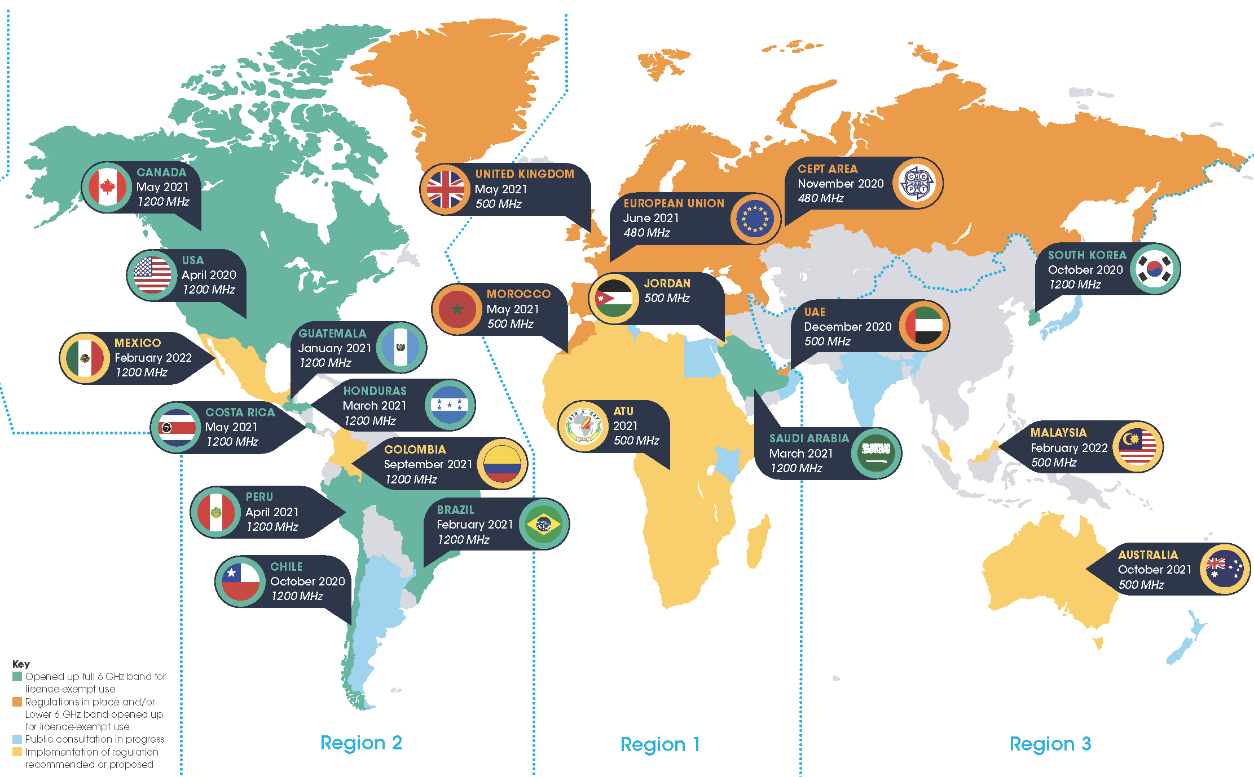
6 GHz is opening globally for unlicenced operation …
Opened up full 6 GHz band (1200 MHz) for unlicensed
Opened up lower 6 GHz band (500 MHz) for unlicensed
Public consultation in progress
Regulation for at least some 6GHz unlicensed recommended
An important decision point is WRC-23 in Dec 2023 at which it will be decided if the upper 6 Hz will be designated as IMT in Region1 (Africa & Europe) – this is a political & technical decision! GSMA is “wining & dining” heavily
Varied rules on C2C, VLP & standard power

Slide 80
The new 6 GHz band will hopefully satisfy the demand for unlicensed bandwidth (especially for Wi-Fi)
European unlicensed situation
  Available unlicensed & licensed spectrum is roughly equal in Europe today …
        More than 1000 MHz in low/mid-band for licensed operation
        About 1000 MHz for unlicensed operation (excluding upper
        6 GHz band)
  … & yet licensed spectrum only delivers about 5% of data traffic
    Most of the remaining 95% is delivered by Wi-Fi …
    … based on German data
    … confirmed by recent UK data
  There is an excellent case to allocate all of the 6 GHz band globally for unlicensed use …
    Data continues to grow …
    …. which Wi-Fi in unlicensed can serev more efficientlu than cellular in licensed
    … Wi-Fi can serve QoS/determinism needs
    … and Wi-Fi will enable continued economic growth
  … despite the assertions of the GSMA representing cellular stakeholders
    Often based flawed studies, eg this economic model

Slide 81




6 GHz spectrum is tied into coexistence … and is probably the key to avoiding the worst coex issues
Wi-Fi is the prime technology in unlicenced spectrum?
It is unclear whether NR-U will succeed;
LAA has not succeeded so far
Yes
No
All 1200 MHz in 6 GHz unlicensed?
All 1200 MHz in 6 GHz unlicensed?
Answer will vary
by country
Yes
No
Yes
No
Wi-Fi has room to grow & thrive for benefit of all
Insufficient unlicensed spectrum for Wi-Fi to meet users’ needs!
Coex issue between
Wi-Fi & LAA/NR-U, mitigated by possibility of using avoidance
Coex issue between
Wi-Fi & LAA/NR-U, with no current known mitigations
1200 MHz of unlicensed is vital

Slide 82
  Agenda items
  60 GHz status?

Slide 83
The Coex SC has previously discussed coexistence in 60 GHz …
  At the Coex SC meeting in Mar 2021 a submission was presented that provided the status of 60 GHz work in ETSI BRAN
    See 11-21-0430-00 (Assaf Kasher (Qualcomm))
  In May 2021, the Coex SC heard about Coexistence between radars and communication systems in the 60 GHz band
    See 11-21-0796-00 (Alecsander Eitan (Qualcomm) et al)
  In Jul 2021,the Coex SC heard about Coexistence between radars and communication systems in the 60GHz band – U.S. Update
    See 11-21-1089-00 (Alecsander Eitan (Qualcomm) et al)
  In Sep 2021, the Coex SC heard NPRM work was occurring in 802.18

Slide 84
… but there was not much to report to the Coex SC in relation to 60 GHz coex in May 2022
  An e-mail was sent to Alecsander Eitan (Qualcomm) asking for an update on 60 GHz coex activities …
  … and in May 2022 he responded:
    Unfortunately, there is nothing new that can be reported. Many submissions have been sent to the FCC, and several comments on the other submissions have been also sent. There are some discussions between companies on compromise ideas
    …
    The FCC 60GHz NPRM is still undergoing so it may be premature to close this topic, however we don’t have any details that we can present. We can re-evaluate the situation in the future meeting

Slide 85
… and there is not much to report to the Coex SC in relation to 60 GHz coex in Sept 2022
  Alecsander Eitan (Qualcomm) provided an update on 60 GHz coex activities in July 2022
    There was no change in the last months.
    The situation is exactly the same:
    “The FCC 60GHz NPRM is still undergoing so it may be premature to close this topic, however we don’t have any details that we can present. We can reevaluate the situation in the future meeting. “
  And there has been no further update in Sept 2022
  At this point, the plan is to keep monitoring …

Slide 86
  Coex SC
  Plans for next meeting

Slide 87
The Coex SC will continue its normal business in Nov 2022 (hybrid meeting in Bangkok)
Possible agenda items for Bangkok …
  Review ETSI BRAN coex activities
    EN 301 893 (5 GHz)
    EN 303 687 (6 GHz)
  Discuss answers to questions discussed today
    Do we have a coex issue between LAA/NR-U and W-Fi?
    What should be do about 802.11ax/be coex in 5 Ghz in Europe
  Hear updates
    SL-U
    60 GHz
    BT in 6 GHz
    802.15.5ab UWB
    NB FH
  … but as usual, submissions are requested!

Slide 88
Other potential topics for Nov 2022
  Sumit Roy (UofW) is planning to provide some new coex results in Sep/Nov 2022
    Abstract tbd
    An invitation will be sent
  We could hear about ML based coexistence between Wi-Fi and NR-U/LAA from Szymon Szott (AGH University)
    See 11-22-0979-01 (presentation to AIML TIG)
    An invitation will be sent

Slide 89
The IEEE 802.11 Coexistence SC hybrid meeting in September 2022 is adjourned!

