Slide 1
Comment Resolution (D0.1) Status Update and Recommendations
Date: 2022-07-28
Authors:

Slide 2
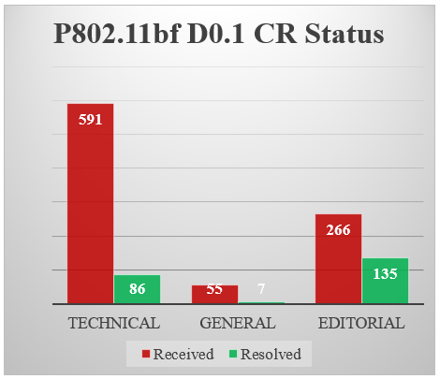
Current status
As discussed in the plenary, we have approved 25% of the comments submitted to CC40 so far.
  Progress on technical and general comments has been slower: 93 out of 646 (14.4%)
  Progress of non-DMG subclauses has been even more slow: 9 out of 522 (1.7%).

Slide 3
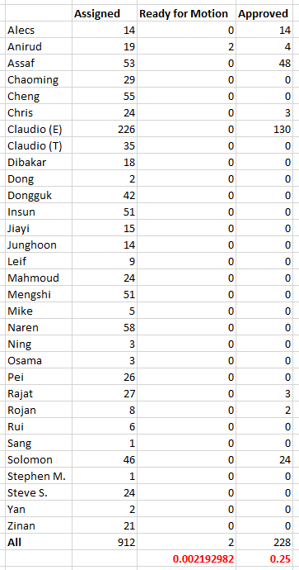
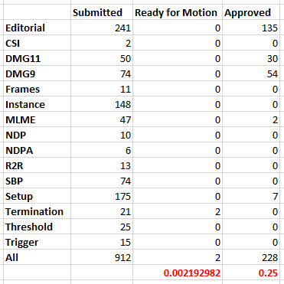
Current status
Note: These tables can be found in 22/0919r3.

Slide 4
Discussion
Our progress has not been slowed down by a particular person or group of people, by discussions on a given topic, or by meeting time constraints.
Main reasons for slow progress seem to be (1) relatively small number of contributions, and (2) discussions required to address key technical issues.
As a contribution-driven organization, we are counting on you (individual contributors) to progress in our D0.1 comment collection resolution process.

Slide 5
Timeline
It has been discussed and suggested that we change our timeline for publishing D1.0 in November 2022 (that is, in less than 4 months from now).
Given that we still have 511 sub-7 GHz technical comments open, it may be useful to set a short-term goal of addressing 300 of such comments by the end of the September interim (7 weeks).
Note: Even if we let the timeline slip to January 2023, we would still need ~200 sub-7 GHz technical comments to be resolved by the end of the September interim.

Slide 6
Suggestions
PoCs
  Please work with your group so that each comment group has at least 50% of its comments resolved by the end of the September interim
    It may be useful to ask volunteers the number of CIDs they plan to resolve by the end of the September interim.
  Please continue to facilitate offline progress (for example, by scheduling ad-hoc calls)
Use SPs as a tool to reach consensus
  Number of contributions doesn’t seem to reflect number of on-going discussions
Focus on the draft, and not on the SFD
  If new requirements and/or features are identified, contribution should be in the form of a PDT
Avoid adding and/or keeping TBDs in new CR/PDT contributions
  D0.1 has 106 TBDs; D0.2 has 93 TBDs
If you have any further suggestions and/or see any problems, please do let us know.

