Slide 1
SBP Procedure Setup
Date: 2022-07-26
Authors:
Name | Affiliations | Address | Phone | Email
Claudio da Silva | Meta |  |  | claudiodasilva@fb.com
Cheng Chen | Intel |  |  | cheng.chen@intel.com
Oscar Au | Origin Wireless Inc. |  |  | Oscar.au@originwireless.com
Notes:
September 2012

Slide 2
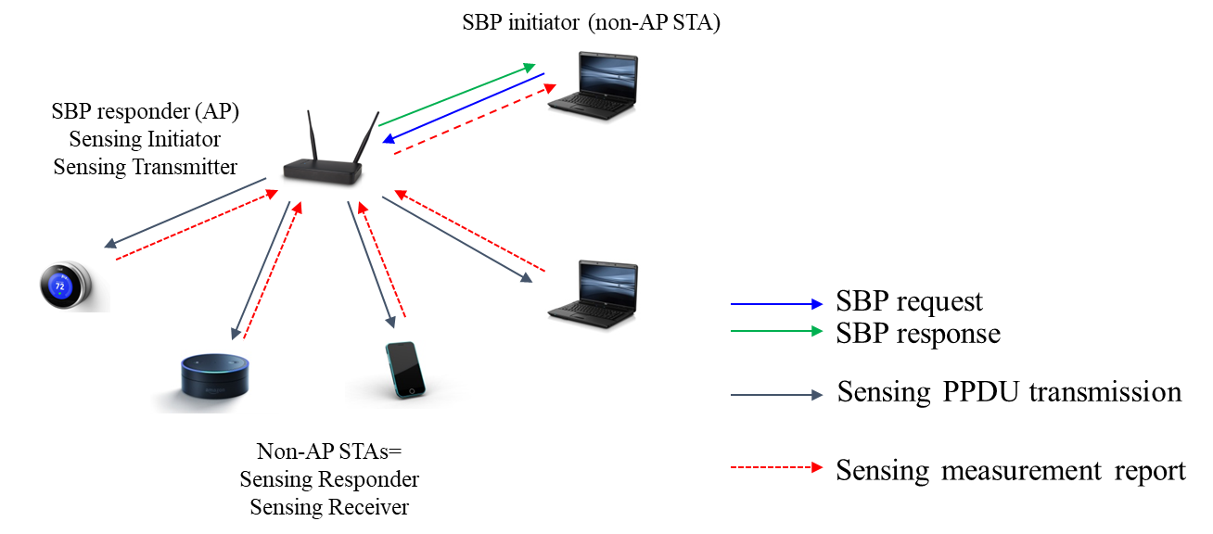
Background
Basic framework of the SBP procedure is defined in D0.1.
  SBP is a procedure that allows a non-AP STA to request an AP to perform WLAN sensing on its behalf.
  It can be roughly divided into three “phases”
    SBP procedure setup: To establish an SBP procedure, the SBP initiator (non-AP STA) sends an SBP Request frame to an SBP responder (AP).
    WLAN sensing: “An SBP responder that sends an SBP Response frame with status code SUCCESS should initiate a WLAN sensing procedure with one or more non-AP STAs using operational parameters derived from those indicated within the SBP Request frame that requested the SBP procedure.”
    SBP procedure reporting (optional)

Slide 3
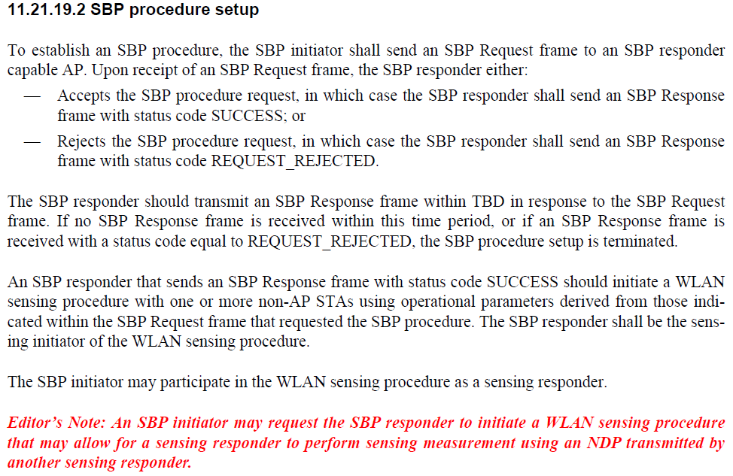
D0.2

Slide 4
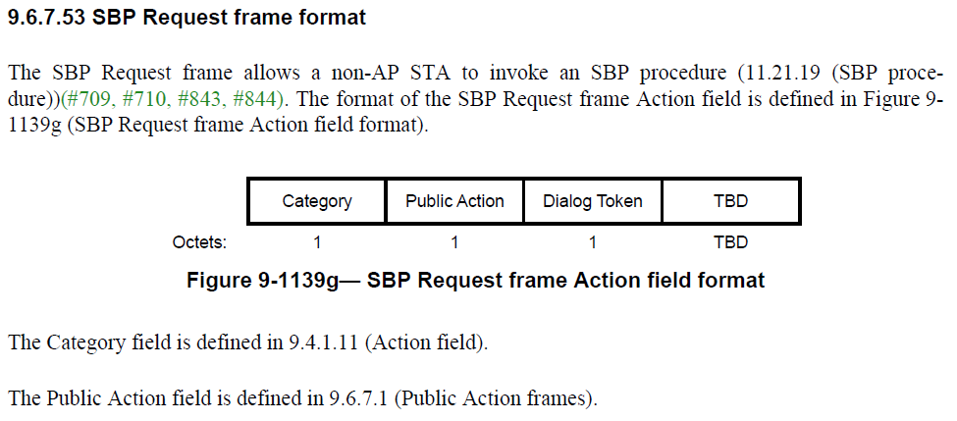
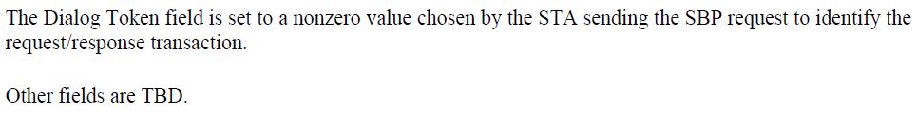
D0.2

Slide 5
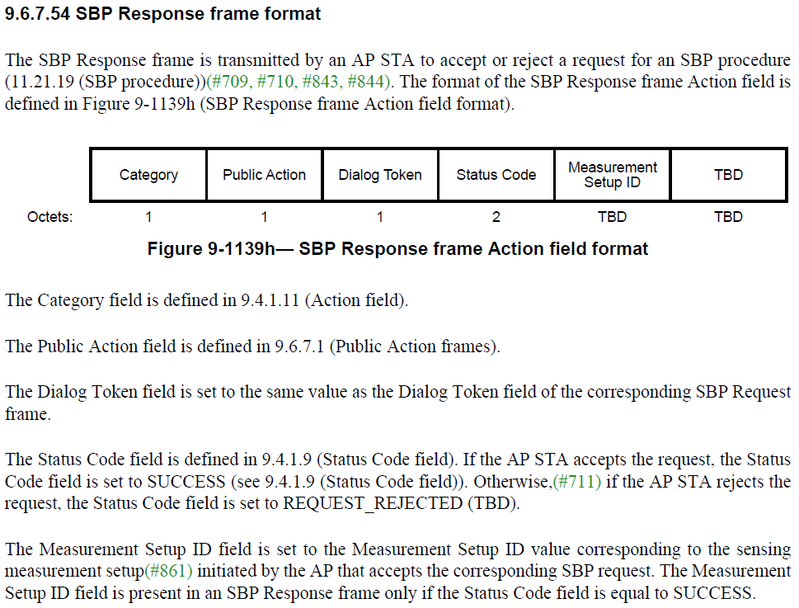
D0.2

Slide 6
Problem Statement
Currently, the following items are pending and need to be defined to complete the definition of the SBP procedure.
  How does the SBP initiator “selects” and requests sensing responders to be used in WLAN sensing procedures initiated by an SBP request?
  How does the SBP initiator requests operational attributes to be used in WLAN sensing procedures initiated by an SBP request?
  How does the SBP initiator signals its intent to participate in WLAN sensing procedures initiated by an SBP request?
There are several CIDs on these topics, including: 47, 204, 276, 459, 493, 573, 576, 595, 596, 743.
This contribution aims to seek feedback from the group, and converge, on possible answers/solutions to the above questions.

Slide 7
Sensing Responder “Selection”
Two cases have been discussed so far in various contributions and email threads:
Case 1: SBP initiator does not have a preferred list of STAs
  SBP initiator relies on the SBP responder to identify potential sensing responders.
    Note: SBP initiator may not even be aware of any other devices nearby except for the SBP responder AP it is associated with.
  Solution: The SBP initiator requests a number of sensing responders.
Case 2: SBP initiator has a preferred list of STAs
  This could happen in a controlled or managed network (e.g., enterprise scenarios or retail stores) where devices can easily discover each other via some implementation specific means (app, cloud, etc.).
    List of preferred STAs is provided by SME (SBP initiator); the standard does not define a procedure to obtain preferred STA list.
  This case was discussed at a few contributions, for example, 22/0671r1.
  Solution: SBP initiator requests a desired sensing responder list to SBP responder.
    Preferred sensing responders are identified with MAC addresses

Slide 8

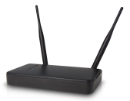



Illustration of Case 1
Illustration of Case 2
SBP request
SBP response
SBP Initiator (non-AP STA)
SBP Initiator (non-AP STA)
SBP Responder (AP)
Sensing Initiator
SBP Responder (AP)
Sensing Initiator
SBP Request includes
Number of sensing responders
Operational parameters
SBP Request includes
Preferred sensing responder list
Operational parameters
Example: 3 sensing responders, 160 MHz
Example: STA1’s MAC address, STA4’s MAC address, 160 MHz
STA1
160 MHz-capable
STA1
160 MHz-capable
STA4
160 MHz-capable
STA4
160 MHz-capable
STA2
80 MHz-capable
STA3
160 MHz-capable
STA2
80 MHz-capable
STA3
160 MHz-capable
Sensing Responders
Sensing Responders

Slide 9
Operational Parameters
SBP Request frame includes requested operational parameters to be used in sensing measurement instances associated with an SBP request.
The list of operational parameters could include, but possibly not limited to, the following items:
  SBP specific parameters: Number of sensing responders, whether SBP initiator participates in resulting SBP procedures.
  “Conventional” operational parameters: Role of sensing responders, PHY parameters
    “Conventional” operational parameters are those found in the Sensing Measurement Parameters element, which is included in the SBP Request frame.
To keep complexity at bay, one set of operational parameters is defined in the SBP Request frame that applies to all sensing responders.
  Recall that SBP Response frame includes a single Measurement Setup ID.

Slide 10
SP 1
Do you agree with the following:
SBP Request frame shall include
  One field used to request a total number of sensing responders
    One bit used to indicate if the request shall be rejected or may be accepted if the total number of sensing responders can’t be supported.
      Example: Set to 1 to indicate that request shall be rejected if the total number of sensing responders can’t be supported. Set to 0 to indicate that a smaller number of sensing responders is acceptable.
  One optional element that defines a Sensing Responder List used to indicate the identities of sensing responders requested by the SBP initiator
    The element includes a list of MAC addresses of the preferred sensing responders
    One bit used to indicate if only sensing responders in the provided list shall be used or not.
      Example: 1 is set to indicate only sensing responders in the provided list shall be used. 0 is set to indicate that sensing responders that are not on the list, but that can satisfy requested operational parameters, may be used.

Slide 11
SP2
Do you agree with the following:
The SBP Request frame shall include one Sensing Measurement Parameters element, as defined in 9.4.2.317 (Sensing Measurement Parameters element), that is used to request operational parameters to be used in sensing measurement instances that result from the SBP request.
The SBP Request frame may also include other SBP-specific operational parameter fields/elements, such as one used to indicate whether the SBP initiator requests to participate in the WLAN sensing procedure as a sensing responder.

