Slide 1
Tame ACK (TACK) in QUIC
Date: 2022-07-12
Authors:

Slide 2
Abstract
The dependence on frequent acknowledgments (ACKs) is an artifact of current transport protocol designs rather than a fundamental requirement.
We analyzes the problems caused by contentions and collisions on wireless medium between data packets and ACKs in WLAN.
We propose an ACK mechanism that minimizes the frequency of ACK Frame in QUIC, improving the performance of transport layer connection.

Slide 3


Scenarios: ACKs cause internal interference
ACK: ACKnowdedgement
External Interference
Internal Interference
Forward path：Data packets
Backward path：
ACK packets
External Interference：Between wireless devices on the same channel
Internal Interference： Between data packets and ACKs in the same connection
Notes:
Most modern WLANs are based on the IEEE 802.11 standards.
It is well-studied that medium access overhead in WLAN can significantly reduce transport-layer throughput,
this is because ACKs cause internal interference on the same connection.

Slide 4
ACKs cause similar medium access overhead
Inter-frame space
(IFS)
Contention window
(random back off)
Last frame
Next frame
Time
Extra overhead for sending each packet
independent with packet size
Medium acquisition overhead in WLAN based on the IEEE 802.11 medium access control (MAC) protocol
Notes:
When frames are operated in the MAC layer,
the time period including the inter-frame space and a random back-off period is the extra overhead
between completion of the last frame and starting of the next frame.
【】Since the extra overhead for sending each packet is independent with packet size,
ACKs cause almost similar medium access overhead despite the much smaller size.
As a result, the internal interference between data packets and ACKs is non-negligible.

Slide 5
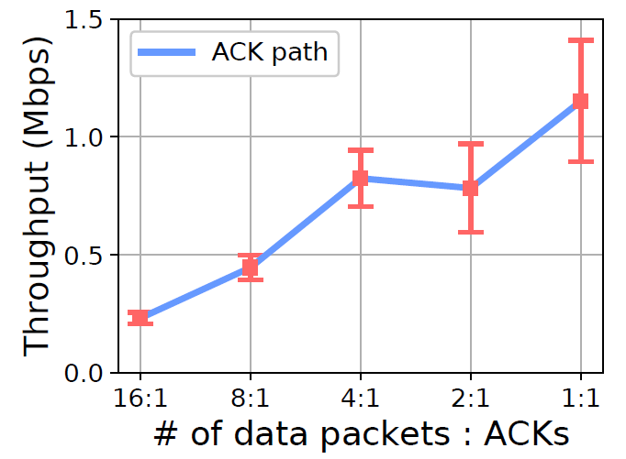
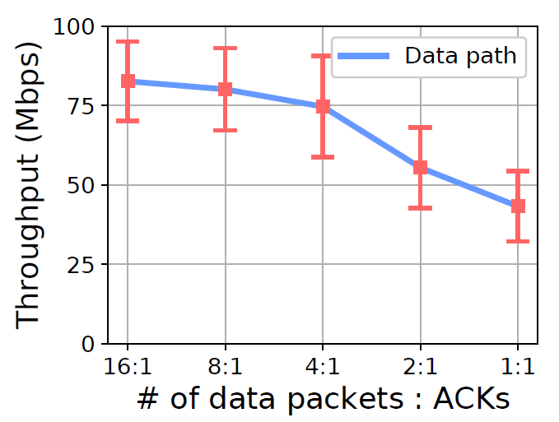
Reducing ACK frequency improves throughput
ACK frequency increases
(a) ACK throughput
(b) Data throughput
Experiments for contention between data packets and ACKs over 802.11n wireless links
  *Data is collected by a UDP-based simulation tool Ackemu (https://github.com/fillthepipe/ackemu)
Notes:
To explain the internal interference more clearly,
we conduct emulations over wireless links.
Basically, TCP sends an ACK for every one or two packets which is frequent.
As shown in the left figure,
【】the throughput on the ACK path is relatively low,
however, as shown in the right figure,
【】the throughput on the data path decreases significantly with the increase of ACK frequency.

Slide 6
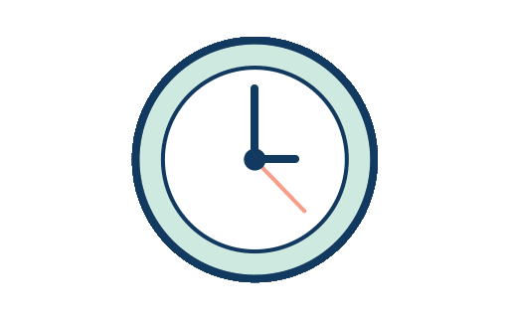




Two ways to reduce ACK frequency (f)
Byte-counting ACK
Periodic ACK
$$f=\frac{bw}{L∙MSS}$$
$$f=\frac{1}{α}$$
Data
ACK
$$α$$
ACK
ACK
(L=2)
$$α$$
(L=1)
(L=3)
ACK
f: ACK frequency with unit of Hz, i.e., number of ACKs per second
L: number of full-sized packets counted before sending an ACK
MSS: maximum segment size
bw: data throughput
𝛼: time interval between two ACKs
Notes:
ACK frequency can be denoted by f with the unit of Hz,
that is, the number of ACKs per second,
which can be reduced in two fundamental ways:
byte-counting ACK and periodic ACK.
【】Byte-counting ACK reduces ACK frequency by sending an ACK
for every two or more incoming full-sized packets.
The frequency is proportional to data throughput.
【】We can also reduce ACK frequency by sending an ACK for each time interval,
that is, periodic ACK.

Slide 7
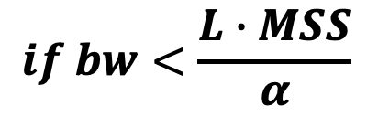
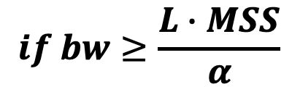
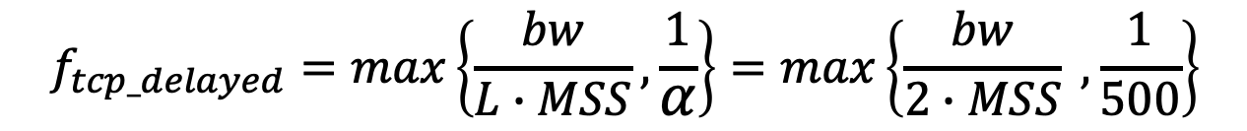
Delayed ACK is not bounded or not minimized under bandwidth change
ACK frequency Modeling:
RFC 1122 & RFC 5681
$$f_{tcp_delayed}=max\left\{\frac{bw}{L∙MSS},\frac{1}{α}\right\}=max\left\{\frac{bw}{2∙MSS} , \frac{1}{500}\right\}$$
$$if bw≥\frac{L∙MSS}{α}$$
$$if bw<\frac{L∙MSS}{α}$$
(Byte-counting ACK)
(Periodic ACK)
bw: data throughput
MSS: maximum segment size
L: number of full-sized packets counted before sending an ACK
𝛼: time interval between two ACKs
f: ACK frequency with unit of Hz, i.e., number of ACKs per second
Notes:
Legacy TCP or QUIC alternatively adopts delayed ACK,
in which a data receiver may delay sending an ACK for every L full-sized incoming packets
or by a given time interval.
As recommended in RFCs,
L is limited up to 2 and ⍺ is tens to hundreds of milliseconds,
and varies in different Linux distributions.
【】when data throughput is high,
the ACK frequency still might be large.
【】On the other hand, when data throughput is low,
the ACK frequency is always as high as that in the case of a high throughput,
which wastes resources.
This reveals that the frequency of TCP’s delayed ACK is not bounded
or not minimized under bandwidth change.
In other words,
The delayed ACK is far from being optimal.

Slide 8
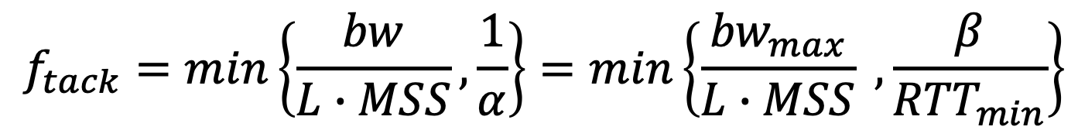
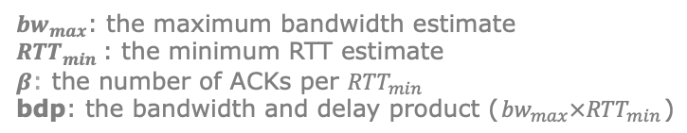
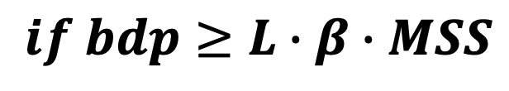
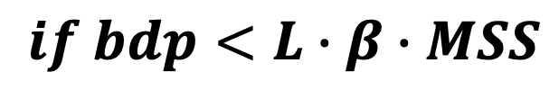
Tame ACK (TACK) Achieves Required Minimal ACK Intensity
$$f_{tack}=min\left\{\frac{bw}{L∙MSS},\frac{1}{α}\right\}=min\left\{\frac{{bw}_{max}}{L∙MSS} , \frac{β}{{RTT}_{min}}\right\}$$
$$if bdp<L∙β∙MSS$$
$$if bdp≥L∙β∙MSS$$
(Byte-counting ACK)
(periodic ACK)
f: ACK frequency with unit of Hz, i.e., number of ACKs per second
L: number of full-sized packets counted before sending an ACK
${bw}_{max}$: the maximum bandwidth estimate
${RTT}_{min}$: the minimum RTT estimate
$β$: the number of ACKs per ${RTT}_{min}$
bdp: the bandwidth and delay product (${bw}_{max}×{RTT}_{min}$)
Notes:
We propose TACK,
a new acknowledgement whose frequency is decided by bdp
(the bandwidth and delay product).
The frequency of TACK is the minimum value between byte-counting ACK and periodic ACK.
【】Specifically, TACK applies periodic ACK when bdp is large,
【】and falls back to byte-counting ACK when bdp is small.
In this case, when data throughput is high,
the ACK frequency is bounded. On the other hand,
when data throughput is low,
the ACK frequency is reduced proportionally.

Slide 9
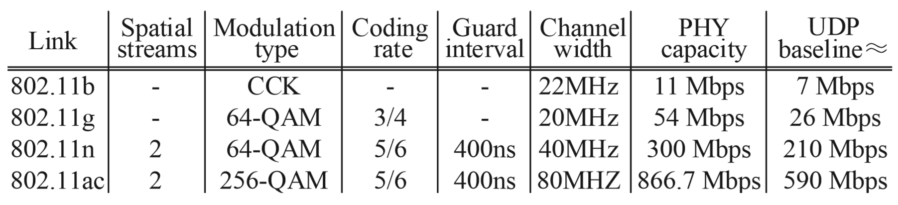
How is TACK’s “positive effect”?
Various wireless links: IEEE 802.11 b/g/n/ac
Method
  To better estimate TACK’s “positive effect”, we build a UDP-based simulation tool Ackemu to assure that there is no “negative effect”
  Ackemu (https://github.com/fillthepipe/ackemu)
    Ackemu sender keeps sending 1518-byte UDP packets
    When trigger condition is met, Ackemu receiver sends one 64-byte UDP packet as an ACK
Notes:
Then, we estimate TACK’s “positive effect” over various wireless links,
we build a UDP-based tool instead of TCP to assure that there is no “negative effect” when reducing ACK frequency.
The sender keeps sending large UDP packets,
and the receiver has implemented various ACK thinning technologies including TACK.
When the trigger condition is met,
the receiver sends one small UDP packet as an ACK.

Slide 10
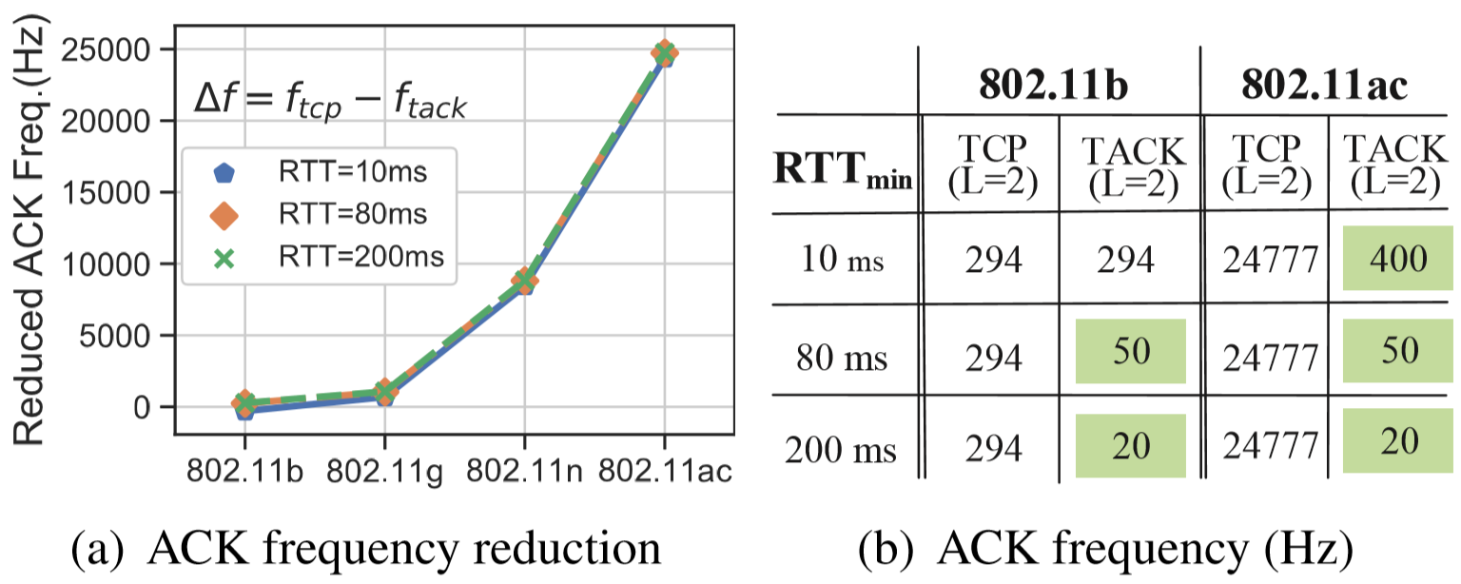
TACK reduces ACK frequency significantly
PHY rate increases
Quantitative analysis of TACK frequency over IEEE 802.11 b/g/n/ac wireless links
Notes:
The result is that
more number of ACKs are reduced in the case of a faster physical rate.
【】For example, TACK has the same frequency as delayed ACK
over 802.11b links with a small RTT.
【】However, for the 802.11ac links,
the frequency of TACK has dropped two orders of magnitude when RTT is 10ms
【】and three orders of magnitude when RTT is 80 ms.

Slide 11
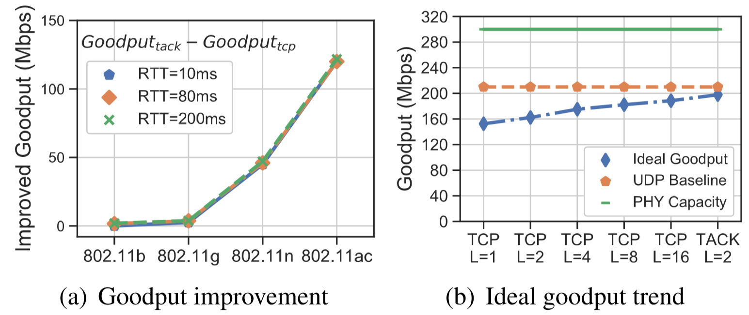
Ideally, TACK approaches transport upper bound
transport upper bound
(RTT=80 ms, IEEE 802.11n)
Transport upper bound: Transport control will not be impacted by reducing ACK frequency
Notes:
Ideally, links with faster physical rates increase goodput improvement.
TACK approaches the transport upper bound with a minimized ACK frequency.

Slide 12
But, simply reducing ACK frequency hurts transport performance
“A TCP receiver which does not generate an ACK for every second full-sized segment exhibits a "Stretch ACK Violation".
Reducing ACK frequency has both “positive effect” and “negative effect”
--- 1999, RFC 2525, Vern Paxson et.al
Positive Effect
throughput (Mbps)
Negative
Effect
Transport control depends on frequent ACKs
Goodput
of legacy TCP
Ideal goodput with reduced ACK frequency
Actual goodput with reduced ACK frequency but without advancements
Notes:
In wireless scenarios,
reducing ACK frequency has a “positive effect” on the transport performance
due to the reduced contentions.
Unfortunately, simply reducing ACK frequency hurts transport performance,
which is called “negative effect”.
This “negative effect” is because that transport control depends on frequent ACKs
and the packet-clocking algorithms are impacted when ACK frequency is excessively reduced.

Slide 13
What is TACK’s “negative effect”?
Issues in loss recovery
Issues in round-trip timing
Issues in send rate control
Reducing ACK frequency enlarges feedback delay upon loss events. ACK loss or retransmission loss doubles the delay
Generating only one RTT sample among multiple packets is likely to result in biases
CC: The fewer ACKs sent, the larger the bursts of packets released
FC: Delay acknowledging packet receipts and reporting rwnd, resulting in feedback lags and bandwidth under-utilization
Notes:
Here we list several major issues to handle in terms of loss recovery, round-trip timing,
and send rate control including congestion control and flow control.
Because of time limitation in this talk, I will explain the negative effect by only taking the round-trip timing as an example.

Slide 14
Example: Advancements in Round-trip Timing
RTT samples
RTT_{min} sample
OWD samples
20 | 16 | 22 | 15 | 30
15
10 | 11 | 20 | 7.5 | 8
Carry timestamps for a packet who achieves OWD_{min}
Data
packet
ACK
Sender
Receiver
Sender
Receiver
Receiver-side one-way delay (OWD) sampling without maintaining too many states
Legacy way: sender-side RTT sampling
t1
Packet
t3
ACK
t4
t2
RTTmin_sample = t2 (ACK arrival) – t1 (packet with OWDmin departure) - delta_t (ACK Delay)
delta_t = t3 (packet with OWDmin arrival) – t4 (ACK departure)
Notes:
Take the minimum RTT estimation as an example.
The legacy way of sender-side RTT sampling is either inaccurate or expensive. To get all RTT samples, one ACK has to carry all timestamps of every packet, which induces high overhead. When the ACK only carries the timestamp of the recently received packet as the default, a higher minimum RTT with bias might be computed.
【】To tackle this issue, it is recommended to sample the one-way delay at the receiver,
and the TACK carries the timestamps for a packet
who achieves the minimum one-way delay.
The sender then generates the minimum RTT sample according to this TACK.
Because TACK only carries the necessary information,
the TACK-based protocol design not only reduces overhead,
but also ensures accuracy.

Slide 15
Implementation and Interoperability
Data
Sender
Data
Receiver
5
6
7
8
Send
Buffer
1
2
3
4
Receive
Buffer
Loss Recovery
Monitor
Receive
Round-trip Timing
Feedback Handling
TACK-based ACK Mechanism
ACK Frame
Send
Send Rate Control
Packet (ACK-INTENSITY Frame)
Notes:
Here we illustrate the implementation and inter-opera-bility of the TACK-based protocol stack,
in which the advancements in loss recovery, round-trip timing, and send rate control
are the most key reasons
that the dependence on frequent ACKs has decreased.

Slide 16
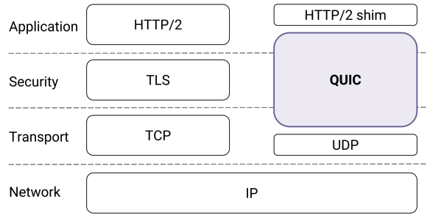
QUIC (Quick UDP Internet Connections)
Improve performance for transmission
  Reduce handshake time (0-RTT)
  Prevent head-of-line blocking
  Improve loss recovery
  Modular congestion control
  Connection migration across IPs
Avoid middlebox meddling
Protect user data
Facilitate rapid deployment
  Implement TACK upon QUIC rather than TCP.
Notes:
Before discussing details of implementing TACK in QUIC, we first give a brief overview of QUIC.
QUIC is a protocol stack proposed by Google to improve performance for transmission
【】It reduces the connection establishment time from a few RTTs for TLS over TCP to potentially 0-RTTs
【】It can multiplex multiple flows over the same connection without HOL bloc
【】It has a better loss recovery mechanism
【】It provides a modular plug and play CC
【】It allows connection migration, so for example your connections do not break if you’re phone switched between WiFi and LTE
and many other smaller hacks and optimizations
【】but performance was not QUIC’s only goal. QUIC authenticates everything and encrypts most QUIC communications to prevent modification of the protocol by middleboxes.
【】and Finally, QUIC has been designed to allow rapid experiment and deployments
and for that, it has been implemented in the userspace, as opposed to TCP which are part of the kernel which means deploying a change can take a long time, sometimes years.【】 This is also why we recommend to implement TACK upon QUIC rather than TCP.

Slide 17
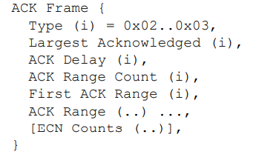
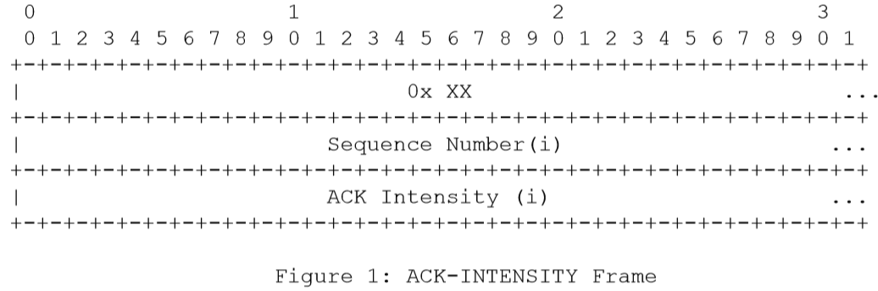
What’s new for QUIC protocol deployed with TACK?
Transport Parameter: ack-intensity-support
A new field named ack-intensity-support should be added for negotiation between both parties whether starting the dynamic ACK intensity function in QUIC connection.
2. ACK-INTENSITY Frame
A new frame should be added for exchange the updated ACK intensity calculated by the sender.
3. OWD-based RTTmin Estimation
Change “ACK Delay = t3 (the largest acknowledged packet arrival) – t4 (ACK departure) ”
To: “ACK Delay = t3 (packet with OWDmin arrival) – t4 (ACK departure)”
Notes:
So, what is new for QUIC protocol deployed with TACK?
First of all, the transport parameters should be extended for ACK mechanism negotiation.
Second, a new sender-controlled frame should be defined to sync the updated TACK frequency to the receiver. Third, the algorithm of minimum RTT monitoring should be implemented in a receiver-based way. In this case, the legacy ACK frame of QUIC has to be modified a little bit. For example, we change the way of computing the ACK delay field to carry more accurate information for RTT estimation.

Slide 18
Summary
The delayed ACK is far from being optimal
  TACK adopts a “min” instead of a “max” to assure the minimized ACK frequency in the context of network dynamics
To avoid TACK’s “negative effect” protocol modifications have to be make on both sender and receiver sides
  We also give some details of how to implement TACK in QUIC
  To avoid TACK’s “negative effect” protocol modifications have to be make on both sender and receiver sides
  tcpm wg: https://tools.ietf.org/html/draft-li-tcpm-advancing-ack-for-wireless-00
  quic wg: https://tools.ietf.org/html/draft-li-quic-optimizing-ack-in-wlan-04
Notes:
To summarize,
First, the legacy TCP or QUIC’s delayed ACK is far from being optimal.
Instead,
TACK adopts a “min” function to assure the minimized ACK frequency
in the context of network dynamics.
Second,
To avoid TACK’s “negative effect” protocol modifications have to be make on both sender and receiver sides. We also give some details of how to implement TACK in QUIC.
Moreover,
This work is also being discussed in IETF working groups.

Slide 19
Next Steps
1. OWD-based RTTmin Estimation might also be applicable for other ACK thinning mechanisms.
2. Advancements in loss recovery should be considered:
  Reuse packet number of QUIC
  TACK + Instant ACK Frame
3. Advancements in send rate control should be considered:
  Congestion control: Pacing
  Flow control: Instant ACK Frame
Any comments welcome
Notes:
It is worth noting that the one-way-delay-based RTT estimation might also be used for other ACK thinning mechanisms. For the next steps, more advancements should be considered to design a full protocol stack based on QUIC. For example, in loss recovery, we can reuse the packet number of QUIC to enable the receiver-based loss detection, and define more types of ACK frames to make faster feedback when loss occurs. In send rate control, we can adopt pacing to avoid burst send pattern and introduce instant ACK frame for on-demand flow control, and so on.

Slide 20
References
[1] Tong Li, Kai Zheng, Ke Xu, Rahul Arvind Jadhav, Tao Xiong, Keith Winstein, Kun Tan. TACK: Improving Wireless Transport Performance by Taming Acknowledgments. ACM SIGCOMM, pp. 15-30, 2020.
[2] Tong Li, Kai Zheng, Ke Xu. Acknowledgment On Demand for Transport Control. IEEE Internet Computing, vol.25, no.2, pp. 109-115, 2021.
[3] Tong Li, Kai Zheng, Rahul Arvind Jadhav, Jiao Kang. Optimizing ACK mechanism for QUIC. IETF Draft, draft-li-quic-optimizing-ack-in-wlan-04, 2022.

Slide 21
BACKUP

Slide 22
Enlarged delay in loss recovery
Sender
Receiver
Receiver’s APP
Packet 3
ACK2
Packet 1
Packet 1~11
ACK3
Packet 2
ACK3
ACK3
delay of packet reassembling
ACK3
Retransmit Packet 3
Packet 12
Packet 3~11
Packet 12
Packet 3 blocks the head of line (8 subsequent packets)
Case study: Legacy TCP
Notes:
It is well-known that head-of-line blocking incurs high delay of packet reassembling
and thus leads to transport performance decline.
In the case of legacy TCP,
the loss of packet 3 blocks the head of line with 8 subsequent packets.

Slide 23
Enlarged delay in loss recovery
Sender
Receiver
Receiver’s APP
TACK1
Packet 1
Packet 3
…
Packet 2
Packet 1~100
delay of packet reassembling
…
TACK2
Retransmit Packet 3
Packet 3
Packet 101
Packet 3~100
Packet 3 blocks the head of line (97 subsequent packets)
Case study: TACK
Notes:
Since TACK might be excessively delayed.
Applying TACK will further enlarge this delay incurred by head-of-line blocking.
In the case of TACK,
the loss of packet 3 blocks the head of line with 97 subsequent packets.
When loss occurs during the TACK interval,
the excessive TACK delay disturbs loss detection,
resulting in costly retransmission timeouts.
TACK loss further aggravates this problem.

Slide 24
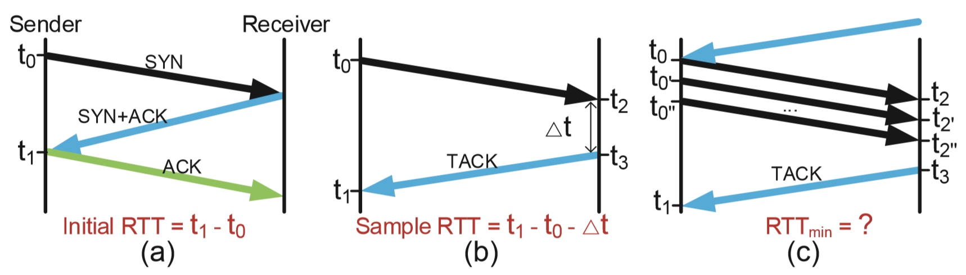
Biased round-trip timing
TACK-based round-trip timing: A case study
Notes:
In terms of round-trip timing,
the initial RTT can be computed during handshakes,
【】after that, the sender calculates an RTT sample upon receiving a TACK.
【】The problem here is that
multiple data packets might be received during the TACK interval,
generating only one RTT sample among multiple packets is likely to result in biases.
For example, a larger minimum RTT estimate
or a smaller maximum RTT estimate.
In general, the higher the throughput, the larger the biases.

Slide 25
Burst send pattern
ACK
Data packet
ACK Interval
ACK
Frequent ACK
Data packet
ACK1
ACK2
ACK3
ACK4
ACK5
ACK6
ACK7
time
ACK Interval
Infrequent ACK
TACK1
TACK2
time
Burst send pattern
Notes:
Third, for congestion control,
a burst of packets can be sent in response to a single delayed ACK.
Since TACK might be excessively delayed,
the burst send pattern may cause larger buffer requirement,
higher loss rate,
and longer queueing delay if not carefully handled.

Slide 26
Delayed send window update
Sender
Receiver
Application
rwnd=0
TACK1
RcvBuffer
buffered data
RcvBuffer released
AWND
free buffer space
Stop sending
Delayed update
rwnd=100
TACK2
Data packets
Receive buffer
Delayed send window update
Notes:
For send window update,
TCP ACKs report the announcement window in the TCP header for flow control.
Reducing ACK frequency might also lead to feedback lags
and bandwidth under-utilization.
For example, assume TACK is sent every 50 ms.
TACK1 notifies a zero window due to the receive buffer runs out,
upon receiving this TACK, the sender stops sending data.
In the case that the receiver buffer is released 5 ms after sending TACK1 due to loss recovery,
the sender continues to be blocked for another 45 ms until TACK2 is sent,
and thus wastes opportunity of sending data.
TACK loss further aggravates this issue.

Slide 27

Features of TACK-based acknowledgement mechanism
More types of ACKs
  Apart from the ACK type of TACK, also introduce the ACK type of IACK (“Instant ACK”）
  IACK and TACK are complementary
More necessary information carried in ACKs
  Carry more contiguous range of lost packets when ACK loss rate has reached a critical level
  Sync ACK delay, timestamp, loss rate, delivery rate, etc. between endpoints
Less number of ACKs, but are exactly what are required by transport
  IACK is instant event-driven , whose frequency is usually low and negligible
The design rationale: an analogy
Notes:
To solve these issues,
we propose a full TACK-based acknowledgement mechanism.
There are some notable features of this mechanism
which are important for reasoning about the differences from legacy TCP.
First, apart from the ACK type of TACK,
we also introduce the ACK type of IACK
to assure timely feedback upon instant events.
IACK and TACK are complementary.
IACK assures timely signaling
while TACK acts as the last resort mechanism in the case of ACK loss.
Second, when the loss rate on the ACK path has reached a critical level,
TACK should carry more information
such as contiguous range of lost packets or received packets.
With more types of ACKs and more necessary information carried in ACKs,
the TACK-based acknowledgement mechanism
therefore is able to send less number of ACKs
but are exactly what are required by transport.

Slide 28
Advancements in round-trip timing
RTT samples
Design Rationale: Variation of OWD reflects the variation of RTT
20 | 16 | 22 | 15 | 30
  Accuracy
Data
packet
ACK
This paper
Sender
Receiver
Per-packet RTT sampling
Legacy way: sender-side RTT sampling
  Better
RTT_{min} sample
OWD samples
15
10 | 11 | 20 | 7.5 | 8
Carry timestamps for a packet who achieves OWD_{min}
RTT sampling of the largest acked packet
Sender
Receiver
  0
This paper: receiver-side one-way delay (OWD) sampling without maintaining too many states
  Overhead
Notes:
Take the minimum RTT estimation as an example.
The legacy way of sender-side RTT sampling is either inaccurate or expensive.
In this paper, we sample the one-way delay at the receiver,
and the TACK carries the timestamps for a packet
who achieves the minimum one-way delay.
The sender then generates the minimum RTT sample according to this TACK.
【】Because TACK only carries the necessary information,
the TACK-based protocol design not only reduces overhead,
but also ensures accuracy.

Slide 29
Other advancements in TACK-based protocol design
Advancements in loss recovery
  Packet number enables receiver-based loss detection
  IACK speeds up loss recovery on lossy data path
  TACK assures loss recovery robustness on bidirectionally lossy path
  Advancements in send rate control
  Pacing
  An IACK updating the AWND should be sent without delay when encountering an abrupt change of receive buffer
  For more details, please refer to the paper TACK: Improving Wireless Transport Performance by Taming Acknowledgments.
Notes:
For other advancements in TACK-based protocol,
we adopt a receiver-based loss detection,
in which the packet number, the IACK, and the TACK play different roles.
Packet number enables receiver-based loss detection,
IACK speeds up loss recovery,
and TACK assures loss recovery robustness.
In order to control the amount of sent data,
TACK-based congestion controller should integrate with pacing
instead of the burst send pattern.
Also, an IACK updating the announcement window should be sent without delay
when the receive buffer runs out.
For more details, please refer to the paper.

