Slide 1
Network Operator's Perspective on Next Generation WLAN
Date: 2022-07-DD
Authors:

Slide 2
Introduction
In this contribution, we discuss the direction of the next generation WLAN (i.e. post-be) from a network operator perspective.
Wi-Fi and 6G mobile wireless will be integrated with each other to realize use cases of next generation wireless access.
  Use cases discussed in IMT-2030 and use cases that several companies proposed for post-be in WNG SC have a commonality.
  Note: the single system usage (i.e., Wi-Fi or 6G mobile wireless only) still exists.
Use cases not only for business to the customer (B2C) but also for business to business (B2B) should be covered in post-be.
  After the formation of post-be SG, we should start discussing the inclusion of B2B use cases and KPIs (key performance indicators) for creating PAR and CSD.

Slide 3
Wi-Fi markets for B2B from network operator's perspective
The Wi-Fi markets for B2B (significantly solution businesses and M2M / IIoT, etc) are growing more and more in recent years, and products powered by Wi-Fi are essential commodities for network operators.
Usages of B2B are treated as prominent use cases in 6G mobile wireless such as IMT-2030.
Global M2M connection growth by industries from Cisco Annual Internet Report (2018-2023) [1]

Slide 4






Recap: proposed use cases in WNG SC for post-be era [2]-[14]
AR/VR/XR
22/0032
22/0046
22/0030
22/0418
22/0729
22/0734
22/0694
22/0685
22/0779
Video/Cloud Gaming
22/0032
22/0030
22/0059
22/0418
22/0734
22/0685
P2P / Fast Data Transfer
22/0046
22/0059
22/0418
22/0729
22/0734
22/0685
IIoT/Robotics
22/0032
22/0046
22/0734
Dense Environment
22/0059
22/0729
AI/Machine Learning
22/0030
22/0458
22/0723
22/0694
22/0685

Slide 5
Proposed use cases and KPIs in WNG SC for post-be era
KPIs | Use Cases
 | Video / Cloud Gaming | P2P / Fast Data Transfer | AR/VR/XR | AI / ML | Dense Environment | IIoT / Robotics
Throughput | ✓ | ✓ | ✓ | ✓ | ✓
Efficiency | ✓ |  | ✓ | ✓ | ✓ | ✓
Latency | ✓ | ✓ | ✓ | ✓ | ✓ | ✓
Reliability | ✓ | ✓ | ✓ |  |  | ✓
Mobility / Roaming |  |  |  | ✓ | ✓ | ✓
Coverage |  |  | ✓ | ✓ | ✓ | ✓
Power consumption |  |  | ✓ |  | ✓ | ✓
Manageability |  |  |  | ✓ | ✓ | ✓
Connectivity |  | ✓ |  |  | ✓ | ✓
Scalability | ✓ |  |  | ✓ | ✓
B2C oriented
B2B oriented

Slide 6
Considerations on proposed use cases and KPIs
The performance of those use cases is evaluated by several KPIs that are not only throughput but also various aspects such as latency, reliability, and power consumption, etc.
  Though Wi-Fi has been developed as a high-speed local area network historically, it is now one of the dominant wireless access that can realize various attractive use cases and applications.
Those use cases are classified roughly into B2C oriented or B2B oriented.
  For example, AR/VR/XR, video, cloud gaming, and P2P tend to be B2C. On the other hand, IIoT and robotics are considered to be B2B.
Though the major market segment of Wi-Fi is B2C until now, the importance of B2B for Wi-Fi market will be increased in near future.

Slide 7
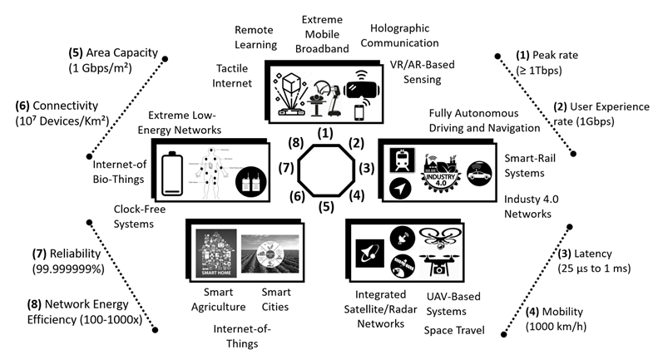
A vision for IMT 2030 systems and its underlying use cases [15]
Essential use cases and KPIs for IMT-2030 are discussed in ITU WP5D.
  The essential use cases and KPIs of IMT-2030 almost correspond to those of post-be.
  The Wi-Fi systems should also support some use cases and KPIs from those, and it would contribute to expanding the Wi-Fi market if it could collaborate with 6G mobile wireless.

Slide 8
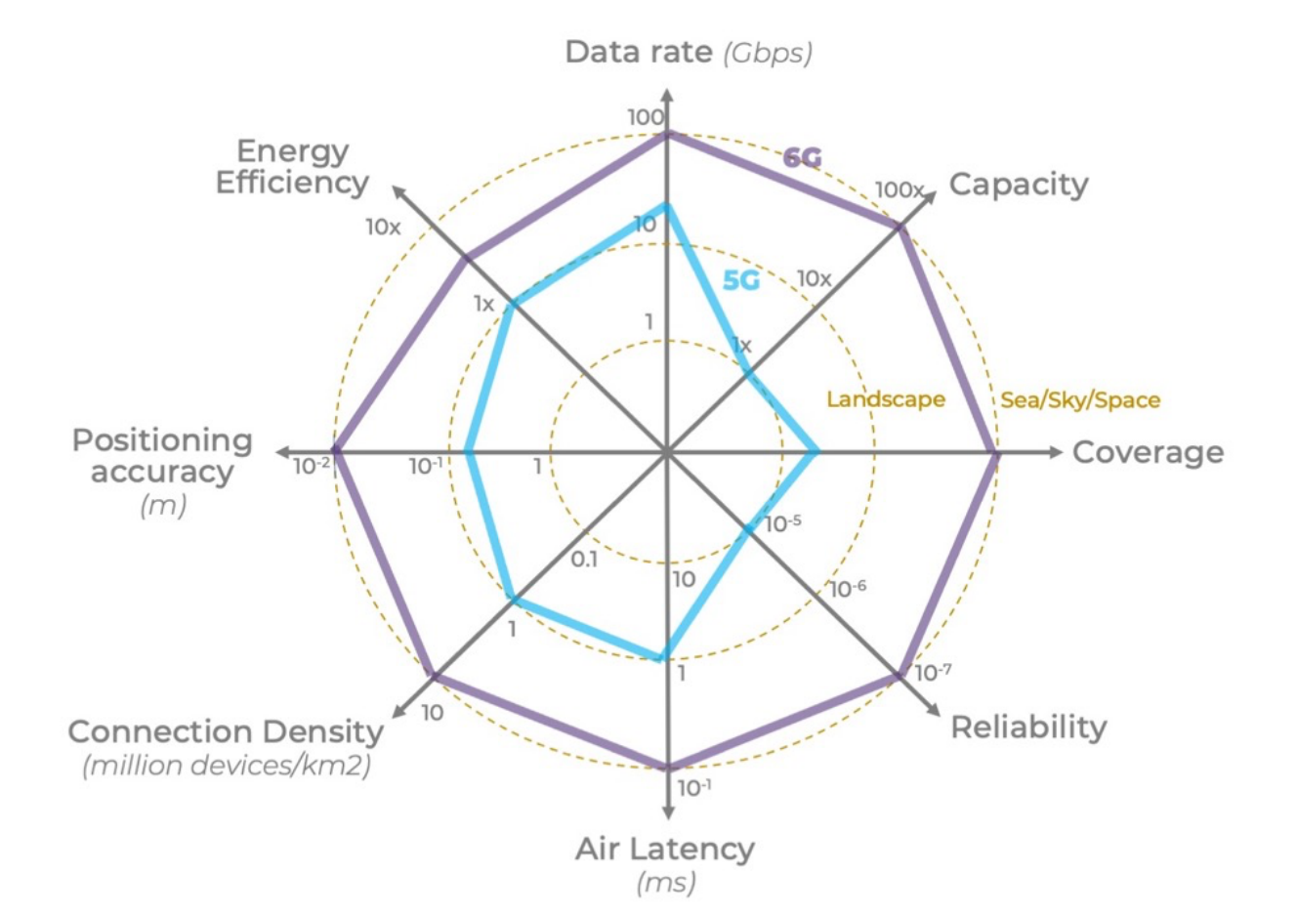
Requirements for 6G wireless technology [15]
Drastic improvements in each KPI are anticipated in 6G mobile wireless. However, there is room for discussion on which KPIs should be considered and how the target values would be determined in post-be SG.
  As next-generation wireless access as a whole, those KPIs and those target values should be achieved by integration of Wi-Fi and 6G mobile wireless.
In post-be SG, we should discuss the above, and the concrete target value of each KPI should be clarified in the PAR, not like the case of TGbe.
  In TGbe, a concrete target value of worst case latency had not been clarified in the PAR.
Extract of EHT PAR [16]: This amendment defines at least one mode of operation capable of improved worst case latency and jitter.

Slide 9
Possible timeline of post-be
2021 | 2022 | 2023 | 2024 | 2025 | 2026 | 2027 | 2028 | 2029 | 2030
IEEE 802.11be
According to the timeline proposed by contributions from several companies, the post-be standard would be published before IMT-2030.
To realize use cases for private networks earlier than IMT-2030 would expand the market of Wi-Fi.
TGbe D1.0~
D2.0~
D3.0~
SB Draft ~publishing
post-be
Post-be SG
Post-be TG
ITU Report on new Future Technology Trends
Technical performance requirements
Evaluation criteria & methodology
Technology Proposals for “IMT-2030”
Recommendation on a new IMT Vision of IMT towards 2030 and beyond
Evaluation
Requirements, evaluation criteria, and submission templates
Report on IMT feasibility above 100GHz
Consensus building
Workshop
Outcome & decision
Modifications of Resolutions 56 and 65(or new)
Circular Letter (and later addenda)
IMT-2030 [17]
“IMT-2030” specifications
Background & process

Slide 10
Summary
Use cases for B2B are discussed in WNG SC, in addition to use cases for B2C, which are important markets of Wi-Fi.
  Those use cases are common to 6G mobile wireless and are also discussed in organizations such as ITU IMT-2030.
To build robust and flexible next-generation wireless access, integration of Wi-Fi and 6G mobile wireless should be required.
Post-be SG/TG should include use cases for B2B as a scope to realize this, and discussions on target KPIs and performance will be inevitable.
  It should be indicated clearly in the PAR and CSD of post-be SG.

Slide 11
References
[1] Cisco Annual Internet Report (2018-2023)
[2] 11-22-0030-01-0wng-look-ahead-to-next-generation
[3] 11-22-0032-00-0wng-next-gen-after-11be
[4] 11-22-0046-01-0wng-next-generation-after-802-11be
[5] 11-22-0059-00-0wng-beyond-be
[6] 11-22-0418-00-0wng-considerations-of-next-generation-beyond-11be
[7] 11-22-0458-01-0wng-looking-ahead-to-next-generation-follow-up
[8] 11-22-0685-00-0wng-discussion-on-next-generation-wi-fi
[9] 11-22-0694-00-0wng-thoughts-on-next-gen-wlan
[10] 11-22-0708-00-0wng-beyond-be-next-step
[11] 11-22-0723-01-0wng-further-discussion-on-next-generation-wlan
[12] 11-22-0729-01-0wng-next-generation-after-802-11be-follow-up
[13] 11-22-0734-00-0wng-next-gen-after-11be-v2
[14] 11-22-0779-00-0wng-802-11bx-enabling-metaverse-metaverse-ar-vr-and-wearables
[15] ITU-R R19-WP5D Temporary Document 664: Working document towards a preliminary draft new Recommendation ITU-R M.[IMT.VISION 2030 and Beyond] - IMT Vision - Framework and overall objectives of the future development of IMT for 2030 and beyond
[16] 11-18-1231-06-0eht-eht-draft-proposed-par
[17] 11-21-1809-00-AANI-itu-imt-2030-status

