Slide 1
EBCS Traffic Stream Mapper Discussion
Date: 2022-06-28
Authors:

Slide 2
Abstract
This presentation is a discussion material about EBCS traffic stream mapper.

Slide 3
Comments
CID 3163 (P25L40, 4.3.31.2.2)
it is unclear which entity configures the EBCS traffic stream mapper. Please clarify
CID 3159 (P25L44, 4.3.31.2.2)
to which configuraton is "the cofniguration" refer? Please change "the configuration" to "configurations" or change the order of this and the following sentence.
CID 3006 (P26L34, 4.3.31.2.4)
The sentence "An EBCS AP broadcasts traffic streams as EBCS traffic streams." needs clarification. An EBCS AP will also have its own infra BSS in which it can broadcast non-EBCS content which will be received by non-EBCS receivers.
CID 3184 (P83L53, 11.55.3.2)
Is EBCS traffic stream mapper part of the EBCS AP or outside of the EBCS AP? If outside of the EBCS AP, which entity should configure the mapper?

Slide 4
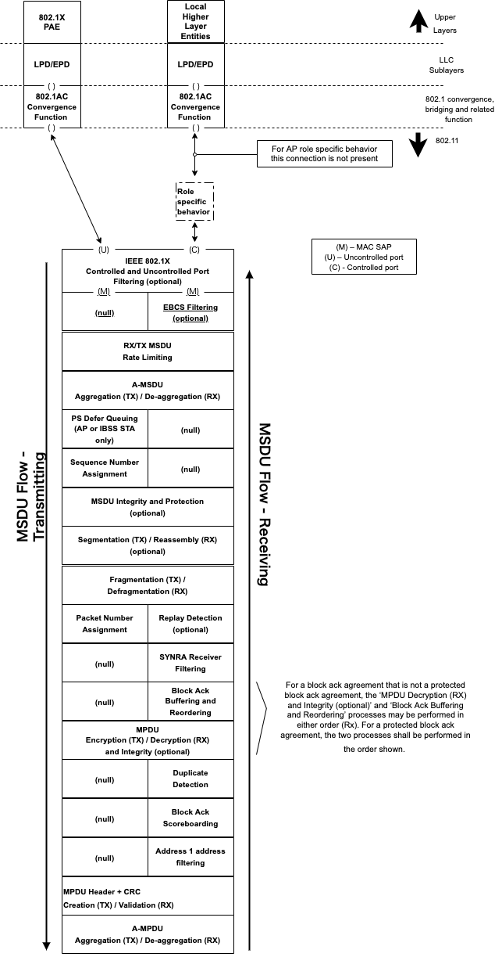
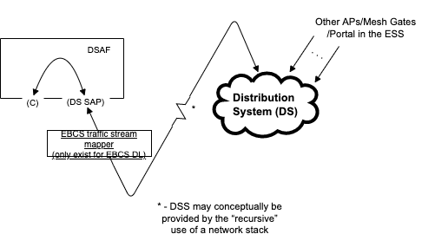
D3.0 Architecture
The EBCS traffic stream mapper locates outside of AP.
Which entity can configure the EBCS traffic stream mapper?
Can the EBCS traffic stream mapper move into AP?

