Slide 1
DMG passive sensing based on DTI
Date: 2022/5/24
Authors:
Name | Affiliation | Address | Phone | Email
Narengerile | Huawei Technologies Co., Ltd. | Shenzhen, China |  | narengerile@huawei.com
Rui Du
Mengshi Hu
Yan Xin |  | Ottawa, Canada
Notes:
*This presentation contains 9 sides for technical materials and 7 slides for SPs.

Slide 2
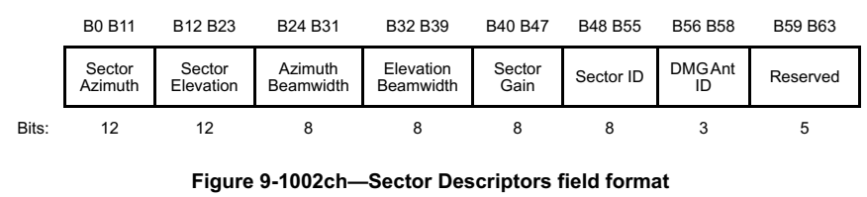
Recap – DMG passive sensing
DMG passive sensing during BTI [1].
  Downlink passive sensing: The non-AP STA performs sensing measurements via DMG Beacon frames sent by the AP/PCP.
DMG passive sensing during A-BFT [2].
  Uplink passive sensing: The AP/PCP performs sensing measurements via SSW frames/Short SSW PPDUs sent by the non-AP STA.
The non-AP STA/AP sends Information Request frame to the AP/non-AP STA to request the location (LCI) of the AP/non-AP STA, sector information (Sector Descriptors), etc [3].
  In the Information Response frame, the AP/non-AP STA can indicate that the sector information is for the previous or next BTI/A-BFT.
Note:
  The transmitting STA refers to the STA which transmits PPDUs that are used for passive sensing.
  The receiving STA refers to the STA which performs sensing measurements based on the received PPDUs.
Relate the Sector Descriptor to the Sector and DMG Ant in use.
Relate the Sector Descriptor to the PPDU transmission.
Notes:
*The BHI duration is not specified in the standard, and is free to be chosen by the system designer.
*Typically, the BHI is in the order of a few milliseconds, and the DTI consumes the bulk of the BI.

Slide 3
Proposal
DMG passive sensing during DTI.
  Motivation:
    To enable passive sensing during any period of a Beacon Interval (BI). DTI takes up most of the time in a Beacon Interval.
    Compared with BTI/A-BFT, for some types of PPDUs in DTI, such as BRP PPDUs, multiple beam directions can be scanned and measured during a PPDU.
  Objective:
    Enable one of the STAs from a beamforming pair to perform passive sensing.
    Allow other STAs that are not from the beamforming pair to perform passive sensing.
  Proposal 1: Based on beamforming (BF) training procedure
    Proposal 1a – During SLS: The receiving STA performs sensing measurements based on SSW frames/Short SSW PPDUs sent by the transmitting STA.
    Proposal 1b – During BRP or BRP TXSS: The receiving STA performs sensing measurements based on BRP PPDUs sent by the transmitting STA.
  Proposal 2: Based on beam tracking process
    The beam tracking initiator and/or the beam tracking responder can perform sensing measurements based on the TRN field appended to Data frames.
Notes:
*The BHI duration is not specified in the standard, and is free to be chosen by the system designer.
*Typically, the BHI is in the order of a few milliseconds, and the DTI consumes the bulk of the BI.

Slide 4
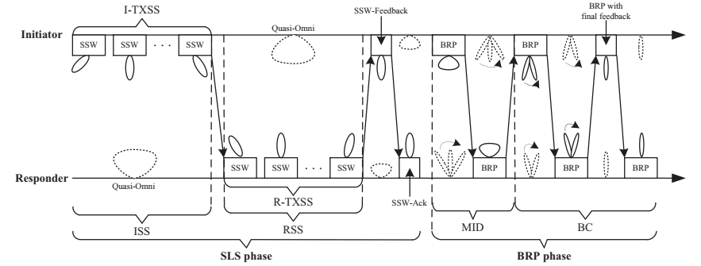
Proposal 1a – DMG passive sensing based on SSW/Short SSW
The BF training process occurs within an SP or CBAP in DTI.
  SLS phase and BRP phase
Sector-level sweep (SLS) phase – To train TXSS (normally)
  In [2], each SSW frame/Short SSW PPDU contains an indication bit.
  Both BF initiator and responder can perform passive sensing measurements using the received SSW frames/Short SSW PPDUs.
  Existing techniques in the Draft 0.1 [3], such as the Information Request/Response, DMG Sector Descriptors element, can be re-used.
    Information Request/Response frames may be transmitted after the completion of the SLS.
[4]

Slide 5
Proposal 1b – DMG passive sensing based on
BRP frames
Beam refinement protocol (BRP) phase
  BRP setup subphase
  Multiple sector ID detection (MID) subphase (optional)
    BRP-RX PPDU
  Beam combination subphase (optional)
    BRP-RX PPDU
  Beam refinement transaction
    BRP-TX PPDU, BRP-RX PPDU
    BRP-RX/TX PPDU
Each BRP PPDU contains a TRN field for the training of TX and/or RX antenna weight vector (AWV).
  BRP-RX PPDU (with a TRN-R field): To train the RX AWV of the receiving STA.
  BRP-TX PPDU (with a TRN-T field): To train the TX AWV of the transmitting STA.
  BRP-RX/TX PPDU (with a TRN-R/T field): To train the TX AWV of the transmitting STA and the RX AWV of the receiving STA simultaneously.
Based on the TRN field in the BRP PPDU, the receiving STA can perform passive sensing measurements.
For EDMG STAs, the BRP PPDUs sent in the BRP TXSS process can also be used for passive sensing at the receiving STAs.
Transmitter
Receiver
Notes:
*AWV: antenna weight vector, to describe the amplitude and phase for each element of the antenna array -> corresponds to a beam direction (e.g., elevation and azimuth)

Slide 6
Proposal 1b – What changes are required?
The STA that supports passive sensing needs to indicate that:
  The BRP frames sent can be used for passive sensing measurements at the receiving STA;
  This STA is able to provide information on the TRN subfields in the BRP PPDU
Possible ways of the indication:
  During capability exchange, feasible types of frames for passive sensing can be indicated.
  The DMG/EDMG PHY header can contain an indication bit.
  The BRP frame can contain an indication bit.
The Information Response frame should include the location info of the transmitting STA, sector direction info, sector ID, DMG antenna ID, etc.
Additional information that needs to be included in the Information Response frame:
  More than one TX sectors may be scanned during a BRP PPDU. Each Sector Descriptor will describe a beam corresponding to a TRN subfield in a PPDU. Each Sector Descriptor needs to be matched to a specific TRN subfield in a specific PPDU. Multiple PPDUs may have different TRN settings.
    Number of PPDUs used for passive sensing
    Use Dialog Token field in the BRP frame or a Timestamp to reference the BRP PPDU
    Types of the BRP PPDU
    Number of TX directions per PPDU
      = Number of AWV feedback IDs (denoted as “a” in 11ay) or Number of TRN subfields per PPDU (denoted as “i” in 11ay)
      TRN-LEN, TRN-N, TRN-M, TRN-P, RX TRN-Units per Each TX TRN-Unit
Notes:
*The receiving STA needs to know that this Sector Descriptor is for which TRN subfield in which PPDU.
*PHY indication:
DMG C mode: L-Header B22-B23
DMG SC: L-Header B46-B47
EDMG C mode: EDMG Header A 1 bit
EDMG SC/OFDM: L-Header B47, EDMG Header A 10 bit

Slide 7
Proposal 2 –DMG passive sensing based on beam tracking in DTI
Beam tracking allows DMG/EDMG STAs to track changes in the AWVs of its antenna settings, without the need to perform a BRP procedure. The beam tracking initiator can select an optimal transmit or receive beam based on beam tracking results to transmit or receive the remaining data.
  Append a TRN-R, TRN-T, TRN-R/T field to Data frames.
The receiving STA (the beam tracking initiator or responder) can perform passive sensing measurements based on the received TRN subfields.
Initiator Requests TRN-R
Initiator Requests TRN-T

Slide 8
Proposal 2 – What changes are required?
The STA that supports passive sensing needs to indicate that:
  The Data frames appended with a TRN field can be used for passive sensing measurements;
  This STA is able to provide information on the TRN subfields as part of beam tracking.
Possible ways of the indication:
  During capability exchange, feasible types of frames for passive sensing can be indicated.
  The DMG/EDMG PHY header can contain an indication bit.
  The Data frame can contain an indication bit.
The Information Response frame should include the location info of the transmitting STA, sector direction info, sector ID, DMG antenna ID, etc.
Additional information that needs to be included in the Information Response frame:
  Each Sector Descriptor needs to be matched to a specific TRN subfield in a specific PPDU that is appended with a TRN field for beam tracking.
    Number of PPDUs used for passive sensing
    Use Timestamp to reference the PPDU
    Types of the PPDU
    Number of TX directions per PPDU
      = Number of AWV feedback IDs (denoted as “a” in 11ay) or Number of TRN subfields per PPDU (denoted as “i” in 11ay)
      TRN-LEN, TRN-N, TRN-M, TRN-P, RX TRN-Units per Each TX TRN-Unit

Slide 9
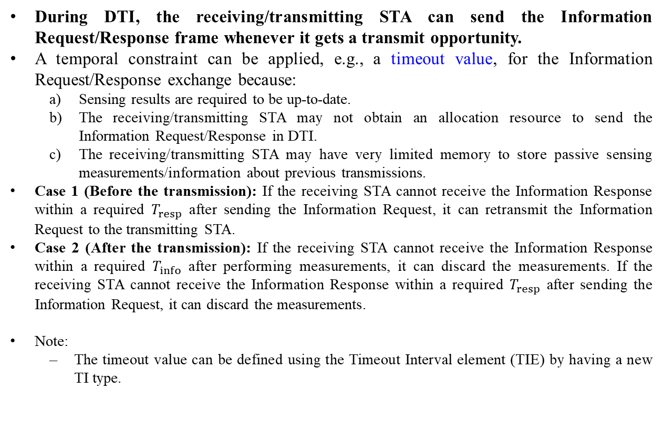
Proposal 1 and 2 – Information Request/Response
During DTI, the receiving/transmitting STA can send the Information Request/Response frame whenever it gets a transmit opportunity.
A temporal constraint can be applied, e.g., a timeout value, for the Information Request/Response exchange because:
  Sensing results are required to be up-to-date.
  The receiving/transmitting STA may not obtain an allocation resource to send the Information Request/Response in DTI.
  The receiving/transmitting STA may have very limited memory to store passive sensing measurements/information about previous transmissions.
Case 1 (Before the transmission): If the receiving STA cannot receive the Information Response within a required $T_{resp}$ after sending the Information Request, it can retransmit the Information Request to the transmitting STA.
Case 2 (After the transmission): If the receiving STA cannot receive the Information Response within a required $T_{info}$ after performing measurements, it can discard the measurements. If the receiving STA cannot receive the Information Response within a required $T_{resp}$ after sending the Information Request, it can discard the measurements.
Note:
  The timeout value can be defined using the Timeout Interval element (TIE) by having a new TI type.
Notes:
*Timeout Interval element (TIE) defined in subclause 9.4.2.48. Perhaps to define a new TI type, using value 5 or 6.
During DTI, BF training and beam tracking occur within an SP or CBAP.
If the source DMG STA (SP) or the TXOP holder (CBAP) performs passive sensing measurements, it can send the Information Request frame within the same allocation slot.
If the destination DMG STA (SP) or the TXOP responder (CBAP) performs passive sensing measurements, it may send the Information Request frame in another allocation slot, e.g., if it has been assigned with another SP or can contend for another TXOP.

Slide 10
Summary
In this contribution, we propose a DMG passive sensing based on BF training and beam tracking during DTI.
  Enable the DMG/EDMG STAs to perform passive sensing measurements based on the TRN field in the BRP PPDUs and the TRN field appended to the PPDU for beam tracking
Existing methods, such as Information Request/Response frames for DMG passive sensing, are re-used.
  Provide additional information on the PPDU transmissions and the associated TRN subfields, e.g., which PPDU the TRN subfields belong to, the number of PPDUs used for passive sensing, TRN settings, etc.
Passive sensing uses transmissions that are not designed for sensing to do sensing, without the need to initiate a complete sensing procedure. Therefore, the passive sensing can be opportunistic, depending on the timing of a sensing request, the topology of sensing devices, the application of wireless networking, etc.

Slide 11
Straw Poll 1
Do you agree to add the following to the SFD:
  The DMG/EDMG STAs can perform DMG passive sensing measurements in DTI based on SSW frames or Short SSW PPDUs.
  Y/N/A

Slide 12
Straw Poll 2
Do you agree to add the following to the SFD:
  The DMG/EDMG STAs can perform DMG passive sensing measurements in DTI based on BRP PPDUs.
  Y/N/A

Slide 13
Straw Poll 3
Do you agree to add the following to the SFD:
  The DMG/EDMG STAs can perform DMG passive sensing measurements based on the TRN subfields appended to the PPDU as part of beam tracking.
  Y/N/A

Slide 14
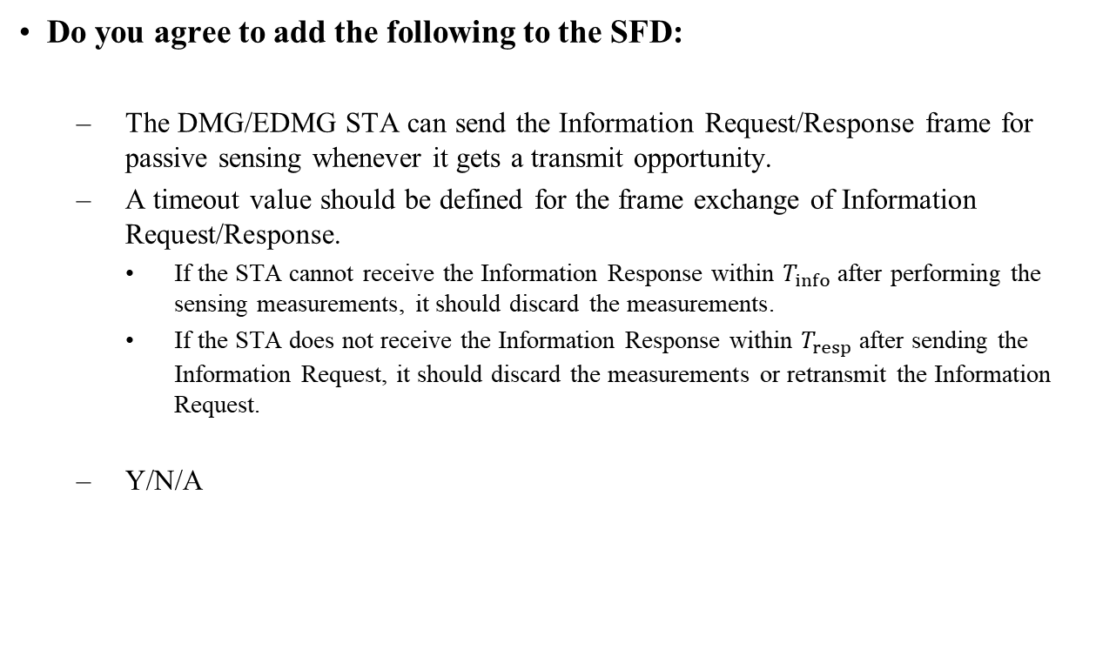
Straw Poll 4
Do you agree to add the following to the SFD:
  The DMG/EDMG STA can send the Information Request/Response frame for passive sensing whenever it gets a transmit opportunity.
  A timeout value should be defined for the frame exchange of Information Request/Response.
    If the STA cannot receive the Information Response within $T_{info}$ after performing the sensing measurements, it should discard the measurements.
    If the STA does not receive the Information Response within $T_{resp}$ after sending the Information Request, it should discard the measurements or retransmit the Information Request.
  Y/N/A

Slide 15
Straw Poll 1a
Do you agree to add the following to the SFD:
  The DMG/EDMG STAs can perform DMG passive sensing measurements in DTI based on SSW frames or Short SSW PPDUs.
    Enable an indication bit in the SSW frame or Short SSW PPDU.
    Use Information Request/Response frame to provide beam information on SSW frames or Short SSW PPDUs.
      Reuse DMG Beacon Sector Descriptors element in [3] for SSW frames or Short SSW PPDUs.
  Y/N/A

Slide 16
Straw Poll 2a
Do you agree to add the following to the SFD:
  The DMG/EDMG STAs can perform DMG passive sensing measurements in DTI based on BRP PPDUs.
    The passive-sensing-supporting STA needs to indicate that BRP PPDUs it sends can be used for passive sensing.
    Use Information Request/Response frame to provide beam information on the TRN subfields in BRP PPDUs. In addition to Draft 0.1, the following information can be included.
      Types of BRP PPDU
      Dialog Token or Timestamp to reference BRP PPDU
      Number of BRP PPDUs for passive sensing
      Number of TX directions per PPDU or Number of TRN subfields per PPDU
  Y/N/A

Slide 17
Straw Poll 3a
Do you agree to add the following to the SFD:
  The DMG/EDMG STAs can perform DMG passive sensing based on the TRN subfields as part of beam tracking.
    The passive-sensing-supporting STA needs to indicate that the PPDUs it sends during beam tracking can be used for passive sensing measurements.
    Use Information Request/Response frame to provide beam information on the TRN subfields appended to PPDU for beam tracking. In addition to Draft 0.1, the following information can be included.
      PPDU type
      Timestamp to reference PPDU transmission
      Number of PPDUs for passive sensing
      Number of TX directions per PPDU or Number of TRN subfields per PPDU
  Y/N/A

Slide 18
Reference
[1]https://mentor.ieee.org/802.11/dcn/22/11-22-0002-00-00bf-dmg-passive-sensing.pptx
[2]https://mentor.ieee.org/802.11/dcn/22/11-22-0423-00-00bf-dmg-passive-sensing-based-on-a-bft.pptx
[3]https://grouper.ieee.org/groups/802/11/private/Draft_Standards/11bf/Draft%20P802.11bf_D0.1.pdf
[4] https://ieeexplore.ieee.org/document/8319416

