Slide 1
Rogue MPDU detection in RSNA
Date: 2022-06-16
Authors:

Slide 2
Abstract
CIDs 1002, 1821, 1017, 1014, 1745, 1808, 1013, 1015 and 1016 raise issues related to valid MPDUs not getting acknowledged, as a result of malicious attacks.
Efforts are made to improve the security and resolve some of these issues using Protected Block Ack, but there are still vulnerabilities which need further work.
Offline discussion between some members established that there is a common understanding about the issues and a number of different solutions have been considered. We invite members to participate in the discussion, so that the group can identify the best way forward.

Slide 3
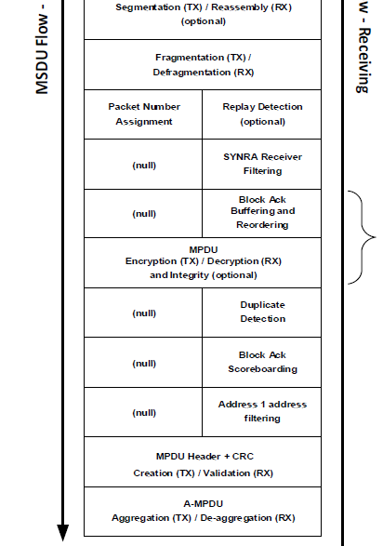
Summary of issues
The 802.11 spec has rules to describe:
Which MPDUs get Acked, using (unencrypted) SN in Block Ack Scoreboarding Control
  WinStartR divides SN space in “new” and “old”
How MPDUs are discarded as Duplicates (based on SN), before the MPDU reaches the Reordering Buffer or it is checked for Replay (PN)
Which MPDUs are accepted for buffering and reordering using SN, before the MPDU is check for Replay (PN)
  WinStartB divides SN space in “new” and “old”
The existing rules allow Replays (detected late) to cause valid MPDUs to:
I1: Not get Acked (WinStartR moved incorrectly)
I2: Be discarded in the reordering buffer (rogue MPDU with same SN takes entry)

Slide 4
Example of an attack
WinStartR = 1000 (recipient has received and Acked SNs up to 999)
Rogue device replays SN=999 MPDU, changing its SN to 2200 (> WinStartR+WinSizeR)
STA receives MPDU SN=2200 and it is a valid frame, so sets WinStartR=2200
Peer transmits MPDU with SN=1000, but STA does not Ack SN=1000 in the BlockAck response due to:
  2200+2^11 = 152 <= 1000 < 2200
Reordering buffer processing drops the MPDU for the same reason (replay set WinStartB=2200)

Slide 5
How to fix Issues
Principles to ensure vulnerabilities are addressed:
P1. Attacker cannot move WinStartR, or if WinStartR moved by an attacker does not cause legal MPDUs to not be Acked.
How can an attacker move WinStartR:
  Unprotected Block Ack Request
  Replay (same PN using different SN)
P2. Duplicate Detection can trust the MPDU
SN unprotected, so in current specification only PN can be trusted. Receiver cache identifier RC9 in current Draft effectively disables Duplicate Detection for QoS Data under BA.
P3. Block Ack Buffering and Reordering can trust the MPDU
SN unprotected, so in current specification only PN can be trusted

Slide 6
Proposals (so far)
P1
STA to support partial-state operation
  Scoreboard temporary record can be either “forgotten” or can relax partial-state rules to remove 2^11 SN space restrictions (discussion ongoing)
P2 (link to support Protected Block Ack)
Protect SN in AAD (Requires a new feature and support by both transmitter and recipient STA), or
Use SN only after PN is checked (Requires changes to specification but no changes at the peer STA)
P3 (link to support Protected Block Ack)
STA to discard unsolicited Block Ack frames, and
Protect SN in AAD, or
Use PN to identify valid MPDUs in Reordering Buffer processing
  Full solution requires buffering multiple MPDUs in each position of the reordering buffer, but
  If STA can implement it, does not require peer STA support

Slide 7
Impact on Architecture

Slide 8
Specification Changes – Not Acked MPDUs
Specification changes to allow valid FCS MPDUs to be Acked.
Discussion: Can restrict changes to apply when STA supports Protected BA
Options:
Discard the temporary current record of scoreboard context control after a Block Ack is transmitted
Replace 2^11 with 2^12 in scoreboard context control operation
Discussion:
  Option 1 is simple to implement and discarding of current record is allowed in some cases already
  Option 2 allows Ack information to be retained so may reduce retransmissions in some case when not all Block Ack frames are received by peer.
TGm would have to select an option.

Slide 9
Specification Changes – Discarded MPDUs
Specification changes to fix issues with valid MPDU discarded.
Prerequisite: Link supports Protected Block Ack
Options:
Protect the SN. Can be added to AAD.
Use PN in Duplicate, Buffering and Reordering
Discussion:
  Option 1 is simpler and robust, however requires a new feature to be defined and does not benefit implementations which cannot comply, e.g. AAD calculations implemented in Hardware, or when peer does not support.
  Option 2 does not need peer to change and does not require new calculations, so it likely implementable by existing devices.
TGm would have to select one or even both options.

Slide 10
Option 2 – Discussion
Duplicate Detection and Replay Check if run in cooperation (i.e. until an MPDU reaches the start of the reordering buffer, duplicates are not identified and discarded) can be used to determine if an MPDU is legal, i.e. satisfies both SN Duplicate and PN Replay checks
As a consequence:
A replay within a reordering buffer cannot cause valid MPDUs to be discarded (since only one is currently stored)

Slide 11
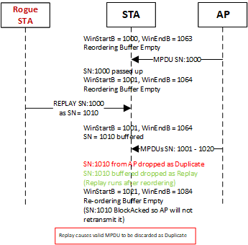
Option 2 – How it works
Claim: Current spec rules run Replay Check after Duplicate Detection. A Replay may occupy a position in the reordering buffer and cause a valid MPDU (with the same SN as the rogue MPDU) to be discarded as Duplicate: “It is also responsible for identifying and discarding duplicate frames (i.e., frames that have the same sequence number as a currently buffered frame) that are part of this block ack agreement.”
Fix: When Duplicate Detection and Replay Check run in consecutive steps, Replay can be detected, rogue MPDU dropped and valid MPDU accepted

Slide 12
Conclusion
Security can be improved using either a protected SN, or the protected PN
Discussion so far raise confidence that issues can be addressed
Option 2 is worth considering, if members believe:
  issues shall be addressed without defining a new feature (protected SN), and
  Proposed Option 2 (PN-only checks) is implementable by existing devices
Otherwise, Option 1 would be the preferred way forward
  note that it would be a new feature that might not be possible via firmware upgrade

Slide 13
References

