Slide 1
Harmonization for TGbf NDPA
Date: 2022-03-31
Authors:
Name | Affiliation | Address | Phone | Email
Junghoon Suh | Huawei |  |  | junghoon.suh@huawei.com
Yan Xin |  |  |  | yan.xin@Huawei.com

Slide 2
NDPA Issues
Format
  The same Frame Control field subtype as the 802.11 baseline NDPA
    The first two digits in Dialog Token field set to 00 (VHT)
    The first two digits in Dialog Token field set to 10 (Ranging)
  Different Frame Control field subtype from the 802.11 baseline NDPA
    Using the Control Frame Extension subtype
Parameters
  Is the Common Info field (or Special STA Info field) necessary?
    Size of the Measurement Set-up ID and Instance ID
    How to utilize 6 bit Dialog Token Number in the Dialog Token field
    I2R NDP TX Power, R2I NDP Target RSSI
  STA Info field
    Feedback Bandwidth, I2R N_STS, R2I N_STS
    Ng, Scale Factor, CSI FB Bit Size

Slide 3
Format: Using the same subtype in the Frame Control field
Octets
:
1 Common Field (4 ?) 4?
4? 4?
MAC
Header
Sounding
Dialog
Token
NDPA
Version
ID
Measurement
Set-up ID
Disambi-
guation
STA Info # n
Reserved
Reserved
STA Info # 1
FCS
0 0
B0
B11
VHT NDPA based Sensing NDPA
B2
B7
Measurement Instance ID
B0
(Ranging)
B1
(HE)
Sounding Dialog
Token Number
Bits
:
1 1 6
Octets
:
1 Common Field (4) ? 4
4 4
MAC
Header
Sounding
Dialog
Token
Dummy
AID (?)
Disambi-
guation
Measurement
Set-up ID
STA Info # n
Reserved
STA Info # 1
FCS
1 0
B0
B11
B15
Ranging NDPA based Sensing NDPA

Slide 4
Comparison: VHT NDPA based vs. Ranging NDPA based
 | Pros | Cons
VHT NDPA based Sensing NDPA | 11bit dummy AID is not necessary in the Common Info field Can be extended for future amendments through Version ID Any size of Common Info field and (or) the STA Info field is supported → Any size (multiple of 2 bytes) | The legacy 11ac, 11ax and new 11be devices need to parse the Sensing NDPA until the end of the frame Common field is required
Ranging NDPA based Sensing NDPA | Keeping the Ranging NDPA format unchanged | 11bits wasted for dummy AID in case of Common Info field HE devices only checks B1, so the legacy 11az, 11ax and 11ac devices need to parse the Sensing NDPA until the end of the frame A couple of bits are needed in every STA Info field for the Sensing NDPA indication Size of the STA Info field should be fixed to 4 bytes Size of the Common Info field should be a multiple of 4 bytes

Slide 5
Format: Using the different subtype in the Frame Control field
Octets
:
4 4
2 2 6 6 2? 4
Frame
Control
STA Info # n
Duration
RA
TA
Common Info field
STA Info # 1
FCS
NDPA Variant /
I2R NDP TX Power/
R2I NDP Target RSSI
Protocol
Version
Control
Frame
Extension
Power Management /
More Data /
Protected Frame / +HTC
Measurement Instance ID /
Measurement Set-up ID /
Type
Subtype
(0110)
B8
B11
B12
B15
Bits:
8?
8?
B0
B1
B2
B3
B4
B7
The Control Frame Extension subtype in the Frame Control field shall set a TBD value in the Control Frame Extension subfield which is located immediately following the Subtype subfield in the Frame Control field to introduce a new NDPA Frame.
Name of the new NDPA Frame is TBD
In the new NDPA Frame, the Common field (corresponding to the Sounding Dialog Token field in the incumbent NDPA) may be larger than 1 byte and consist of NDPA Version subfield followed by Measurement Instance ID subfield
  Name of Common field is TBD
  Name and length of NDPA Version subfield is TBD
  Name and length of Measurement Instance ID subfield is TBD
  Size of the STA Info field is TBD

Slide 6
NDPA Parameters
Parameters | Size (bits) | Description
Measurement Set-up ID | TBD | Common Info Field (?)
Measurement Instance ID | 6 | Dialog Token Number (Common Info Field)
Feedback Bandwidth | 9 | STA Info Field (?): Sub-channel Indication for Feedback with 20 MHz resolution and 40 MHz Resolution for 320 MHz
I2R N_STS | 3 | STA Info Field: Number of TX Streams
R2I N_STS | 3 | STA Info Field: Number of RX Streams
Ng | 2 | Measurement Set-up: Subcarrier size for feedback
Scale Factor | 1 | Measurement Set-up: Scale size for the normalization of CSI FB
CSI FB Bit Resolution | 2 | Measurement Set-up
I2R NDP TX Power | TBD | Common Info Field
R2I NDP Target RSSI | TBD | Common Info Field

Slide 7
Proposal
We need two modes of NDPA available to accommodate both the EHT PPDU based NDP and Ranging NDP
  EHT NDP supports 320 MHz and Preamble Puncturing along with the extension of the Number of LTF Symbols
  Ranging NDP provides the R2I NDP format
We propose to use a New NDPA frame for the case the EHT NDP needs to be transmitted
  This New NDPA frame can be transmitted along with the Ranging NDP as well
    It may need more than 4 bytes in STA Info field (?)
We suggest to use the Ranging NDPA in case the Ranging NDP needs to be transmitted

Slide 8
New NDPA frame
Octets
:
4 4
2 2 6 6 4 4
Frame
Control
STA Info # n
Duration
RA
TA
Common Info field
STA Info # 1
FCS
NDPA Variant /
I2R NDP TX Power/
R2I NDP Target RSSI/
Reserved
Protocol
Version
Control
Frame
Extension
Power Management /
More Data /
Protected Frame / +HTC
Measurement Instance ID /
Measurement Set-up ID /
Type
Subtype
(0110)
B0
B1
B2
B3
B4
B7
B8
B11
B12
B15
For the STA Info field (4 byte)
  AID (11 bits)
  Feedback Bandwidth (9 bits)
  I2R N_STS (3 bits)
  R2I N_STS (3 bits)
  Reserved (6 bits)
Control Frame Extension
  0000: Next Generation NDPA
  Name is TBD
  0001 ~ 1111: Reserved

Slide 9
Reuse of Ranging NDPA
B2
B7
Measurement Instance ID
B0
(Ranging)
B1
(HE)
Sounding Dialog
Token Number
Bits
:
1 1 6
Ranging NDPA based Sensing NDPA
Octets
:
1 Special STA Info Field (4) 4
4 4
MAC
Header
Sounding
Dialog
Token
AID:
2045
I2R NDP
TX Power
R2I NDP
Target RSSI
Disambi-
guation
Measure-ment
Set-up ID
STA Info # n
STA Info # 1
FCS
1 0
B0
B10
B11
B18
B19
B26
B27
B28
B31
Sensing
Sensing
(Reserved)
B26 and/or B31 indicates the Sensing NDPA

Slide 10
SP 1
Do you agree to support two modes of NDPA depending on the type of NDP PPDU?
  One mode of reusing the Ranging NDPA
  The other mode of the new NDPA Frame using the Control Frame Extension subtype in the Frame Control Field

Slide 11
SP 2
Do you support the new NDPA frame using the Control Frame Extension subtype in the Frame Control field as shown in slide 8?

Slide 12
SP 3
Do you agree to support reusing the Ranging NDPA for Sensing as shown in slide 9?

Slide 13
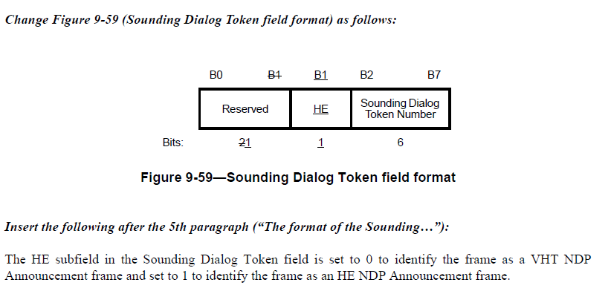
Appendix
from 11ax, P802.11ax D8.0

