Slide 1
SP for TGbf Freq Domain CSI Feedback
Date: 2022-03-31
Authors:
Name | Affiliation | Address | Phone | Email
Junghoon Suh | Huawei |  |  | junghoon.suh@huawei.com
Yan Xin |  |  |  | Yan.Xin@huawei.com

Slide 2
Background
The following CSI Feedback (Freq. Domain) methods have been introduced in TGbf
  11n based CSI Quantization with extension to higher bandwidth and number of RF chains [1]
  2’s power scaling method [2]
  Differential CSI Quantization [3]
  Phase and Magnitude [4]
A thorough examination of each scheme has been conducted based on the following three metrics
  Performance (Signal to Quantization Noise Ratio)
  Complexity
  Feedback Overhead

Slide 3
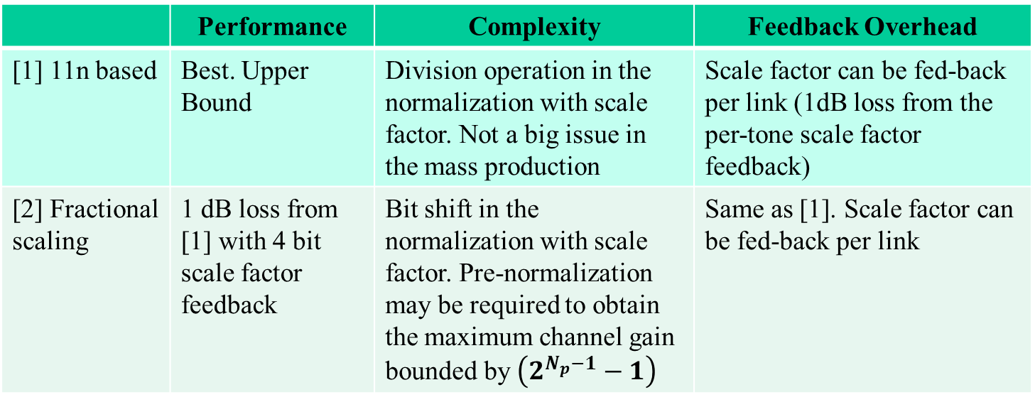
Comparison of two schemes
 | Performance | Complexity | Feedback Overhead
[1] 11n based | Best. Upper Bound | Division operation in the normalization with scale factor. Not a big issue in the mass production | Scale factor can be fed-back per link (1dB loss from the per-tone scale factor feedback)
[2] Fractional scaling | 1 dB loss from [1] with 4 bit scale factor feedback | Bit shift in the normalization with scale factor. Pre-normalization may be required to obtain the maximum channel gain bounded by $\left(2^{N_{p}−1}−1\right)$ | Same as [1]. Scale factor can be fed-back per link

Slide 4
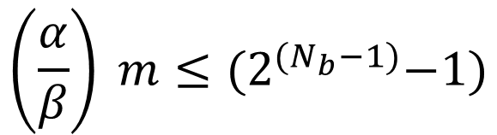
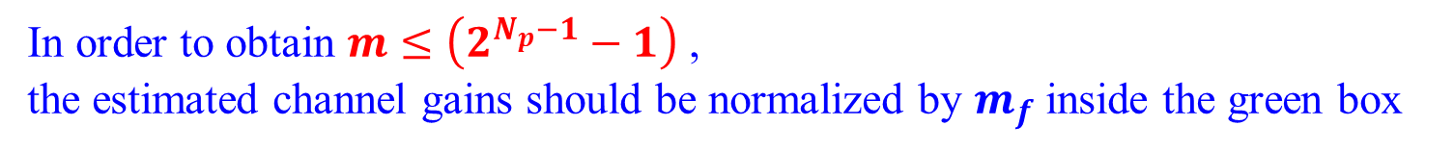
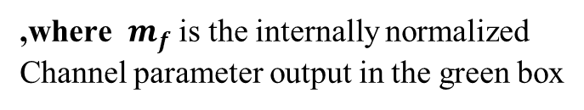

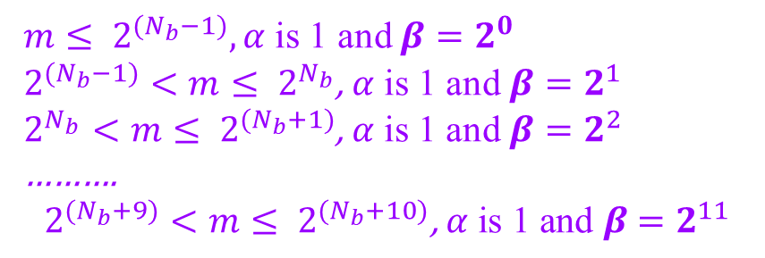
Issue with 2’s power scaling method
Assuming $α$ is 1 and $β∈\left\{2^{0}, 2^{1}, 2^{2}, 2^{3}, …2^{11}\right\},$
$$\left(\frac{α}{β}\right) m≤{(2}^{{(N}_{b}−1)}−1)$$
$m≤ 2^{{(N}_{b}−1)},α$ is 1 and $β=2^{0}$
$2^{{(N}_{b}−1)}<m≤ 2^{N_{b}}$, $α$ is 1 and $β=2^{1}$
$2^{N_{b}}<m≤ 2^{{(N}_{b}+1)}$, $α$ is 1 and $β=2^{2}$
……….
$$2^{{(N}_{b}+9)}<m≤ 2^{{(N}_{b}+10)}\text{, }α \text{is}\text{ 1 }\text{and} β=2^{11}$$
$$m= Round\left(m_{f}∗ \left(2^{N_{p}−1}−1\right)\right)$$
,where $m_{f}$ is the internally normalized
Channel parameter output in the green box
In order to obtain $m≤$ $\left(2^{N_{p}−1}−1\right)$ ,
the estimated channel gains should be normalized by $m_{f}$ inside the green box

Slide 5
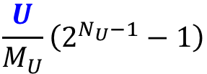
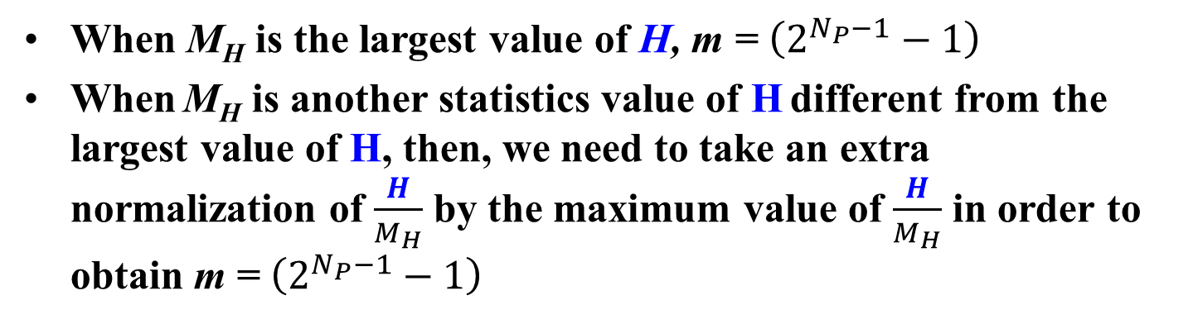
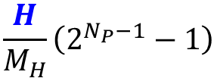
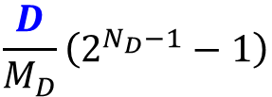
Controlling Output Data Path Size
$$\frac{U}{M_{U}}\left(2^{N_{U}−1}−1\right)$$
$$\frac{D}{M_{D}}\left(2^{N_{D}−1}−1\right)$$
U
D
GI Removal and
Channel Estimation
H
N_{P}
AGC
ADC
FFT
N_{U}
N_{D}
Statistics of the amplitude of U, M_{U}
Statistics of the amplitude of D, M_{D}
Statistics of the amplitude of H, M_{H}, where H is the channel parameter
$$\frac{H}{M_{H}}\left(2^{N_{P}−1}−1\right)$$
When M_{H} is the largest value of H, m = $\left(2^{N_{P}−1}−1\right)$
When M_{H} is another statistics value of H different from the largest value of H, then, we need to take an extra normalization of $\frac{H}{M_{H}}$ by the maximum value of $\frac{H}{M_{H}}$ in order to obtain m = $\left(2^{N_{P}−1}−1\right)$

Slide 6
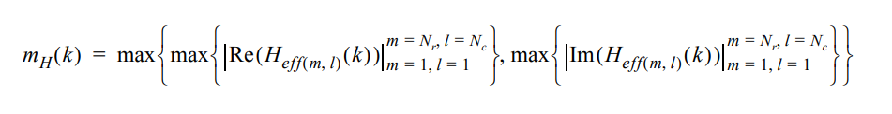
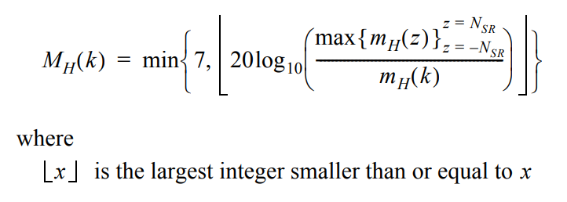
802.11n CSI matrices quantization procedure
The maximums of the real and imaginary parts of each element of the matrix in each subcarrier are found as following
The scaling ratio is calculated and quantized to 3 bits as following

Slide 7
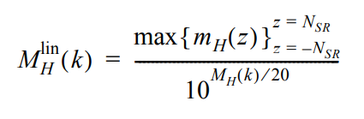
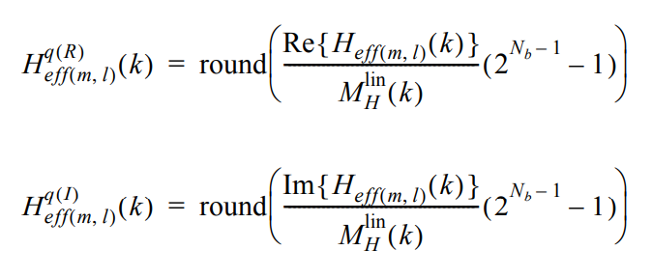

802.11n CSI matrices quantization procedure continues …
3. Linear Scaler of step 2 is given as following
4. The real and imaginary parts of each element in the matrix $H_{eff(m,l)}$(k) are quantized to N_{b} bits in twos complement encoding as defined by following
N_{SR} indicates the half the size of
Subcarriers per symbol excluding Nulls
k is the subcarrier index
R represents real component
I represents imaginary component

Slide 8
References
[1] 11-21-1676-01-00bf-simplified-scaling-factor-feedback-for-csi-matrices
[2] 11-22-0414-02-00bf-fractional-scaling-factor-for-sensing-measurement-report
[3] 11-22-0506-01-00bf-differential-quantization-for-csi-report
[4] 11-21-1921-00-00bf-partial-csi-feedback
[5] Christian Berger, “CSI Feedback Format”, TGbf CSI_ESTIMATE Offline Discussion Group

Slide 9
SP 1
Do you agree to have a conditional mandatory CSI Feedback scheme according to the CSI matrices feedback as defined in IEEE Std 802.11-2020 with the additional following implementation updates?
  The bandwidth parameter is extended to support up to 160 MHz/320 MHz depending on Sensing NDP format
  The TX-RX pair parameters are extended to support up to 8 RF chains in each TX and RX
  The maximums of the real and imaginary parts across the entire subcarriers can be found per each link (TX-RX pair) for the Scale Factor
  This is for the freq domain CSI feedback
  “conditional mandatory” means that the CSI Feedback Scheme proposed in this SP is mandatorily supported, when the CSI Feedback is supported in a STA

