Slide 1
802.11be enhancements for TSN time-aware scheduling and network management considerations
Date: 2022-04-19
Authors:
Notes:
Revise with all partiants - Dave

Slide 2
Introduction
Growing interest in wireless for time-sensitive applications
  Factory/process automation, robotics, AR/VR/XR are a few examples
  A wide range of latency/reliability KPIs, but “determinism” is a common need
  Time-sensitive and other types of applications need to work in a converged network
  Interoperability/standards-based connectivity is needed for practical/wide scale adoption
Wi-Fi with TSN capabilities (WTSN) is a solution for time-sensitive applications in managed Enterprise/industrial networks
This presentation will discuss
  Time-sensitive application requirements
  Existing Wi-Fi capabilities including 802.11ax and TSN support
  Evolution of Wi-Fi capabilities (802.11be)
  Examples/demonstrations of Wi-Fi enabling industrial applications

Slide 3




Application Classes
Monitoring & Analytics
Augmented/virtual reality
Closed-loop Control Systems
Autonomous & Mobile Robots
Delay-Tolerant
Delay-Intolerant
Time/Safety-Critical
(Hard Real-Time & Isochronous)
Need bounded latency & determinism
Notes:
Add XR (connected worker) here – future of work – Malcolm

Slide 4






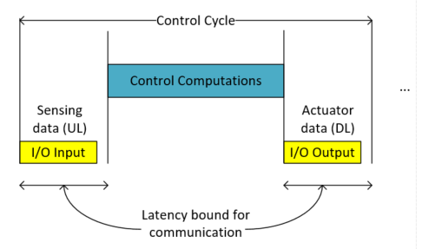
Use cases where deterministic connectivity service with bounded latency are critical
Isochronous Industrial Control
Extended Reality
Control
Edge
Sensing
Actuation
“Actuation”
“Sensing”
Client
Motion to Photon Cycle
Rendering
HMD state
Video
Latency bound for communication
Control Cycle: sensing (I/O input), computing (control algorithm) and actuation (I/O output)
Motion to Photon Cycle: user tracking (“sensing”), computing (rendering) and display (“actuation”)

Slide 5
Leading Use Cases and Requirements (Avnu Alliance WTSN Working Group)
 | Mobile Robots | Live Events | Closed loop Control | AR/VR
Typical area of service | Small/medium/large | Medium/large | Small/medium/large | Small/Medium
End stations per area of service | 100 | 100-500 | 50 | <5 devices/group
Traffic Profile | Cyclic and Event | Continuous stream | Cyclic and Isochronous | Cyclic (UL), video (DL)
Time Synchronization Accuracy | ~1 µsec | 1 µsec or better | 1 µsec or better | ~1 µsec
Bounded Latency | 10 – 1msec (cyclic) 100 – 10 msec (events) | 1msec | 10 – 1 ms (Cyclic) 10 – 100 ms (Events) | 3 to 10 msec
Reliability | 99.9 to 99.99% | 99.9 to 99.99% | 99.9 to 99.9999% | 99.9 to 99.99%
Security | Authentication, integrity and resilience to DOS/Interference | Authentication, privacy, resilience to DOS/Interference | Auth., integrity and resilience to DOS and time/QoS attacks | Auth., integrity and resilience to DOS.
Ref: https://avnu.org/wirelessTSN/

Slide 6
Requirement considerations
Wide range of latency/reliability KPIs
  Many use cases in the 1 to 50 msec latency range
  Some use cases (e.g., motion control) need even lower latency 10’s to 100’s microsecs
Most mission-critical Enterprise and industrial applications that need “deterministic” service have predictable traffic flow behavior
  Devices need service at periodic intervals for a fixed amount of data (known a priori)
  Time-critical data needs to be delivered within a deadline
Practical scenarios are Managed, Enterprise & Industrial IOT networks
  Wi-Fi and WLAN networks are carefully planned and managed, including coverage tools, frequency planning, admission control policies, etc.

Slide 7
Deterministic Wi-Fi
Enablers
6 GHz
Multi-radio clients/ APs
Core Capabilities
QoS management
802.11ax: OFDMA, Triggered access
802.11be MLO, 320 MHz, SCS, Restricted TWT
Deterministic
Wi-Fi Enabling
Tools
Wireless TSN
Time synch (.1AS)
Time-aware scheduling (.1Qbv)
Redundancy (.1CB)
Network
E2E wireless-wired integration
Management & scheduling

Slide 8
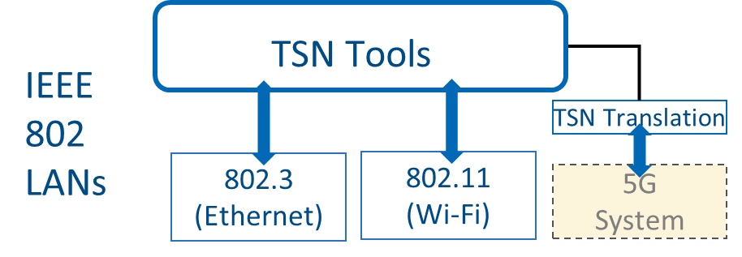
TSN “toolbox” and 802.11 (Wi-Fi) support
Time-Sensitive Networking (TSN) = deterministic data delivery with bounded latency without loss due to congestion or errors. Standards defined by the IEEE 802.1 TSN Task Group.
Example TSN tools (not a complete list) enabled by 802.11
Time synchronization (802.1AS-2020)
TSN toolbox
Redundancy (802.1CB)
…
802.1AS over 802.11 TM,/FTM
Synchronization
Reliability
802.11be Multi-link
802.1AS + 802.1Qbv enable synchronous application cycle:
→ deterministic/periodic data with delivery deadlines
Bounded Latency
Time-aware scheduling (802.1Qbv)
TSN Config (802.1Qcc, P802.1Qdj)
…
Resource Mgmt
Clear requirements mapped to 802.11ax and 802.11be features to meet the deadlines within the BSS:
Scheduling (802.11ax)
802.11be Enhancements: SCS/Flow QoS Characteristics and rTWT

Slide 9
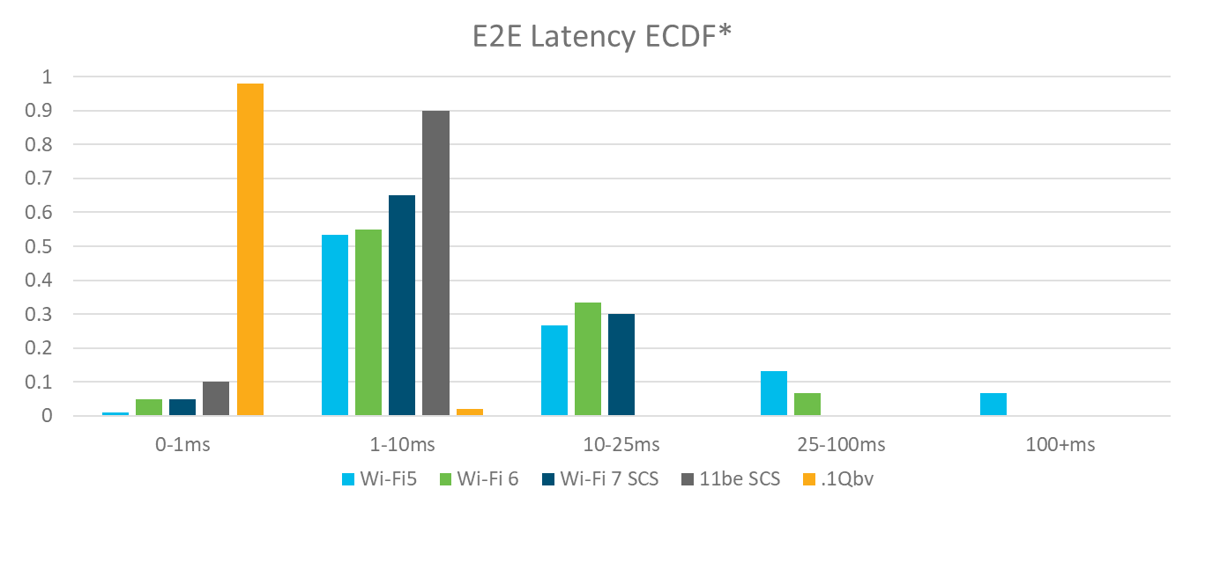
Evolution of Wi-Fi determinism
Wi-Fi 5 (SU) experiences very high variability (>>100ms worst case) and effectively unbounded latency
Wi-Fi 6 (ULOFDMA) bounds max latency (<100ms)
WiFi7 (SCS QoS Characteristics w/ 20ms period) provides significant latency gain w.r.t. Wi-Fi 6 (<25ms)
11be (SCS QoS Characteristics w/ 20ms period + start-time) expected to bound latency to more stringent (<10ms) requirements
Wireless TSN (802.1Qbv) manages E2E latency to within 1ms 98%-ile for scheduled traffic
* E2E includes host-to-host including L2 switch and WLAN hops

Slide 10

Network Configuration & Management
CUC
End Station Configuration
(OPC_UP Pub/Sub)
UNI
CNC
TSN-CS
WTSN-CS
End Station Configuration
OPC_UA (Pub/Sub)
Wired-TSN
Stream Data
1) End Station Configuration
Talker End Stations
TSN Bridges
Listener End Stations
End Station Configuration
Stream Data
1) Traffic flow QoS requirements and configuration between Talker and CUC/CNC
AP
AP
3) AP schedules channel access to meet QoS requirements using 802.11ax and 802.11be tools
2) SCS Req (Flow QoS)/
SCS Resp.
3) Trigger +
DATA
2) BSS QoS requirements and schedule aligned with TSN configuration
Stream Data
Wireless Talker End Stations
Wireless Listener End Stations
Wireless-TSN

Slide 11
WTSN Evolution
…
2019
2021
2023
…
802.11ac
802.11ax
802.11be
Time Synchronization
Traffic shaping over
EDCA
Traffic shaping and bounded latency with scheduled OFDMA operation
TSN Enabling Capabilities
Deterministic low latency enhancements
Redundancy over MLO
Redundancy over multi-radio
WTSN Configuration and management
802.11 and TSN will continue to evolve and introduce new TSN tools

Slide 12
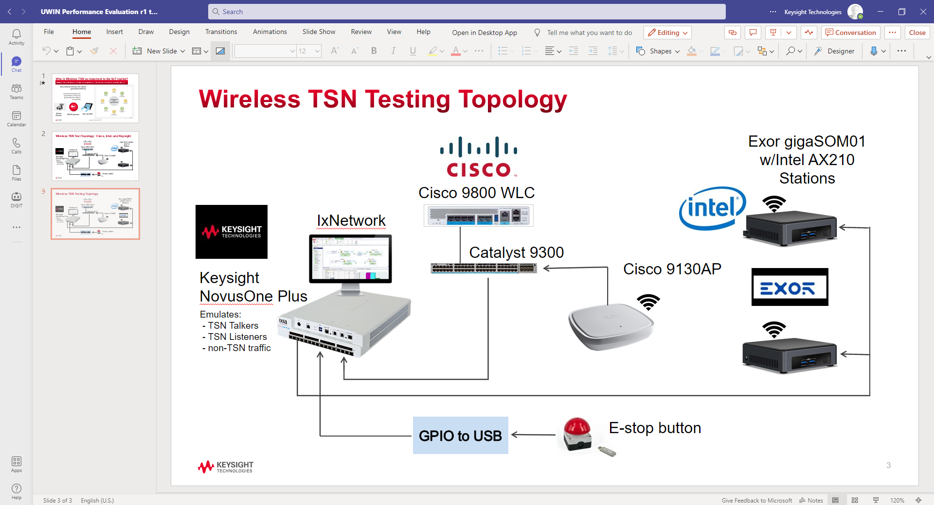
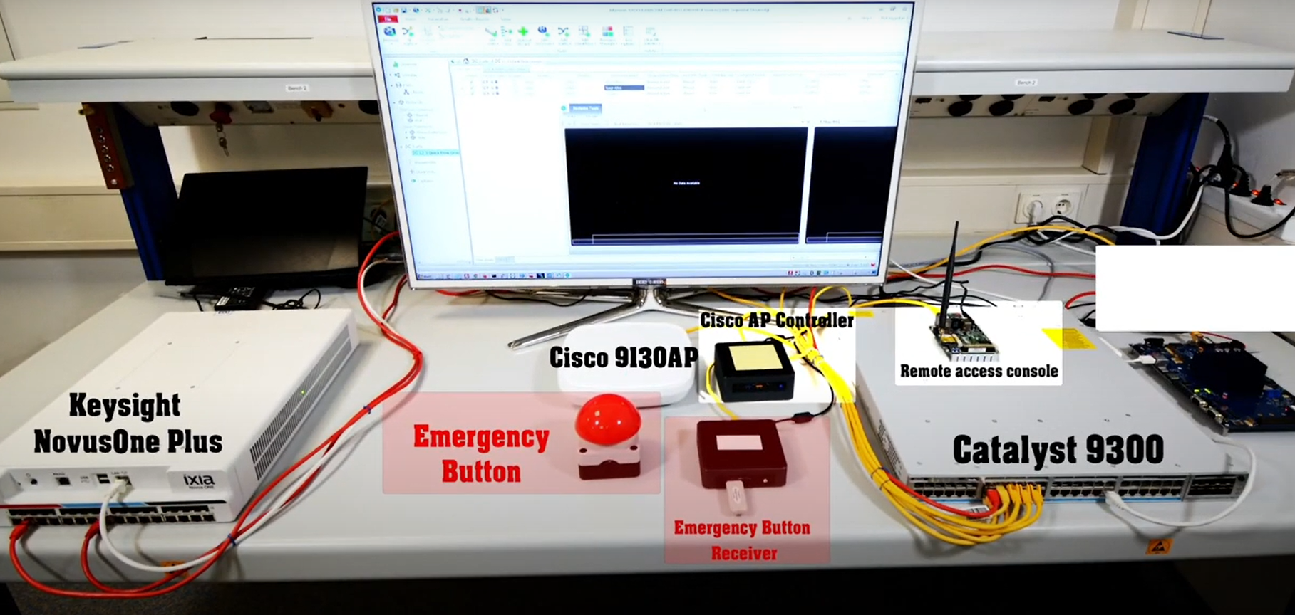
TSN over WiFi 6 demo at MWC 2022
Joint demo by Cisco, Intel, Exor, and Keysight
Illustrating Realistic HMI scenario
  Heartbeat frame transmitted every 1ms
  Wireless emergency stop button generates repeated “emergency-stop” frames every 1ms when pressed
  Best Effort Traffic: ~20Mbps traffic
Demonstrated Technologies
  802.1AS synchronization via FTM
  802.1Qbv schedule with 1ms cycle time
Measurements conducted
  802.1AS synchronization performance
  Latency histograms illustrating 802.1Qbv performance

Slide 13


Ecosystem activities in WBA and Avnu Alliance
Workgroup launched Feb. 2021 - https://wballiance.com/wi-fi-6-6e-for-industrial-iot/
Continue the IIOT work :
https://wballiance.com/resource/wi-fi-6-trial-report-industrial-manufacturing/
https://www.mettisgroup.com/wifi6/
Wireless TSN WG
https://avnu.org/wirelessTSN/
Defining use cases, market requirements and TSN capability testing specifications/Interop Events
https://avnu.org/wireless-tsn-paper/

Slide 14
Conclusions
802.11 is already used as a connectivity solution for deterministic Enterprise applications such as Industrial IOT (IIOT) and AR/VR/XR
New capabilities (802.11be and Wireless TSN) are enabling support for these and future time-sensitive applications
  To meet isochronous communication requirements
  To more tightly bound latency and reliability
  To deliver on each application’s unique requirements
Wi-Fi and TSN trials, testing and deployments are in progress (WBA and Avnu Alliance)

