Slide 1
Introduction of Vice Chair Candidate Jon Rosdahl
Date: 2022-03-07
Authors:

Slide 2
Abstract
Candidate information presentation

Slide 3
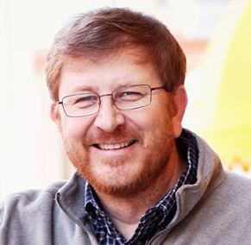
Jon Rosdahl
2022 Candidate for IEEE 802.11 Vice-Chair

Slide 4
My Expectations
I would like to start by saying “Thank You!!”
Having served as the IEEE 802.11 Vice Chair since 2008, I hope you would continue your support of my service to the Working Group.
My success does not depend on someone else’s failure.
The IEEE 802.11 WG is a model of efficient collaboration and operation. Over the 14 years of service, we have improved on automation, collaboration and communication tools.

Slide 5
IEEE Experience
29th Anniversary of participating in 802 sessions this month.
Over the course of the 29 years, I have served as
Vice-Chair of 802.11 for 16 years.
Treasurer for 14 years
Task Group leader (TGm – Secretary/Vice Chair); SG Chair (HT SG)
PAR Review SC Chair
Assisted Various WG Assignments – P&P, Counting, PAR etc.
802 Executive Committee:
Executive Secretary for 12 years
Served on the IEEE-SA Standards Board and Standing Committees
IEEE-SA Standards Board (member 10 years) – (Vice Chair 4 years)
NesCom (8 yrs); PatCom (3 yrs); ProCom (4 yrs); RevCom (6 yrs); AudCom (1 yr)
Computer Society Vice President Standards Activities – 2017-2018
ComSoc Society Standards Development Board – 2016
IEEE Governance Committee 2021-2022; IEEE Conferences Committee 2021-2022
Senior Member of the IEEE -- Member of IEEE-SA
Affiliation and endorsement filed with 802 EC Recording Secretary

Slide 6
Why Continue?
I enjoy working with you.
I believe that my contributions to the group have made an impact.
I believe my experience and skill set can be utilized to make a difference in the future of IEEE 802.11.
Today’s challenges are going to be solved with cooperation of the committee members.
We all just need the opportunity to engage in the process.
Notes:
I believe:
Working Group Officers serve the needs of the Working Group.
Diligence, integrity and stability are as important as capability and execution.
The IEEE 802.11WG members should choose officers that are able to facilitate the Working Group process in order to provide standards that fulfill the requirements of the consumers in marketplace.

Slide 7
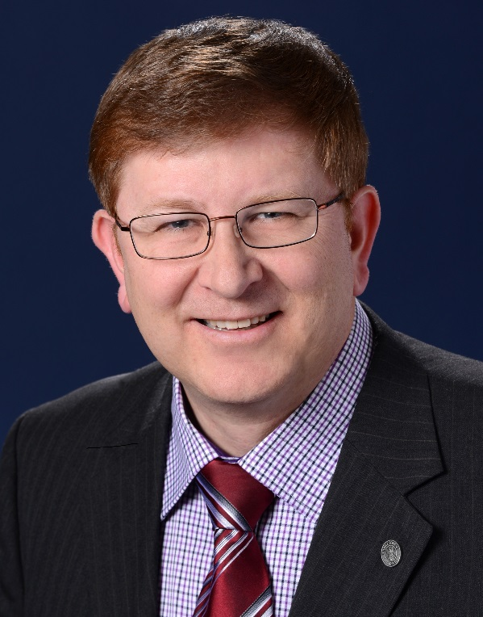
Thanks, and Request for your Support
I thank you for your confidence in me over the years, and hope that I have earned your trust and confidence to re-elect me as your Vice-Chair.
Jon Walter Rosdahl

