Slide 1
Quick Recovery for MLO
Date: 2022-02-23
Authors:

Slide 2
Abstract
The slides proposes a new mechanism called Quick Recovery Mode to support shorter retransmission time under MLO

Slide 3
Motivation
MLO is currently not utilized efficiently to enhance retransmission compared to single-link operation
  In latency sensitive traffic, BA is discouraged due to retransmission latency as retransmission needs to wait until full A-MPDU is received and Block ACKed when failed MPDUs may already be expired
    This is still not handled with ML-BA
  Increased size of A-MPDU (512 and 1024 subframes are now possible) makes quick recovery of MPDUs in the front of the A-MPDU beneficial
    Currently, we need to wait until all MPDUs are received and processed by MAC layer and BA is received to recover

Slide 4
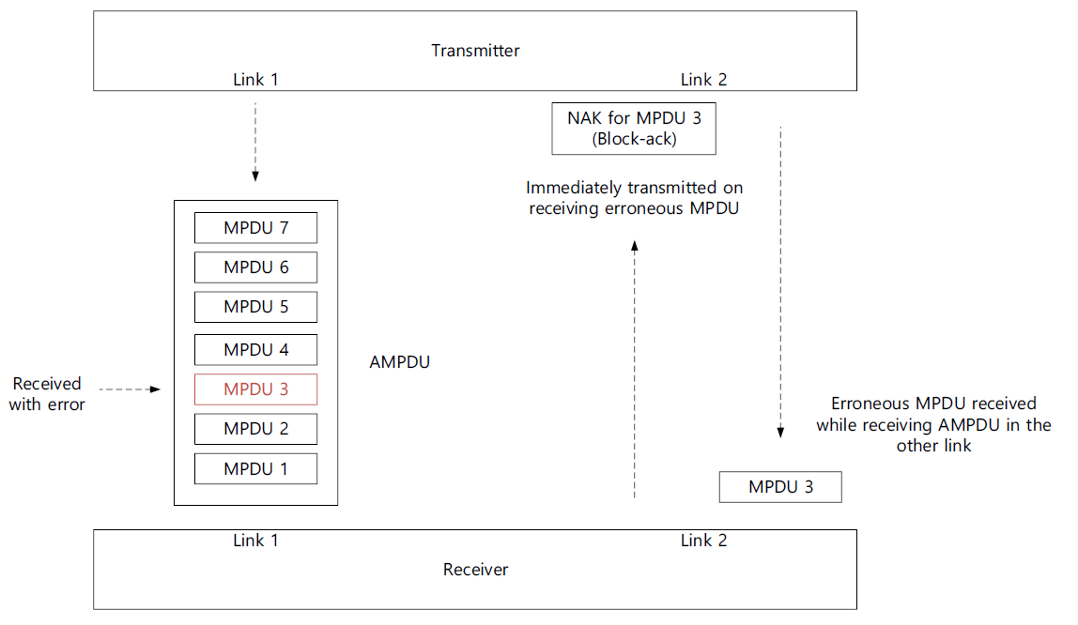
High-Level Operation of Proposed Quick Recovery for MLO
If one link is used for transmission of A-MPDU, other links (that has same TID mapped to it) can help quickly recover failed MPDUs
This requires new capability indication by both transmitter and receiver
Even though optimized Quick Recovery is expected to achieve maximum gain, even an opportunistic approach can also be useful
Opportunistic Quick Recovery means that when Quick Recovery capability is indicated, then if another link where same TID is mapped to as well (same TID as the link carrying QoS data), then it is used for immediate re-transmission by utilizing same BA frame

Slide 5
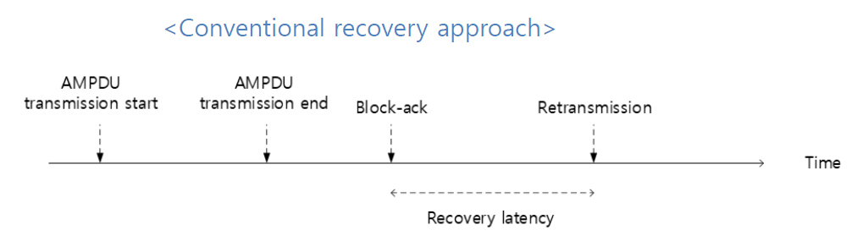
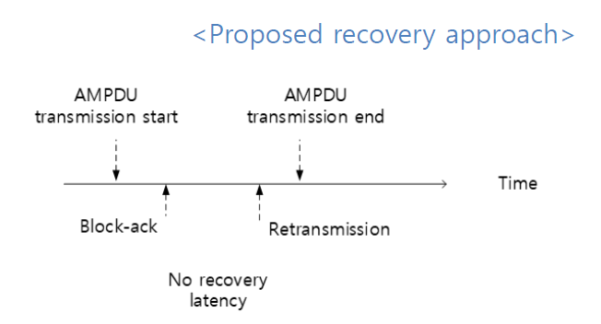
Recovery Time Reduction
Recovery time for proposed approach is smaller as we may be able to finish retransmissions before original transmission is completed and acknowledged
BA that is used in the recovery link can acknowledge correct reception of older MPDUs and indicate the first failure
It can be left to implementation to choose how to utilize the parallel BA in QR mode
QoS Data Link
Recovery Link

Slide 6
Straw Poll
Do you agree that 11be should introduce Quick Recovery Mode for MLO by allowing BA to be sent on a different link before the end of A-MPDU transmission on QoS data carrying link?
  Yes in R1
  Yes in R2
  No
  Abstain

Slide 7
Q&A
Q: Is this proposal specifically designed when both sides are STR?
  Yes, there is an inherent assumptions that the data carrying link and the Quick Recovery link are STR. As R1 is focusing on STR and EMLSR for R1 so this should be fine in that direction. A small addition for clarification, what I am proposing here is a very simple change that we allow quicker reception of BA on other links instead of what the current spec allows (which is BA being sent after SIFS for immediate BA and maybe later in non-immediate BA). I think that this is a good capability to allow in the spec instead of the rigid timing of BA that was inherited from single link operation and can now be more flexible with the MLO in 11be
Q: There seems to be many missing details,
  This is a high-level idea of the operation but we can discuss the details of the operation further as we agree on the benefit of the approach. However, one simple way is to just use an opportunistic approach where we only need capability indication.
Q: STR is needed, which is only there for the high end client. Most of the potential cases for client in R1 are single radio, eMLSR, and potential NSTR. STR in R1 is for AP MLD)
  Even though STR is not mandatory in R1 it is in some sense conditional mandatory as non-AP MLD has to support either eMLSR or STR. I understand that eMLSR will be the most preferred as it is easier for implementation but we think that STR for non-AP MLD may still be attainable in the time-frame of R1

Slide 8
Q&A
STR is used when you have a lot traffic, otherwise, you may still go to power save for one link. To use this feature, now we have to be STR all the time without power save, this seems to introduce a tradeoff
  This feature is targeting quick recovery that enables recovery in the same TXOP on a different link. This is specially helpful for low-latency traffic where the possibility of recovery in the same TXOP may enable using BA instead of avoiding it to avoid outdated re-transmissions. This is still up to the non-AP MLD to either turn on or turn off this capability as capability indication may be in a dynamic form depending on the needs of the non-AP MLD if it is preferring power saving on other links or quicker recovery
Q: How many BA you plan to send. There may be many error MPDUs in an AMPDU. If we want to have quick recovery, then we basically have to send one feedback for every error MPDU, and that can be a lot of BA
  There can be many ways to look at this. One way is to leave it to implementation or we can set rules in the spec. For example,
    Implementation may consider to only use this feature if an error occurs in the first half of the A-MPDU otherwise it is too late to send BA
    Another approach is to use this feature for pro-active recovery asking for sending the whole A-MPDU on the other link for duplicate transmission
    Another approach is that receiver won’t send the BA on the other link unless a certain threshold/number of errors have occurred and this can be combined with another condition on the location of the erroneous MPDU
    Receiver may opt for sending multiple BAs and recover for each MPDU separately or in a grouped manner as this operation is transparent to the receiver

Slide 9
Q&A
Q: Constantly changing the preparation of BA based on instantons reception seems to be a completely new implementation consideration
  It is added feature that will require implementation support. However, keeping it in spec can open the door for implementation to start building such a capability even with simple assumptions as a start and then optimize later for R2 or later
Q: Since STR is only mandatory for AP MLD in R1, do we need to consider this in R1?
  It is preferred if we add in R1 specially that it does not require a lot of changes from the spec side but we may consider it for R2 as well. However, putting it in the spec can enable simple versions of QR mode to be implemented in R1 and optimized in later releases as mentioned

