Slide 1
Agenda for IEEE 802.11 Coexistence SC virtual meeting in March 2022
11 March 2022
Authors:
Name | Company | Phone | email
Andrew Myles | Cisco | +61 418 656587 | amyles@cisco.com

Slide 2
Welcome to the 11th virtual meeting of the Coex SC in March 2022
IEEE 802.11 PDED ad hoc
1 | Warsaw | Sep 2016
2 | San Antonio | Nov 2016
3 | Atlanta | Jan 2017
4 | Vancouver | Mar 2017
5 | Daejeon | May 2017
IEEE 802.11 Coexistence SC
9 | Bangkok | Nov 2018
10 | St Louis | Jan 2019
11 | Vancouver | Mar 2019
12 | Atlanta | May 2019
13 | Vienna | Jul 2019
14 | Hanoi | Sep 2019
15 | Hawaii | Nov 2019
16 | Irvine | Jan 2020
17 | Virtual 1 | Jul 2020
18 | Virtual 2 | Sep 2020
19 | Virtual 3 | Nov 2020
20 | Virtual 4 | Jan 2021
21 | Virtual 5 | Mar 2021
22 | Virtual 6 | May 2021
IEEE 802.11 Coexistence SC
23 | Virtual 7 | Jul 2021
24 | Virtual 8 | Sep 2021
25 | Virtual 9 | Nov 2021
26 | Virtual 10 | Jan 2022
27 | Virtual 11 | Mar 2022
28 | Hybrid 1 | May 2022
IEEE 802.11 Coexistence SC
1 | Berlin | July 2017
2 | Hawaii | Sep 2017
3 | Orlando | Nov 2017
4 | Irvine | Jan 2018
5 | Chicago | Mar 2018
6 | Warsaw | May 2018
7 | San Diego | July 2018
8 | Hawaii | Sep 2018

Slide 3
Registration is required for the IEEE 802.11 WG electronic plenary session in March 2022
  This meeting is part of the March IEEE 802 plenary session
  You must pay the registration fee in order to attend
  If you have not already done so, you can register here or follow the registration link here https://802world.org/plenary/
  If you do not intend to register for this session you must leave this meeting and, if you have logged attendance on IMAT, email the 802.11 chair or vice chairs to have your attendance cancelled

Slide 4
Coex SC minutes today will be kept by our permanent SC secretary
  It is important to keep proper minutes of all Coexistence SC meetings …
  … and fortunately, way back in July 2017 in Berlin at a time when we actually saw each other F2F
  … Guido Hiertz (Ericsson) agreed to be appointed the IEEE 802.11 Coexistence SC’s permanent Secretary

Slide 5
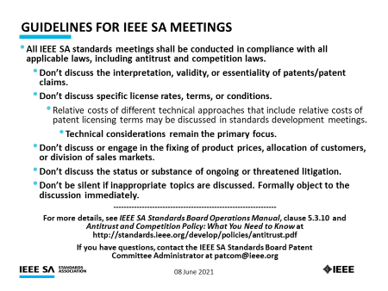
The Coex SC will review the official IEEE-SA patent material for pre-PAR groups
Approved slide

Slide 6
Participant behavior in IEEE-SA activities is guided by the IEEE Codes of Ethics & Conduct
Approved slide
  All participants in IEEE-SA activities are expected to adhere to the core principles underlying the:
    IEEE Code of Ethics
    IEEE Code of Conduct
  The core principles of the IEEE Codes of Ethics & Conduct are to:
    Uphold the highest standards of integrity, responsible behavior, and ethical and professional conduct
    Treat people fairly and with respect, to not engage in harassment, discrimination, or retaliation, and to protect people's privacy.
    Avoid injuring others, their property, reputation, or employment by false or malicious action
  The most recent versions of these Codes are available at
    http://www.ieee.org/about/corporate/governance

Slide 7
Participants in the IEEE-SA “individual process” shall act independently of others, including employers
Approved slide
  The IEEE-SA Standards Board Bylaws require that “participants in the IEEE standards development individual process shall act based on their qualifications and experience”
  This means participants:
    Shall act & vote based on their personal & independent opinions derived from their expertise, knowledge, and qualifications
    Shall not act or vote based on any obligation to or any direction from any other person or organization, including an employer or client, regardless of any external commitments, agreements, contracts, or orders
    Shall not direct the actions or votes of other participants or retaliate against other participants for fulfilling their responsibility to act & vote based on their personal & independently developed opinions
  By participating in standards activities using the “individual process”, you are deemed to accept these requirements; if you are unable to satisfy these requirements then you shall immediately cease any participation

Slide 8
IEEE-SA standards activities shall allow the fair & equitable consideration of all viewpoints
Approved slide
  The IEEE-SA Standards Board Bylaws (clause 5.2.1.3) specifies that “the standards development process shall not be dominated by any single interest category, individual, or organization”
    This means no participant may exercise “authority, leadership, or influence by reason of superior leverage, strength, or representation to the exclusion of fair and equitable consideration of other viewpoints” or “to hinder the progress of the standards development activity”
  This rule applies equally to those participating in a standards development project and to that project’s leadership group
  Any person who reasonably suspects that dominance is occurring in a standards development project is encouraged to bring the issue to the attention of the Standards Committee or the project’s IEEE-SA Program Manager

Slide 9
Participants are required to adhere to the IEEE SA Copyright Policy
Approved slide
  By participating in this activity, you agree to comply with the IEEE Code of Ethics, all applicable laws, and all IEEE policies and procedures including, but not limited to, the IEEE SA Copyright Policy.
    Previously Published material (copyright assertion indicated) shall not be presented/submitted to the WG nor incorporated into a WGdraft unless permission is granted.
    Prior to presentation or submission, you shall notify the WG Chair of previously Published material and should assist the Chair in obtaining copyright permission acceptable to IEEE SA.
    For material that is not previously Published, IEEE is automatically granted a license to use any material that is presented or submitted.

Slide 10
Participants are required to adhere to the IEEE SA Copyright Policy
  The IEEE SA Copyright Policy is described in the IEEE SA Standards Board Bylaws and IEEE SA Standards Board Operations Manual
    IEEE SA Copyright Policy, see:
      Clause 7 of the IEEE SA Standards Board Bylaws
      Clause 6.1 of the IEEE SA Standards Board Operations Manual
  Other material
    IEEE SA Copyright Permission
    IEEE SA Copyright FAQs
    IEEE SA Best Practices for IEEE Standards Development
    Distribution of Draft Standards (see Clause 6.1.3 of the SASB Operations Manual)

Slide 11
The Coex SC will only meet once during the virtual IEEE 802.11 WG plenary meeting in March 2022
Schedule
  Monday, 14 Mar 2022 @ 4-6pm ET
Webex details
  https://ieeesa.webex.com/ieeesa/j.php?MTID=m04e7af92b3503cea449e111794e44067
    Meeting number: 234 795 24723
    Meeting password: wireless (94735377 from phones and video systems)

Slide 12
The Coex SC will consider a proposed agenda for its virtual meeting in March 2022
Proposed agenda is light ☹
  Bureaucratic stuff
    Scope of IEEE 802.11 Coex SC
    Approve minutes from Jan 2022
  What is happening this week? (in no particular order)
    Key messages!
    Drivers of Coex SC work
    ETSI BRAN update
      EN 301 893 (5 GHz) status
      EN 303 687 (6 GHz) status
        NB FH in 6 GHz
        C2C
      Future BRAN meetings
    Coex work for IEEE 802.11 WG
      Coexistence challenges for 802.11be in 5 GHz
      Possible LS to TGbe/WG/WFA
      Specification challenges for 802.11ax/be in 6 GHz
    Coex Tech Talk request
    Coex measurement request
    5.8 GHz update
    6 GHz spectrum availability
    3GPP update
    60 GHz update
    Plans for next meeting

Slide 13
  Scope of IEEE 802.11 Coexistence SC

Slide 14
The Coex SC scope was revised in Sept 2020
IEEE 802.11 Coex SC Scope
  The Coex SC shall promote, within the 802.11 WG and externally, an environment that enables IEEE 802.11 technologies to have equitable access to unlicensed spectrum globally
  The Coex SC should focus particularly on coexistence of 802.11ax & 802.11be with LAA & NR-U in the 5 GHz & 6 GHz bands globally
  The Coex SC may consider coexistence with other technologies and in other bands as directed by the Chair of the 802.11 WG
IEEE 802.11 Coex SC close down criteria
  802.11 WG Chair has authority to close down SC

Slide 15
The scope of the Coex SC was expanded in March 2021 to include 60 GHz coexistence issues
  It was noted during the March 2021 plenary that ETSI BRAN is working on 60 GHz Harmonised Standards that may impact IEEE 802.11ay coexistence
  Subsequently, the 802.11 Chair directed the Coex SC to consider 60GHz coexistence within scope
    At today's WG11 Opening Plenary, the comment was made that ETSI BRAN is also considering operational and coexistence requirements related to 57-71 GHz (60GHz) spectrum, relevant of course to 802.11ad and 11ay
    The scope of the Coex SC focuses on, "coexistence of 802.11ax & 802.11be with LAA & NR-U in the 5 GHz & 6 GHz bands globally". However, it "may consider coexistence with other technologies and in other bands as directed by the Chair of the 802.11 WG". So the Coex SC can consider 60 GHz issues if directed by the WG Chair
    I have directed the Coex SC to additionally consider coexistence topics for 60GHz operation

Slide 16
  Minutes

Slide 17
The Coex SC will consider the approval of its virtual meeting minutes from Jan 2022
  The draft minutes for the Coex SC at the virtual meeting in Jan 2022 are available on Mentor:
    See 11-22-0361-00
  Proposed motion:
    The IEEE 802 Coex SC approves 11-22-0361-00 as the minutes of its virtual meeting in January 2022
    Moved:
    Seconded:
    Result:

Slide 18
Coex SC
Key messages for Mar 2022

Slide 19
There are few key message for the Coex SC that arise out of today’s session
Key messages from today’s session include …
  LAA deployment seems to be stalled, although any increase will likely have an adverse impact on coexistence
  The future deployment of NR-U, and thus any adverse impact on coexistences, is currently unknown
  EN 301 893 (5 GHz) & EN 303 687 (6 GHz) are progressing towards completion, with some open issues deferred to the future
    TGbe/Coex SC need to resolve issues related to 802.11be operation in 5 GHz
    C2C & NB FH have been deferred in 6 GHz
    There are some open & potential specification issues for the WG in 6 GHz
  5.8 GHz & 6 GHz access remains competitive
  Ongoing monitoring of 3GPP is required (inc for SL-U)
… you can leave if you are not interested in the details ☺

Slide 20
  Agenda items
  Drivers of coexistence
  Unlicensed LAA/NR-U deployment

Slide 21
There was a significant LAA deployment in
Chicago as early as Jan 2020
No update
Chicago LAA deployment (Jan 2020)
  A study in Chicago in Jan 2020 shows a significant LAA deployment … that was expanding rapidly
    In Jan 2020, AT&T mostly used channel 149 & Verizon mostly used channel 36, avoiding intra-LAA coex issues
  See Measurement-based coexistence studies of LAA & Wi-Fi deployments in Chicago
    Vanlin Sathya, Muhammad Iqbal Rochman, & Monisha Ghosh (Uni of Chicago)
AT&T
Verizon
T-Mobile

Slide 22
We have tracked the use of 5G by SPs in unlicensed bands to highlight the importance of coexistence work
No update
Tech | Stage | GSMA¹ (July ‘18) | GSA² (Oct ‘18) | GSA³ (Jan ‘19) | GSA⁴ (Jul ‘19) | GSA⁵ (Nov ‘19) | GSA⁶ (Dec ‘19) | GSA⁷ (Mar ‘20) | GSA⁸ (Aug ‘20)
LAA | Trials/plans | 23 | 22 | 26 | 29 | 30 | 29 | 29 | 28
 | Deployed | 4 | 6 | 6 | 8 | 8 | 8 | 9 | 9
eLAA | Trials/plans | ? | 1 | 1 | 1 | 1 | ? | 0 | 1
 | Deployed | ? | 0 | 0 | 0 | 0 | ? | 1 | 0
LWA | Trials/plans | ? | 2 | 2 | 2 | 2 | 2 | 2 | 2
 | Deployed | ? | 1 | 1 | 1 | 1 | 1 | 1 | 1
LTE-U | Trials/plans | ? | 8 | 8 | 8 | 8 | 9 | 9 | 9
 | Deployed | ? | 3 | 3 | 3 | 3 | 3 | 3 | 3
GSMA (July 2018)
GSA: Evolution from LTE to 5G: Global Market Status (Nov 2018)
GSA: LTE in unlicensed and shared spectrum (Jan 2019)
GSA: Evolution from LTE to 5G: Global Market Status (Aug 2019)
GSA: LTE Unlicensed - LTE in Unlicensed and Shared Spectrum (Nov 2019
GSA: LTE and 5G Market Statistics (Dec 2019)
GSA: LTE in Unlicensed Spectrum and Shared Spectrum (Mar 2020)
GSA: LTE and 5G in Unlicensed Spectrum: Trials, Deployments & Devices (Aug 2020)

Slide 23
We are now also tracking 5G clients in unlicensed bands to highlight the importance of coex work
Updated
Feb 2022
Tech | Stage | GSA⁹ (Oct ‘20) | GSA¹⁰ (Jan ’21) | GSA¹¹ (Feb ’21) | GSA^{12, 13} (Mar ’21) | GSA¹⁴ (Jun ’21) | GSA¹⁵ (Aug ’21) | GSA¹⁶ (Dec ’21) | GSA¹⁷ (Jan ’22)
LAA | Trials/plans | 27 | 27 | 27 | 27 | - | 27 | 27 | 27
 | Deployed | 9 | 9 | 9 | 9 | - | 9 | 9 | 9
 | Devices | - | - | - | 247 | 329 | - | - | -
LWA | Trials/plans | 2 | 2 | 2 | 2 | - | 2 | - | -
 | Deployed | 1 | 1 | 1 | 1 | - | 1 | - | -
 | Devices | - | - | - | 16 | 16 | - | - | -
LTE-U | Trials/plans | 9 | 9 | 9 | 9 | - | 9 | - | -
 | Deployed | 3 | 3 | 3 | 3 | - | 3 | - | -
 | Devices | - | - | - | 46 | 46 | - | - | -
GSA: LTE and 5G Market Statistics (Oct 2020)
GSA: LTE and 5G Market Statistics (Jan 2021)
GSA: Networks, Technologies & Spectrum Snapshot: LTE and 5G Market Statistics (Feb 2021)
GSA: LTE Ecosystem Status (Mar 2021)
GSA: LTE 5G Market Statistics (Mar 2021)
GSA: LTE Ecosystem Report (Status Update Jun 2021)
GSA: NTS Stats Update (Aug 2021)
GSA: NTS database snapshot: LTE and 5G Market Statistics (Dec 2021)
GSA: NTS Statistics (Jan 2022)

Slide 24
The number planned/testing & deployed LAA SP networks globally has been steady for 2+ years
Updated
Feb 2022
Stable!

Slide 25
  Agenda items
  Coex measurements

Slide 26
The Coex SC heard about an LAA/Wi-Fi coexistence studies in Chicago throughout 2021
Refined from
Nov 2021
  One of concerns with many of the conclusions drawn in relation to coexistence is that they are based on simulation studies …
  … which have been used over the years to provide evidence for just about any conclusion one might want to draw
  A good complement to simulation studies is measurements of actual deployments …
  … recognising they also have limitations
  During 2021, the Coex SC heard about various LAA/Wi-Fi coexistence measurements undertaken in the in the Chicago area
    See 11-20-1973 (Jan 2021)
    See 11-21-1858 (Nov 2021)

Slide 27
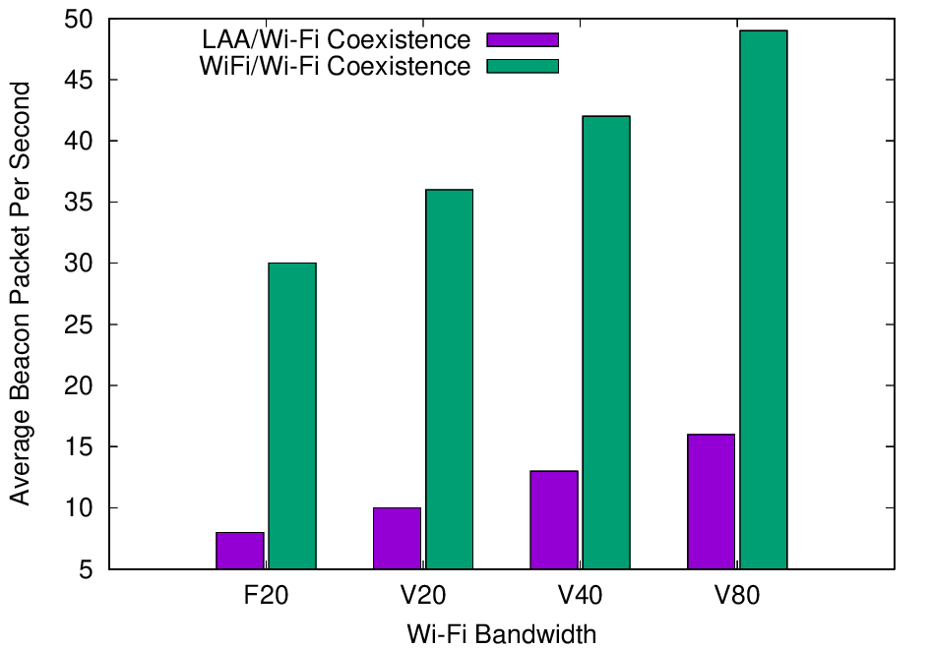
Experiments reported in Jan 2021 showed LAA has a significant adverse impact on Wi-Fi Beacons
Refined from
Mar 2021
  The Uni of Chicago study (11-20-1973) investigated the effect of LAA on Wi-Fi operation in various typical configurations, including hidden nodes
  The work showed that LAA
  caused significant interference
  to Wi-Fi Beacons in the tested
  configuration
    Probably because LAA is:
      Using ED @ -72 dBm
      Rather than PD @ - 82 dBm
    Also because LAA typically uses
    long TxOPs (~8 ms)
Addition of a single LAA system to five Wi-Fi systems causes successful Beacon rate to reduce by > 75%
Pushing Wi-Fi APs into the same channel also causes successful Beacon rate to reduce, but by less than LAA

Slide 28
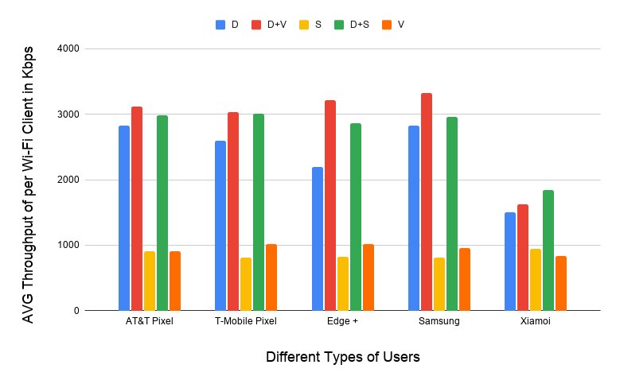
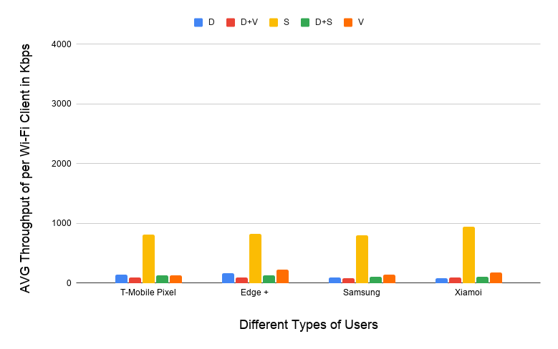
Experiments reported in Jan 2021 showed LAA also has a significant adverse impact on Wi-Fi data
Refined from
Mar 2021
  The Uni of Chicago study (11-20-1973) showed that LAA caused significant interference to data traffic in the tested configuration
    Probably because LAA is using ED @ -72 dBm rather than PD @ - 82 dBm
    Also because Wi-Fi’s hidden station mitigation mechanisms based on RTS/CTS have no effect on LAA
5 Wi-Fi APs on one channel, no LAA
5 Wi-Fi APs on one channel, one LAA
11-20-1973 slide 16
All client close
to Wi-Fi APs
Addition of LAA caused all Wi-Fi traffic to collapse …
… except streaming because LAA uses licensed for streaming

Slide 29
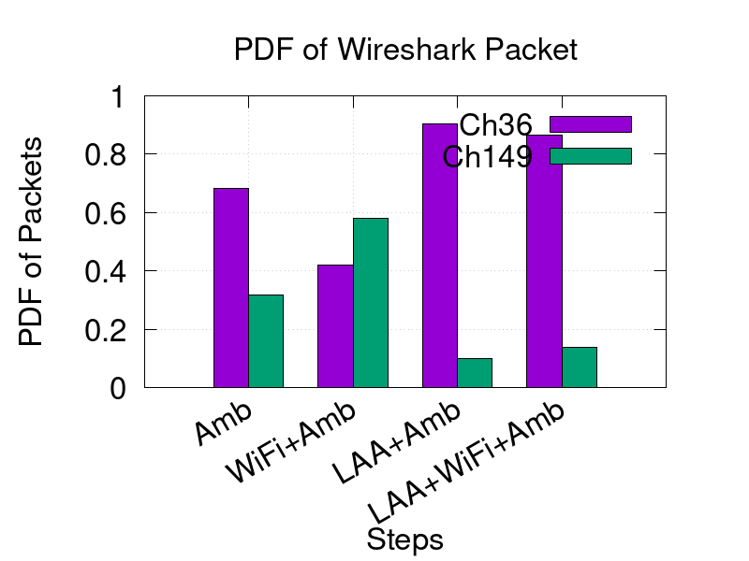
New measurements reported in Nov 2021 seem to confirm the adverse impact of LAA on Wi-Fi
Refined from
Jan 2022
  The latest Uni of Chicago results (11-21-1858-01) confirmed previous results …
  … that LAA seems to block most Wi-Fi traffic on an LAA channel
    The problem appears to be that LAA doesn’t back off because it is hidden from the indoor Wi-Fi APs
  It doesn’t help that deployed LAA & Wi-Fi systems are typically quite static in their choice of channels
    Neither system are sharing by avoiding using the same channels

Slide 30
Questions were posed in Dec 2021 in relation to LAA/Wi-Fi coex issues
No response after Jan 2022
LAA/Wi-Fi coex questions posed on WG reflector in Dec 2021 …
  Does anyone have new measurement data related to LAA/Wi-Fi coex?
    The University of Notre Dame is planning to continue the Uni of Chicago work, with results possibly available by July 2022
  Are there any proposed mitigations to avoid LAA/Wi-Fi coex issues?
    Particularly the hidden station issues highlighted by the Uni of Chicago measurements
… without much response so far! ☹

Slide 31
Questions were posed in Dec 2021 in relation to
NR-U/Wi-Fi coex issues
No response after Jan 2022
NR-U/Wi-Fi coex questions posed on WG reflector in Dec 2021 …
  Does the likely market deployment of NR-U suggest a potential
  Wi-Fi/NR-U coex problem in the near future?
    Does anyone have a NR-U deployment forecast?
  Have coex issues between Wi-Fi/NR-U been observed in deployments?
    Are there any deployments?
    Is anyone undertaking or planning to undertake any measurement based studies?
  Are there any proposed mitigations to avoid NR-U/Wi-Fi coex issues?
    Particularly hidden station issues similar to those for Wi-Fi/LAA coex?
… without much response so far! ☹

Slide 32
  Agenda items
  ETSI BRAN issues

Slide 33
Note that ESTI BRAN documents are available to IEEE 802.11 WG members
  Today’s material references many ETSI BRAN documents
  They are (or should be) available in the IEEE 802.11 WG members area
    See http://www.ieee802.org/11/private/ETSI_documents/BRAN

Slide 34
  Agenda items
  ETSI BRAN 5 GHz

Slide 35
The latest revision of EN 301 893 (5 GHz), including the adaptivity compromise, is now in final review
Document status after BRAN#113 (Feb 2022)
  Draft EN 301 893 v.2.1.47 (stable draft)
Discussion during BRAN#113
  v2.1.47 was published after BRAN#113 with mostly editorial changes
    Compromise for adaptivity (& associated testing) remains, as originally agreed way back in BRAN#109
  v2.1.47 will most likely be sent for review in parallel by:
    NSOs in an ENAP ballot
    An EC appointed consultant
  Hopefully, this means this revision of EN 301 893 (5 GHz) is close to completion!

Slide 36
The EN 301 893 journey wrt coexistence has been long & interesting … with risks for 802.11be
V1.8.1
Standard
Mar 2015
802.11a/n/ac conformant devices use access mechanisms in 802.11 standard
Other devices followed weird rules with little connection to anything
Very 802.11 focused …
… as only game in town
… but unclear there was good sharing between Wi-Fi/LAA/…
V2.1.1
Standard
May 2017
EDCA based adaptivity
  802.11a/n/ac conformant devices can use using use EDT at -62 dBm
  Other devices use EDT @ -72 dB
Enabled reasonable sharing, using LBT with exponential backoff …
… but a compromise, with different thresholds for Wi-Fi & LAA/NR-U/…
V2.1.8
Stable draft
Sep 2018
EDCA based adaptivity
  Any devices using 802.11 defined PD may use EDT at -62 dBm
  Otherwise use EDT @ -72 dB
Enabled any technology to use either of the two options …
… but 3GPP community were unhappy as they did not want to use 802.11’s PD
V2.1.47
Stable draft
Feb 2022
EDCA based adaptivity
  802.11a/n/ac/ax conformant devices may use ED @ -62 dBm
  Other devices use ED @ -72 dB
Allows traditional Wi-Fi operation …
… but forces 802.11be to use ED-only
@ -72 dBm, with potential coex issues (only way to make progress)
Likely end point, wrt coex
Potential coex issues

Slide 37
The Coex SC will review issues related to 802.11be in 5 GHz in Europe
  Summary of future issues
    See 11-22-278-01

Slide 38
  Agenda items
  ETSI BRAN 6 GHz issues

Slide 39
The latest revision of EN 303 687 (6 GHz), including the adaptivity compromise, is now in final review
Document status after BRAN#113
  Draft EN 303 687 v0.0.19 (stable draft)
Discussion before and during BRAN#113
  v0.0.19 was published after BRAN#113 with mostly editorial changes
    Adaptivity based ED-only at -72 dBm included
    Some aspects of NB FH in 4.3.3.2 (specification) & 5 (testing) included
    All support for C2C features removed, at least for the moment
  v0.0.19 will most likely be sent for review in parallel by:
    NSOs in an ENAP ballot
    An EC appointed consultant
  Hopefully, this means the first version of EN 303 687 (6 GHz) is close to completion!

Slide 40
  Coex SC
  ETSI BRAN 6 GHz issues
  NB FH update

Slide 41
Many believe NB FH systems represent a potential threat to coexistence in the 6 GHz band in Europe
  In Nov 2020, the Coex SC were made aware of two PSD limits being discussed for VLP devices in Europe:
    Default: 1 dBm/MHz
    Narrowband (NB) devices: 10 dBm/MHz with FH across at least 15 hops, with NB defined as a BW of less than 20 MHz
    See ECC Decision (20)01 & EC 2021/1067 for details
  Many Wi-Fi/NR-U/LAA stakeholders were concerned that these NB FH systems could have an adverse affect on Wi-Fi/NR-U/LAA systems
    ie, they will randomly “stomp” on Wi-Fi (and LAA/NR-U) systems without LBT leading to poor coexistence ☹
    The concern was exacerbated by NB FH being pushed through the regulatory process in Europe without the knowledge or involvement of many stakeholders

Slide 42
The debate on how to incorporate NB FH into EN 303 687 with good coex raged for more than a year
  Since early 2021, the debate has raged in the Coex SC & ETSI BRAN on how to include NB FH in EN 303 687 (6 GHz)
    Particularly in a way that allows adequate spectrum sharing, as required by ECC Decision (20)01
  Options discussed included incorporating into EN 303 687 (6 GHz):
    The FH rules from EN 300 328 (2.4 GHz)
    A variation of DAA from EN 300 328 called eDAA
    NB FH with the use of LBT based on a 20 MHz based CCA
    … and more (it was hard to keep track)
  The debate in ETSI BRAN and the Coex SC during 2021 is summarised in the January 2022 Coex SC agenda (11-21-1997-01)

Slide 43
DE, UK , FR admins set a direction for NB FH at BRAN #112 … that was subsequently followed
  The Germany, France, UK administrations set the direction for resolution of the NB FH issue at BRAN#112 in BRAN(21)112019 by noting:
    NB FH was only introduced late in the process … but it is part of regulation
    BRAN should work hard on a NB FH resolution while other issues are still open
    If a resolution is not possible then EN 303 687 should go ahead without a special NB FH access method …
    … instead using current LBE/FBE access & channelisation
    In that case, a special/new NB FH specific access method can be included in next version after further discussions
  By the end of BRAN#112, some limited NB FH requirements & testing material was included in the draft of EN 303 687
    This outcome was maintained into BRAN#113

Slide 44
  During BRAN#113, the limited NB FH requirements & testing material in EN 303 687 remained unchanged
Enable VLP NB at LPI power levels
Table 3: Mean EIRP density limit
Frequency range (MHz) | PSD limit (dBm/MHz)
 | LPI usage | VLP usage | VLP NB usage
5 945 to 6 425 | 10 | 1 | 10 (see 4.3.3.3)
From
BRAN(21)112016r3
4.3.3.3 VLP NB usage with a PSD above 1 dBm/MHz
The duty cycle of narrowband (NB) transmissions by a VLP device with a PSD above 1 dBm/MHz shall not exceed 1/15 on any transmission frequency.
NB devices require a frequency hopping mechanism based on at least 15 hop channels and meet the above duty cycle to operate at a PSD value above 1 dBm/MHz.
Note: Frequency hopping in the context of this standard implies the use of the channel access mechanisms and channelization as defined in the present document.
Must use LBE/FBE with 20 MHz channelisation

Slide 45
Discussion has started on a NB FH solution for the following revision of EN 303 687
  The default in the next version of EN 303 687 will be that NB FH uses the LBE/FBE channel access mechanisms and channelization’s
  However, discussion is likely for an alternative proposed for the following revision of EN 303 687
    See BRAN(21)112011 (Apple) - Narrow Band Channel Access in 6 GHz for some initial discussions
    This proposal defines a variation on the previous eDAA proposal (itself derived from EN 300 328 – 2.4 GHz) with a wideband detection mechanism
  The plan is for the Coex SC to monitor any future discussions …

Slide 46
  Coex SC
  ETSI BRAN C2C

Slide 47
There are a variety of views on the whether C2C operations should be managed or even allowed
  Some vendors are keen on C2C operations in 6 GHz using:
    VLP rules (indoor and outdoor)
    LPI rules (indoor only), by allowing C2C when a client can hear an LPI AP in any channel (hearing the indoor AP suggests the client is also indoors)
  Currently in:
    US: neither VLP/LPI based C2C operation is allowed, and only VLP C2C operation is being considered, although LPI C2C operation has been proposed
    Europe: VLP/LPI C2C operation is allowed, and mechanisms to enable LPI C2C operation were being discussed in ETSI BRAN
  There are differences of opinion on unmanaged C2C operations
    Some enterprise vendors would like to manage in which channels C2C operations occur to avoid interference with managed networks
    Some incumbents are concerned by interference from any LPI C2C operations
    Some client vendors don’t want to be subject to any infrastructure management of C2C operation

Slide 48
There was ongoing disagreement on how to define C2C operation at LPI power levels in Europe
  LPI C2C operations were previously proposed (BRAN(21)111023) so that a client may operate in any 6 GHz channel at LPI power levels if:
    … the client can hear an LPI AP Beacon in any 6 GHz channel
    … above a certain power level (currently in Draft EN 303 687 v0.0.15 with square brackets at -99 dBm/MHz)
    …. at least every 4 sec
  The concept is that if a client can hear an LPI AP then it is probably indoors and can operate using LPI power levels
  Ericsson previously made a counter proposal to set the threshold for C2C clients relatively high (BRAN(21)111016) …
    … thus ensuring the C2C client was very close to the LPI AP
    … and even applying a similar rule for normal clients
  … and Broadcom et al countered with a solution (BRAN(21)112020) whereby the power threshold was set to -95 dBm/MHz

Slide 49
A variety of new documents on C2C were discussed at BRAN #113
BRAN #113 documents
  BRAN(22)112f006 - Proposal for new clause C.5.5
    Broadcom
  BRAN(22)112f009r1 - On c2c operation
    Ericsson
  BRAN(21)113009r3 - C2C Updated proposal including TPC
    Broadcom, Facebook, Qualcomm, Intel, Google, Apple
  BRAN(22)113024 - Enabling signal additional requirements
    Broadcom, Qualcomm
  BRAN(22)113037 - Client to client path forward
    Broadcom, Facebook, Qualcomm, Intel, Google, Apple

Slide 50
After the usual disagreements about C2C … the proposal was suddenly withdrawn
BRAN #113 discussion
  BRAN#113 started with the ongoing disagreement about the energy from an LPI AP that can enable C2C operation
    Proposals were -99dBm/MHz vs −95dBm/MHz
  It appeared compromise was reached …
    For an enabling signal of −95dBm/MHz
    With TPC over a range of 9 dB
  … when suddenly the C2C proposal was completely withdrawn
    On the basis that the −95dBm/MHz enabling signal was problematic ..
    … and it was more important to finish EN 303 687 than insert C2C
  The plan is for the Coex SC to monitor any future discussions …
    The status quo in Europe and the US in the meantime is that there is no C2C in 6 GHz

Slide 51
  Coex SC
  ETSI BRAN 6 GHz issues
  Specification challenges

Slide 52
Coex SC/Tgbe/TGme needs to decide how to specify 802.11ax/be in context of 6 GHz rules in Europe
  In EN 303 687, the EDT is -72 dBm for both 802.11ax & 802.11be
  This is different to traditional 802.11 operations, which generally uses an PD/ED @ -82/-62 dBm
  The Coex SC/Tgbe/TGme need to decide how to handle this difference for 802.11ax/be in 6 GHz in Europe
    Use PD/ED @ -82/-72 dBm (which may disadvantage Wi-Fi compared to NR-U)
    Allow ED-only @ -72 dBm (like NR-U), at least when NR-U/LAA is around
    Something else
  The decision could be:
    Reflected in the standard
    Handled outside the standard

Slide 53
Coex SC will park the issue of 802.11be compatibility with EN 301 893 (5 GHz) & EN 303 687 (6 GHz)
  Both EN 301 893 (5 GHz) & EN 303 687 (6 GHz) are based on EDCA style access, which was suitable for 802.11ax (Wi-Fi 6/6E)
    Actually, given the EN 301 893 draft, anything in 802.11ax is allowed in 5 GHz
  802.11be is being developed now, with new features that might not all be aligned with the existing HS’s adaptivity assumptions
  This suggests two tasks/options for the Coex SC/TGbe
    Identify any likely 802.11be features that may not be allowed by EN 301 893
    (5 GHz) and EN 303 687 (6 GHz)
    Plan to make a case to ETSI BRAN to refine EN 301 893 (5 GHz) and EN 303 687 (6 GHz) to allow these features
  So far, discussions with 802.11be experts have not identified any features not aligned with EN 301 893 (5 GHz) & EN 303 687 (6 GHz)
    Maybe MLO & AP Coordination?????
  It is proposed we park this issue until such issues are identified …

Slide 54
  Coex SC
  Future ETSI BRAN meetings

Slide 55
ETSI BRAN has tentatively agreed its 2022 schedule based on F2F & virtual meetings
Meeting schedule for 2022
  BRAN #114
    3 Jun 2022 - 10 Jun 2022
    Virtual only?
  BRAN #115
    29 Aug 2022 until 2 Sep 2022; AND
    5 Sep 2022 until 9 Sep 2022
  BRAN #116
    17 Oct 2022 until 21 Oct 2022
  BRAN #117
    5 Dec 2022 until 9 Dec 2022

Slide 56
ETSI BRAN has scheduled various virtual meetings related to EN 301 893 & EN 303 687
  BRAN #113e
    21 Mar 2022 @ 17:00-20:15
    EN 303 687
  BRAN #113f
    26 Apr 2022 @ 11:30-14:45
    EN 303 687
  BRAN #113g
    1 Apr 2022 @ 13:00-16:15
    EN 301 893
  BRAN #113h
    30 May 2022 @ 17:00-20:15
    EN 301 893

Slide 57
  Agenda items
  5.8 GHz in Europe update

Slide 58
The Coex SC will hear an update on 5.8 GHz discussions in Europe
  In Jan 2022, it was suggested that the should Coex SC hear an update on 5.8 GHz discussions in Europe
  Guido Hiertz volunteered to provide the update
    See <doc>

Slide 59
  Agenda items
  Coex Tech Talk

Slide 60
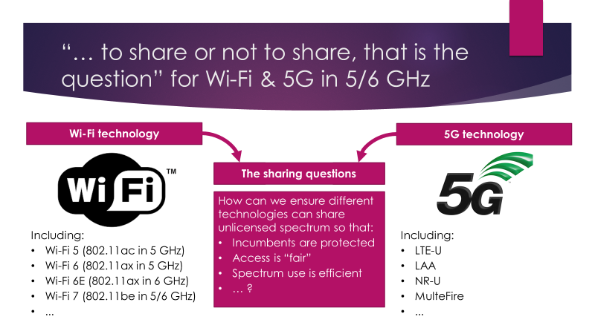
Assistance is requested for a IEEE 802 Tech Talk on coexistence in Jun 2022
IEEE 802 Tech Talks
  IEEE 802 is running a
  series of tech talks in 2022
  The last of the series is
  tentatively scheduled
  to be on coexistence
  The Coex SC Chair will
  facilitate efforts …
  …but assistance is requested from anyone who is interested in:
    Preparing
    Presenting

Slide 61
  Agenda items
  6 GHz spectrum availability

Slide 62
Coexistence will become increasingly important as
6 GHz opens globally for unlicenced operation …
Costa Rica,
Guatemala,
Honduras
Taiwan
Jordan, Qatar, Oman
1200 MHz
1200 MHz Consultation
500 MHz
500 MHz Consultation
TBD (early in process)
No formal activity yet

Slide 63
The battle for 6 GHz continues globally …
Refined from Sept 2021
Unlicensed 6 GHz is progressing in Europe
  The EC has formally released the lower 6 GHz band by a formal announcement in the OJEU
  The European Electronic Communications Committee (ECC) has initiated studies WAS/RLAN operations in the 6425-7125 MHz
GSMA aggressively advocating for licensed 6 GHz
  GSMA are advocating for at least half the band to be licenced
    GSMA et al published a joint statement advocating for licensed operation in some/all of 6 GHz
  GSMA are urging regulators to do nothing until at WRC-23
    Vision 2030, Insights for Mid-band Spectrum Needs – GSMA - July 2021
  GSMA has had some success … even persuading one regulator to reverse a previous decision

Slide 64
… with the GSMA campaign to license at least part of the 6 GHz band conting into 2022
  A blog (published in Feb 2022) …
  … based on a GSMA Intelligence study (published in Jan 2022) …
  … concluded that is never makes sense to allocate the entire 6 GHz band to unlicensed use
    Is there a scenario where allocating the full band for unlicensed use generates the greatest socio-economic benefit?
    Not according to the GSMA Intelligence study, because allocating the lower
    6 GHz band is sufficient to meet demand, even if the 60 GHz band is not used.
    This means there are no additional gains from allocating the full 6 GHz band for unlicensed use
  GSMA published a blog asserting that

Slide 65
A series of seminars by 6ghzopportunity is advocating the licensing of the 6 GHz band
  An organisation called https://6ghzopportunity.com/ is also advocating for use of 6 GHz for licenced use via a series of seminars (inc. at MWC)
    Hosted by Ericsson, GSMA, Huawei, Nokia, ZTE
  At a seminar in Dec 2021, focused on Europe, there were fervent justifications for the allocation of the upper 6 GHz \for licensed use
    See slides and recording (last hour most interesting)
  Some interesting aspects of the discussions incuded
    Most speakers equated unlicensed with Wi-Fi ☺
    There was little mention of LAA/NR-U ☺
    The case for licensed allocation in upper 6 GHz was reliability, security, fairness/balance & to stop OTT operators from bypassing operators
    Some of the regulators in attendance were not convinced any 6 GHz spectrum should be allocated to licensed operation ☺

Slide 66
In the US, the battle for 6 GHz continues with ongoing concerns about coex with incumbents
Facts
  On 13 Dec 2021, FCC OET granted an application (exhibit) from AT&T for an experimental license to test Wi‑Fi 6E and LTE-LAA/5G NR-U in U-NII-5 & U-NII-7
  AT&T plans to test both commercially available LPI devices and “pre-AFC certified experimental” standard-power equipment
  AT&T says it will explore “the potential for interference and co-existence with incumbent licensed fixed services”
Commentary
  There is an ongoing concern among some stakeholders as to the ability of Wi-Fi to coexist with incumbents

Slide 67
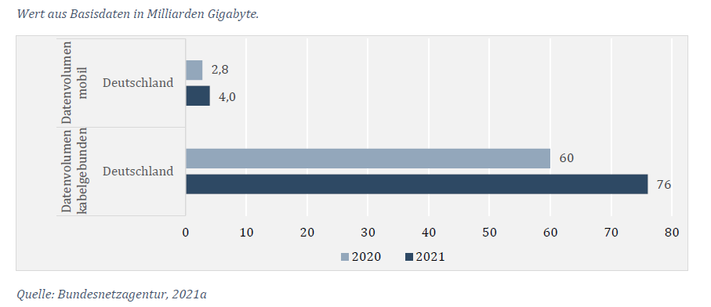
The evidence for Wi-Fi access to more spectrum
(ie all 1200 MHz in 6 GHz) continues to grow
  A chart from a recently published report by the German Ministry for Economic Affairs & Climate Action shows …
  … in 2021, 95% of data in Germany was transferred via the fixed network (mostly Wi-Fi), with only 5% over mobile networks
  … in 2020-21, fixed traffic increased by 16 EB compared to an increase of only 1.2 EB for mobile traffic

Slide 68
  Agenda items
  3GPP update

Slide 69
The Coex SC will monitor coex impacts of SL-U
  In Jan 2022, Dorin Viorel (CableLabs) provided an update on 3GPP RAN activities relevant to coexistence
    See 11-22-0124-00
  It was noted that SL-U may cause future coex issues for Wi-Fi
    SL-U is Side Link Unlicensed
    Coex of SL-U with NR-U and Wi-Fi has not been studied
    It is possible that SL-U will not follow the NR-U access framework
  The Coex SC will follow progress and any risks of SL-U
    It is believed a more accurate perspective of SL-U will become available by 3Q2022

Slide 70
  Agenda items
  60 GHz coexistence

Slide 71
The Coex SC has previously discussed coexistence in 60 GHz …
  At the Coex SC meeting in Mar 2021 a submission was presented that provided the status of 60 GHz work in ETSI BRAN
    See 11-21-0430-00 (Assaf Kasher (Qualcomm))
  In May 2021, the Coex SC heard about Coexistence between radars and communication systems in the 60 GHz band
    See 11-21-0796-00 (Alecsander Eitan (Qualcomm) et al)
  In Jul 2021,the Coex SC heard about Coexistence between radars and communication systems in the 60GHz band – U.S. Update
    See 11-21-1089-00 (Alecsander Eitan (Qualcomm) et al)
  In Sep 2021, the Coex SC heard NPRM work was occurring in 802.18

Slide 72
… but there is not much to report to the Coex SC in relation to 60 GHz coex today
  The e-mail was sent to Alecsander Eitan (Qualcomm) asking for an update on 60 GHz coex activities; responded:
    Unfortunately, there is nothing new that can be reported
    Many submissions have been sent to the FCC, and several comments on the other submissions have been also sent
    There are some discussions between companies on compromise ideas
  At this point, the Coex SC has a few choices:
    Keep 60 GHz coex issue on our plate
      … hopefully doing something useful
    Close the 60 GHz coex question
      … maybe after a final status update?
  Thoughts?

Slide 73
  Coex SC
  Plans for next meeting

Slide 74
The Coex SC may continue its normal business in May 2022 (hybrid meeting in Warsaw)
Possible agenda items for Warsaw …
  Discuss coexistence measurement studies
  Review ETSI BRAN coex activities
    EN 301 893 (5 GHz)
      Impact on 802.11be coex with 802.11ax in 5 GHz
    EN 303 687 (6 GHz)
      Enabling 802.11be features in 6 GHz (& 5 GHz)
  3GPP update
  60 GHz update
… assuming a hybrid meeting with the Chair in Australia is feasible
Submissions are requested …

Slide 75
The IEEE 802.11 Coexistence SC virtual meeting in March 2022 is adjourned!

