Slide 1
DMG use of multiple Golay seqeunces
Date: December 27, 2021
Author:

Slide 2
Agenda
DMG and EDMG TRN fields, use a single (pair) of Golay sequences in the TRN field of a single spatial stream PPDU.
In this presentation we give motivation to using multiple Golay sequences in DMG bi-static and multi-static sensing.

Slide 3
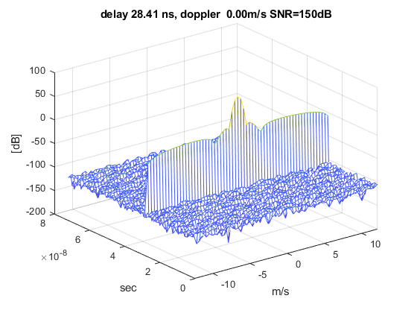
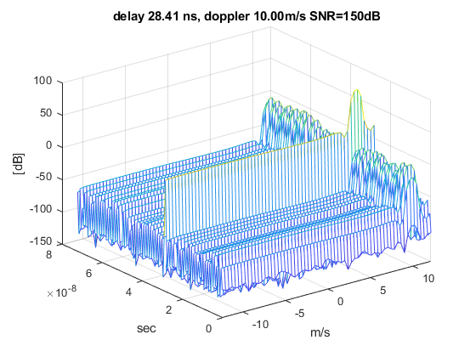
Doppler Sidelobes with Golay
Here we see the range/doppler maps for a Golay sequences based radar, for a speed of 0 and 10ms.
We can see that at non-zero speed, there are sidelobes to the main target, at different ranges.
64 pulses, PRI=100usec, each pulse a single TRN subfield, doppler processing – FFT+Chebychev window.

Slide 4
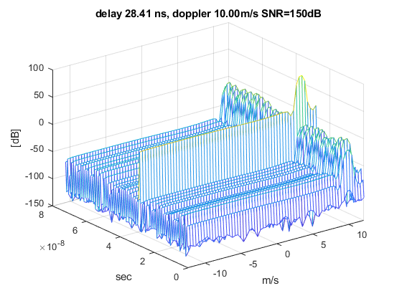
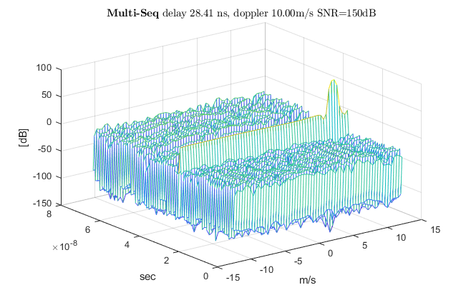
Improving by using multiple Golays
In the right graph, rather than use a single Golay sequences, we use (the TGay) 8 sequences

Slide 5
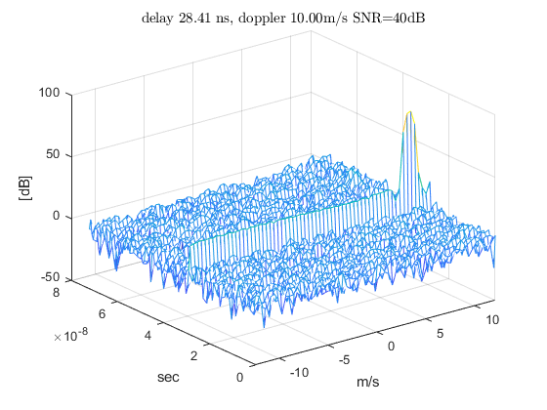
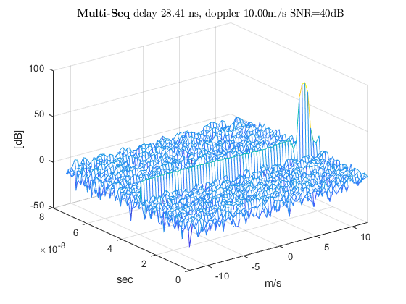
Improving by using multiple Golays – lower SNR
In the right graph, rather than use a single Golay sequences, we use (the TGay) 8 sequences. In the case of 40dB SNR, all the sidelobes seem to be buried in noise, but we can see them on the next slide.

Slide 6
Improving by multiple Golays
We can see that using multiple sequences reduce the maximum spur values by 10dB. This is important as we are looking for peaks above the noise.

Slide 7
Another view – CDF of sidelobes
The graphs shows the CDF of the sidelobes height. we can see that using multiple Golays increases the average height, but lower the maximums, which helps in CFAR detections

Slide 8
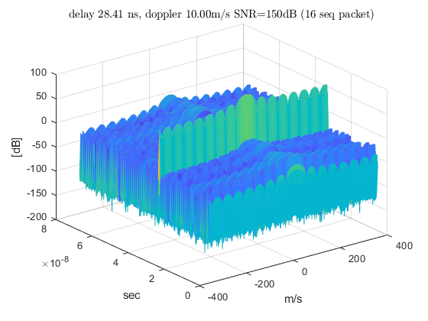
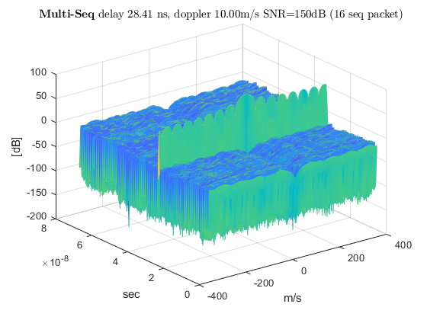
A more realistic scenario
This is a scenario of a 16 sequences packet, repeated 16 times at an interval of ~1ms
16 pulses with a short PRI of 3.5usec, repeated 16 times with a PRI=1ms, each pulse a single TRN subfield, doppler processing – FFT+Chebychev window.

Slide 9
Improvement by multiple Golays
We can see that using multiple Golays lowers spurious targets by 20dB at high SNR and 10dB at 40dB SNR.

Slide 10
Another view – CDF of sidelobes
The graphs shows the CDF of the sidelobes height. we can see that using multiple Golays increases the average height, but lower the maximums, which helps in CFAR detections.

Slide 11
How are the sequences selected
To reduce the doppler sidelobes, the order of the sequences needs to be “random”
In the simulation, each group of 8 sequences was a random permutation of the sequences 1 through 8.
In a standard, the list of sequences can be predetermined pseudo random list of indices (between 1 and 8) and the point in the sequence of the first TRN subfield can be indicated in the header.

Slide 12
Conclusions
Using multiple Golay sequences can reduce sidelobes in the range/doppler map of bistatic and multi-static DMG sensing.
The change needed in the standard is small since the sequences are already defined.

Slide 13
Strawpoll
Do you agree to add to the SFD:
“DMG bi-static and multi-static sensing may optionally use groups of the 8 (128×N_{CB}) Golay sequences in bi-static and multi-static sensing.
  the sequences are the Golay sequences defined in EDMG (Ga and Gb in Table 28-75 in P802.11-2020)
  The order of the sequences in the group is TBD”

