Slide 1
Discussion on Adaptation of MLO to Dynamic Changes in Link Conditions
Date: 2021-12-10
Authors:
Name | Affiliations | Address | Phone | Email
Yoshihisa Kondo | ATR |  |  | kondo@atr.jp
Hiroyuki Yokoyama
Michio Miyamoto
Ayano Onishi
Toru Osuga | NICT
Tomoki Ohsawa
Fumiko Ohori
Satoko Itaya
Takeshi Matsumura

Slide 2
Introduction
11be MLO is expected to provide efficient and robust communications using multi-link
More discussions on multi-link transmission controls are needed for achieving ideal behaviors of MLO
In this contribution, we show example of multi-link transmission control and evaluation results for discussions

Slide 3
Expected behaviors of multi-link transmissions
Maximize amount of data transmission per unit time
If link conditions are same, Round-robin is best
Adapt to dynamic changes in link conditions
Balance frame transmissions nicely
Avoid causing large latency by exploiting alternative link(s)
Sudden “Wait” caused by interferences
Sudden increase of error rate
MLO
3
1
4
3
2
1
4
2
MLO
3
1
MLO
4
3
1
4
3
2
1
4
2
4
3
2
1
2
Balance
MLO
3
１
Retry
1
Retry
1
MLO
4
3
2
1
4
2
4
3
2
1
3
１
4
2
Exploit alternative link

Slide 4
Design of multi-link transmission control
Design policy
Follow structure of 802.11 MAC
Based on protocols defined in 11be
Maximize amount of data transmission per unit time
Design concept
Enhance response
Control on A-MPDU Tx buffer, lower part of MAC, is employed
Enhance robustness
All frames are replicated and stored in all Tx buffers for exploiting alternative links promptly
Enhance efficiency
Delivered frames on a link are deleted from all Tx buffers for mitigating redundant transmissions
MAC
Retry
1
4
3
2
1
4
3
2
1
MAC
3
１
4
2
4
3
2
1
Store replicated frames
Delete delivered frames

Slide 5
Implementation of multi-link transmission control Mirroring + Merged BA （MMBA）
10
3
2
1
STA(Tx)
Information sharing
Block Ack（BA）carries information of delivered frames on all links
Deletion of delivered frames
Delivered frames on other links are deleted from Tx buffer according to received BA
Operation overview
All frames are stored in all Tx buffers（Mirroring）
Scoreboard contexts are shared among all Rx MACs
Merged scoreboard information is sent to Tx MACs using BAs
Each Tx MAC deletes delivered frames according to received BA
Mirroring
1
2
3
10
ML
10
3
2
1
STA(Rx)
MAC
MAC
MAC
MAC
Tx buffer
1
Tx buffer
1
2
3
4
5
1
Sharing
1
2
3
4
5
6
7
8
9
10
2
Wait/Retry
6
7
8
9
10
8
9
BA:1,2,3,4,
5,6,7,8
BA:1,2,3,4,
5,6,7,8,9
1
2
3
4
5
1
2
3
4
5
9
6
7
8
9
10
6
7
8
9
10
Wait/Retry
10
BA:10
BA:9,10
10
9
10

Slide 6
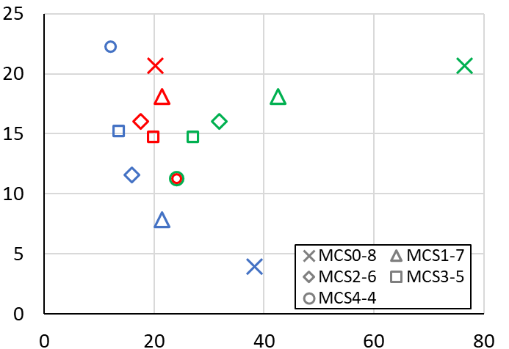
Evaluation results Achieved data rate and channel occupation time for delivery of 100 frames
Good
Combination of MCS of each link is different
Improved by MMBA
Round-robin：Efficiency becomes degraded as gap of link speed becomes larger
Mirroring：Achieved data rate becomes larger as gap of link speed becomes larger
MMBA：Efficiency is improved by frame deletion using sharing BA
MMBA
Mirroring
Achieved data rate [Mbps]
Improved by Mirroring
Round-robin
Poor
Good
Chanel occupation [ms]
Poor
（Total airtime including retransmissions and duplicated transmissions）

Slide 7
Conclusion
Adaptation to changes in link conditions is one of important capabilities of multi-link transmission
We showed a transmission control scheme which exploited shared Rx frame information carried by BAs for deleting delivered frames on other links
Our simulation results showed that the transmission control scheme improved achieved data rate efficiently when link conditions of multi-link are different

Slide 8
Appendix

Slide 9
Overview of simulation setup
APP
(Source)
Evaluated schemes
Round-robin
Allocate frames to each link in sequence order
Mirroring
Each frame is replicated and allocated to both links
Mirroring + Merged BA（MMBA）
Delivered frames deleted from all Tx buffers using sharing BAs
Simulation environment
MAC and PHY: 11ax(EDCA)
Simultaneous Tx/Rx device
Alloc
802.11
TX MAC 1
TX MAC 2
Latency measurement
BA
BA
CSMA/CA
Packet error
CSMA/CA
Packet error
RX MAC 1
Notify
RX MAC 2
Notify
Reordering
802.11
APP
(Sink)

Slide 10
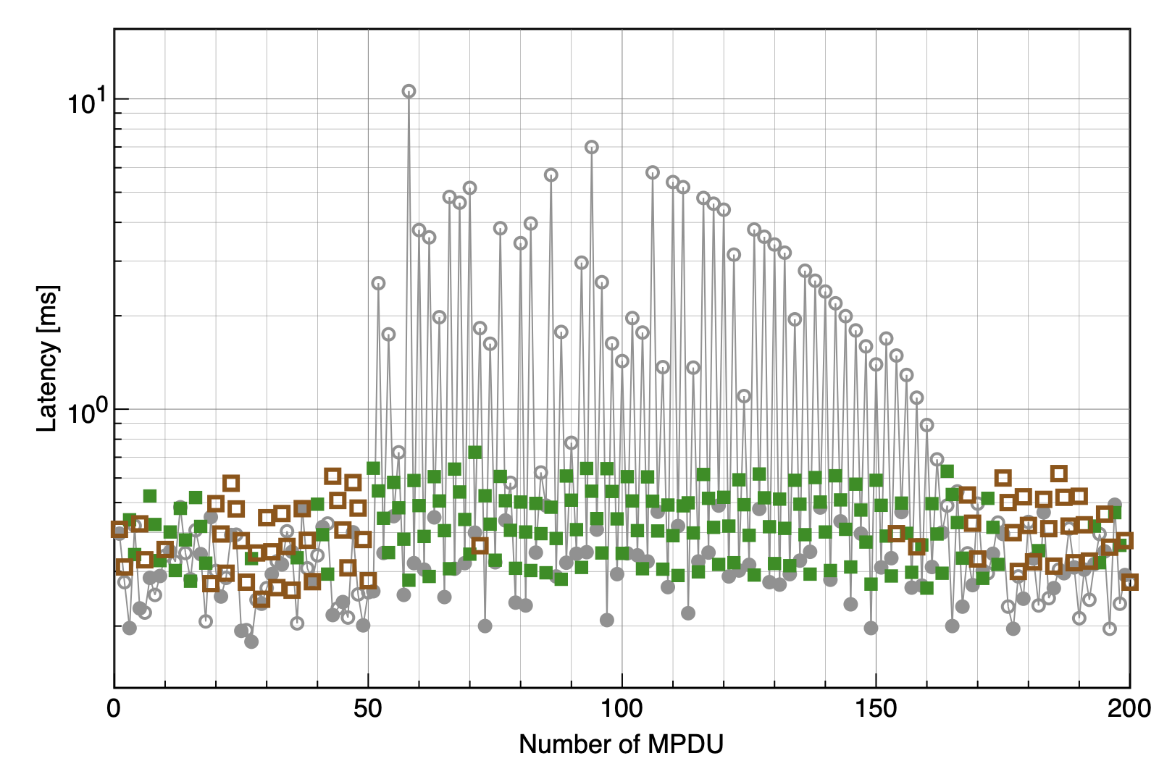
Measured latency when FER of a link becomes high
MCS4 is applied to each link
Round-robin (Delivered via Link-1)
Round-robin (Delivered via Link-2)
MMBA (Delivered via Link-1)
MMBA (Delivered via Link-2)
FER of Link-2 is changed from 0 to 0.8
・Behavior when Round-robin is applied
3
１
Retry
1
4
3
2
1
4
2
Latency
・Behavior when MMBA is applied
Retry
1
4
3
2
1
4
3
2
１
Tx frame ID (Transmission interval is 100us)
Latency
Latency does not become larger even when FER of Link-2 becomes higher
Transmission from alternative link works efficiently when one of links is in a bad condition

Slide 11
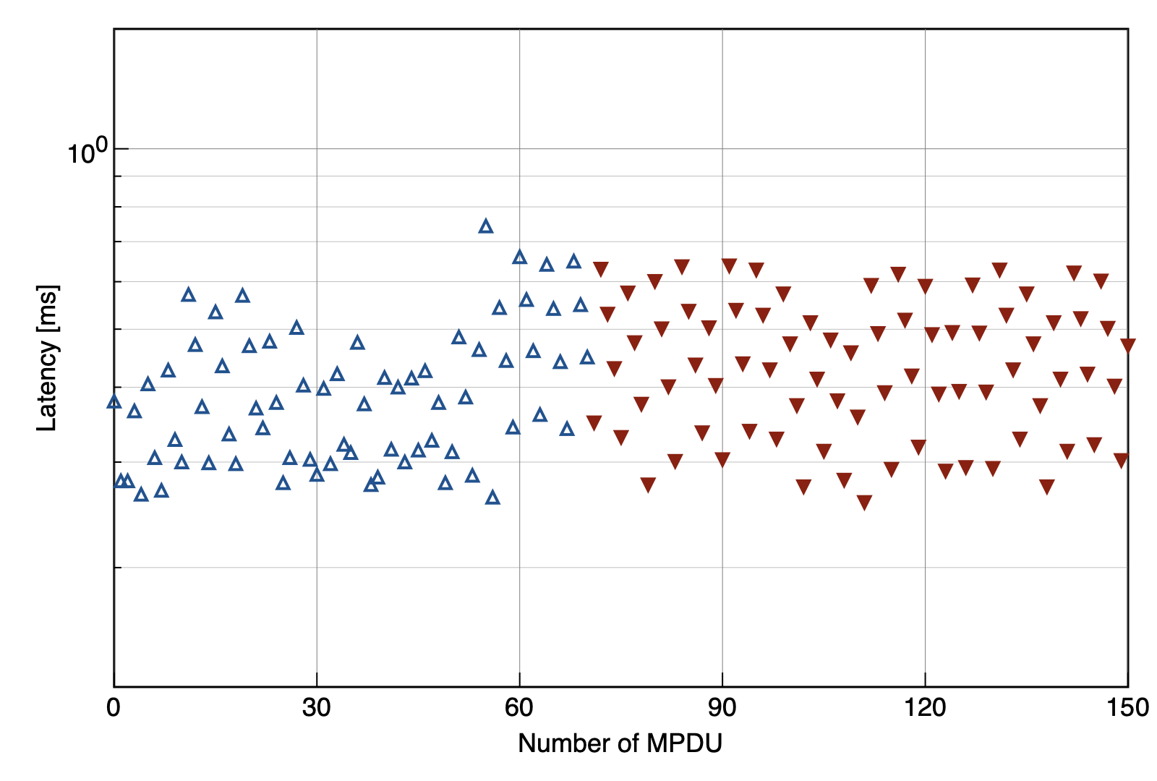
Response time of frame deletion from Tx buffers
MCS4 is applied to each link
MMBA: Duplicated Tx occurs
MMBA: Duplicated Tx does not occur
(Frame deletion using BA works fine)
Start blocking of Link-2
i
j
k
Arrival of frames on Tx STA
i
j
k
Delete i-k
AMPDU
Busy
AMPDU
i - j
AMPDU
(k +1) - l
2ms
Link-1
BA
Transmitted multiple times
BA
i - k
Duplicated
Non-duplicated
These types of duplicated transmissions do not occur when MAC blocks are synchronized on a Tx STA
Tx frame ID (Transmission interval is 100us)
After 2 ms from start of blocking, frame deletion using sharing BA starts working

