Slide 1
Consideration on EDCA Operation for Restricted TWT
Date: 2021-11-15
Authors:
Name | Affiliation | Address | Phone | Email
Liuming Lu | OPPO |  |  | luliuming@oppo.com
Lei Huang
Chaoming Luo
Pei Zhou
Liuming Lu (OPPO)

Slide 2
Introduction
Several comments on r-TWT concern the protection of r-TWT SPs for the transmission of latency sensitive traffic, and the fairness issue for r-TWT member STAs and non-member STAs.
This document proposes a candidate mechanism to differentiate the EDCA operations during or outside of r-TWT SPs for r-TWT scheduled STAs and r-TWT unscheduled STAs.

Slide 3
Issues
CID | Commenter | Clause | Pg/Ln | Comment | Proposed Change
5877 | Liangxiao Xin | 35.6.4 | 298.37 | Which EDCAF should be used for the channel contention of R-TWT SP? If we use the existing EDCAF, it mixes the purposes of channel contention for non-latency sensitive traffic and latency sensitive traffic | add a new EDCAF for the channel contention of R-TWT SP only.
5879 | Liangxiao Xin | 35.6.4 | 298.37 | fast channel access and the fairness issue should be considered for a R-TWT member STA. While STA should have higher priority to access the channel during R-TWT SP, it should lower its priority to access the channel outside R-TWT SP. | change the EDCA and MU-EDCA of ACs at R-TWT member STAs to accesserate their channel access during a R-TWT SP and slow down their channel access for a period of time after a R-TWT SP.
6547 | Patrice Nezou | 35.6.4 | 298.40 | A medium access mechanism has to be specified during the TWT service period. | Use dedicated EDCA parameters during the TWT service period to optimize bandwidth usage.
6356 | Mohamed Abouelseoud | 35.6.4 | 298.37 | Currently the scheduled RTWT is not guarnteed to start at the scheduled time. Non-AP EHT STAs and future 802.11 deviced can ignore the quite element and gain access to the channle. | define a procedure to increase the chance of the AP or the members of the RTWT gaining access to the channel to start the RTWT
7865 | Yonggang Fang | 35.6.4 |  | The clause 35.6.4 is about channel access rules for restricted TWT. However, no channel access rule has been defined to support time sensitive traffic to access to media in the restricted TWT SP. | Please specify channel access mechanisms and rules to be used for time sensitive traffic in restricted TWT SP.

Slide 4
Discussion
The comments made in the list of CIDs on Slide 3 are reasonable.
The protection mechanism of r-TWT SPs specified in 11be Draft 1.4 seems to be not enough, which would impact the scheduled transmission of latency sensitive traffic during the r-TWT SPs. And the fairness issue also needs to be considered for a r-TWT scheduled and unscheduled STAs.
All STAs can still access the SP using EDCA except certain rules applied to a trigger-enabled SP
the Non-AP EHT STAs may behave as if overlapping quiet intervals do not exist, which means that the unscheduled EHT STAs may contend for channel access during the SPs.
the support for the quiet function with the Quiet element is also optional for the legacy STAs, which means that the legacy STAs would also contend for the channel access during the SPs when not supporting the quiet function.
A quiet interval for this protection purpose is only 1 TU and expect a r-TWT SP is commonly at least a few msecs.
The EPCS priority access in 11be Draft 1.4 also specified the mechanism to adjust the EDCA Parameters Set of authorized non-AP STAs for priority access, which can be regarded as a reference for the suggested function.

Slide 5
Candidate Solution
Differentiate the EDCA Parameter Sets of member and non-member r-TWT scheduled STAs, r-TWT unscheduled STAs during r-TWT SPs, and/or the EDCA Parameter Sets of r-TWT scheduled STAs, r-TWT unscheduled STAs outside of r-TWT SPs
1) An r-TWT scheduled STA： an EHT STA that supports r-TWT and is a member of one or more SP(s) during a given time period.
A member r-TWT scheduled STA： an r-TWT scheduled STA which has established a membership for the specific SP(s)
A non-member r-TWT scheduled STA： an r-TWT scheduled STA which has not established a membership for the specific SP(s)
2) An r-TWT unscheduled STA： an EHT STA that supports r-TWT but is not a member of any SP during a given time period.
3) A non-r-TWT STA： an EHT STA that doesn’t support r-TWT or a legacy STA.
Differentiate EDCA operations(or parameters) for different roles of EHT STAs supporting r-TWT in different time intervals, and EHT STAs not supporting r-TWT and legacy STAs
EDCA operation for an r-TWT scheduled STA during the SPs : EDCA operation for an r-TWT scheduled STA during the SPs of which it is a member.
EDCA operation for an r-TWT unscheduled STA during the SPs: EDCA operation for an r-TWT unscheduled STA during the SPs of which it is not a member
EDCA operation for an r-TWT scheduled STAs outside of the SPs: EDCA operation for r-TWT scheduled STAs outside of the SPs at least one of which it is a member for the given time duration.
EDCA operation for r-TWT unscheduled STAs outside of the SPs : EDCA operation for r-TWT unscheduled STAs outside of the SPs none of which it is a member for the given time duration.
EDCA operation for non-r-TWT STAs: no SPs can be identified

Slide 6
Candidate Solution
Add an optional mechanism for the configuration of EDCA Parameter Sets during the SPs or outside of SPs for different roles of EHT STAs
EDCA parameters of r-TWT scheduled STAs and unscheduled STAs during r-TWT SPs would lead to:
higher priority of the ACs corresponding to r-TWT UL TID(s) of r-TWT scheduled STAs
reduced channel access for the associated MPDUs of other ACs of r-TWT scheduled STAs
reduced channel access for r-TWT unscheduled STAs
EDCA parameters of r-TWT scheduled STAs and unscheduled STAs outside of r-TWT SPs would lead to:
reduced channel access for the associated MPDUs of the ACs corresponding to r-TWT UL TID(s) of r-TWT scheduled STAs
the same level of priority as r-TWT unscheduled STAs’ for channel access of the associated MPDUs of other ACs of r-TWT scheduled STAs
higher priority of channel access for r-TWT unscheduled STAs compared with r-TWT scheduled STAs, and the same level of priority as non-r-TWT STAs.

Slide 7
Candidate Solution
Define a new element - Restricted TWT EDCA Parameter Set element
Table 9-32—Beacon frame body
Order | Information | Notes
<Last assigned + 1> | Restricted TWT EDCA Parameter Set | The Restricted TWT EDCA Parameter Set element is optionally present if dot11RestrictedTWTOptionImplemented is true.
Table 9-39—Probe Response frame body
Order | Information | Notes
<Last assigned + 1> | Restricted TWT EDCA Parameter Set | (#5877)The Restricted TWT EDCA Parameter Set element is optionally present if dot11RestrictedTWTOptionImplemented is true.
 | Element ID | Length | Element ID extension | EDCA Parameter Set Presence Bitmap | EDCA Parameter Set for r-TWT Scheduled STAs In SPs | EDCA Parameter Set for r-TWT Scheduled STAs Outside SPs (optional) | EDCA Parameter Set for r-TWT Unscheduled STAs In SPs (optional) | EDCA Parameter Set for r-TWT Unscheduled STAs Outside SPs (optional)
Octets: | 1 | 1 | 1 | 1 | 20 | 0 or 20 | 0 or 20 | 0 or 20
Figure 9-xxx –Restricted TWT EDCA Parameter Set element format

Slide 8
Candidate Solution
The EDCA Parameter Set for r-TWT Scheduled STAs In SPs field specifies the EDCA Parameter Set for r-TWT scheduled STA(s) during SPs by the EDCA Parameter Set element.
Mandatorily present
The EDCA Parameter Set for r-TWT Scheduled STAs Outside SPs field specifies the EDCA Parameter Set for r-TWT scheduled STA(s) outside of SPs by the EDCA Parameter Set.
Optionally present, and the default EDCA Parameter Set is used if not present
The EDCA Parameter Set for r-TWT Unscheduled STAs In SPs field specifies the EDCA Parameter Set for r-TWT unscheduled STAs during SPs by the EDCA Parameter Set element.
Optionally present, and the default EDCA Parameter Set is used if not present
The EDCA Parameter Set for r-TWT Unscheduled STAs Outside SPs field specifies the EDCA Parameter Set for r-TWT unscheduled STAs outside of SPs by the EDCA Parameter Set element
Optionally present , and the default EDCA Parameter Set is used if not present
 | Element ID | Length | Element ID extension | EDCA Parameter Set Presence Bitmap | EDCA Parameter Set for r-TWT Scheduled STAs In SPs | EDCA Parameter Set for r-TWT Scheduled STAs Outside SPs (optional) | EDCA Parameter Set for r-TWT Unscheduled STAs In SPs (optional) | EDCA Parameter Set for r-TWT Unscheduled STAs Outside SPs (optional)
Octets: | 1 | 1 | 1 | 1 | 20 | 0 or 20 | 0 or 20 | 0 or 20
Figure 9-xxx –Restricted TWT EDCA Parameter Set element format

Slide 9
Candidate Solution
Restricted TWT service periods announcement
If there is any restricted TWT agreement set up, the EHT AP shall announce the restricted TWT service period schedule information in the broadcast TWT element that carries one or more Restricted TWT Parameter Set fields, and the optional Restricted TWT EDCA Parameter Set element contained in transmitted Management frames.
EDCA operation during or outside of restricted TWT service periods
—During the restricted TWT service periods, the r-TWT scheduled STAs update its CWmin[AC], CWmax[AC], AIFSN[AC], and TXOP[AC] state variables to the values provided in the EDCA Parameter Set for r-TWT Scheduled STAs In SPs field of the Restricted TWT EDCA Parameter Set element
—During the restricted TWT service periods, the r-TWT unscheduled STAs update its CWmin[AC], CWmax[AC], AIFSN[AC], and TXOP[AC] state variables to the values provided in the EDCA Parameter Set for r-TWT Unscheduled STAs In SPs field of the Restricted TWT EDCA Parameter Set element - optional
—Outside of the restricted TWT service periods, the r-TWT scheduled STAs update its CWmin[AC], CWmax[AC], AIFSN[AC], and TXOP[AC] state variables to the values provided in the EDCA Parameter Set for r-TWT Scheduled STAs Outside SPs field of the Restricted TWT EDCA Parameter Set element. -optional
—Outside of the restricted TWT service periods, the r-TWT unscheduled STAs update its CWmin[AC], CWmax[AC], AIFSN[AC], and TXOP[AC] state variables to the values provided in the EDCA Parameter Set for r-TWT Unscheduled STAs Outside SPs field of the Restricted TWT EDCA Parameter Set element. –optional

Slide 10
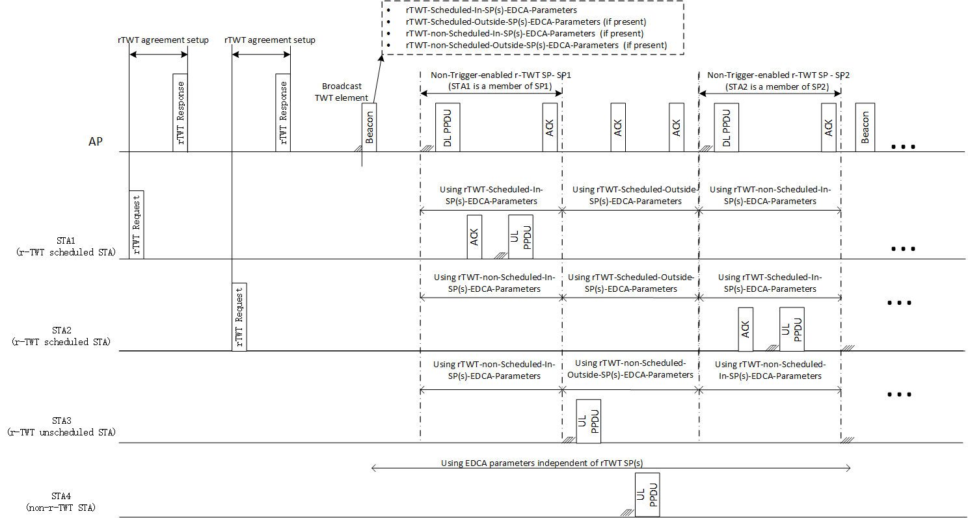
Candidate Solution
An example of the differentiation of EDCA operations(or parameters) for different roles of STAs

Slide 11
Q & A
[Q1]: A major concern for rTWT is it would not work well in the presence of legacy STAs and OBSSes, and the new element (e.g., this r-TWT EDCA Parameter set element) will not be understood and honored by legacy STAs and OBSSes, so this fundamental issue for rTWT remains.
[A]: The candidate solution can handle the issue caused by legacy STAs. Although legacy STAs cannot understand the r-TWT EDCA Parameter set element, EHT AP can configure and coordinate the EDCA Parameter set of legacy STAs by Probe response or Beacon with legacy EDCA Parameter set element and that of EHT STAs by r-TWT EDCA Parameter set element.
The solution mainly considers the issue of the channel access in the same BSS, and may handle the partial issue of OBSS. For example the usage of r-TWT EDCA Parameter set for scheduled STAs can increase their opportunity to obtain an TXOP, as a result the impact of OBSS may be reduced.
[Q2]: Adding additional restrictions to EHT STAs can cause their performance degradation relative to legacy STAs. In addition, it would be complex for EHT STAs to follow many different sets of EDCA parameters under different conditions (e.g., within or outside a particular rTWT SP), and it is questionable whether the behavior can be tested successfully.
[A]: The candidate solution is an optional feature, its intention is to strengthen the protection of r-TWT SPs for the channel access of scheduled STAs and it may impact the performance of EHT STAs. The balance between the extent of the protection and the impact of the performance can be considered for EHT AP and STAs according to the deployment scenario. And only the EDCA Parameter Set for r-TWT Scheduled STAs In SPs is mandatory in the r-TWT EDCA Parameter element, and the other EDCA Parameter sets are optional. Different Parameter sets can be flexibly selected to reduce the impact to the performance of ETH STAs as far as possible.

Slide 12
Benefits
The candidate mechanism to differentiate the EDCA Parameter Sets of different roles of STAs can satisfy the following currently specified requirement for channel access during r-TWT SPs
“During a restricted TWT SP, the AP and member r-TWT scheduled STAs prioritize their transmission of QoS Data frames that are latency sensitive traffic (see 35.7 (Restricted TWT)).”
“An r-TWT scheduling AP or a member r-TWT scheduled STA that has initiated or participated in a frame exchange during a restricted TWT SP shall ensure QoS Data frames of r-TWT TID(s) to be first delivered during the r-TWT SPs. ”
The candidate mechanism may bring about benefits especially for non-trigger-enabled r-TWT SPs
non-trigger-enabled r-TWT SPs are the important component of r-TWT SPs
The overhead of the transmission of trigger frames can be avoided for non-trigger-enabled r-TWT SPs
The candidate mechanism is an optional feature and it gives a tool for AP to have the capability to adjust the EDCA parameters during or outside of SPs for corresponding STAs if appropriate. AP can balance the priority of channel access for r-TWT UL TIDs of rTWT scheduled STAs and the chance of the collision the adjustment would lead to, and decides whether to adjust.

Slide 13
Summary
The protection mechanism for r-TWT SPs needs to be improved for the effectiveness of r-TWT as well as considering of the fairness among R-TWT member STAs and non-member STAs.
This document proposes a candidate mechanism to differentiate the EDCA Parameter Sets during or outside of Restricted TWT SPs adopted by r-TWT scheduled STAs and r-TWT unscheduled STAs.

Slide 14
SP
SP1: Do you support to have r-TWT prioritized EDCA Parameter Set for a r-TWT scheduled STA during the r-TWT SP of which it is a member?
SP2 : Do you support to have r-TWT deprioritized EDCA Parameter Set for a r-TWT scheduled STA outside the r-TWT SP of which it is a member?
Note: non-member r-TWT scheduled STA, r-TWT unscheduled STA and non-r-TWT STA update EDCA parameters following the procedures in 10.2.3.2 (HCF contention based channel access (EDCA)).
Liuming Lu (OPPO)

