Slide 1
Conditional STR
Date: 30-11-2021
Authors:
Name | Affiliation | Address | Phone | Email
Evgeny Khorov | IITP RAS
Dmitry Bankov | IITP RAS
Ilya Levitsky | IITP RAS
Yaroslav Okatev | IITP RAS

Slide 2
Abstract
This presentation shows that STR capabilities are not binary as assumed in the current spec.
Sometimes cross-link interference may allow STR operation with a more robust MCS, which we refer to as Conditional STR operation, however it requires additional information to be provided to the TX MLD
We propose signaling for Conditional STR operation.

Slide 3
Introduction
Client MLDs may have neighboring radios operating at different links that may cause severe cross-link interference.
For such devices and interfering links, the standard describes special rules of NSTR operation.
NSTR reduces the performance in comparison to STR.
With existing devices we study, how the distance between the radios and the distance between the channel affects the performance.

Slide 4
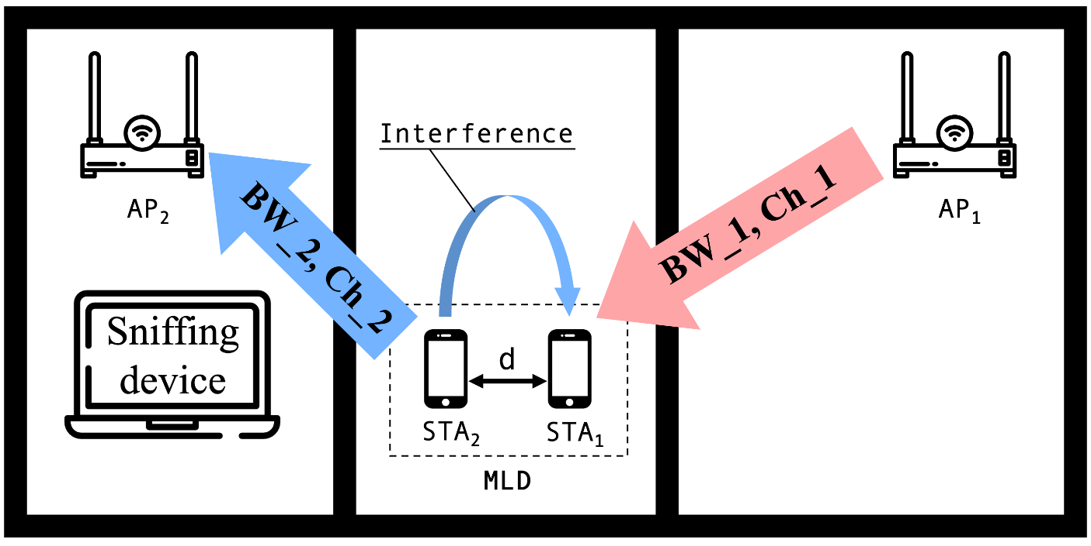
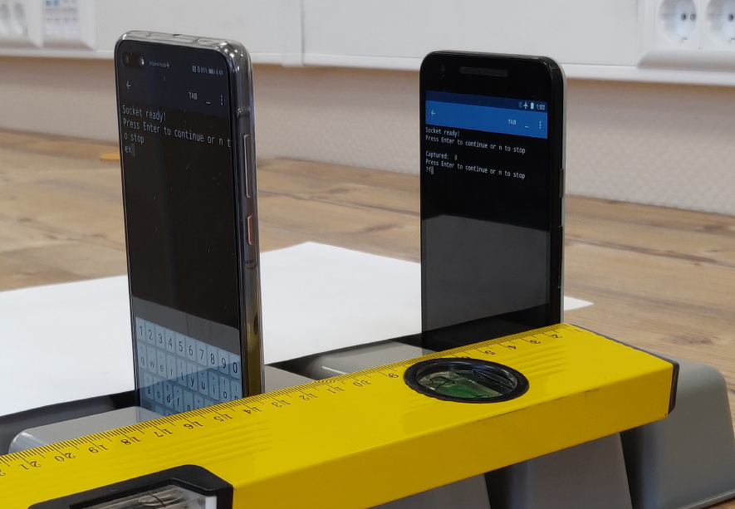
Experimental setup (1/2)
We set up an experiment to find how modern mobile devices may simultaneously transmit and receive if located close to each other (which emulates cross-link interference for future MLDs)
We emulate an NSTR non-AP MLD with two adjacent mobile phones (STAs) and an STR AP MLD with two APs located far from each other.
Each STA is associated with respective AP.
Saturated traffic
Saturated traffic
d=7… 30 cm

Slide 5
Experimental setup (2/2)
AP1 uses binary compiled for AP’s OS, that generates UDP-packets with 972 byte payload. With headers, MPDU payload is 1kB.
STA1 runs Python script with Pydroid 3 app, that receives packets, counts amount of correct ones, calculates time and resulted throughput.
STA2 runs Python script with Pydroid 3 app, that generates UDP-packets with 972 byte payload, after adding headers, MPDU payload is 1kB.
Independence of Ch_2 throughput from transmissions in Ch_1 is controlled with the Sniffing device.
A-MPDU is used; MIMO 2x2 is on, but used sometimes; beamforming is off.

Slide 6
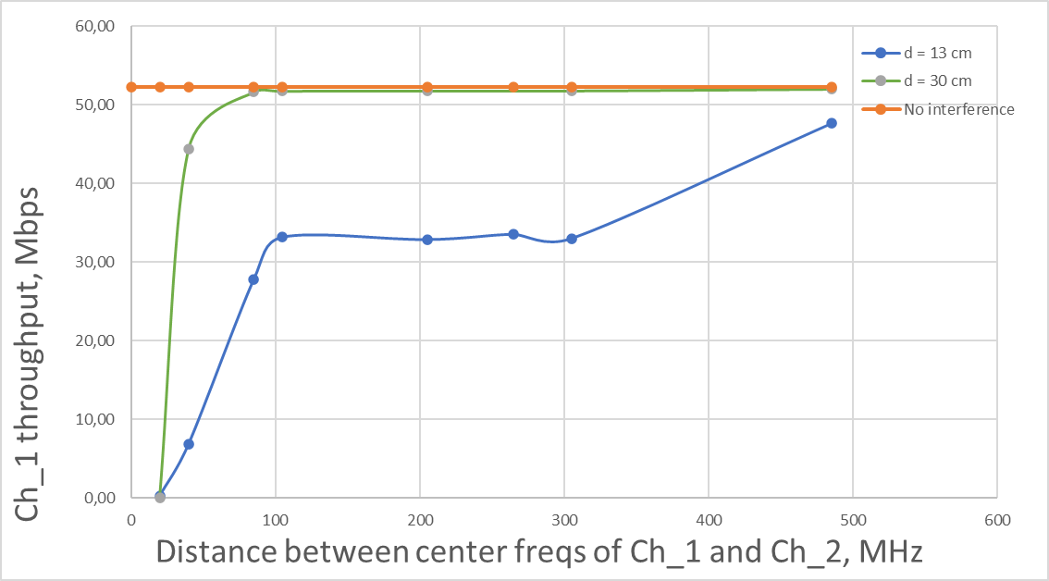
Experimental results (1/3)
BW_1 = BW_2 = 20 MHz
For distance between STAs d = 30 cm, Link 1 throughput fully recovers if spectral distance is more than 80 MHz. This fully corresponds to binary STR operation, specified in the standard
For distance between STAs d=13 cm, throughput has a plateau at 60% thrp even for 300 MHz distance between the links.
STR is possible but with a more robust MCS.
Inter-link interference is a property of a particular device.
Almost zero in adjacent channels, STA1 may disconnect from AP1
NSTR
Conditional STR
STR

Slide 7
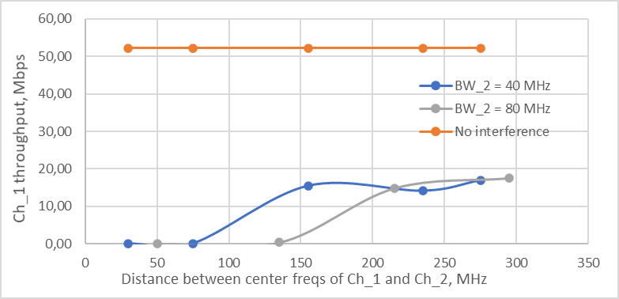
Experimental results (2/3)
BW_1 = 20 MHz, d = 7 cm
Link 1 throughput degrades even for more than 200 MHz,
Almost zero in adjacent channels, STA1 may disconnect from AP1
NSTR
Conditional STR

Slide 8
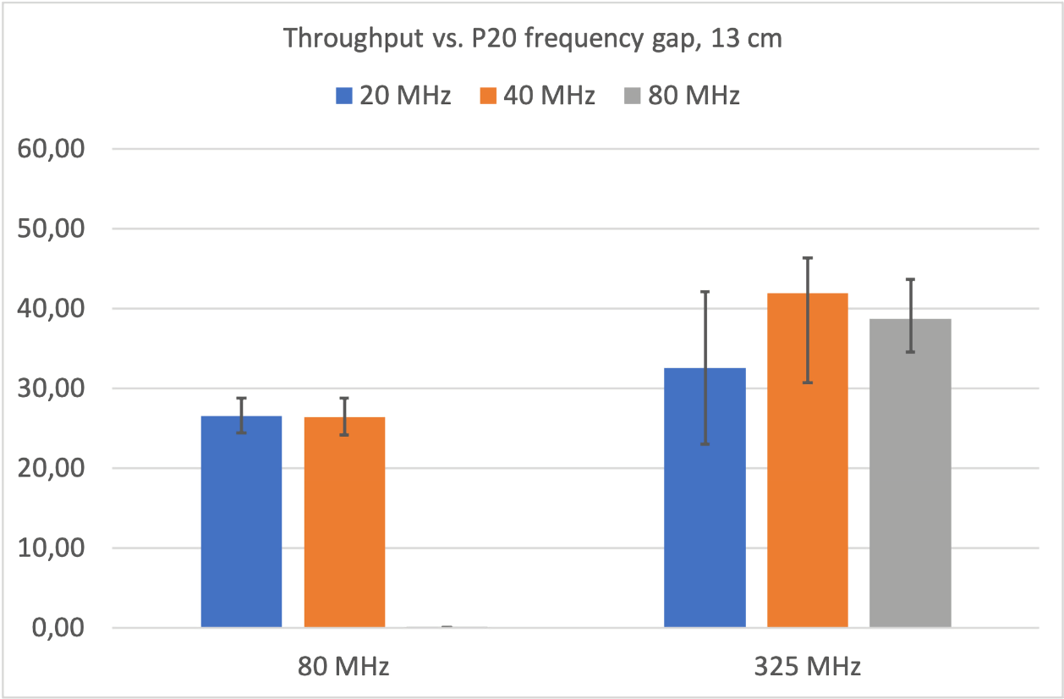
Experimental results (3/3)
BW_1 = 20 MHz, d = 13 cm
BW diff = 0
BW diff = 40 MHz
p20
p20
Maximal thrp w/o intrf
80 MHz
p20
p20
325 MHz
Link 1 thrp = 0, as the channels are adjacent
The NSTR capabilities depend on the channel width!

Slide 9
Conditional STR signaling
We observe from experiments that with NSTR interference MLDs typically have a non-zero achievable throughput in a wide range of frequency distances. STR is possible there, but with lower MCS.
We propose that an MLDs could signal that STR operation is possible on NSTR link pair under certain conditions.
We need a simple Conditional STR signaling – using additional NSTR interference level.
Specifically, if a STA of MLD 1 transmits to a STA of MLD 2 on link 1 while another STA of NSTR MLD 2 is transmitting, the STA of MLD 1 shall use an MCS suitable for the SNR reduced by X dB
NOTE: Traditional approaches to adjust the MCS may not converge because the interference conditions are different when a STA of MLD is transmitting or not.

Slide 10
Summary
We have conducted experiments that show STR interference in mobile MLDs does not fully block STR operation on NSTR link pair.
We have proposed a Conditional STR signaling
So non-AP MLD can inform AP MLD about how exactly NSTR interference impacts reception on some NSTR link pairs.

Slide 11
Straw Poll
Do you agree that 11be supports Conditional STR signaling that allows MLDs to indicate that STR is possible if some conditions are met?
Y:
N:
A:

