Slide 1
Transient Station Identification
Date: 2022-01-06
Authors:
Name | Affiliation | Address | Phone | Email
Nehru Bhandaru | Broadcom | 250 Innovation Drive, San Jose CA 95134 | +1 408 391 2159 | nehru.bhandaru@broadcom.com
Thomas Derham | Broadcom

Slide 2
Introduction
TGbh use cases need the notion of an Identity
  Non-AP STA Identity (ID) used for access control e.g., allowed services etc.
  In general, there can be multiple identities
    Username, Password ID, Permanent MAC address, Application level
    Real Identity may only be known to protocol that establishes security e.g., EAP Method
    Ideally Identity should be bound to security context
Several proposals that indicate non-AP STA identity securely to an AP in an Infra network
  21/1379 – ID query action frames
  21/1585 – Identifiable Random MAC addresses
  21/1083 – Signature based identification schemes
This proposal explores whether TGbh use cases can be supported with
  only a transient ID
  a transient ID that is decoupled from a MAC address that could change any time
    pre-association or while associated

Slide 3
General Security Considerations
Identity is somewhat an abstract notion, can be many
  For our purposes, we can consider it as opaque e.g., octet string
    Permanent or Initial MAC address could be used to identify a user/device
Non-AP STA Identity needs to be securely conveyed to the Infra AP – chicken and egg problem
  Protecting the conveyance requires a security context
  Security context setup is based on a notion of Identity
Protocols should not reveal Identity
  RCM for protecting the real/permanent MAC address, for example
  Asymmetric key signatures (RSA, ECDSA) can leak public keys (see [7] § 4.1.6)
  Should not introduce new trackable identifiers without any security/privacy controls
Identity should be bound to the security context
  Otherwise, there can be misuse – e.g., masquerading with replays etc.
Excessive computation to determine identity based on ‘Randomized Information’ can lead to (additional) denial of service attacks

Slide 4
Proposal Summary
Identity (ID)
  Opaque, higher layer input
Transient Identity (TSID), TSID Key (TSIDK), and TSK Security Association (TSKSA)
  TSID and TSIDK are cryptographically generated
  bound to PTKSA, stored in TSKSA
  TSK Packet Number (TSKPN) for replay protection
TSID Validation
  Using TSID element
TSID Update
  When PTKSA is updated
  Post association update using SA Query extension
  Implicit update using TSID element – pre or post association
Negotiation Support
  RSNXE Capabilities – verified during security association setup

Slide 5
TSID Proposal
Create TSID based on PTKSA (similar to rPMKID 11-21-1697)
  Created and updated every time a PTKSA is created
  Used by non-AP STA, if desired, to securely identify to the AP
During PTKSA creation each side derives the next TSID, TSIDK, TSKPN using IETF RFC5869
  TSID-PRK = HKDF-Extract(“Transient Station Identity” || ID || SA, KDK)
    TSID = HKDF-Expand(TSID-PRK, “TSID”, TSID-NBYTES)
    TSIDK = HKDF-Expand(TSID-PRK, “TSIDK”, TSIDK-NBYTES)
    TSKPN = HKDF-Expand(TSID-PRK, “TSKPN”, 6) // 48-bit random initial packet number
TSKSA is updated with TSID, TSIDK and TSKPN
  HMAC-Hash defined by AKM, TSID-NBITS, TSIDK-NBITS by RSNXE caps
TSID/TSIDK can be updated pre-association using PASN PTKSA (11az)
KDK is derived when TSID features are enabled
  Currently derived for WUR (802.11ba) and 802.11az features

Slide 6
TSID Proposal
TSID element included in selected frames
  (re)association request, PASN Authentication, Probe Requests
    AP uses TSID to lookup the TSKSA
    AP validates TSID using TSID-Hash and TSIDK for the matched TSKSA
    RSNA protocols (e.g., 4-way handshake), PASN create new PTKSA and update TSKSA
      TSID_{i} → TSID_{i+1}, TSIDK_{i} → TSIDK_{i+1}, TSKPN_{i} → TSKPN_{i+1}
TSID-Hash is computed as follows
  TSID-Hash = L(HMAC-Hash(TSIDK, Flags || ++TSKPN || TSID || SA || BSSID), 0, TSID-Hash-NBITS)
One octet Flags
  bit 0 = 0 – Identify, 1 = Identify and Update, other bits reserved
  Flags are not transmitted
ID | Length | Element ID Extension | TSKPN | TSID | TSID-Hash
Figure 9-xxx – TSID element format

Slide 7
TSID Update
TSID update during the lifetime of a PTKSA
  While associated with security or under PASN (State 1a)
    TSID can change, but always bound to the security context
  Non-AP STA updates TSID sending a protected TSID update request at any time
  TSID = L(HMAC-Hash(TSIDK, ++TSID), 0, TSID-NBITS)
  Extension to SA Query action category – Query, TSID Update (new), Response
  TSIDK and TSKPN are not changed
TSID can be updated with TSID element by setting the ‘Update’ bit in Flags
  AP computes one additional hash if identity validation fails
  If update is validated, updates TSID as above
non-AP STA can gracefully change MAC address
  Send a TSID update
  Start using the new address

Slide 8
TSID Proposal
Replay protection
  Additional replay counter for replay checks
  Initial random value to prevent tracking
RSNXE capabilities advertise support for TSID parameters – 2 bits
RSNXE Bits | TSID-NBITS(NBYTES) | TSIDK-NBITS (NBYTES) | TSID-Hash-NBITS (NBYTES)
00 | No Support | N/A | N/A
01 | 64 (8) | 128 (16) | 64 (8)
10 | 64 (8) | 256 (32) | 128 (16)
11 | Reserved, N/A | Reserved | Reserved

Slide 9
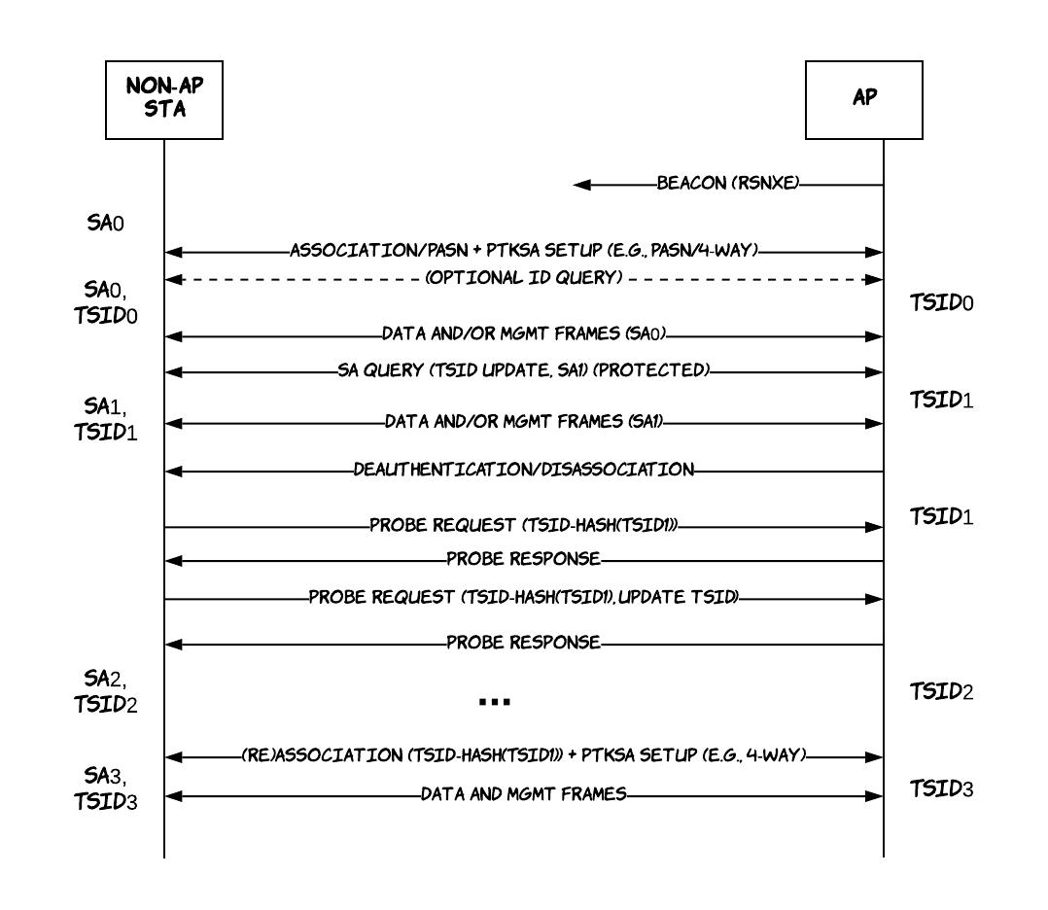
Protocol Usage Example

Slide 10
TSID Proposal – Comparison
Previous Proposal(s) | TSID Proposal
11-21-1585 Identifiable Random MAC addresses | Auto transient ID and key generation/distribution without additional messages Replay protection Binding to address (chain) and security context Better performance with faster validation No check field that can be trackable Leverage Std 802.11 SA query support TSID update – implicit and explicit, pre and post association
11-21-1083 Signature based identification schemes | Does not use public keys Does not leak identity (public key signatures leak the public key) More efficient
11-21-1379 ID Query Action Frame | No (additional) ID exchange is needed But can be used in conjunction to retrieve ID to bind to TSID Uses Std 802.11 SA query support Supports Identity recovery with TSID – higher layers can do the mapping Works when there is no association, after first secure association or PASN

Slide 11
TSID Proposal – Evaluation Metrics
Metric | Comment
Amount of processing required on client and AP | STA: TSID/TSIDK derivation, Hash Computation AP: Lookup PMKSA using TSID, Hash Computation, No iteration computing hashes of all entries.
Storage Requirements | Storage per STA: TSID(8), TSIDK(16 to 32), and PN(6) = 30 to 46 octets
Return to the network and use a different MAC address | Yes - TSID identifies the used/device rather than bound to a MAC address
User opt-in control | Yes - capability negotiation, security context, ID query, SA Query/Update, Optional TSID element inclusion
Pre-association support | Yes
Device/User Identifier provided | Yes, transient identifier decoupled from MAC address
Third party tracking with RCM | No, Protected; STA indicates TSID change before changing/randomizing MAC address
Hidden mechanism | Not hidden from third parties - presence of TSID IE
Requires network encryption | No, but relies on 802.11 RSNA and PASN security
How strongly is ID bound to the user | Very loosely, but ID is bound to TSID/TSIDK generation
PII exposure | No
Network can trust in the ID | Yes
Post association RCM | Yes

Slide 12
Q & A
Where does ID come from?
  EAP Authentication, Password ID, Username, Permanent MAC address, First Association MAC address, email address, or an empty string (anonymous/unknown), Query the user (e.g.,11-21-1379) before TSID generation after PTKSA setup
  ID can be set via MLME, MAC address can be default
Can ID be updated?
  Outside the scope, but TSID can be updated
Can we just use the (random) MAC address instead of TSID
  AP side validation would be inefficient or cumbersome
  Graceful transition when MAC address changes - TSID binds old MAC address to new MAC address
Can TSID be used more than once?
  Yes, a replay counter protects against replays
Can TSID be omitted, with only the hash sent to the AP?
  No, AP rejects the request/association
  AP may require TSID element to be included
  Non-AP STA may choose to include TSID element or not
Is TSID a client identifier
  No, but it can be mapped to one on AP if non-AP STA provides
What happens on failures – M4 lost or implicit update fails (e.g., no/lost probe response)
  TSID will mismatch, next request may be rejected
What happens when PMKSA is deleted?
  TBD
Does TSID have to be 64 bits?
  Should suffice – Random MAC address have much higher probability of collision
Does TSID leak the key?
  No, standard RFC 5869 HKDF is used
Does the proposal require additional key distribution mechanisms?
  No, TSIDK is generated as part of PTKSA
Can PMKID be used as a transient ID?
  No, PMKID is trackable, TSID could be used without a PMK – separation of concern
Does this require PMK caching
  Not necessary, but there needs to be some security association when non-AP STA comes back to the AP/ESS for validating the ID
  There may not be a PMKSA with PASN
How much storage does it need? Does it scale
  TSKSA needs 30 to 46 bytes per client
How does it work with FT and other AKMs?
  TBD – distribute TSID along w/ TSIDK to R1 key holders?
How does it work with multiple APs
  Distribute TSID and TSIDK? Needs a new TSIDK (derive from TSIDK?)
Broadcast probe requests
  Cannot use TSID update, but can identify

Slide 13
TSID Proposal
11-21-0332 TGbh Issues Tracking
11-21-1379 ID Query Action Frame
11-21-1730 Comparison Metrics
11-21-1585 Identifiable Random MAC addresses
11-21-1083 Signature based identification schemes
IEEE Std 802.11™-2020
SEC1 – Elliptic Curve Cryptography
IEEE TGaz Draft 4.0 – October 2020
11-21-1697 rPMKID
IETF RFC 5869 – HMAC-based Extract and Expand

