Slide 1
Fidelity of CSI time domain representations
Date: 2021-10-21
Authors:

Slide 2
Abstract
CSI representation has an intrinsic dimensionality to it, dictated by the physical process of its formation and computation. The dimensionality can be exploited for compression and de-noising by looking at the time-domain converted version. We show what does the intrinsic dimensionality of CSI waveform looks like, and what is the statistical behaviour over some sampled indoor channels.

Slide 3
Background
Use of a Truncated Channel Impulse Response (CIR) as a sensing measurement result has been discussed [1][2]
Truncated Channel impulse response (CIR) is a time-domain representation of the usual Channel State Information (CSI) representation of a channel between a Sensing Transmitter and a Sensing Receiver
CSI and TCIR are comparable
Truncated CIR is formed by discarding time-domain samples based on criteria
TCIR is not comparable to CSI but has been shown in examples to be an acceptable substitution
Favorable response to Straw Polls

Slide 4
Example CSI vs CIR
Magnitude of the Complex frequency response of the channel across the full channel bandwidth
All carriers required to transfer full channel information
= CSI
IDFT of CSI converts to the time domain
Energy in the channel is clustered in few time domain pulses around a “direct path” signal
= PDP

Slide 5
What happens to the channel frequency response if I limit the CIR pulses?
Limit the number of pulses in the time domain
i.e. Select n pulses and set all other pulses to zero
Convert to a channel frequency response in the frequency domain
Inverse DFT/FFT
Colored lines show the frequency domain response of an increasing complex time domain response
i.e. n increasing
n small: Red; n large: Green
Normalized magnitude
Sub-carrier number (in a 20-MHz bandwidth)

Slide 6
Determining an Optimal TCIR Representation
The trade-off in representing a CSI with few time domain pulses is like an usual error (or SNR) vs complexity curve
This curve can be seen by allowing higher and higher degrees of freedom to the inverse DFT for fitting to the CSI waveform
Generate a measure of a reconstruction by transforming the TCIR back to the CSI domain and calculating an error between CSI and reconstructed CSI
Gray line vs colored line
Compare to the power in the reconstructed CSI (as a proxy for the signal power)

Slide 7
Determining an Optimal TCIR Representation
CSI-SNR increases rapidly with increasing time domain pulses
However, CSI-SNR levels out quickly
Beyond a threshold, increasing the number of time domain pulses has limited value
Threshold may be observed to be around 8 to 10 time domain pulses
CSI SNR (dB)
Number of time domain pulses, n, used in reconstruction
$${\text{CSI}\text{−}\text{SNR}}_{n}\text{ (}\text{dB}\text{)}=10{\text{log}}_{10}\frac{\left\|ℱ\left({\text{T}CIR}_{n}\right)\right\|}{\left\|{\text{CSI}}_{RX}−ℱ\left({\text{T}CIR}_{n}\right)\right\|}$$

Slide 8
Visualization in Time and Frequency Domain
CSI reconstruction using different DoF in the IFFT

Slide 9
Visualization in Time and Frequency Domain
Pulses in green box likely contributed by the channel
Pulses under yellow arrows likely to be a contribution of noise
Pulses represent a long reflection distance from the ‘core’ activity in the channel
Analogy in the frequency domain: ‘Jagged’ response is most likely a contribution of noise

Slide 10
“De-Noising” a Channel Response
Truncating the CIR reduces the data content of the channel response
BUT…
CSI-SNR shows that the information of the channel response is not discarded by the truncation
In fact…
Truncating the CIR may favour removal of noise and the preservation of signal
Appropriate truncation of the CIR removes noise from the channel representation

Slide 11
Operating Point
Potential overfitting to noise
CSI SNR (dB)
Potential underfitting to the channel
Number of time domain pulses, n, used in reconstruction
How to determine the optimum operating point
i.e., How many time-domain pulses should represent the channel

Slide 12
Statistical Analysis of Indoor Channel Data Sets
An analysis of 2000 representative indoor channel data sets was carried out to determine the optimum operating point (i.e. the optimum number of time-domain pulses to represent the channel)
‘Optimum operating point’ is a function of adequate representation of the channel vs minimizing the number of time-domain pulses.
20-MHz measurement bandwidth used with 52 active subcarriers
Adequate representation is considered to be when the CSI-SNR change is within 1% of maximum value

Slide 13
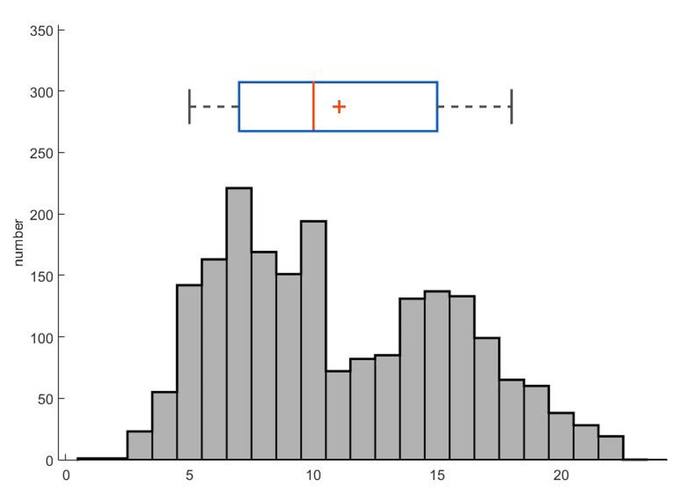
Statistical Analysis of Indoor Channel Data Sets
Average number time domain pulses over all data sets is 9 to 11 (“compression ratio” to CSI representation 4.7 to 5.8)
95% of all data sets are adequately represented by fewer than 17 time-domain pulses (“compression ratio” to CSI representation >3.0)
5% to 95% bound
25% to 75% bound
| median; + mean
Number of time domain pulses, n, used in reconstruction

Slide 14
Summary
CSI-SNR is introduced which describes the Signal-to-Noise ratio of a TCIR
It is shown that it is possible to “over represent” a CSI by a TCIR and that discarding time-domain pulses can reduce noise in the representation of the channel response
It is shown that there is an optimum number of time-domain pulses that make up a TCIR
An analysis of 2000 data sets show that the optimum number of time-domain pulses that make up a TCIR averages 9 to 11 and is almost always fewer than 17 (95%) for a 20 MHz OFDM transmission

Slide 15
References
[1] 11-21-0660-00-00bf-truncated-power-delay-profile.pptx
[2] 11-21-1288-02-00bf-truncated-power-delay-profile-follow-up

